Slide 1
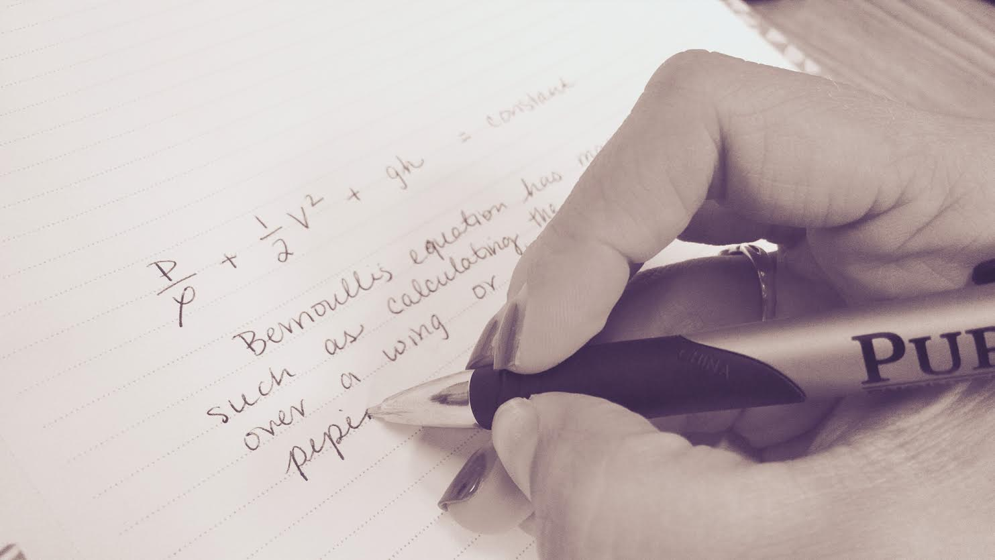
Something to Write Home(work) About: An Analysis of Writing Exercises in Fluid Mechanics Textbooks
Natascha M. Trellinger¹
Rebecca R. Essig²
Cary D. Troy³
Brent K. Jesiek⁴
Joshua Boyd⁵
¹Ph.D. student, School of Engineering Education
²Ph.D. student, Lyles School of Civil Engineering
³Associate Professor, Lyles School of Civil Engineering
⁴Associate Professor, School of Engineering Education / School of Electrial and Computer Engineering
⁵Associate Professor and Director of Undergraduate Studies, Brian Lamb School of Communication

Slide 2
Overview
Current state of writing in engineering
This project: Textbook analysis
Types of writing prompts
Support resources available
Next steps and future work

Slide 3
Introduction: Learn to Write
Writing has been identified as a critical skill and element of the engineering profession (Riemer, 2007)
A common complaint about engineering graduates is their lack of written communication skills
Learning to write takes practice over a long time, but large sophomore and junior level technical classes often do not include any writing.
“WBEC”

Slide 4
Introduction: Write to Learn
Writing can be leveraged in the engineering classroom to enhance learning (e.g. Winsor, 1990; Olds et al., 1993)
Writing is active (Felder et al., 2000)
Writing is linked to critical thinking (Bean 1996)
Unfortunately, it is difficult to include writing in large courses (Oakey et al., 1999)
Assessment/feedback bottleneck

Slide 5
About our work
Overall goal: Understand how writing is, and isn’t used in core engineering science courses in the sophomore and junior engineering classroom, and help instructors to include more writing in these classes.
Starting point → Fluid Mechanics
Research Question: How do popular engineering fluid mechanics textbooks include writing prompts and writing activities?
Notes:
Why textbooks? Textbooks often influence how courses are structured, and reading assignments and homework problems are frequently assigned directly from textbooks.
In this project, we systematically searched for and analyzed writing-based problems in six popular fluid mechanics textbooks, with a focus on chapters with similar technical content. We focused our efforts on identifying learning activities that could potentially allow students to practice writing, to learn through writing, and to use writing to relate course content to broader applications and contexts.

Slide 6
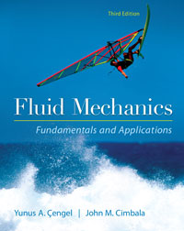
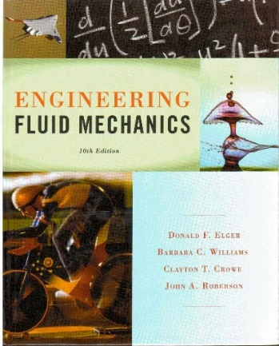
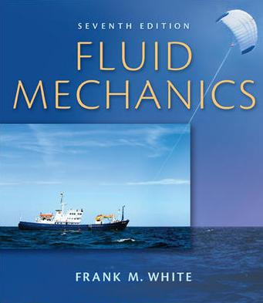
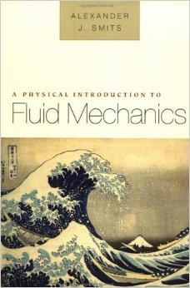
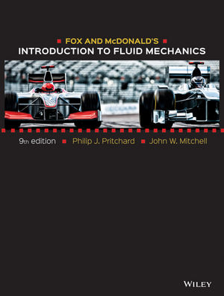
Commonly used fluid mechanics textbooks
In departments of Civil & Mechanical/Aerospace at top 10 engineering schools (US News and World Report)
Examined the chapter on the Bernoulli Equation (or most closely related)
Cengel & Cimballa
Elger et al.
Munsen et al.
White
Smits
Pritchart & Mitchell
Notes:
http://www.mhhe.com/engcs/mech/cengel/Cengel3e13jl_nm2.jpg
http://www.engineerblogs.net/wp-content/uploads/2013/05/Fundamentals-of-Fluid-Mechanics-engineer-blogs.jpg
http://2.bp.blogspot.com/-tXJHPtI5GSI/Uxhl3zO53fI/AAAAAAAAEQU/PMhkrPJElPA/s1600/Engineering+Fluid+Mechanics+10th+Elger+Williams+Crowe+Roberson_Page_001.jpg
http://www.engineerblogs.net/wp-content/uploads/2013/05/Fluid-Mechanics-7th-Edition-by-Frank-M.-White.jpg
http://ecx.images-amazon.com/images/I/51W4TC9M5RL._SY344_BO1,204,203,200_.jpg
http://www.wiley.com/WileyCDA/WileyTitle/productCd-EHEP003329.html

Slide 7
Writing Prompts and Outcomes
Writing prompt type | ABET outcomes | Curricular/embedded outcomes (AACU)
Explain-a-Problem | a, b, e, g | Knowledge Inquiry and analysis Written communication
Real World Example | g,h,i,j | Knowledge Inquiry and analysis Written communication Synthesis
Definition | e,g | Knowledge Information literacy Written communication
Explanation of a concept | g,h,j | Knowledge Inquiry and analysis Written communication Synthesis
Identification of a concept | g,h,j | Knowledge Inquiry and analysis Written communication Synthesis Critical thinking
(g) an ability to communicate effectively
Notes:
Probably need to break this up.

Slide 8
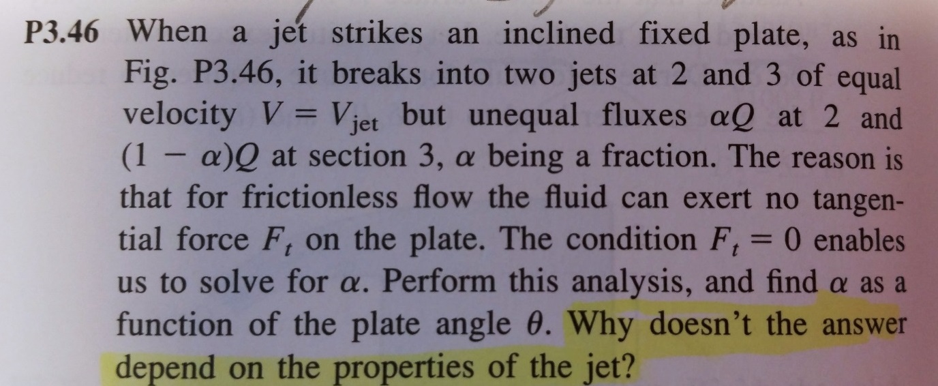
Classification of writing questions and prompts
Explain-a-problem¹ (Cengel & Cimbala 5-51, White 3.46)
¹Hanson, J. H. and Williams, J. M. (2008, J. Eng. Ed.)

Slide 9
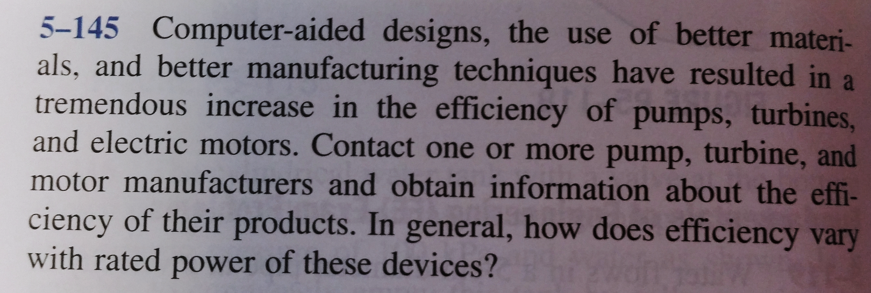
Classification of writing questions and prompts
Real-world-example (Munson 3.1, Cengel & Cimbala, 5-145)]

Slide 10
Classification of writing questions and prompts
Conceptual questions
Definition (Cengel & Cimbala 5-2C)
Explanation of a concept (Munson 3.126)
Identification of a concept (Elger 4.47)

Slide 11
Results: types of writing prompts
 | Cengel & Cimbala¹⁹ | Elger et al.¹⁷ | Munson et al.¹⁶ | White¹⁸ | Smits²⁰ | Pritchard & Mitchell²¹ | Relative % for each promptª
Explain a HW Problem (1.) | 7 | 1 | 3 | 6 | 1 | 7 | 23.6%
Read World Example (2.) | 2 | 1 | 8 | 1 | 0 | 0 | 11.3%
Conceptual: Definition (3. a.) | 13 | 2 | 0 | 0 | 1 | 0 | 15.1%
Conceptual: Explanation of a concept (3. b.) | 13 | 7 | 3 | 3 | 6 | 0 | 30.2%
Conceptual: Identification of a concept (3. c.) | 9 | 3 | 4 | 4 | 1 | 2 | 21.7%

Slide 12
Results: number of writing prompts
Textbook | Total Writing Prompts in Chapter/Total End-of-Chapter Problems | Percentage of problems with writing prompts (%)
Cengel & Cimbala¹⁹ | 44/148 | 29.7%
Elger et al.¹⁷ | 14/112 | 12.5%
Munson et al.¹⁶ | 18/135 | 13.3%
White¹⁸ | 14/207 | 6.8%
Smits²⁰ | 9/42 | 21.4%
Pritchard & Mitchell²¹ | 9/90 | 10.0%

Slide 13
Results: support resources
Solution manuals offered little if no support:
(Cengel & Cimbala)
5-145 Computer-aided design, the use of better materials, and better manufacturing techniques have resulted in a tremendous increase in the efficiency of pumps, turbines, and electric motors. Contact one or more pump, turbine, and motor manufacturers and obtain information about the efficiency of their products. In general, how does efficiency vary with rated power of these devices?

Slide 14
Results: support resources
A pitot-static tube is used to measure the velocity of helium in a pipe. The temperature and pressure are 40 F and 25 psi. A water manometer indicates a reading of 2.3 in. Determine the helium velocity. Is it reasonable to consider the flow as incompressible? Explain.
Thus, the flow can be considered incompressible.
(Munson et al.)

Slide 15
Conclusions and Next Steps
End-of-chapter problems fall into 5 categories – can be used and leveraged for different outcomes
Realistic professional writing prompts are much less common than traditional numerical problems or conceptual leaning problems.
Resources with rubrics and writing guidelines very scarce in solution manuals
Hypothesis: inclusion of supporting material (rubrics, examples of student work, writing guidelines) would lead to greater use of writing based problems end-of-chapter problems from textbooks

Slide 16
Future Work
Textbook analysis of other major engineering topic areas (statics, thermodynamics, circuits)
Further revise and finalize classification scheme of writing prompts
Creation of online resources for engineering faculty
Strategies for transforming existing prompts into writing prompts
Providing rubrics to students and faculty
Efficient assessment and feedback strategies
Samples of graded student writing
From our Engineering Instructor Survey:
TOP CHALLENGES include:
Large classes
Lack of time
Creating high-quality writing assignments
Uncertain about standards/criteria to grade writing

Slide 17
Questions?
Something to Write Home(work) About: An Analysis of Writing Exercises in Fluid Mechanics Textbooks
Natascha M. Trellinger¹
Rebecca R. Essig²
Cary D. Troy³
Brent K. Jesiek⁴
Joshua Boyd⁵
¹Ph.D. student, School of Engineering Education
²Ph.D. student, Lyles School of Civil Engineering
³Associate Professor, Lyles School of Civil Engineering
⁴Associate Professor, School of Engineering Education / School of Electrial and Computer Engineering
⁵Associate Professor and Director of Undergraduate Studies, Brian Lamb School of Communication

Slide 18
Acknowledgements
This work was supported by a Research Initiation Grant in Engineering Education (RIGEE) grant from the Engineering Education and Centers (EEC) Division of the National Science Foundation (grant no. EEC-1340491). Rebecca Essig was funded partially on a Graduate Assistantship in Areas of National Need (GAANN) fellowship.
Any opinions, findings, and conclusions or recommendations expressed in this material are those of the author(s) and do not necessarily reflect the views of the National Science Foundation.

Slide 19
Extra slides

Slide 20
ABET Outcomes
ABET Student Outcomes
(a) an ability to apply knowledge of mathematics, science, and engineering
(b) an ability to design and conduct experiments, as well as to analyze and interpret data
(c) an ability to design a system, component, or process to meet desired needs within realistic constraints such as economic, environmental, social, political, ethical, health and safety, manufacturability, and sustainability
(d) an ability to function on multidisciplinary teams
(e) an ability to identify, formulate, and solve engineering problems
(f) an understanding of professional and ethical responsibility
(g) an ability to communicate effectively
(h) the broad education necessary to understand the impact of engineering solutions in a global, economic, environmental, and societal context
(i) a recognition of the need for, and an ability to engage in life-long learning
(j) a knowledge of contemporary issues
(k) an ability to use the techniques, skills, and modern engineering tools necessary for engineering practice.
Criterion 4. Continuous Improvement
The program must regularly use appropriate, documented processes

Slide 21
AACU Outcomes
AACU Essential Learning Outcomes
1***Knowledge of Human Cultures and the Physical and Natural World
• Through study in the sciences and mathematics, social sciences, humanities, histories, languages, and the arts
2***Intellectual and Practical Skills, including
• Inquiry and analysis
• Critical and creative thinking
• Written and oral communication
• Quantitative literacy
• Information literacy
• Teamwork and problem solving
3***Personal and Social Responsibility, including
• Civic knowledge and engagement—local and global
• Intercultural knowledge and competence
• Ethical reasoning and action
• Foundations and skills for lifelong learning
4***Integrative and Applied Learning, including
• Synthesis and advanced accomplishment across general and specialized studies
http://www.aacu.org/sites/default/files/files/LEAP/EssentialOutcomes_Chart.pdf

Slide 22
The Table
Category/Type of Writing Prompt | Description | Primary learning objective (students will be able to….) | ABET learning outcomes | General curricular (or embedded) learning outcomes (AACU as current model) | Examples
Real-World Example | Students provide an example of a concept or | Establish real-world relevance of subject matter. | g, h, j | Knowledge Inquiry and analysis Written comm. Synthesis | Give an example of: An engineering project that failed as a result of a fluid mechanics-related design flaw.
Explain-a-HW Problem |  |  | a, b, e, g | Knowledge Inquiry and analysis Written comm. | Explain your solution to this problem, in words. What are the three key ideas involved in this problem?
Explain-a-Concept |  |  | a, g | Inquiry and analysis Critical and creative thinking Written comm. | Why does the resultant hydrostatic pressure force always act below the centroid of a submerged planar surface?
How Stuff Works |  |  | g, h, j | Inquiry and analysis Critical and creative thinking Written comm. Synthesis | Describe the flood protection system proposed for the city of Venice. How does an air compressor work? Describe the Burj Khalifa’s water distribution system.
Take a Side |  |  | e, f, g, h, j | Inquiry and analysis Critical and creative thinking Written comm. Civic knowledge Ethical reasoning | Argue for or against the Keystone XL Pipeline from any one of the following standpoints….
Paradox |  |  | e, g | Inquiry and analysis Critical and creative thinking Synthesis

Slide 23
Category/Type of Writing Prompt | Description | Primary learning objective (students will be able to….) | ABET learning outcomes | General curricular (or embedded) learning outcomes (AACU as current model) | Examples
Real-World Example | Students provide an example of a concept or | Establish real-world relevance of subject matter. | g, h, j | Knowledge Inquiry and analysis Written comm. Synthesis | Give an example of: An engineering project that failed as a result of a fluid mechanics-related design flaw.
Explain-a-HW Problem |  |  | a, b, e, g | Knowledge Inquiry and analysis Written comm. | Explain your solution to this problem, in words. What are the three key ideas involved in this problem?
Explain-a-Concept |  |  | a, g | Inquiry and analysis Critical and creative thinking Written comm. | Why does the resultant hydrostatic pressure force always act below the centroid of a submerged planar surface?
How Stuff Works |  |  | g, h, j | Inquiry and analysis Critical and creative thinking Written comm. Synthesis | Describe the flood protection system proposed for the city of Venice. Describe the Burj Khalifa’s water distribution system.
Take a Side |  |  | e, f, g, h, j | Inquiry and analysis Critical and creative thinking Written comm. Civic knowledge Ethical reasoning | Argue for or against the Keystone XL Pipeline from any one of the following standpoints….
Paradox |  |  | e, g | Inquiry and analysis Critical and creative thinking Synthesis

Slide 24
Category/Type of Writing Prompt | Description | Primary learning objective (students will be able to….) | ABET learning outcomes | General curricular (or embedded) learning outcomes (AACU as current model) | Examples
Real-World Example | Students provide an example of a concept or | Establish real-world relevance of subject matter. | g, h, j | Knowledge Inquiry and analysis Written comm. Synthesis | Give an example of: An engineering project that failed as a result of a fluid mechanics-related design flaw.
Explain-a-HW Problem |  |  | a, b, e, g | Knowledge Inquiry and analysis Written comm. | Explain your solution to this problem, in words. What are the three key ideas involved in this problem?
Explain-a-Concept |  |  | a, g | Inquiry and analysis Critical and creative thinking Written comm. | Why does the resultant hydrostatic pressure force always act below the centroid of a submerged planar surface?
How Stuff Works |  |  | g, h, j | Inquiry and analysis Critical and creative thinking Written comm. Synthesis | Describe the flood protection system proposed for the city of Venice. Describe the Burj Khalifa’s water distribution system.
Take a Side |  |  | e, f, g, h, j | Inquiry and analysis Critical and creative thinking Written comm. Civic knowledge Ethical reasoning | Argue for or against the Keystone XL Pipeline from any one of the following standpoints….
Paradox |  |  | e, g | Inquiry and analysis Critical and creative thinking Synthesis

