Slide 1

A Nod in the Right Direction?
Designing a Study to Assess Teacher Ability to Interpret Student Comprehension from Nonverbal Communication
Dr. Brock E. Barry, PE
MAJ Daniel J. Fox
2LT Robert M. Wendel

Slide 2


Introduction
  “A process by which information is exchanged between individuals through a common system of symbols, signs, or behavior.”
  - Hartley, G., & Karinch, M, I can read you like a book, Career Press (2007).
93% of communication is non-verbal
Notes:
http://www.outreach.olemiss.edu/ProfDev/teacher/
http://www.faytechcc.edu/admissions/transferstudent.aspx

Slide 3
Research Question
Do experienced teachers assess student comprehension through nonverbal communication more accurately than less experienced teachers?
***PILOT TEST***
The pilot program informed the performance of a more extensive research study

Slide 4
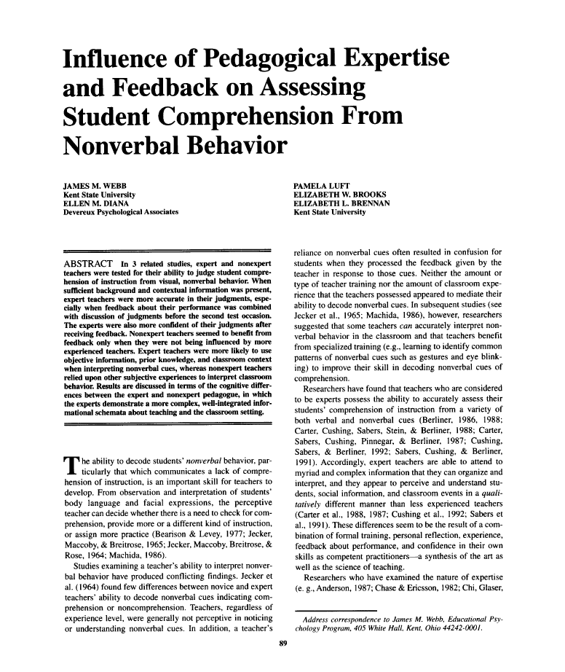
Literature Review
Content specific to decoding student generated cues is scarce
Previous Study:
  Webb, J. M., Diana, E. M., Luft, P., Brooks, E. W., & Brennan, E. L. (1997). Influence of pedagogical expertise and feedback on assessing student comprehension from nonverbal behavior. The Journal of Educational Research, 91(2), 89-97.
Teachers Benefit from nonverbal training!
  Jecker found that 6-8 hours of training on nonverbal cues showed a 7% increase in assessment accuracy

Slide 5
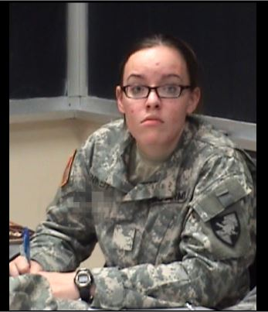
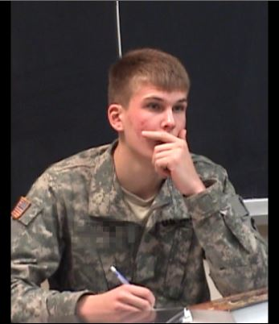
Methods
***Pilot Study***
Participants: 6 total: (4 Male, 2 Female), (1 Novice, 5 Experienced),
(4 Engineering focused, 2 Education focuses), (1 Hispanic, 1 Asian, 4 Caucasian)
Procedure:
Watch video clip
2) Assess whether the
Student is confident or not
Provide self-confidence
of assessment
Interview with researcher to described the specific student behaviors which influenced their determination of the student’s confidence
5) Provide teaching demographic

Slide 6
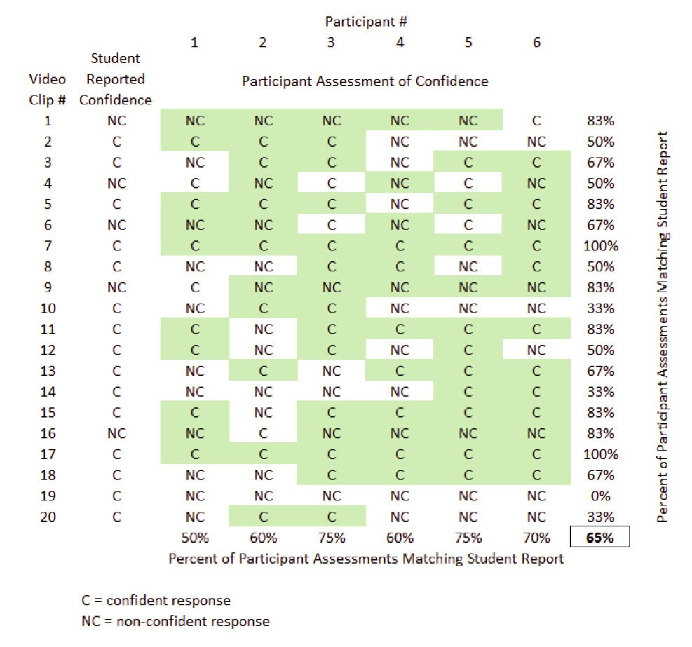
Results

Slide 7
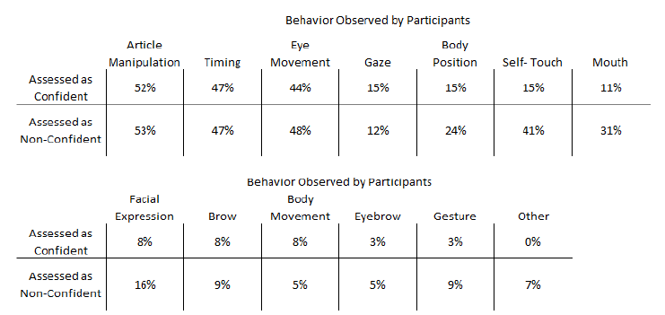
Results

Slide 8
Discussion
***PILOT TEST*** therefore no statistical analysis was performed
Participant feedback influenced selection and duration of video clips
- Crop videos to remove neighbor students/professor
- Video files must be compatible with Apple & Microsoft systems
- Reduce video duration and focus on frequent student behaviors
- Culture Matters
Full Experiment
- Uses an online survey
- 8 videos (no audio)
- Focus on:
1) Assessment of student confidence
2) Participant confidence
3) Free text to capture observed behavior
- Desired Population size of 137 participants to achieve a 25% effect

Slide 9
Future Studies
The results from this survey will help our research team understand teacher perception of student nonverbal communication and aid in the development of training which will improve communication in the classroom.
https://www.surveymonkey.com/s/6ZDQ5JV
Please consider sharing with a colleague….or challenge them to correctly identify when a student is confident!

Slide 10
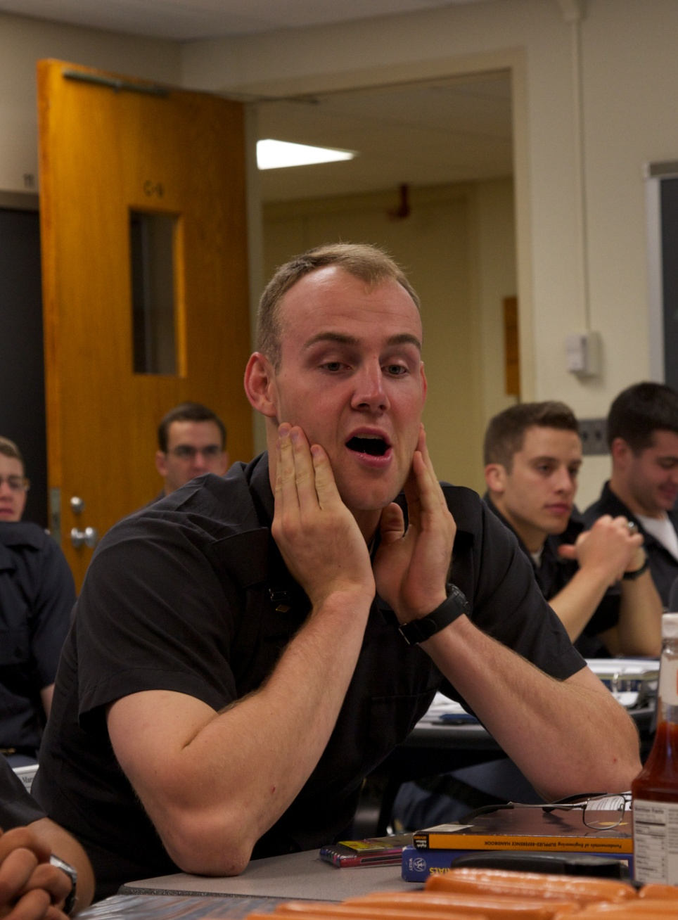
Questions?

