Slide 1
Enhancing Communication Practices through Development of a Departmental Civil Eng. Writing Guide
David Saftner, Mary Christiansen, Adrian Hanson, Jill Jenson, Sara Ojard, Rebecca Teasley, & Emily Woster

Slide 2
Outline
Motivation
Development of Writing Guide
Assessment Prior to Use of Writing Guide
Preliminary Assessment Since Paper Deadline
Plans Before Department-Wide Implementation

Slide 3
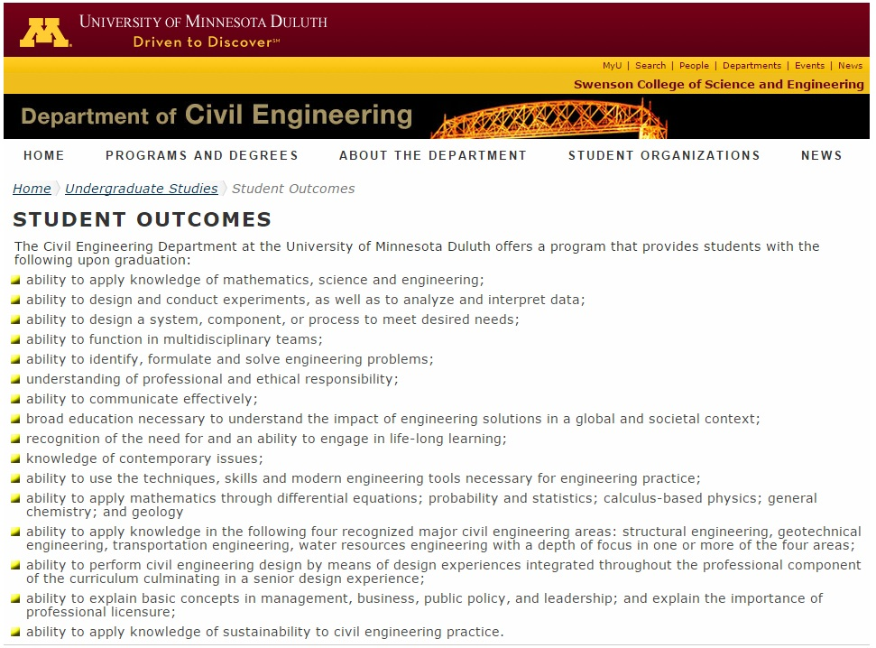
ABET assessment

Slide 4
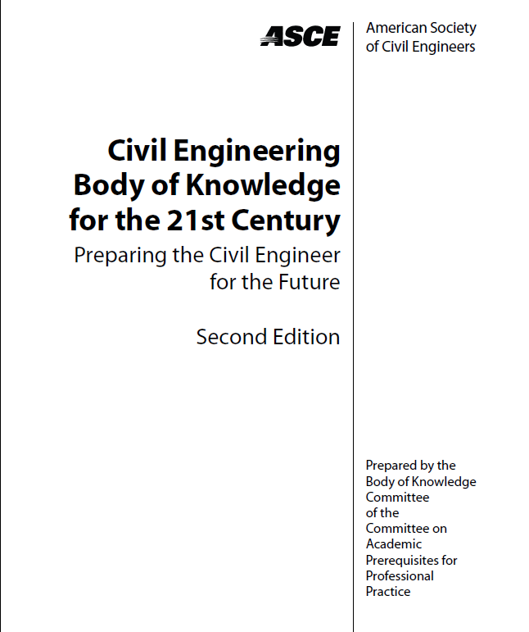
ABET assessment
ASCE Body of Knowledge & industry recommendations

Slide 5
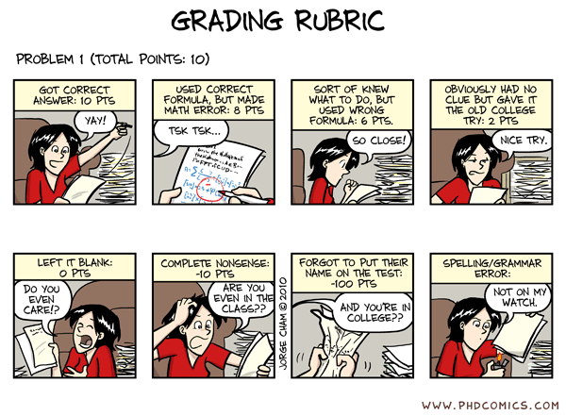
ABET assessment
ASCE Body of Knowledge & industry recommendations
Faculty experience
www.phdcomics.com

Slide 6
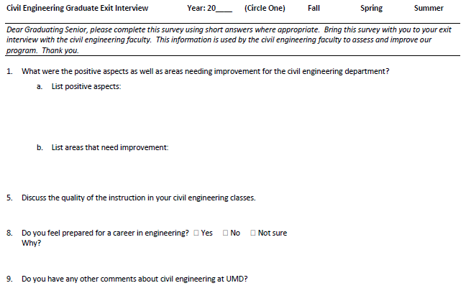
ABET assessment
ASCE Body of Knowledge & industry recommendations
Faculty experience
Student feedback

Slide 7
Outline
Motivation
Development of Writing Guide
Assessment Prior to Use of Writing Guide
Preliminary Assessment Since Paper Deadline
Plans Before Department-Wide Implementation

Slide 8
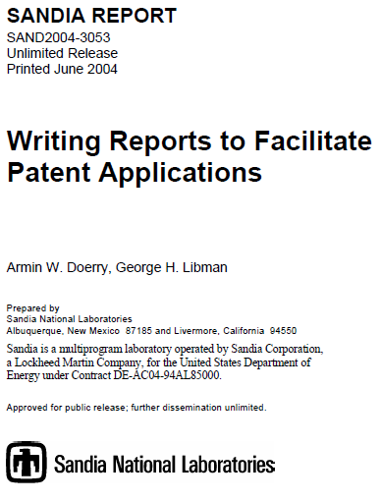
University engineering programs
Public organizations
University library reference lists
…

Slide 10
General Expectations
Reports
Figures
Tables
Equations
References & Citations
Memorandum
Professional E-mail
Homework
General Grading Rubric

Slide 11
Outline
Motivation
Development of Writing Guide
Assessment Prior to Use of Writing Guide
Preliminary Assessment Since Paper Deadline
Plans Before Department-Wide Implementation

Slide 12
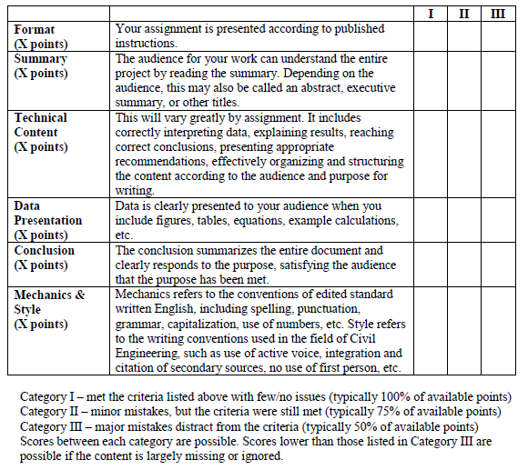

Slide 13
Introduction to Civil Engineering
Hydraulics & Hydrology
Soil Mechanics
Capstone Design
Summary/Conclusion
Technical Content
Data Presentation
Format/Mechanics & Style

Slide 14
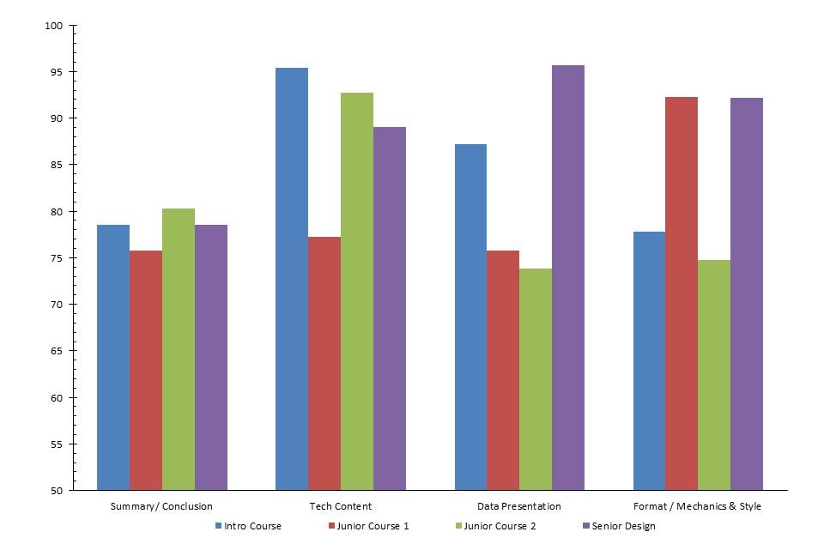

Slide 15
Outline
Motivation
Development of Writing Guide
Assessment Prior to Use of Writing Guide
Preliminary Assessment Since Paper Deadline
Plans Before Department-Wide Implementation

Slide 16
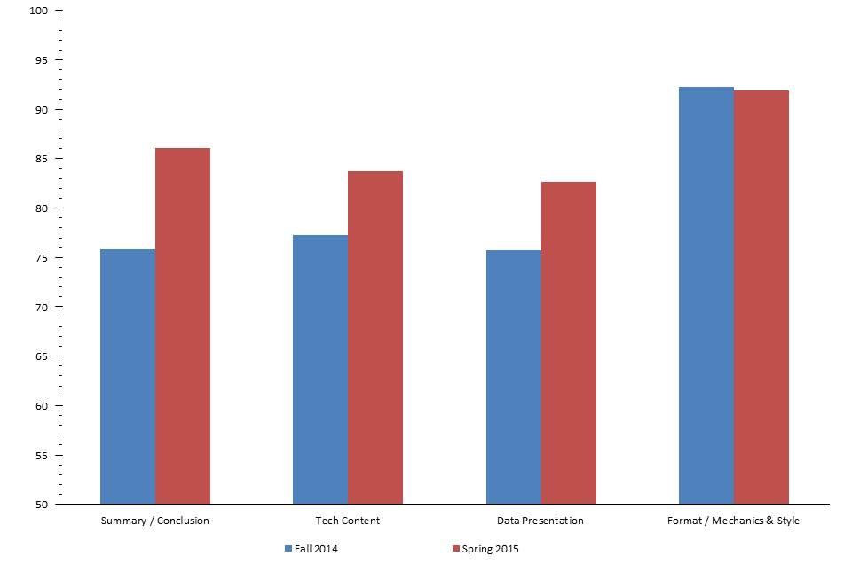
Soil Mechanics

Slide 17
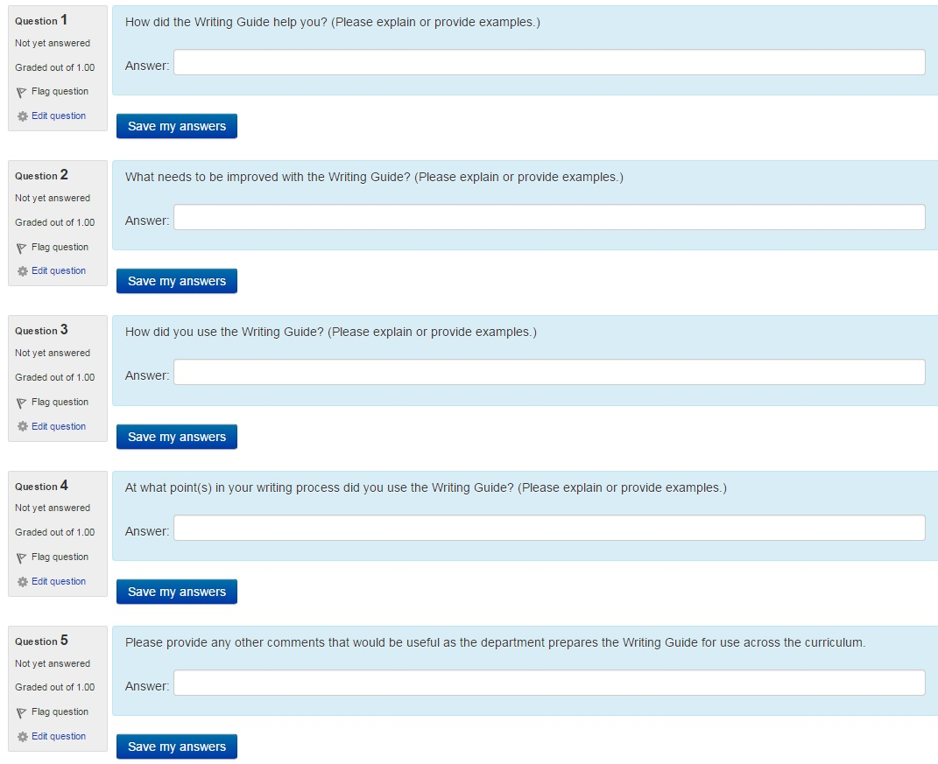

Slide 18
How did the Writing Guide help you?
What needs to be improved with the Writing Guide?
How did you use the Writing Guide?
At what point(s) in your writing process did you use the Writing Guide?
Please provide any other comments that would be useful as the department prepares the Writing Guide for use across the curriculum.

Slide 19
“very structured layout”
“helpful examples”
“rubric was a helpful tool for expectations”
“I hope the writing guide is implemented across the department”
“keep using the writing guide”
“should work the guide in right away”
“would have been nice to have a few years ago”
Writers’ Workshop – specific questions rather than general frustration

Slide 20
Clarity
“what data to include in report vs. appendix”
“more clear on what should go in a memo”
Examples
“ASTM reference format”
“how to present example calculations”
“good and bad examples of lab reports”
“format to make guide more ‘user-friendly’”
Faculty experience – course-specific handouts

Slide 21
Outline
Motivation
Development of Writing Guide
Assessment Prior to Use of Writing Guide
Preliminary Assessment Since Paper Deadline
Plans Before Department-Wide Implementation

Slide 22
Address student feedback (on-going)
Faculty feedback (July, 2015)
Industrial Advisory Board feedback (August, 2015)
Implementation across CE curriculum – Fall, 2015
http://katmichels.com/wp-content/uploads/2013/08/Snoopy-writing.jpg

Slide 23
Summary
Departmental CE writing guide developed through collaborative CE/Writing Studies effort
Pre-writing guide assessment shows variability in student writing
Writing guide piloted in Spring, 2015
Improved assessment results
Implementation across curriculum in Fall 2015

Slide 24
Questions?

