Slide 1
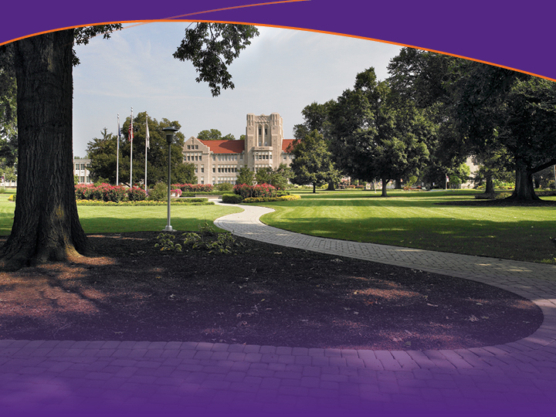
Minding the Gap
How engineering can contribute to a liberal education

Slide 2
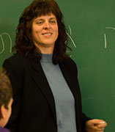
ASEE – June 16, 2015
Mark Valenzuela, PhD, PE
  Associate Professor of Civil Engineering
Valerie Stein, ThD
  Associate Professor of Religion
  Director of First Year Seminar

Slide 3
University of Evansville
Evansville, Indiana
“The University of Evansville is an independent, academically selective, internationally committed University affiliated with the United Methodist Church that integrates distinctive liberal arts education and dynamic professional programs.”

Slide 4

Engineers need the humanities…

Slide 5
The perennial dialog
Mann, C. R. (1918) “A Study of Engineering Education.” Carnegie Foundation for the Advancement of Teaching. Bulletin Number 11. New York.
Ashby, E. (1959) Technology and the Academics. St. Martin’s Press: New York.
Florman, S. C. (1968) Engineering and the Liberal Arts: A technologist’s guide to history, literature, philosophy, art, and music. McGraw-Hill: New York.
Lynch D. R., Russell, J. S., Mason, J. M. and Evans, J. C. (2009) Claims on the Foundation: Professionalism and Its Liberal Base. Journal of Professional Issues in Engineering Education and Practice. Vol. 135, No. 3, July 1, 2009. pp 109-116.

Slide 6
Gen Ed Outcomes
  Critical reading and thinking
Engagement with imaginative expressions of the human condition
Knowledge of human history and the historical context of knowledge
Engagement with fundamental beliefs about human identity, core values, and humankind’s place in the world
Understanding of human aesthetic creation and artistic creativity
Linguistic and cultural competence in a language other than one’s own
Quantitative literacy
Scientific literacy
Understanding of core concepts of society, human behavior, and civic knowledge
Knowledge and responsibility in relation to health and wellness
An ability to think critically and communicate effectively, orally and in writing.

Slide 7
First Year Seminar (FYS)
Small sections (~18 students)
Content proposed based on faculty interest and expertise
Challenging texts as basis for
  Research
  Writing
  Discussion
Few faculty from professional schools

Slide 8
Engineers need the humanities…

Slide 9
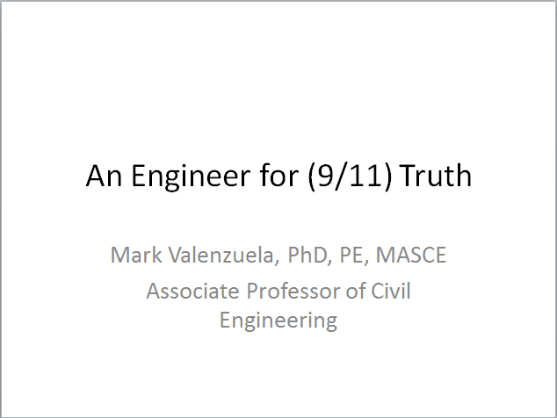
FYS Plenary Lecture

Slide 10
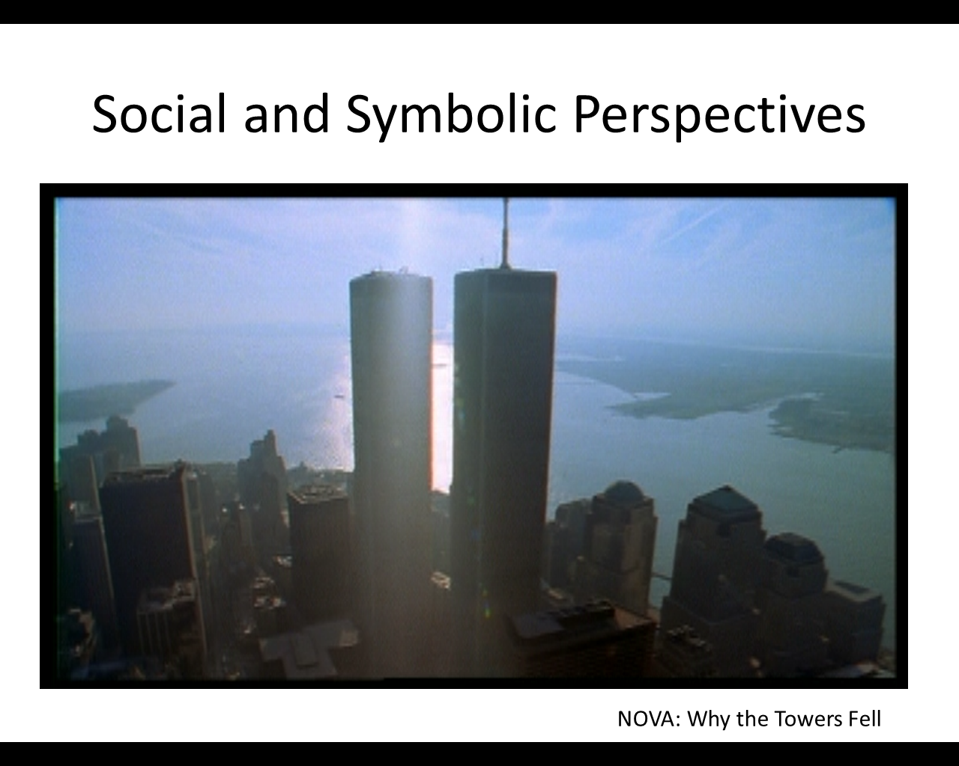
FYS Plenary Lecture

Slide 11
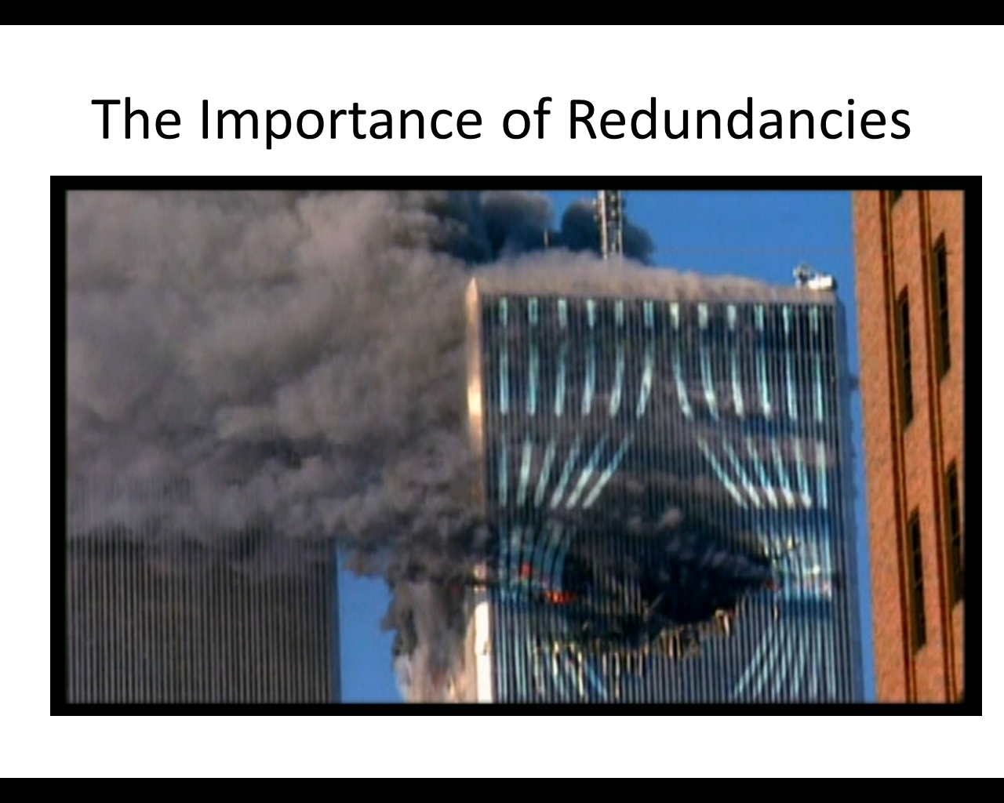
FYS Plenary Lecture

Slide 12
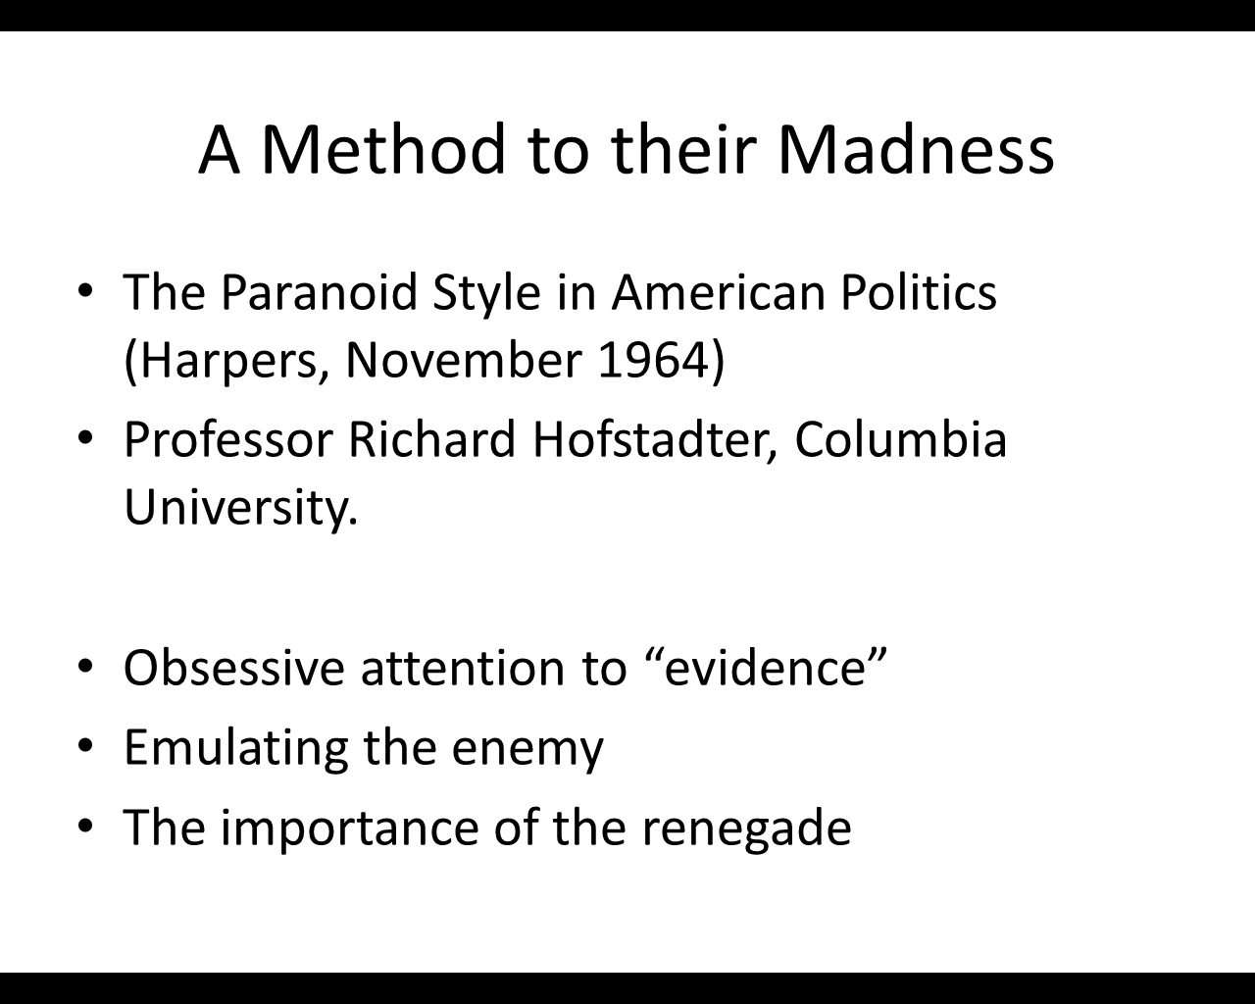
FYS Plenary Lecture

Slide 13
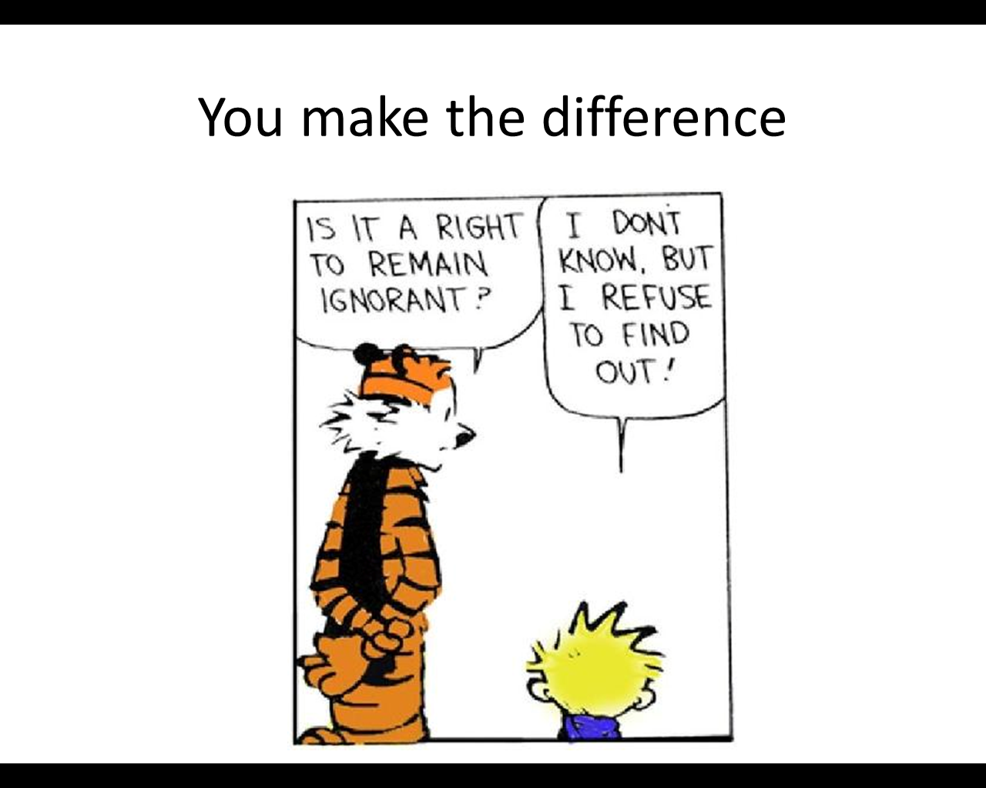
FYS Plenary Lecture

Slide 14
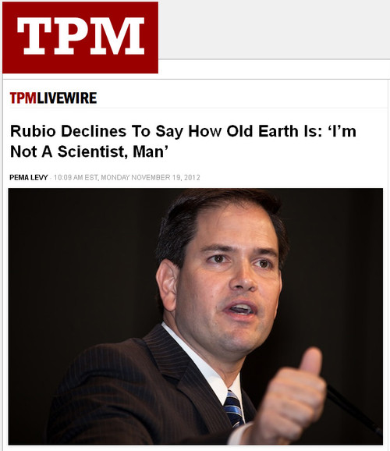
The responsibility to know
“I’m not a scientist…”
http://talkingpointsmemo.com/livewire/rubio-declines-to-say-how-old-earth-is-i-m-not-a-scientist-man

Slide 15
The responsibility to know
“I don’t know and it’s too hard to find out.”
“I don’t know and I don’t want to know.”
“It is impossible to know.”

Slide 16
Engineers need the humanities…

Slide 17
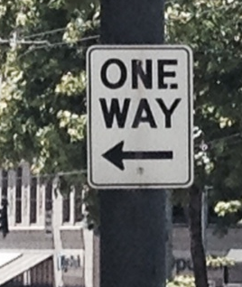
Humanists need engineering!

Slide 18
FYS Bridge Course
Evaluate claims and to be engaged in making decisions that affect society that is shaped by engineering and technology
The challenge:
  Distinct from science general education courses
  Develop intellectual skills (critical analysis) using scientific/engineering concepts

Slide 19
FYS Outcomes
READING: Analysis
  Engages texts. Recognizes relations among parts or aspects of a text, such as effective or ineffective arguments or literary features, in considering how these contribute to a basic understanding of the text as a whole.
READING: Discussion
  Participates in academic discourse about texts. Discusses texts in structured conversations (such as in a classroom) in ways that contribute to knowledge-building and a basic, shared understanding of the text.

Slide 20
FYS Outcomes
CRITICAL THINKING: Explanation of Issues
  Issue/problem to be considered critically is stated, and description begins to define terms, explore ambiguities, determine boundaries, and/or establish backgrounds.
CRITICAL THINKING: Student’s Position
  Specific position (perspective, thesis/hypothesis) acknowledges different sides of an issue. Questions some assumptions. Identifies context(s) when presenting a position. May be more aware of others’ assumptions than one’s own (or vice versa).

Slide 21
FYS Bridge Course
The questions that science, engineering, and the humanities can answer… and those they can’t
Uncertainty, Risk, Climate Change, and the Future (Sorting Fact, Fear, and Fiction)

Slide 22
FYS Bridge Course
Energy: Public Reactions and Engineering Alternatives (Or, is there really a “War on Coal”?)
Infrastructure: Planning for the Future (Or, “Why don’t we have flying cars yet?”)
Infrastructure: Maintaining (and Funding) for the Present (Or, “A stitch in time saves nine.”)

Slide 23
Modes of thinking
Ambiguity
  Uncertainty and risk
Assumptions and context
  Broad social perspective (what about the poor?)
  Long-term vision (effect on future generations?)
  Political orientations (the role of government in a democratic society?)

Slide 24
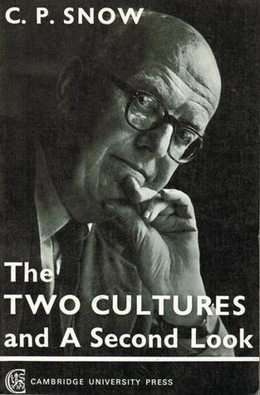
Minding the Gap
Crossing the divide between two cultures in the FYS Bridge Course

