Slide 1
Students Writing for Professional Practice:
Collaboration of Faculty, Practitioners and Writing Specialists Produces Results
Susan Conrad, Ph.D.
Portland State University
William Kitch, P.E., Ph.D.
Cal Poly Pomona
Timothy Pfeiffer, P.E.
Foundation Engineering, Inc.
Tori Rhoulac Smith, P.E., Ph.D.
Howard University
John Tocco, J.D.
Lawrence Technological University
ASEE 2015 - Seattle, Washington
Communication Across the Divisions I: Communication in Engineering Disciplines

Slide 2
Can we help civil engineering students be better prepared for writing in industry
without major curriculum changes?
Writing courses (composition,
tech writing)
?
Mentoring in the workplace
Typical courses
little, if any, writing instruction
writing = “style” and engineering = calculations
no differentiation of academic vs. workplace writing
Our vision: courses that...
integrate writing and civil engineering practice
teach that accuracy, precision, and comprehensibility
are as important in words as in calculations

Slide 3
The Civil Engineering Writing Project
Highlights in this presentation
Analysis
Direct instruction tied to the practice of civil engineering
The team

Slide 4
Practitioner texts from 50 firms & agencies
Student papers from
30 courses at 5 universities
Interviews:
Practitioners,
students, and
faculty
Analysis of Writing
Organization, vocabulary,
grammar features, grammar/punctuation errors, and holistic effectiveness
What student writing features are especially problematic
for engineering practice?
Features of the Analysis

Slide 5
Practitioner texts from 50 firms & agencies
Student papers from
30 courses at 5 universities
Interviews:
Practitioners,
students, and
faculty
Analysis of Writing
Organization, vocabulary,
grammar features, grammar/punctuation errors, and holistic effectiveness
What student writing features are especially problematic
for engineering practice?
Features of the Analysis
Comparing texts by many practitioners and many students
Universities cover diverse students

Slide 6
Practitioner texts from 50 firms & agencies
Student papers from
30 courses at 5 universities
Interviews:
Practitioners,
students, and
faculty
Analysis of Writing
Organization, vocabulary,
grammar features, grammar/punctuation errors, and holistic effectiveness
What student writing features are especially problematic
for engineering practice?
Features of the Analysis
Multiple text characteristics and holistic effectiveness
Analyses by linguists and practitioners (faculty grade as usual)

Slide 7
Practitioner texts from 50 firms & agencies
Student papers from
30 courses at 5 universities
Interviews:
Practitioners,
students, and
faculty
Analysis of Writing
Organization, vocabulary,
grammar features, grammar/punctuation errors, and holistic effectiveness
What student writing features are especially problematic
for engineering practice?
Features of the Analysis
Multiple perspectives to interpret analyses and identify problems

Slide 8
Practitioner texts
from 50 firms & agencies
Student papers from
30 courses at 5 universities
Interviews:
Practitioners,
students, and
faculty
Analysis of Writing
Organization, vocabulary,
grammar features, grammar/punctuation errors, and holistic effectiveness
What student writing features are especially problematic
for engineering practice?
Development of new teaching materials

Slide 9
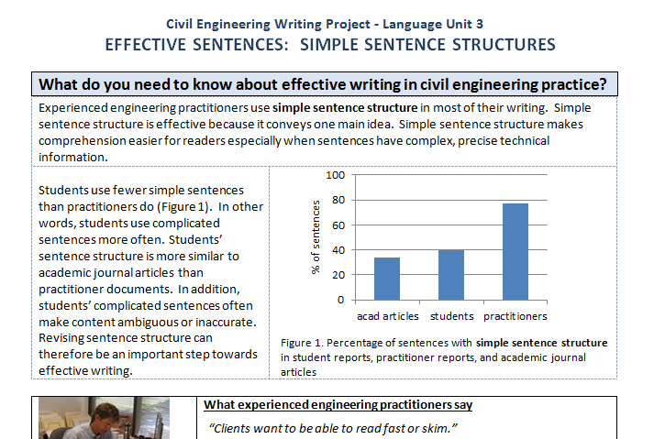
Development of new teaching materials
3 major types: Genre-based Units
Language Units
Grammar/Mechanics Lessons
Faculty (engr or ling) draft units – practitioners comment on drafts
Written units and webcasts

Slide 10
Development of new teaching materials
Connect to engineering content and practice
Provide direct explanation and instruction

Slide 11
Effective Simple Sentence Structure
Practitioner quotes explain reasons
Examples of practitioner writing
Explanations

Slide 12
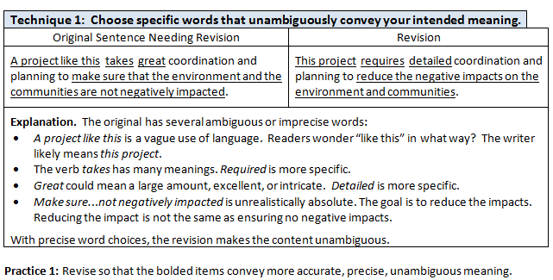
Word Choice
Specific techniques
Exemplified
Explained
Emphasizes precise, accurate meaning, not “style”

Slide 13
Development of new teaching materials
Confront student misconceptions

Slide 14
Word Choice
...one of the oldest and most proliferous firms...
...a somewhat advertisemental feel...
Botany – plant propagation!
Not a word!

Slide 15
Practitioner texts from
50 firms & agencies
Student papers from
30 courses at 5 universities
Interviews:
Practitioners,
students, and
faculty
Analysis of Writing
Organization, vocabulary,
grammar features, grammar/punctuation errors, and holistic effectiveness
What student writing features are especially problematic
for engineering practice?
Development of new teaching materials
Use of materials in CE courses,
new student writing

Slide 16
First full term of piloting
3 universities, 8 courses (first-year and senior-year)
varied use: class workshop
homework + questions in class
posted on website for homework
2 genre units, sentence structure and word choice units

Slide 17
Piloting Results
Statistically significant improvement in all quantitative measures
Assessment Category |  | Quantitative Results
1 | Genre Analysis | Increased effectiveness of sequencing of content Improvement in inclusion of expected content Decrease in extraneous content
2 | Sentence Structure | More single-idea sentences No complex sentences with inaccurate meaning
 | Word Choices | Reduction in vague or inaccurate words
3 | Holistic Evaluation by Practitioner | Increased overall effectiveness

Slide 18
First Sentences of Field Observation Memos
Pre-intervention
1. No context
Our hosts at the site were Lisa Wang, Doug Jones, Luis Fernandez....
2. Too broad
Within the field of civil engineering, there are many different types that go into
the field...
Post-intervention
Team Delta from the CEE101 Introduction to Civil and Environmental Engineering class visited Mercy Hospital at 4298 NW Franklin Park Rd on Thursday November 10th, 2014. The purpose of the visit was ...

Slide 19
Word Choice – first-year students
(Examples from Field Observation Memo conclusions)
Pre-intervention (vague words underlined)
...amazing weather...a lot of knowledge about engineering....
...you learn a lot more actually going out and seeing how things are done.
Post-intervention (more specific words underlined)
This trip to the Tilikum Crossing was informative about the construction and planning portion of civil engineering. Also, it offered me a look at the engineering work being done in the city.

Slide 20
Student comments after use of sentence structure and word choice units
The information in today’s class that made the biggest impression on me was...
how precise engineering writing has to be.
that professional engineering writing had such simple sentences.
that we don’t need to be wordy to be a good writer.
how different CE writing is than what I have learned in my English classes last year.

Slide 21
The team: individual and shared expertise
CE Practitioners: The industry
The impact of
language in industry
Civil engineering
Applied Linguists
Functions of language
Meta-language
Teaching writing
CE Faculty
The students
The department
Courses
Academic setting

Slide 22
Additional benefits for team members
Engineering faculty
Teaching materials – Want to help pilot?
Courage to teach writing – It isn’t about the writing; it’s about the practice of civil engineering.
Practitioners
Vocabulary to talk about writing
Techniques for review (mentoring as teaching)
Workshops for firms
Applied Linguists
Research with specific, useful applications

Slide 23
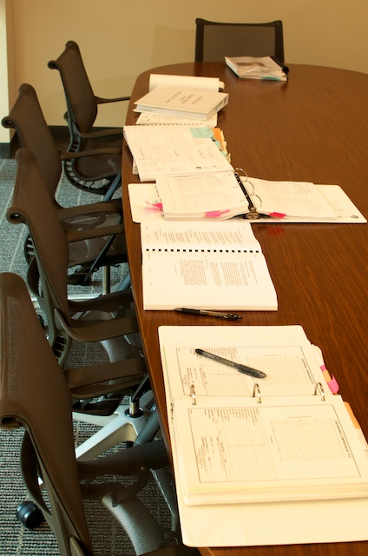
Acknowledgements
Thanks to
Students and faculty in Civil and Environmental Engineering at Portland State University, Cal Poly Pomona, Howard University, and Lawrence Technological University.
Students in the Portland State Dept of Applied Linguistics who have contributed to corpus formatting and analysis.
Engineers at David Evans and Associates
Don Cushing Associates
Foundation Engineering, Inc.
Quincy Engineering, Inc.
Parsons Brinckerhoff
Oregon Dept. of Transportation
City of Portland
Kleinschmidt
and others.
Partial support for this project is provided by the U.S. National Science Foundation (awards DUE-0837776 and DUE-1323259). All opinions, findings, and recommendations expressed in this material are those of the
author and do not necessarily reflect the views of the
National Science Foundation.

