Slide 1
A Transdisciplinary Approach for Developing Effective Communication Skills in a First Year STEM Seminar
Amy S. Van Epps
Engineering Librarian, Associate Professor of Library Science
Jeffrey J. Evans, Sorin Matei, Michael Smith, Esteban Garcia
ASEE Annual Conference
June 16, 2015

Slide 2
Overview
Introduction
Design of the Learning Experience
Badging
Student-Paced Learning
Pattern of student submissions
Lessons Learned
Conclusions

Slide 3
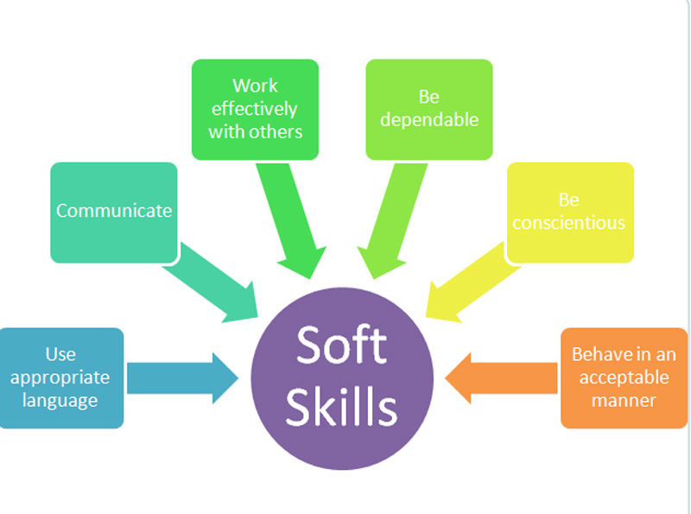
introduction
STEM graduates need ‘soft skills’
Generally underprepared ^{[1]}
Design a learning experience
Transdisciplinary
Student and project-
driven experience
Image from http://commandemployability.blogspot.com/p/hard-skills-soft-skills.html

Slide 4
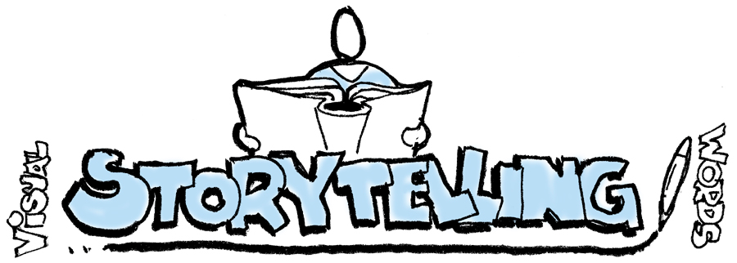
Design of the learning experience
Storytelling as a way of thinking
Tight coupling - communication with global challenges
Oral, written, visual, auditory
Global challenges^{[2]}
Autonomy of topic selection
Continuous feedback
Developing competence
Image from http://thethinkingcanvas.com/2013/10/26/visual-storytelling/

Slide 5
Badging
microcredentialing
More granular than course level grades
‘Gamification’ provides motivation^{[3]}
Fosters higher order thinking
Open Passport – Mozilla Open Badge Platform
Challenges
Components for each badge
Activities to be completed
Image from http://remakelearning.org/opportunity/2014/09/03/digital-badge-lab-summer-learning/

Slide 6
Student paced learning
Soft-deadlines
+
Multiple revision and resubmit
=
Student discomfort
Image from http://financialaidscholarshipworkshop.com/

Slide 7
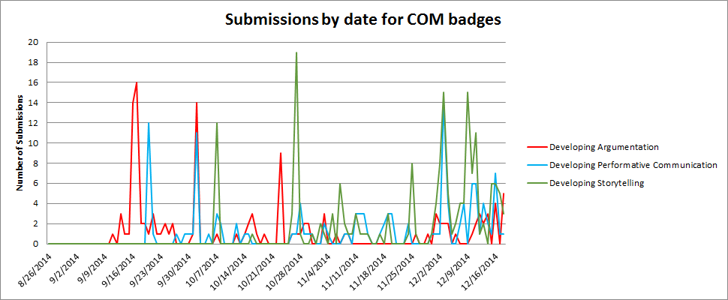
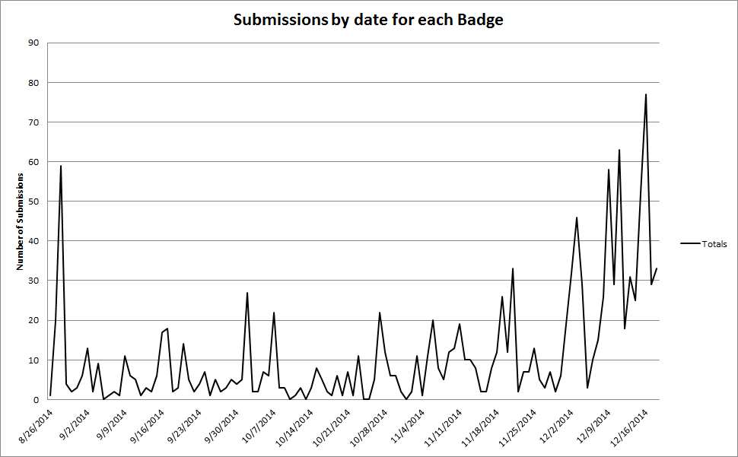
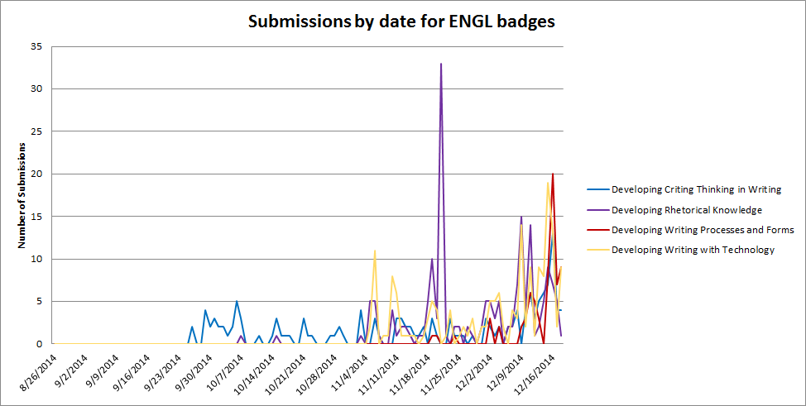
Patterns of student submissions
Figure 1
Figure 2
Figure 3

Slide 8
Lessons learned
Work waited without ‘real’ deadlines
Written feedback easily misinterpreted
More scaffolding needed with first year students
More structured use of studio time
Image from http://www.learnkidslearn.com/about.html

Slide 9
conclusions
Faculty and students learned a great deal
Clarity of competency to assignment connection is necessary
Students – time management skills
Independent learning processes
Faculty – needed supports and structure

Slide 10
references
Arum, R. (2010). Academically Adrift: Limited Learning on College Campuses. Chicago: University of Chicago Press.
Globaltopia (2014). Top 10 Challenges Facing Humanity. Retrieved from http://globaltopia.org/TOP_10_CHALLENGES.html
Kapp, K.M. (2012) The Gamification of Learning and Instruction: Game-Based Methods and Strategies for Gaming and Education. San Francisco, CA: Pfeiffer.

Slide 11
Amy S. Van Epps
Engineering Librarian, Associate Professor of Library Science
Libraries
vanepa@purdue.edu
Purdue Polytechnic Institute
polytechnic.purdue.edu
/ TechPurdue

