Slide 1
Help Needed! ☺
Need volunteers for the following research topics:
Microscopy image processing using 3D de-convolution
Translate from Matlab code to Python
And use GPU to accelerate (not an FPGA project but can be later :-P)
Discrepancy diagnosis between on-FPGA execution and software simulation
Know Vivado and Verilog

Slide 2
L3: FPGA 101
Cong (Callie) Hao
callie.hao@ece.gatech.edu
Assistant Professor
ECE, Georgia Institute of Technology
Sharc-lab @ Georgia Tech https://sharclab.ece.gatech.edu/

Slide 3
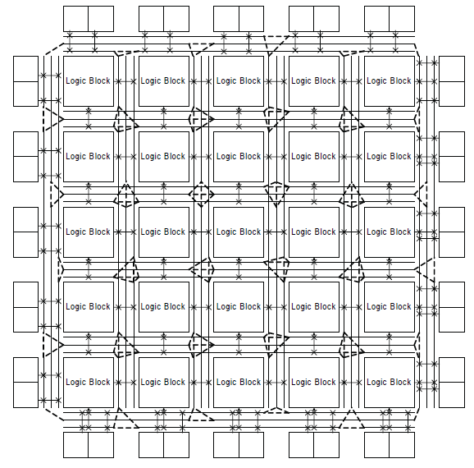
FPGA: Field-Programmable Gate Array
FPGA: Field-Programmable Gate Array
An integrated circuit designed to be configured by a customer or a designer after manufacturing (wikipedia)
Components in an FPGA Chip
Programmable logic blocks
Programmable interconnects
Programmable I/Os

Slide 4
FPGA Components
SRAM-based implementation is popular
Look-up Tables (LUT)
Flip-flop (FF)
Slices and CLBs (configurable logic block)
Block Memory (BRAM)
DSP Blocks
Interconnect and routing resource

Slide 5
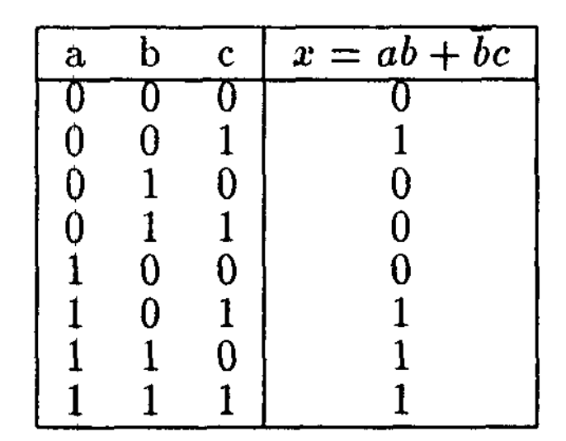
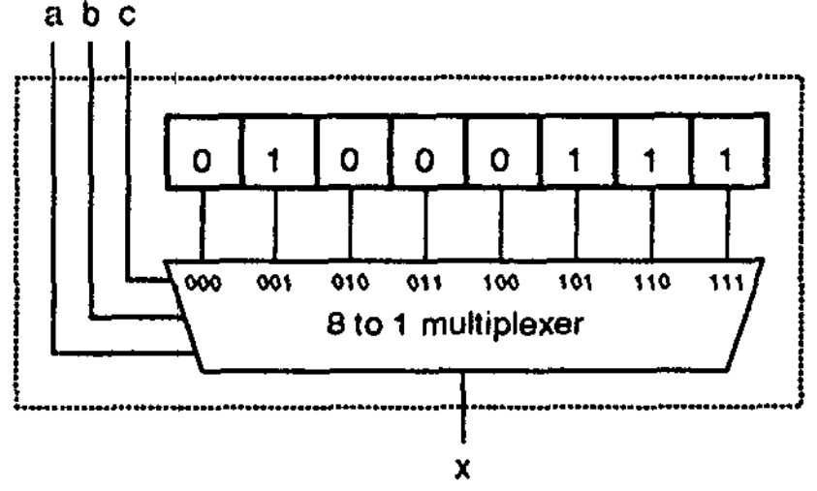
Look-up-Table (LUT)
A k-input LUT (k-LUT) can be configured to implement any k-input 1-output combinational logic
Requires 2^{k} SRAM bits
Delay is independent of logic function
Simply speaking, FPGAs are made of individual logic blocks, each of which is composed of a flip flop (FF) and a Lookup Table (LUT).
SRAM bits
(configurable)
Truth table
3-Input LUT
a
Look
up
Table
Flip
Flop
b
out
c
d
A simple FPGA logic block

Slide 6
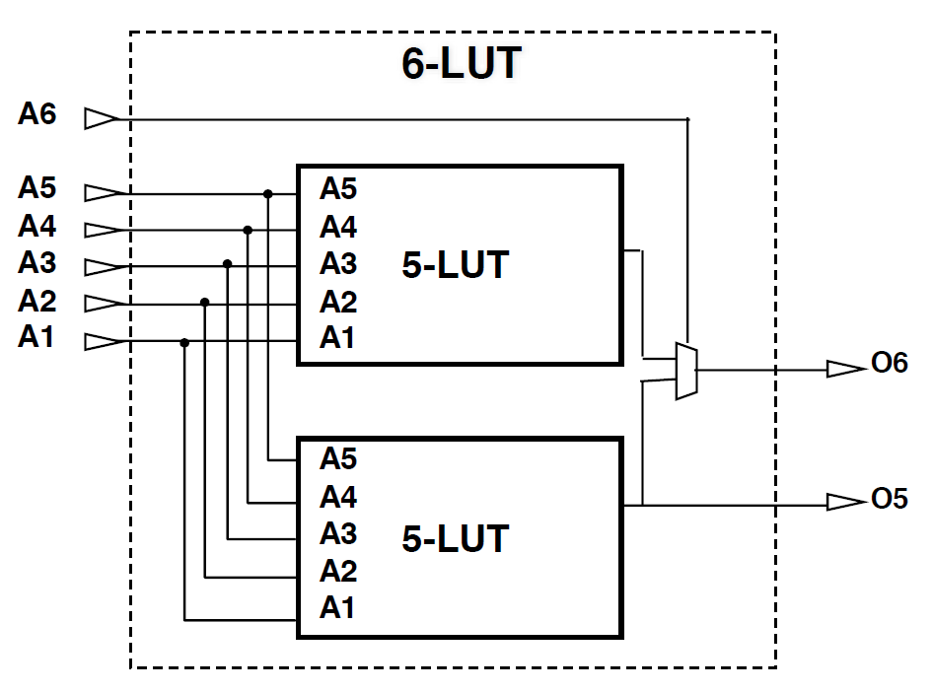
Look-up-Table (LUT)
Larger LUTs can be composed by smaller LUTs
Example: Xilinx 7-series FPGAs
A 6-input LUT can be two 5-input LUTs with common inputs
Any function of six variables or two independent functions of five variables

Slide 7
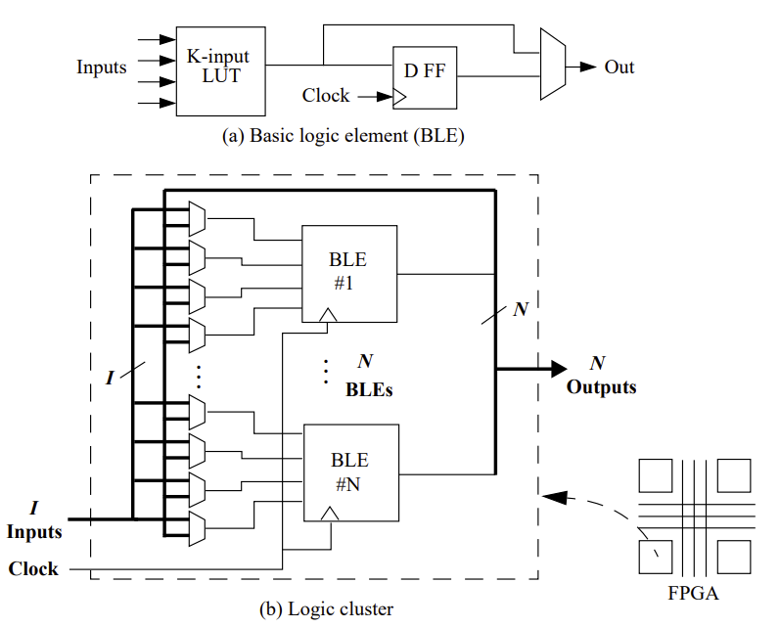
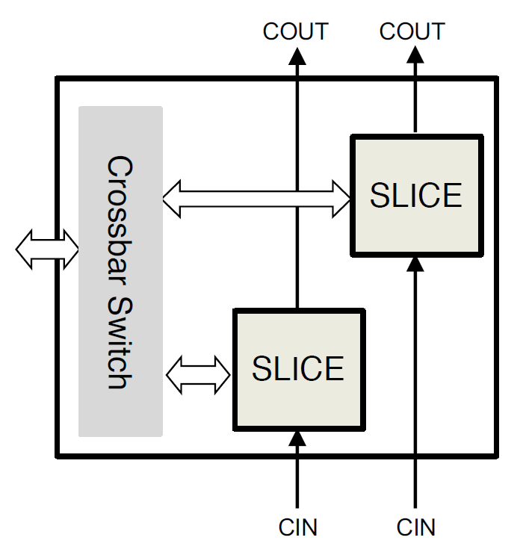
Slice and Configurable Logic Block (CLB)
Hierarchical design
Each slice (called BLE in early generations) can be composed of multiple LUTs
Each CLB can be composed of multiple slices
Example: Xilinx 7-series FPGAs
Each CLB has two slices
Each slice contains four LUTs
Ahmed, E. and Rose, J., The effect of LUT and cluster size on deep-submicron FPGA performance and density. IEEE TVLSI, 2004

Slide 8
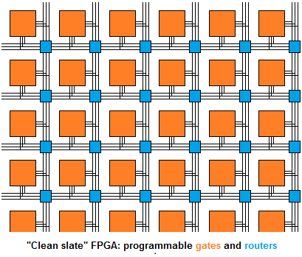
Traditional Homogeneous FPGA Architecture
Switch
block
Routing track
Logic
block

Slide 9
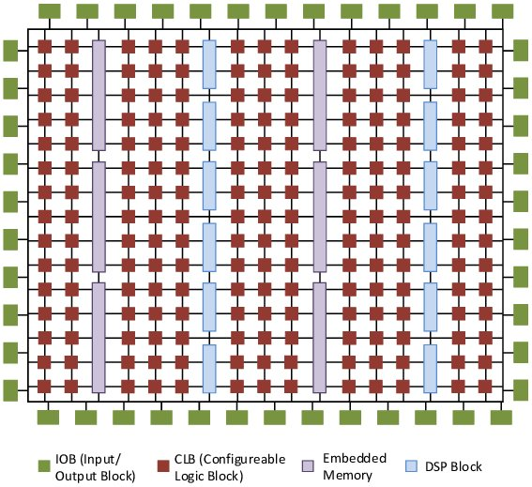
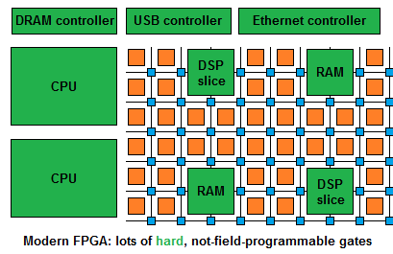
Modern Heterogeneous Programmable SoC
Island-style configurable mesh routing
Lots of dedicated components
Memories/multipliers, I/Os, processors
Specialization leads to higher performance and lower power
Figure source: embeddedrelated.com
Image source: Ronak, Bajaj, and Suhaib A. Fahmy. "Mapping for maximum performance on FPGA DSP blocks." IEEE TCAD

Slide 10
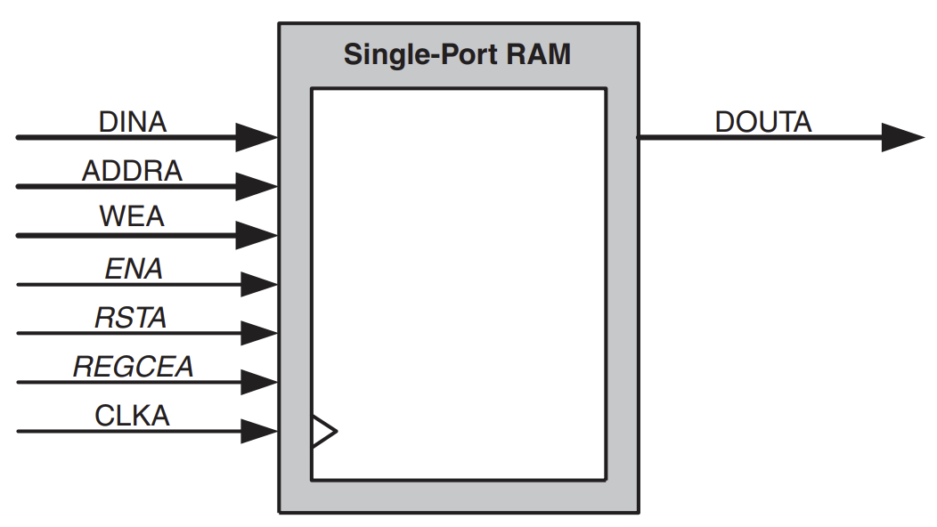
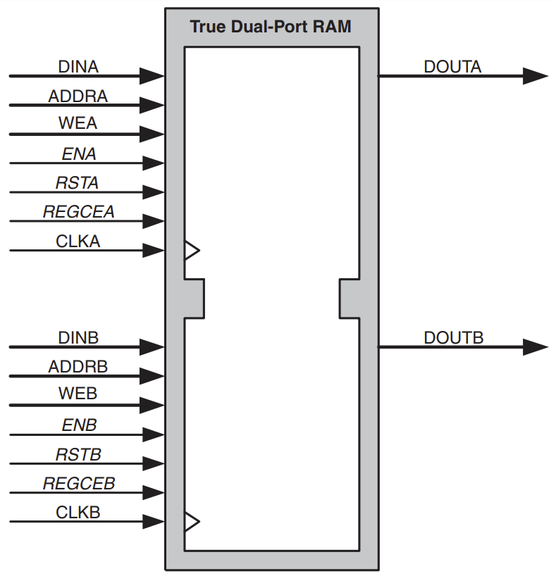
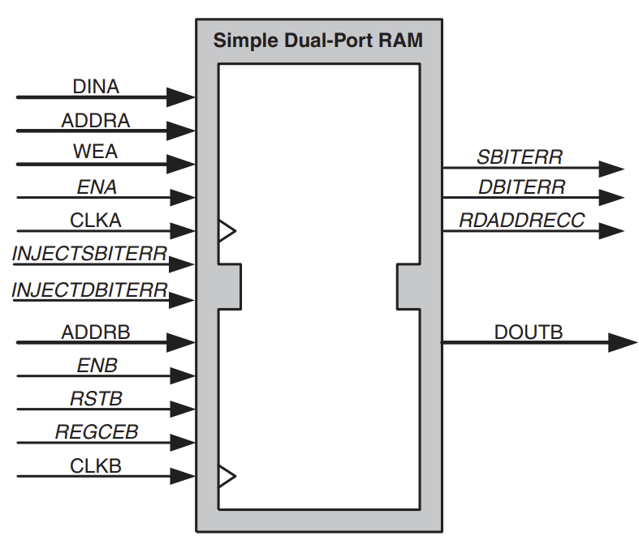
Dedicated Block RAMs (BRAMs)
Block RAMs are used for storing large amounts of data inside of your FPGA
They are SRAM
Also called on-chip memory
Typically, at most two ports
Different ports can be accessed at the same time
Different RAM blocks can be accessed at the same time
Example: Xilinx 18K/36K block RAMs
32k x 1 to 512 x 72 in one 36K block
Simple dual-port and true dual-port configurations

Slide 11
Dedicated DSP Blocks
DSP: Built-in components for fast arithmetic operation optimized for DSP applications
Essentially a multiply-accumulate core with many other features
Fixed logic and connections, functionality may be configured using control signals at run time
Much faster than LUT-based implementation (ASIC vs. LUT)
DSPs and BRAMs are usually the bottleneck resources for efficient FPGA design
Larger parallelism, more DSPs and BRAMs

Slide 12
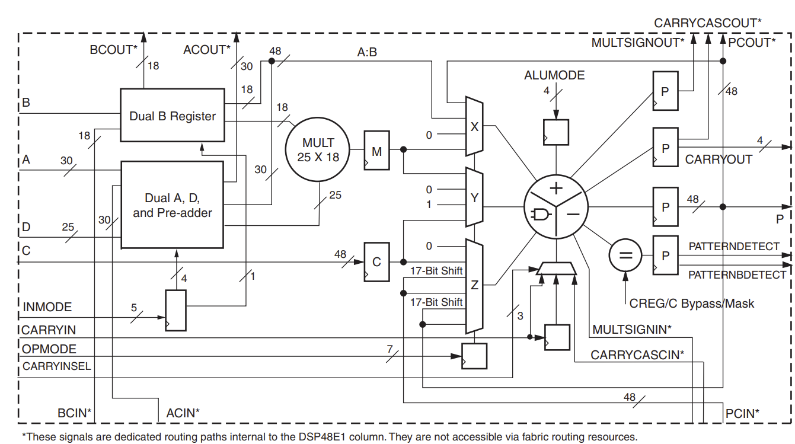
Example: Xilinx DSP48E1
25x18 signed multiplier
48-bit add/subtract/accumulate
48-bit logic operations
SIMD operations (12/24 bit)
Pipeline registers for high speed

Slide 13
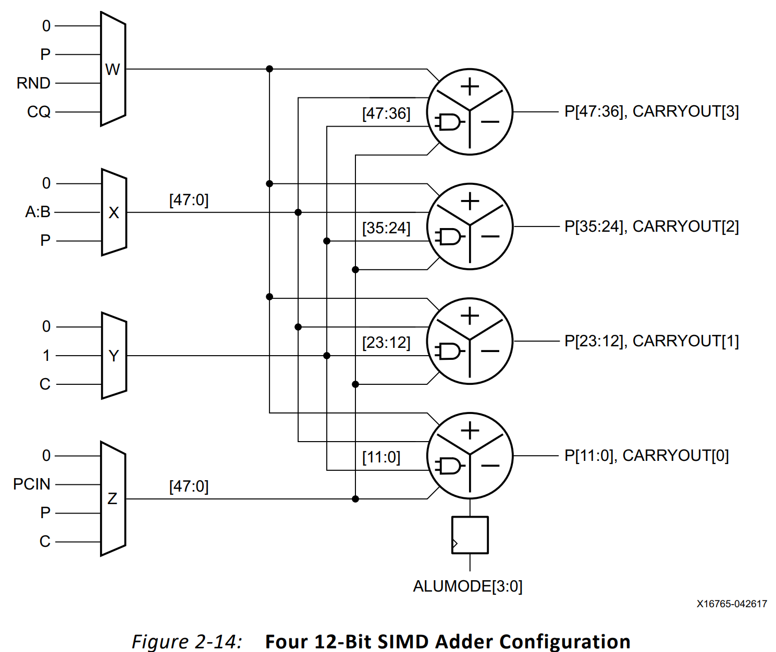
Example: Xilinx DSP48E1 (SIMD Mode)
Four 12-Bit SIMD Adder Configuration

Slide 14
Example: Xilinx DSP48E1
https://www.xilinx.com/support/documentation/user_guides/ug579-ultrascale-dsp.pdf

Slide 15
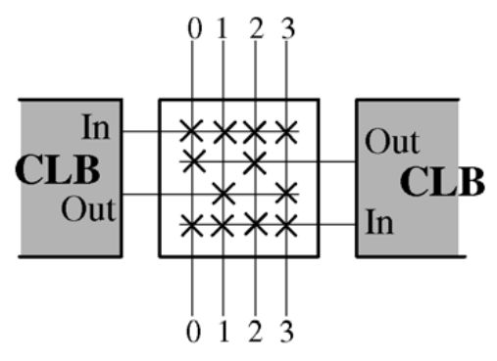
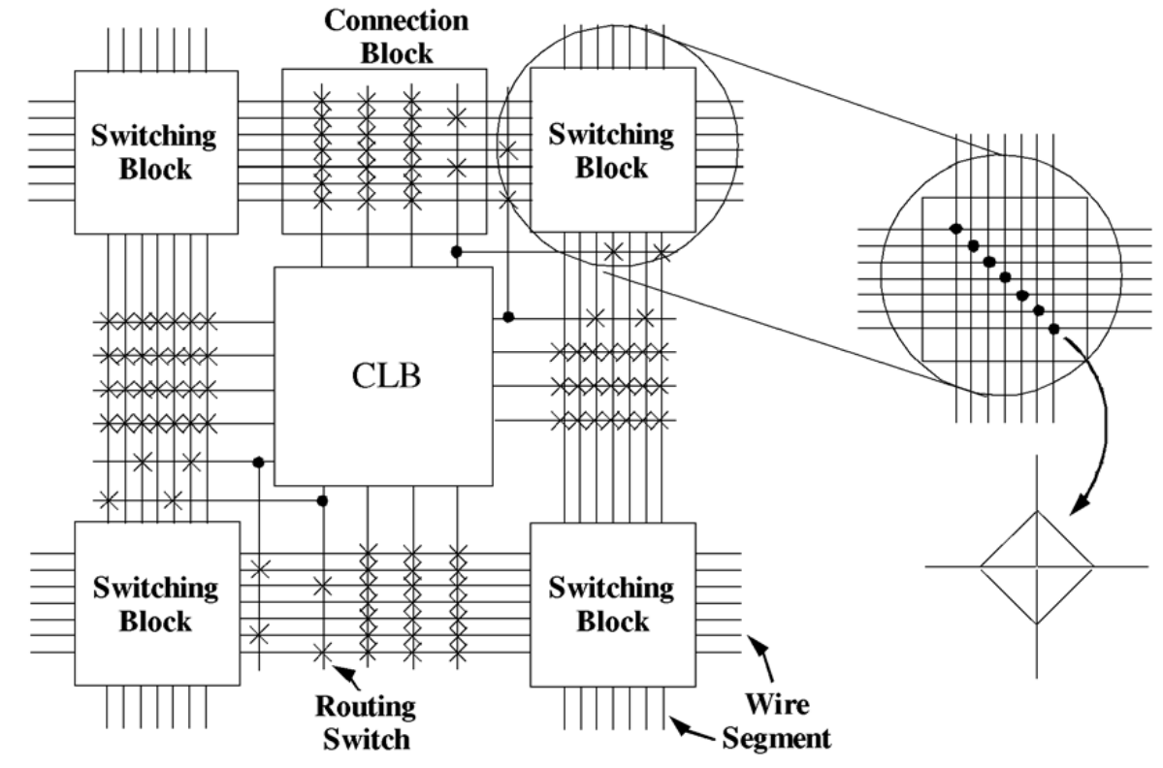
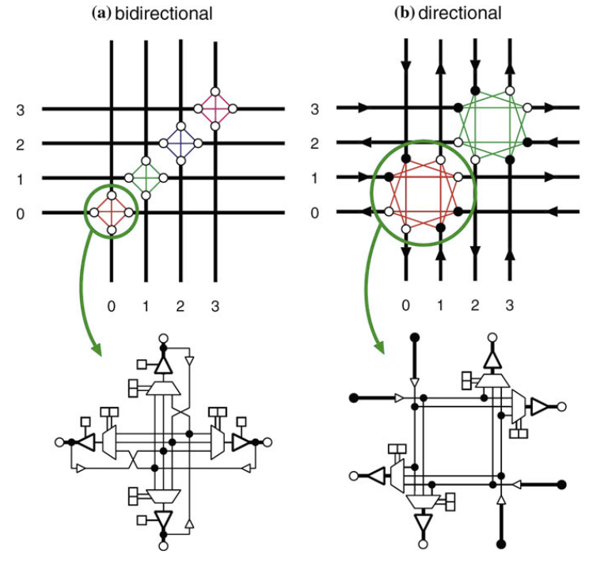
FPGA Routing Architecture

Slide 16
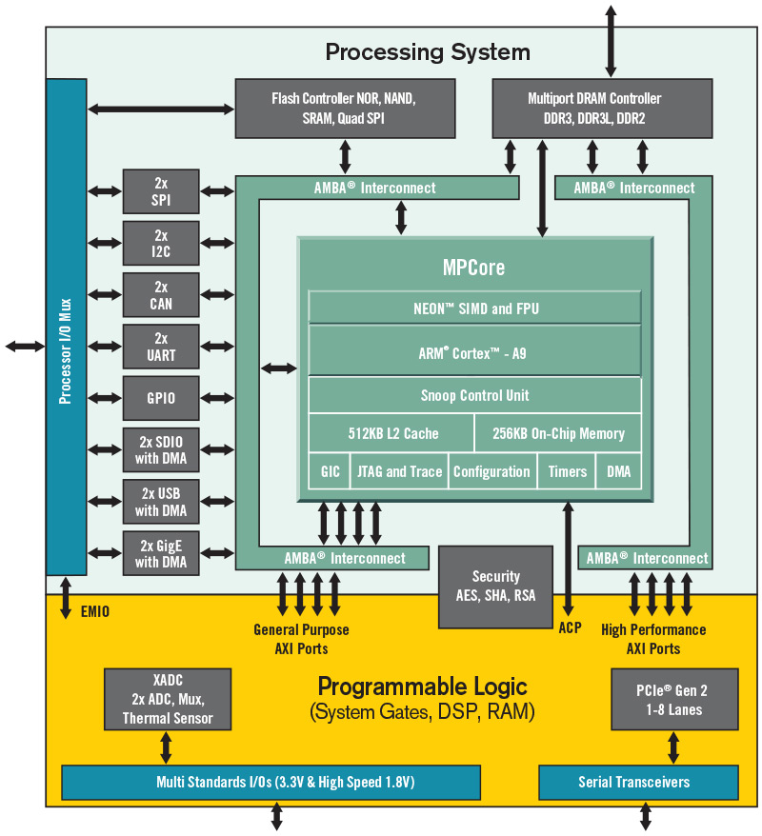
Embedded FPGA System-on-Chip
Processing System (PS)
Dual ARM Cortex-A9 + NEON
SIMD extension @600MHz~1GHz
Handles data movement (e.g., sending to and receiving data from PL) and peripherals (e.g., display, key-board)
Controls PL
Called Host Code
DRAM
Programmable Logic (PL)
This is where you design your accelerator
LUTs, BRAM, FF, DSP

Slide 17
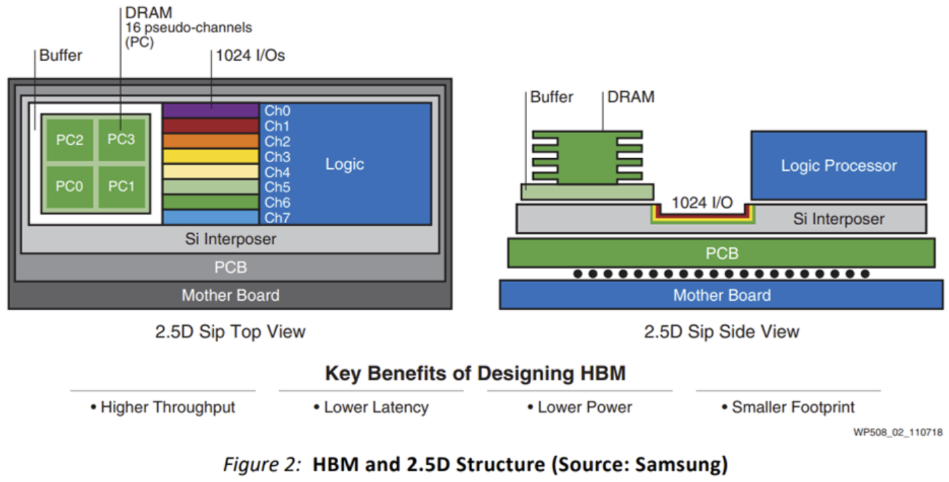
More Advanced Architectures – HBM
High Bandwidth Memory (HBM) on Xilinx FPGA
https://www.xilinx.com/developer/articles/maximizing-memory-bandwidth-with-vitis-and-xilinx-ultrascale-hbm-devices.html

Slide 18
More Advanced Architectures – HBM
High Bandwidth Memory (HBM) on Xilinx FPGA
A theoretical bandwidth up to 460GB/s:
2 x HBM stacks
Each stack has 16 Channels
Each channel is 64-bits of Data (DQ) bits Data can be transferred up to 1800Mbps
2x16x64x1800Mbps = 3.686Tb/s or 460GB/s
https://www.xilinx.com/support/documentation/ip_documentation/hbm/v1_0/pg276-axi-hbm.pdf

Slide 19
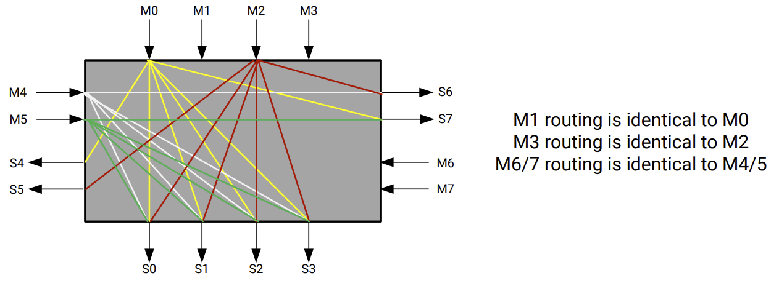
More Advanced Architectures – HBM
High Bandwidth Memory (HBM) on Xilinx FPGA
Bank group interleave reduces latency
32 AXI ports
32 pseudo channels (PC)
https://www.xilinx.com/support/documentation/ip_documentation/hbm/v1_0/pg276-axi-hbm.pdf

Slide 20
More Advanced Architectures – ACAP
Which architecture is best for which task?
Scalar processing elements (e.g., CPUs) are very efficient at complex algorithms with diverse decision trees and a broad set of libraries
But are limited in performance scaling.
Vector processing elements (e.g., DSPs, GPUs) are more efficient at a narrower set of parallelizable compute functions
But experience latency and efficiency penalties because of inflexible memory hierarchy.
Programmable logic (e.g., FPGAs) can be precisely customized to a particular compute function, which makes them best at latency-critical real-time applications (e.g., automotive driver assist) and irregular data structures (e.g., genomic sequencing)
But algorithmic changes have traditionally taken hours to compile versus minutes.
https://www.xilinx.com/support/documentation/white_papers/wp505-versal-acap.pdf

Slide 21
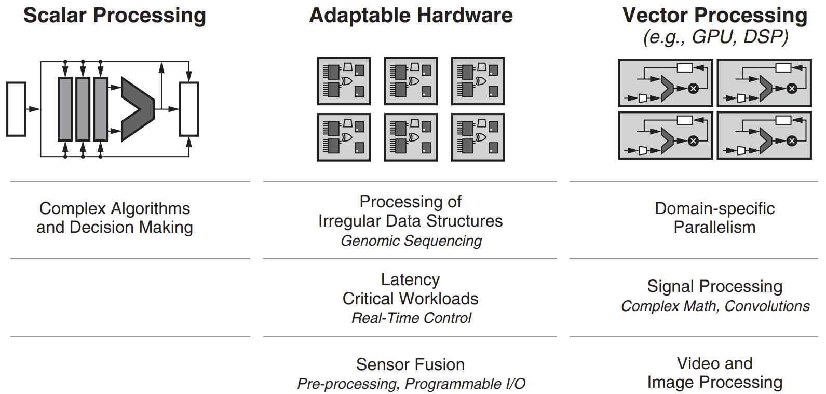
More Advanced Architectures – ACAP
Which architecture is best for which task?
Scalar processing elements (e.g., CPUs) are very efficient at complex algorithms with diverse decision trees and a broad set of libraries
But are limited in performance scaling.
Vector processing elements (e.g., DSPs, GPUs) are more efficient at a narrower set of parallelizable compute functions
But experience latency and efficiency penalties because of inflexible memory hierarchy.
Programmable logic (e.g., FPGAs) can be precisely customized to a particular compute function, which makes them best at latency-critical real-time applications (e.g., automotive driver assist) and irregular data structures (e.g., genomic sequencing)
But algorithmic changes have traditionally taken hours to compile versus minutes.
https://www.xilinx.com/support/documentation/white_papers/wp505-versal-acap.pdf

Slide 22
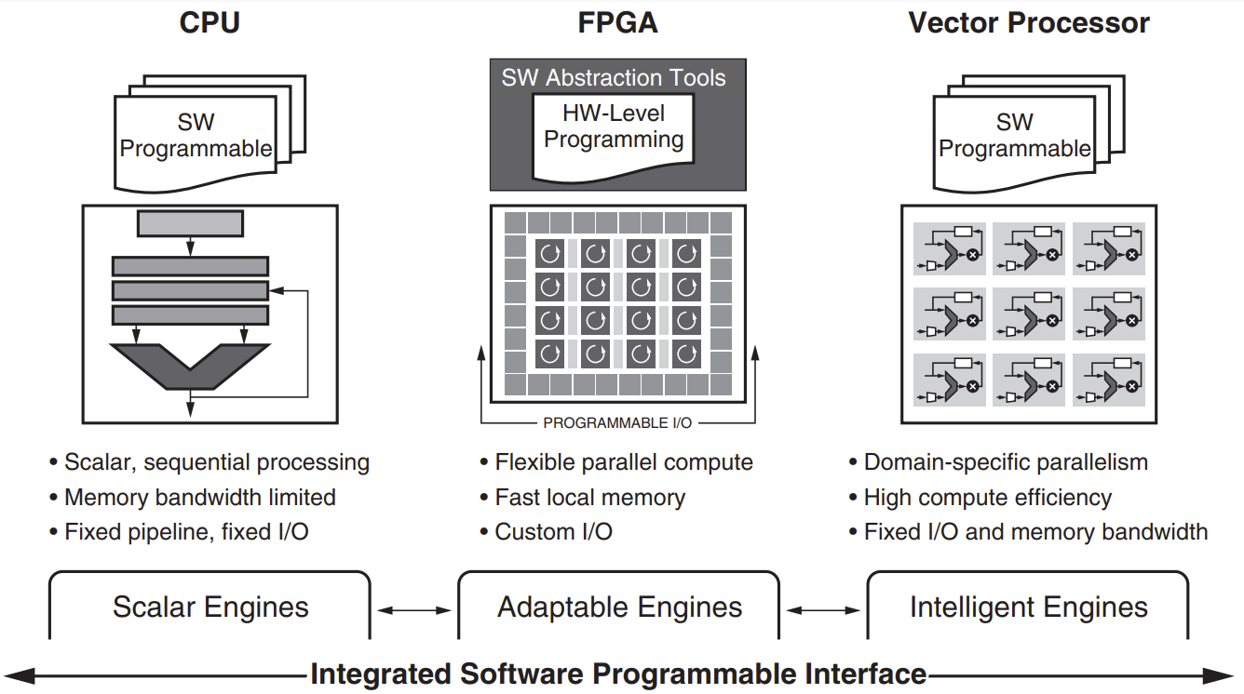
More Advanced Architectures – ACAP
Xilinx introduces heterogeneous adaptive compute architecture, ACAP, which integrates the three:
Vector and scalar processing elements tightly coupled to programmable logic (PL)
With a high-bandwidth network-on-chip (NoC)
They insist that ACAP is not FPGA…
https://www.xilinx.com/support/documentation/white_papers/wp505-versal-acap.pdf

Slide 23
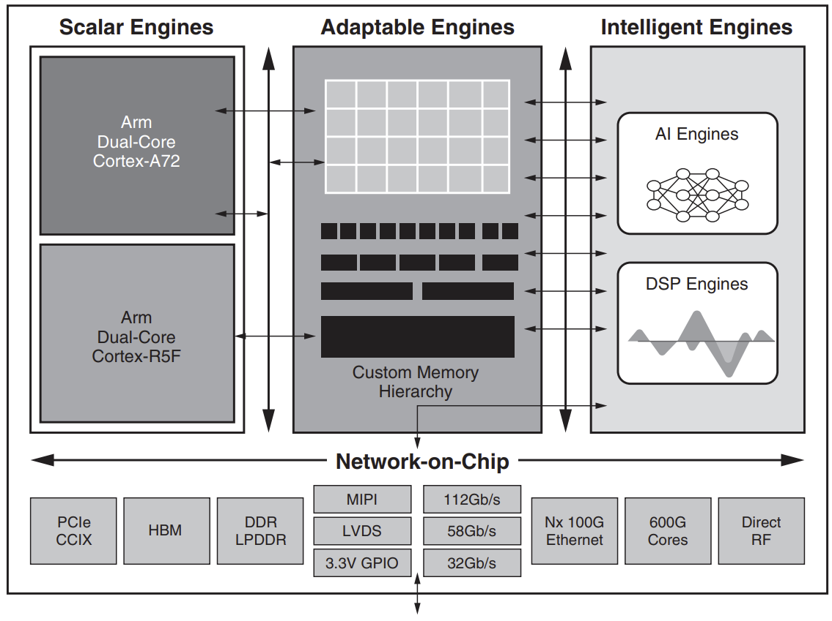
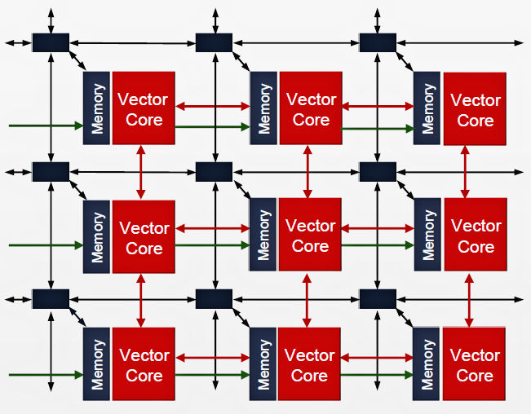
More Advanced Architectures – ACAP
AI Engines

Slide 24
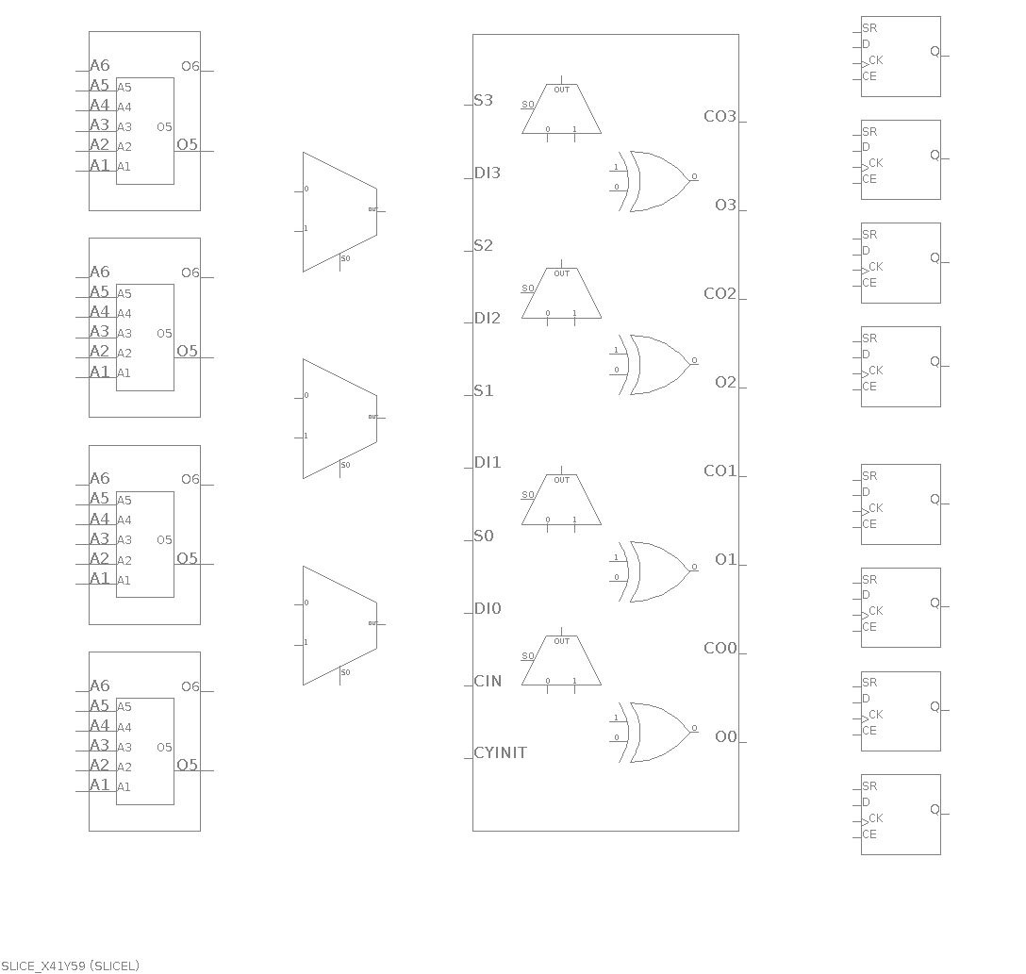
Screenshot from Vivado
DSPs
SLICE
LUTs
FFs
Structure of a SLICE

Slide 25
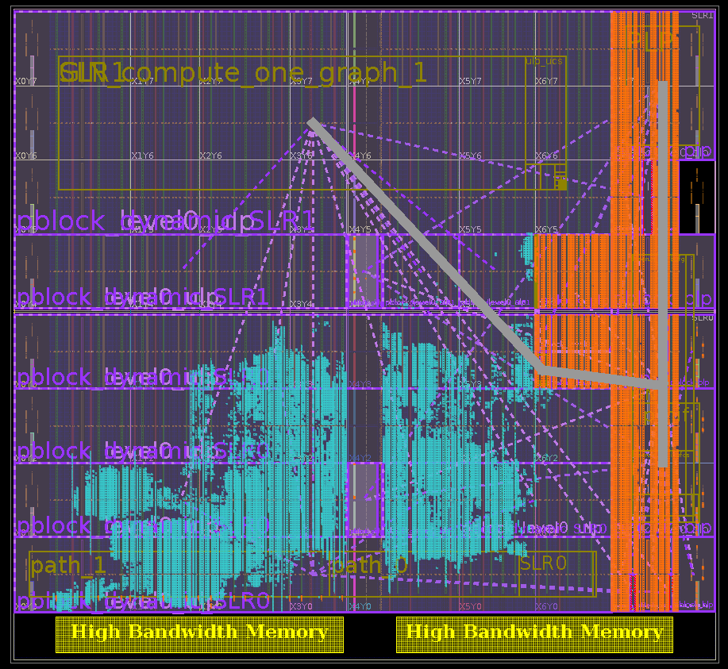
A Real FPGA Design

Slide 26
Summary
Key components on FPGA:
Look-up Table (LUT)
Block RAM (BRAM)
DSP
Flip-flop (FF)
Routing resources
More advanced FPGA technology
High bandwidth memory (HBM)
Adaptive computing acceleration platform (ACAP)

