Slide 1
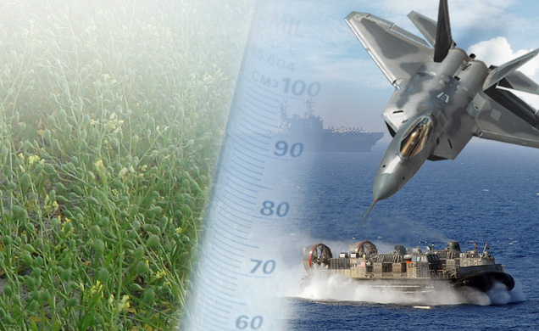
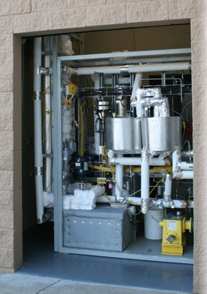
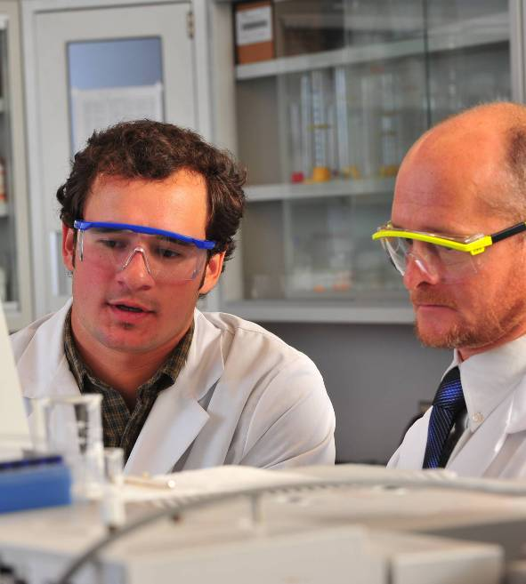
Biofuels ISOCONVERSION Process November 2015
Chuck Red
cred@ara.com
850.914.3188
David M. Wadsworth
dmwad@chevron.com
973.893.3840

Slide 2
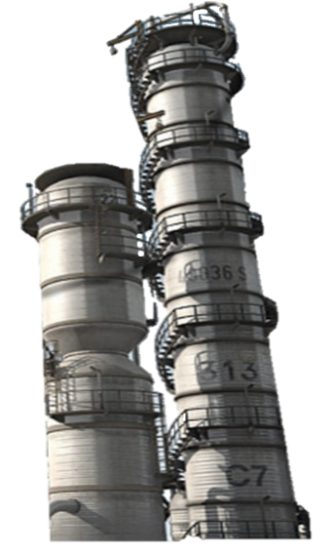
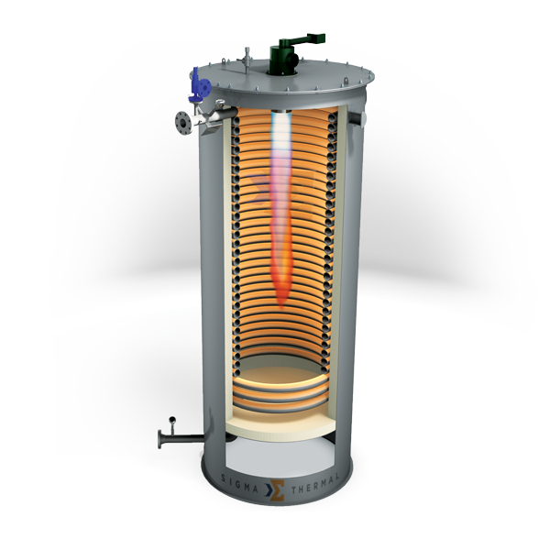
Biofuels ISOCONVERSION Process
Converts industrial oil feedstocks, fats, and greases into 100% drop in fuels and renewable chemicals
Catalytic Hydrothermolysis
Hydrotreating
Fractionation
Supercritical water process converts fats, oils, and greases from plant oils, algae, and animal fats into a crude oil that contains the same molecular distribution of petroleum crude
Saturates olefins & removes any residual oxygenates.
Non-precious metal
Catalysts and conventional hydrotreating
reactor
Produces finished fuels – diesel and jet fuel that meet petroleum specifications without blending, renewable chemicals, and naphtha
2 Minutes
Converts fats oils and greases to crude oil
Conventional
Refinery Processes

Slide 3
Feedstocks – Fats, Oils, and Greases
Biofuels ISOCONVERSION is feedstock agnostic – can process any triglyceride or fatty acid material
Algal
Brown Grease
Camelina
Canola
Carinata
Castor
Distillers Corn
Fatty Acid Distillate
Jatropha
Microbial
Peanut
Shae Butter
Soybean
Tall oil
Tallow
Tung
Yellow Grease
ARA’s Hydrothermal Cleanup removes virtually all inorganic material from challenging feedstocks

Slide 4
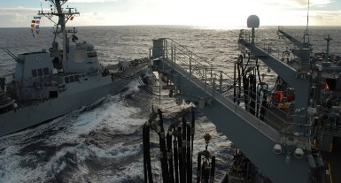
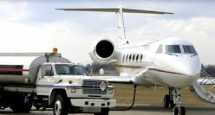
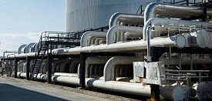
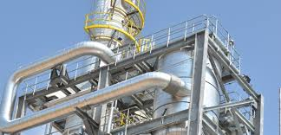
Products
ReadiJet CHCJ-5 – Renewable JP-5 Jet Fuel for Shipboard Use
Products are pure hydrocarbons with the same boiling rate distribution and molecular makeup as their petroleum counterparts
ReadiDiesel CHD-76 – Renewable
F-76 Marine Diesel
ReadiJet Jet-A
Renewable Naphtha
Renewable Chemicals – High value by-products including renewable alkyl aromatics, paraffins, acids, fatty alcohols
Renewable Naphtha

Slide 5
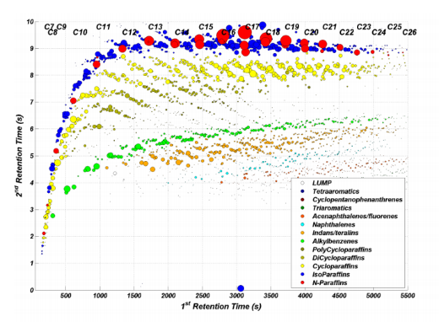
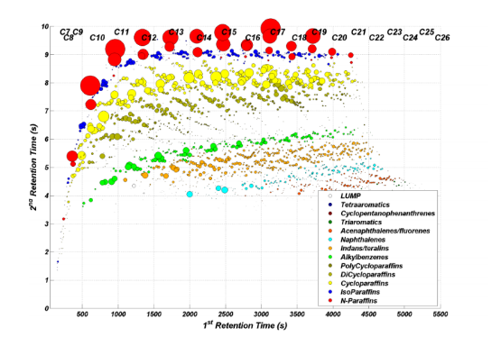
GC X GC
Petroleum Jet Fuel
ReadiJet
Gas Chromatograph – Each bubble represents a different compound.
ARA fuels have same compounds and boiling range distribution as their petroleum counterparts.
Red and Blue bubbles represent paraffin molecules.
Yellow and brown bubbles represent cycloparaffin molecules
Green and orange molecules represent aromatic molecules

Slide 6
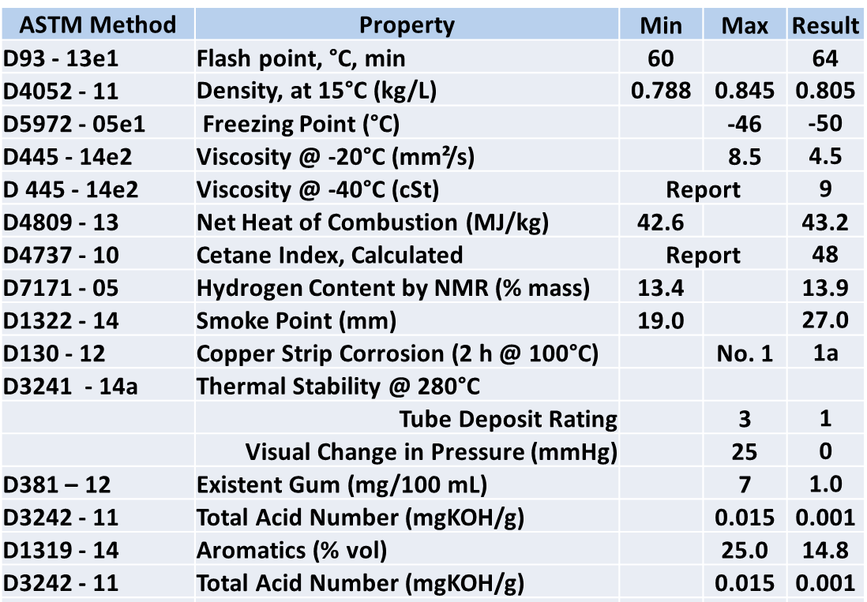
CHJ Test Results

Slide 7
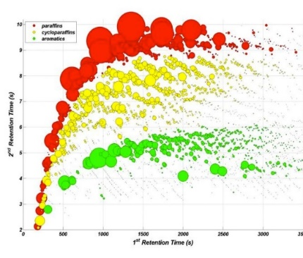
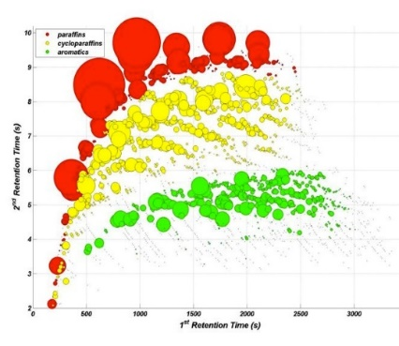
GC X GC
Petroleum Diesel
ReadiDiesel
Gas Chromatograph – Each bubble represents a different compound and the size represents its prevalence.
ARA fuels have same compounds and boiling range distribution as their petroleum counterparts.
Red bubbles represent paraffin molecules.
Yellow bubbles represent cycloparaffin molecules
Green bubbles represent aromatic molecules

Slide 8
Test Facility – Panama City, FL

Slide 9
Certification
ASTM Certification –
ReadiJet is next in queue for Research Report review
Jet Fuel – D7566 Annex Summer 2016
MILSPEC Certification –
100% renewable, drop in, unblended, JP-5 and F-76 – End of 2016

Slide 10
Commercialization
Focus on low quality waste fats and oils
4 licenses in place
First 2 projects in engineering
Construction in 2016

Slide 11
Questions?

