Slide 1
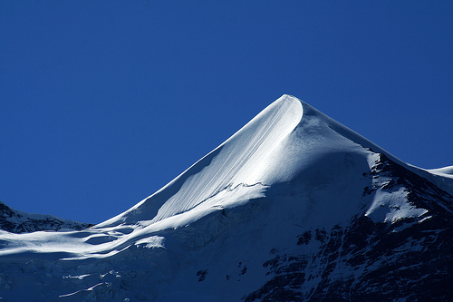
“…The Silberhorn has a subsidary pyramidal peak naped sharply down the sides. Then one of their beauties is in nearly vertical places the find pleatings of the snow running to or from one another, like the newness of lawn in an alb and sometimes cut off short as crisp as celery.”

Slide 2
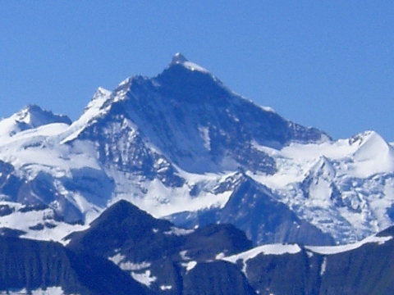
“ There are round one of the heights of the Jungfrau two ends or falls of a glacier. If you took the skin of a white tiger or the deep fell of some other animal and swung it tossing high in the air and then cast it out before you…”

Slide 3
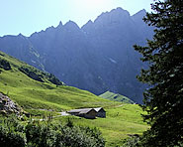
Valley of Reichenbach

Slide 4
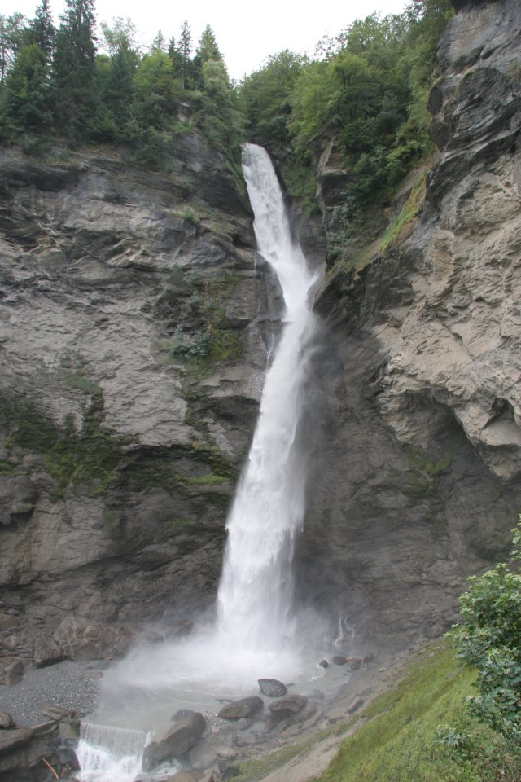
“Then we saw the three falls of the Reichenbach. The upper one is the biggest. At the take-off it falls in discharges of rice or meal but each cluster as it descends sharpens and tapers, and from halfway down the whole cascade is inscaped in fretted falling vandykes in each of which the frets or points, just like the startings of a just-lit lucifer match, keep shooting in races…” (195)

Slide 5
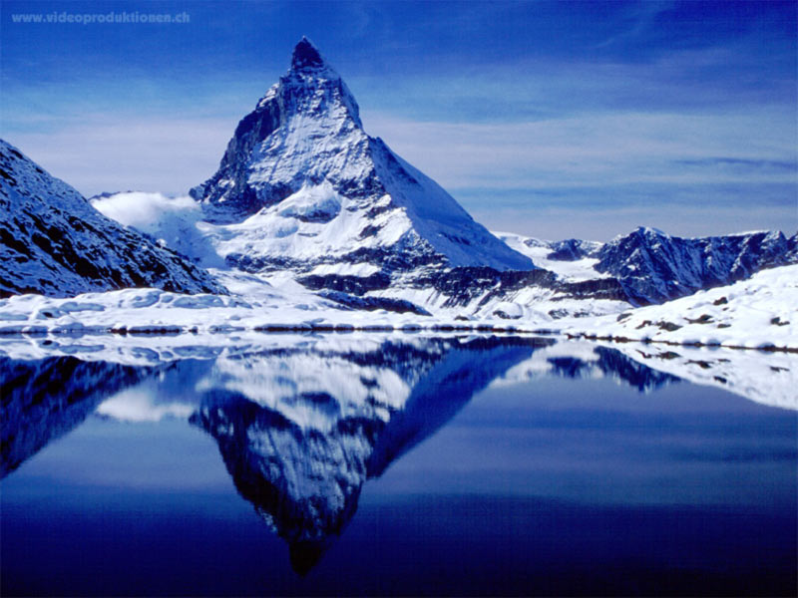
“We could not get a completely clear view of the Matterhorn…”

Slide 6
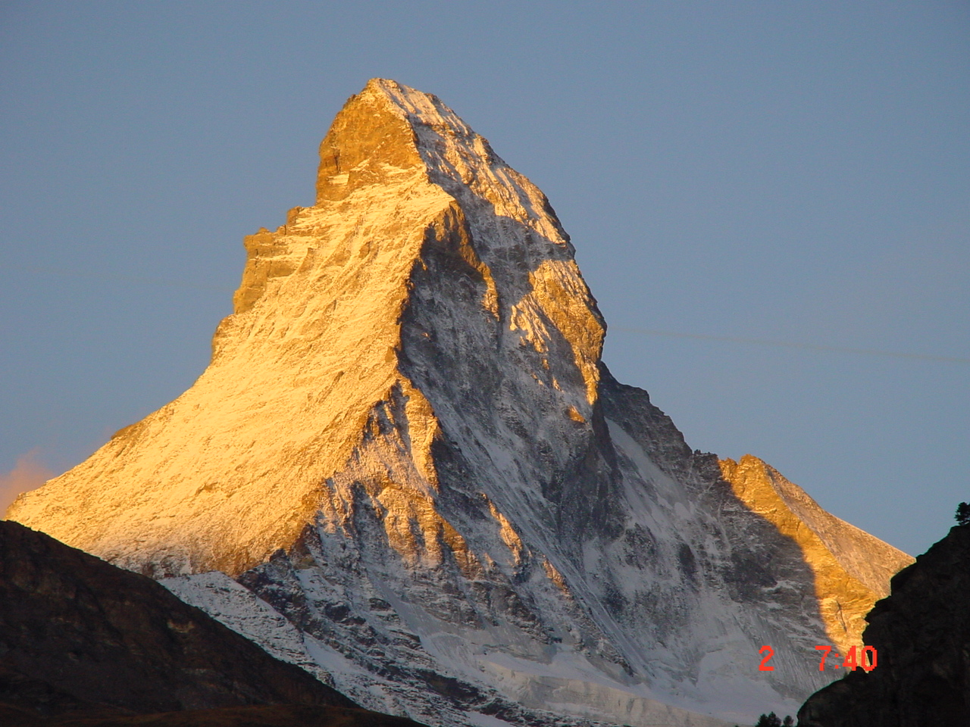
Matterhorn

Slide 7
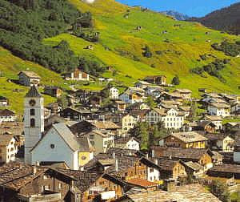
“across the valley a pretty village, the houses white, deep-eaved, pierced with small square windows at effective distances…” (197)

Slide 8
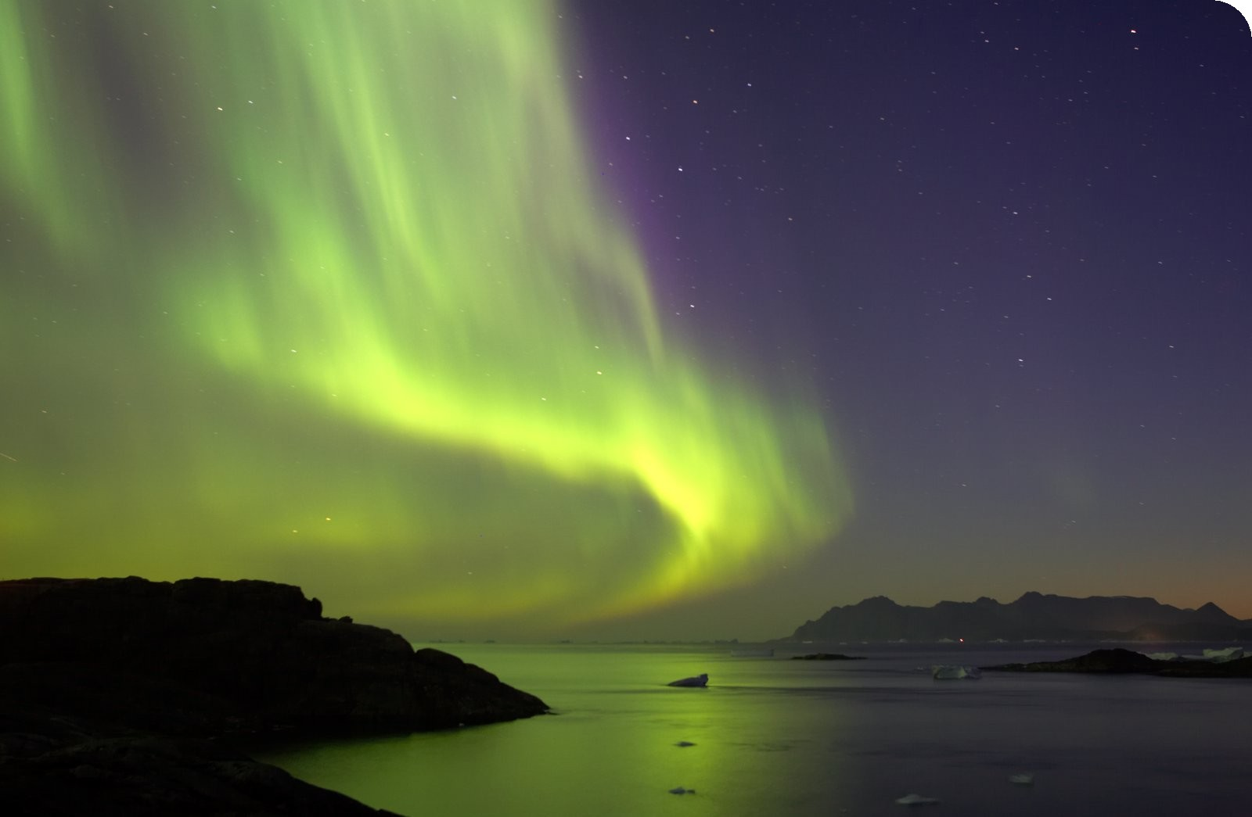
“First saw the Northern Lights… This busy working of nature wholly independent of the earth and seeming to go on in a strain of time not reckoned by our reckoning of days and years, but simpler, and as if correcting the preoccupation with and appealing to and dated to the day of judgment was like a new witness to God.” (203)

Slide 9
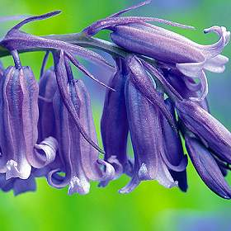
“The bluebells in your hand baffle you with their inscape, made to every sense: if you draw your fingers through them they are lodged and struggle/ with a shock of wet heads; the long stalks rub and click and flatten to a fan on one another…”

Slide 10
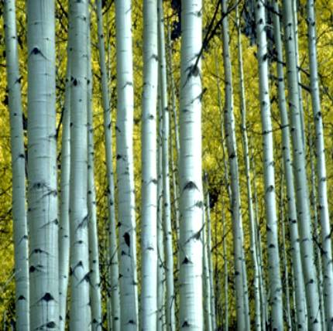
Aspen Trees

Slide 11
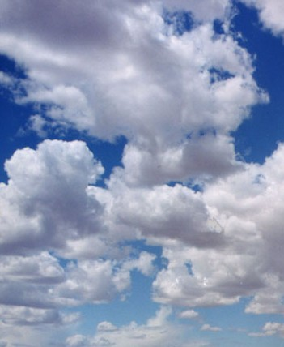
“I have been watching clouds this spring and evaporation, for instance over our Lenten chocolate…” (203)
“…the blue was charged with simple instress, the higher, zenith sky earnest and frowning, lower more light and sweet.”

Slide 15
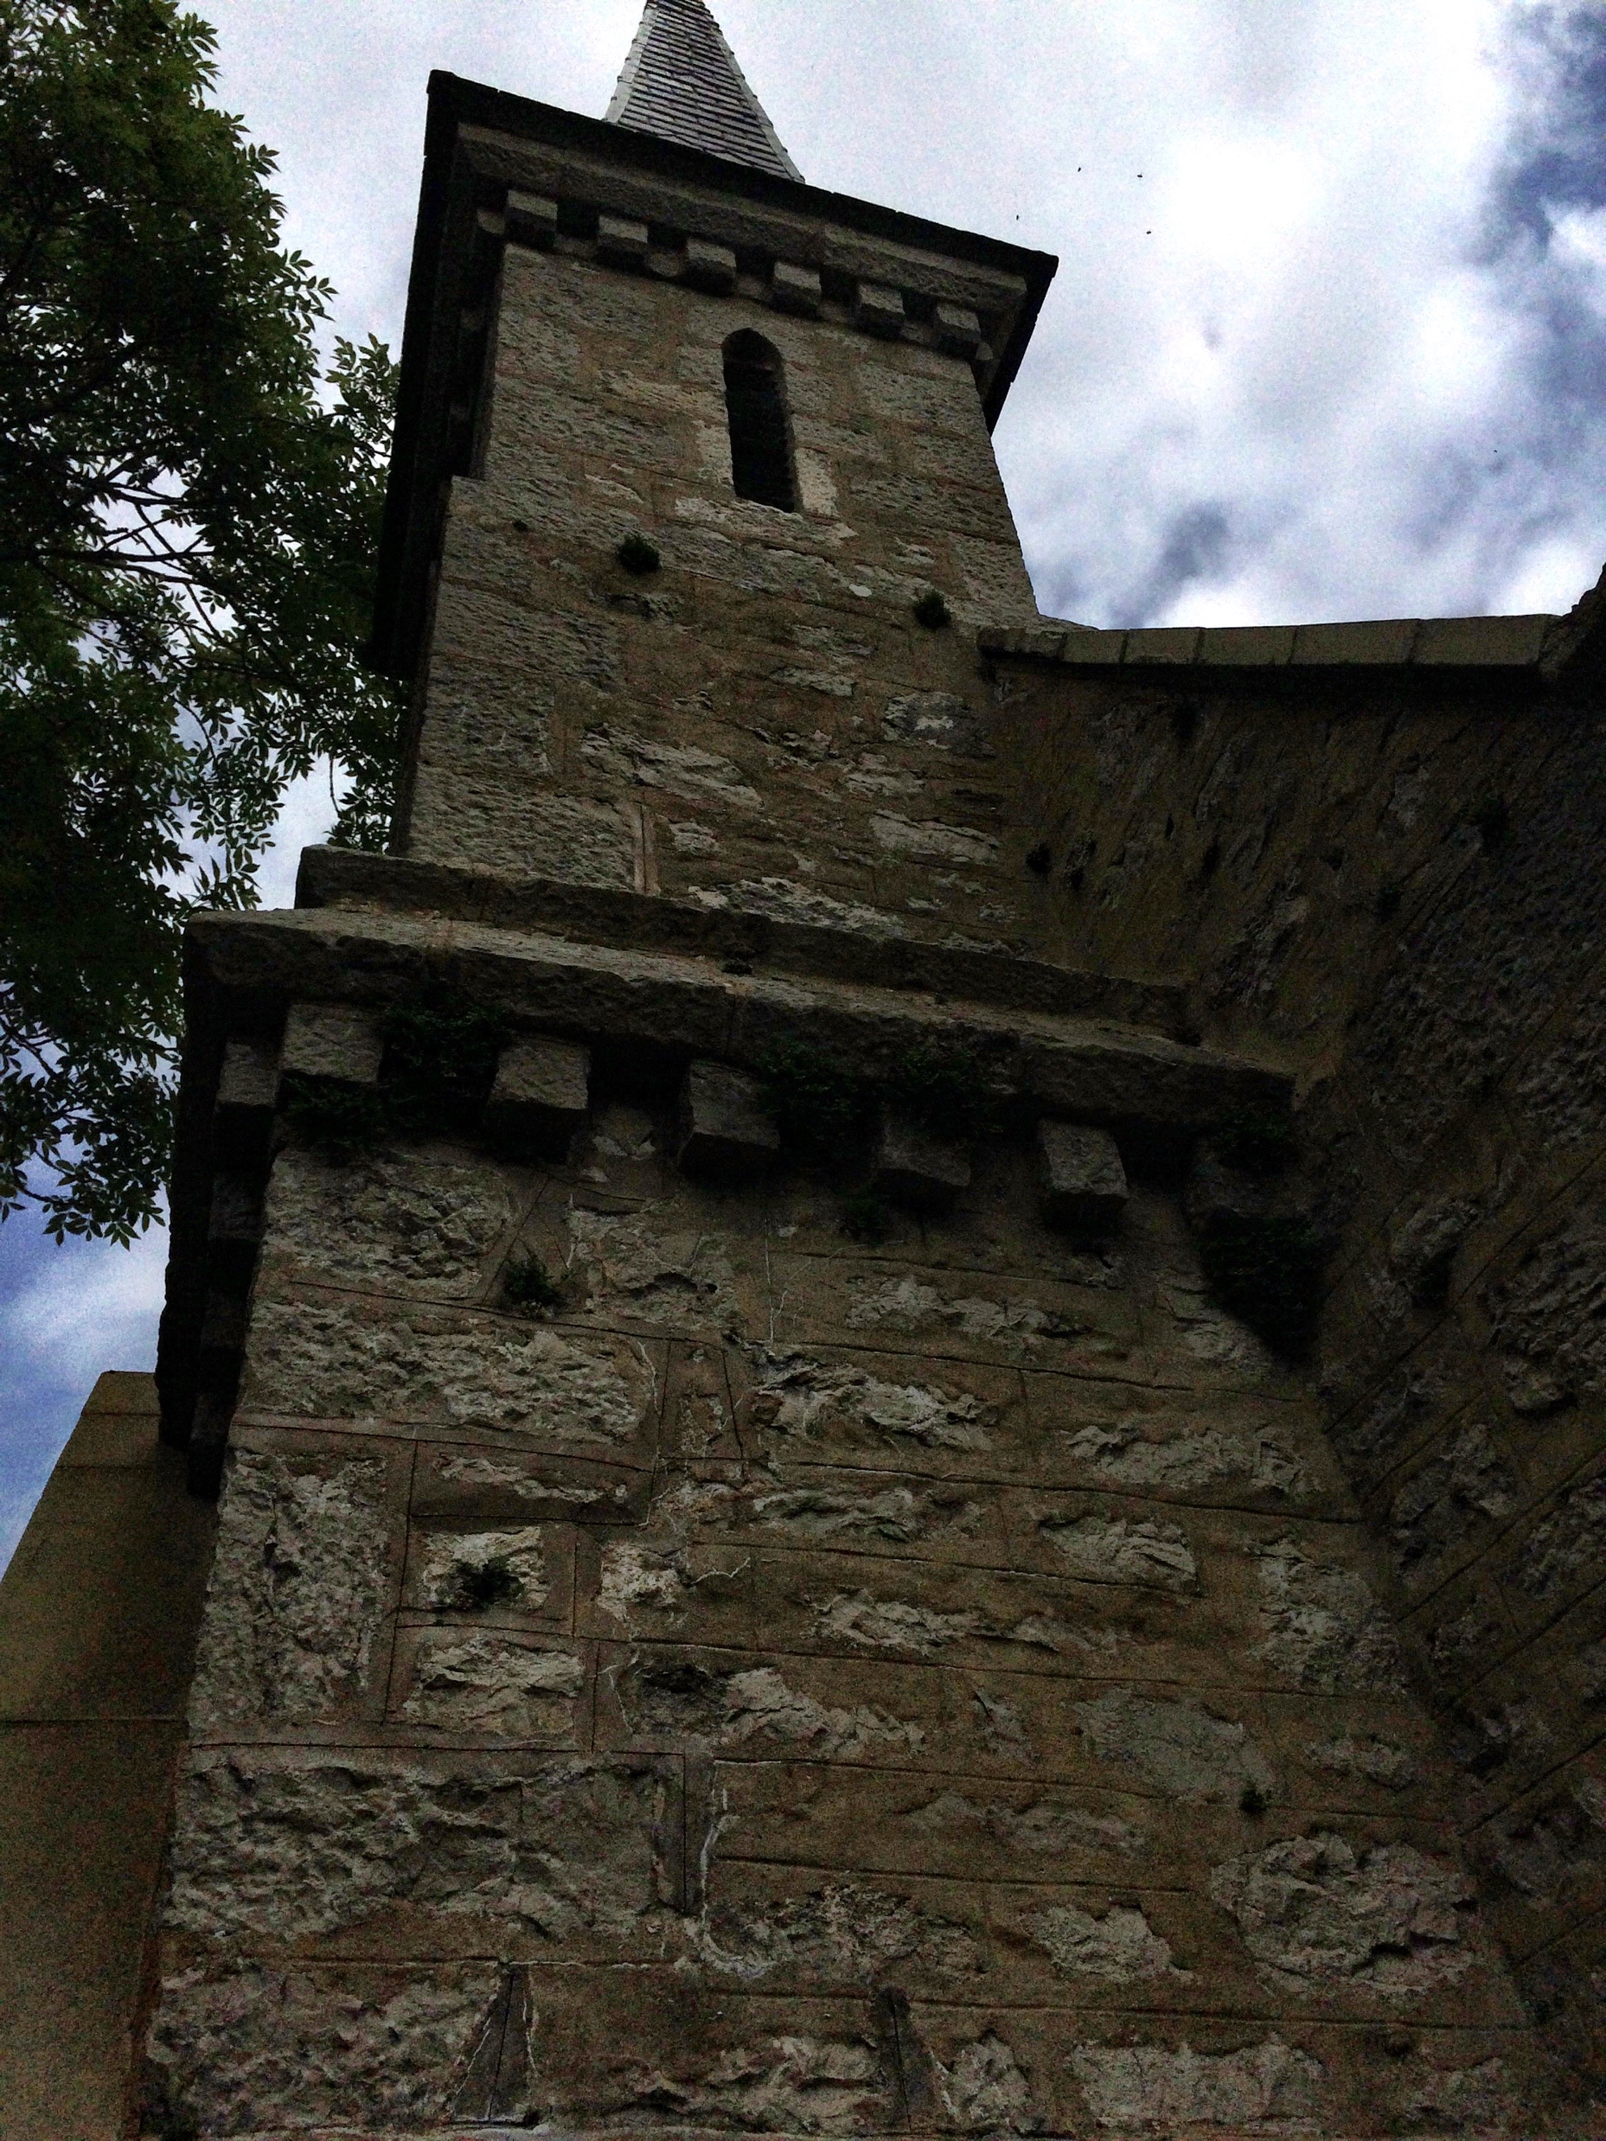

Slide 17
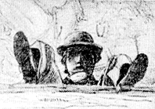
Hopkins, Self Portrait – reflected in Nature

