Slide 1
Welcome Judge Clint Rucker

Slide 2
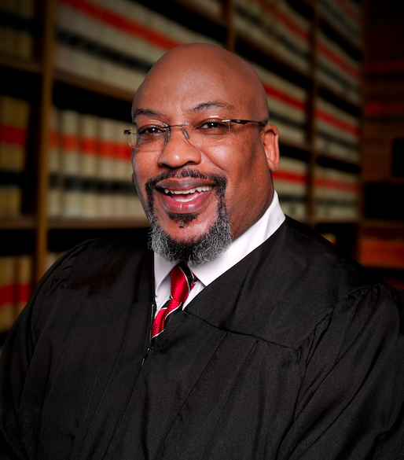
Oxford College
Emory University: Philosophy, Alpha Phi Alpha
Texas Southern College of Law
Fulton County DA Office
”Retired” as a Municipal Court Judge

Slide 3
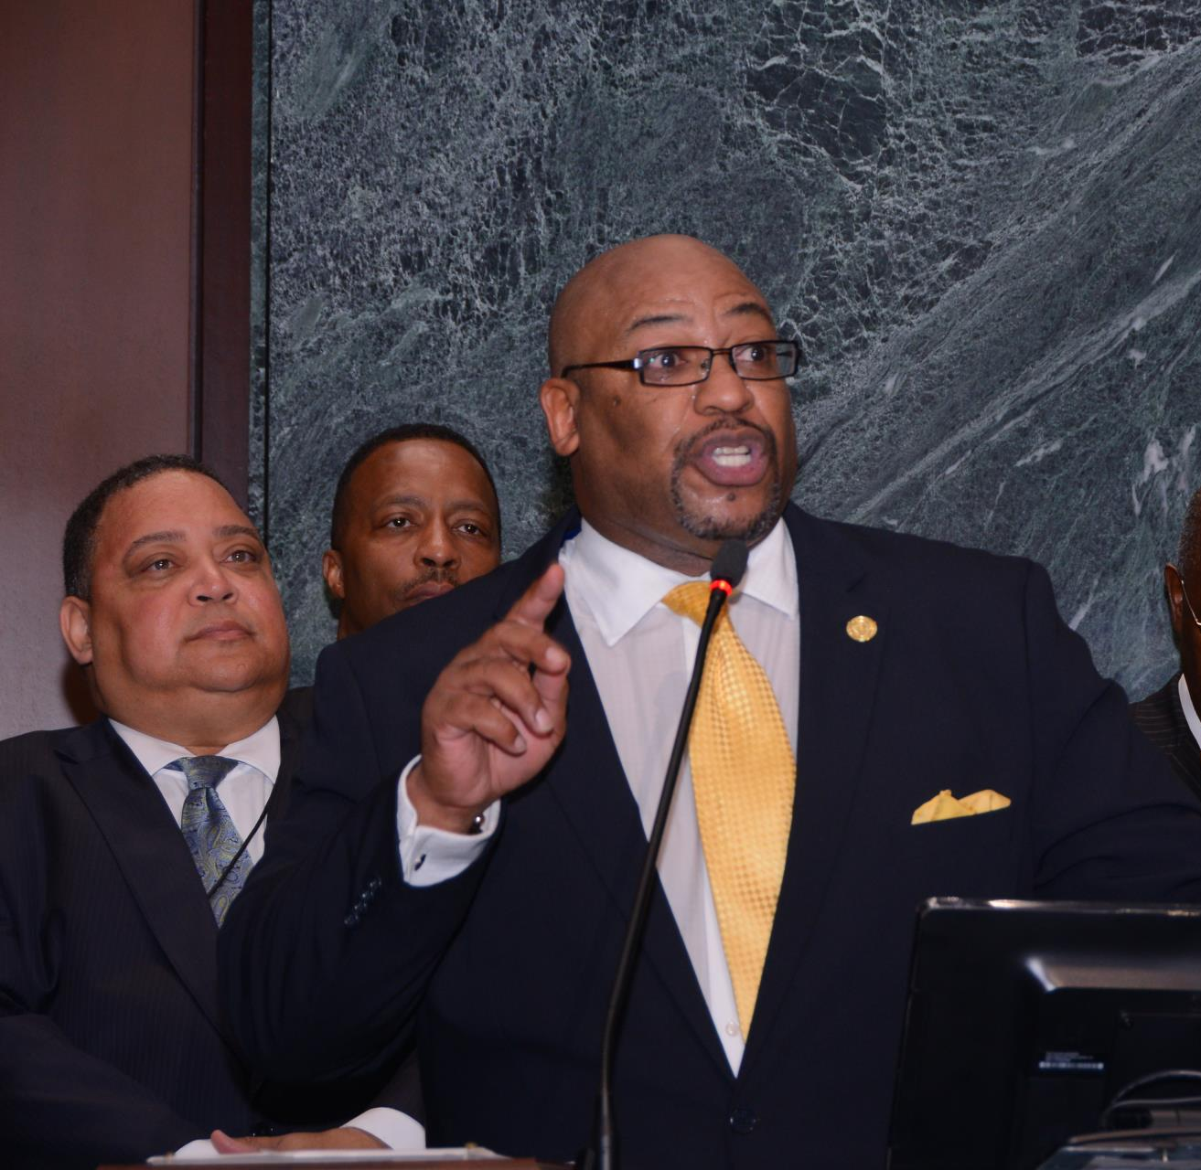
Judge Rucker addressing City Council

Slide 4
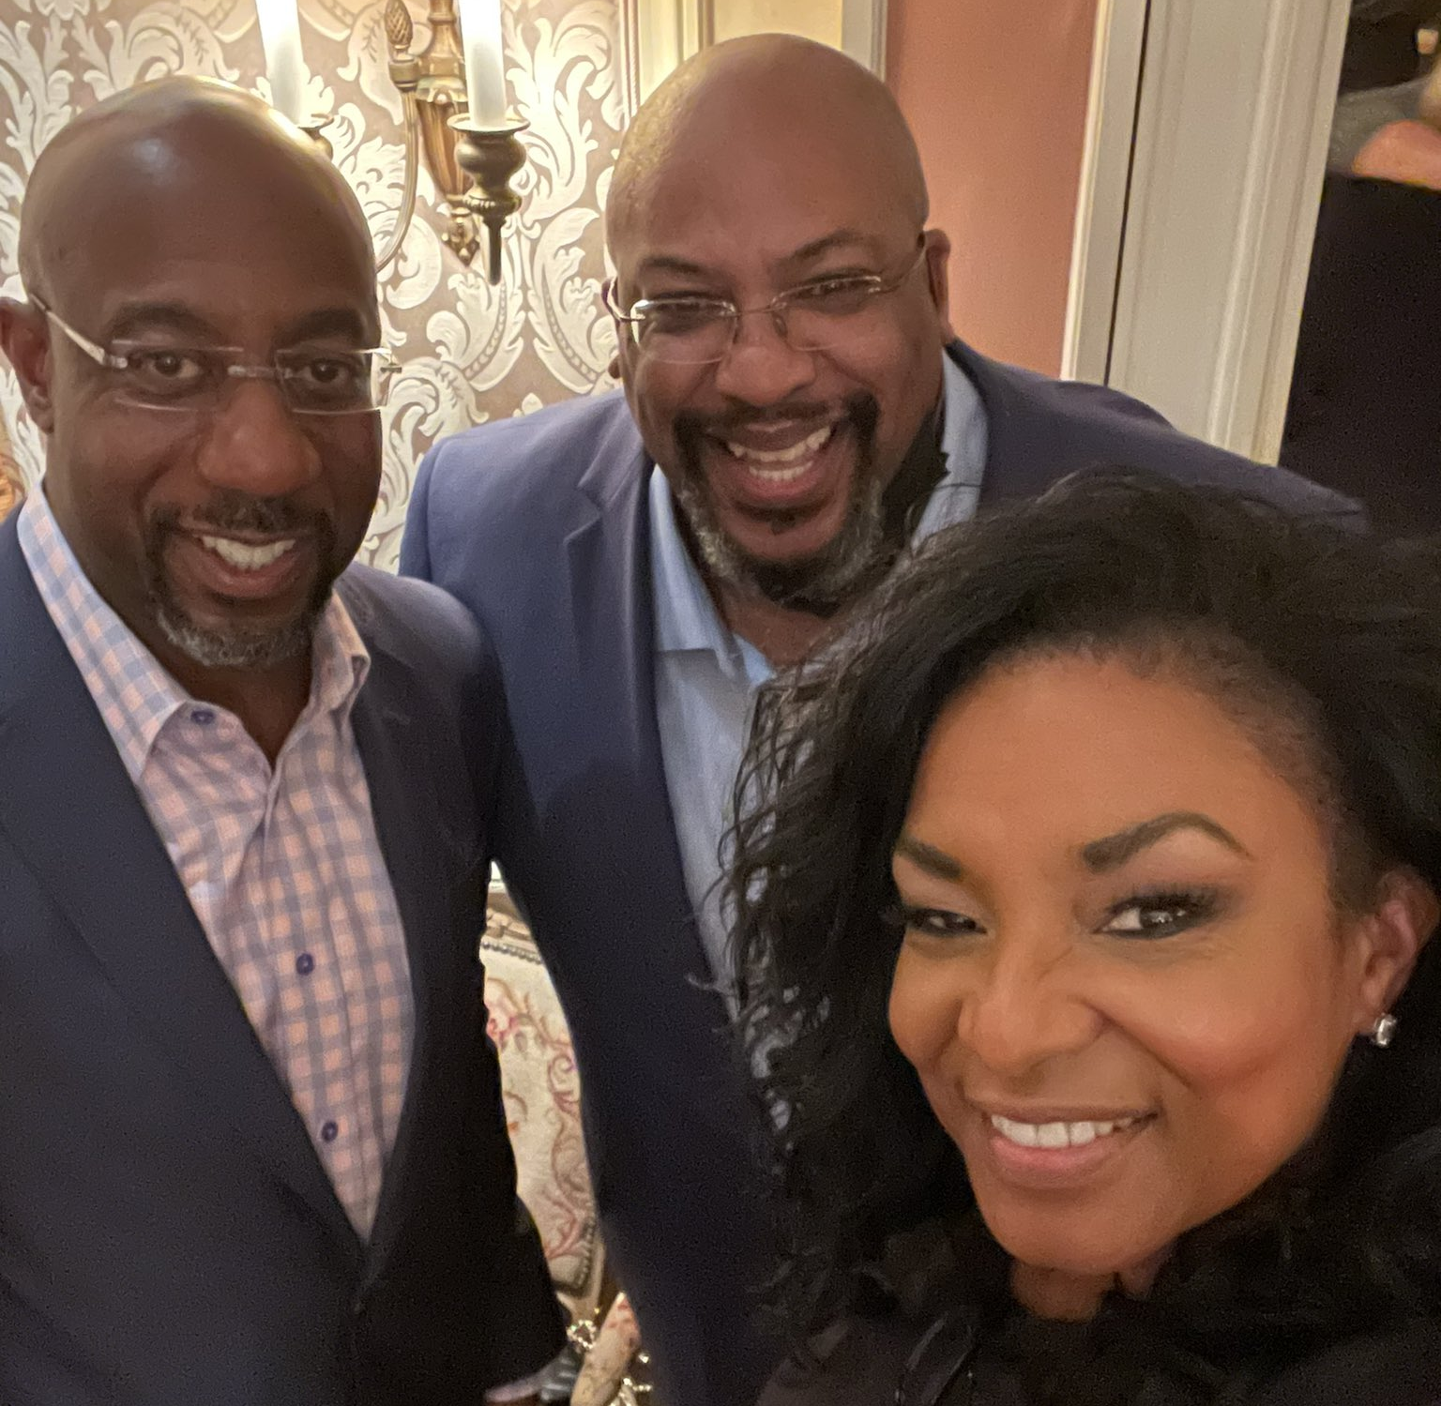
Judge and Ms. Rucker with Senator Warnock

Slide 5
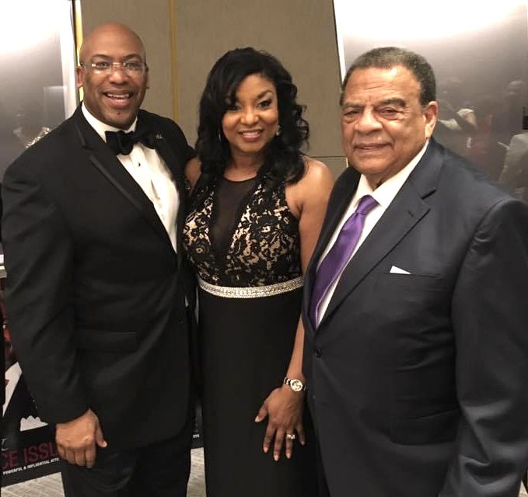
Judge and Ms. Rucker with Ambassador Andrew Young

Slide 6
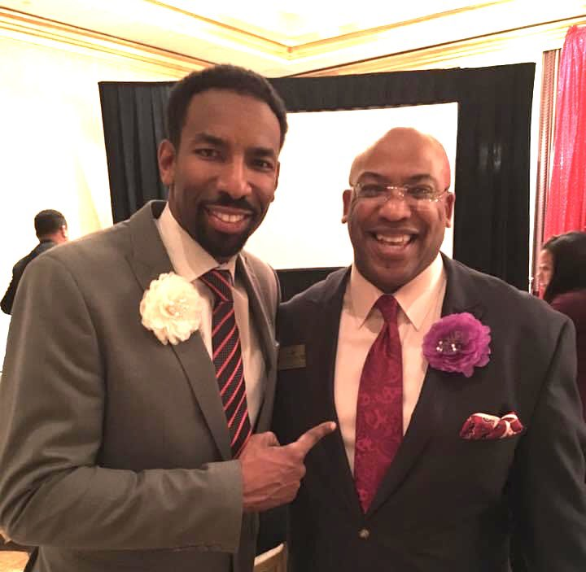
Judge Rucker and Atlanta Mayor Andre Dickens

Slide 7
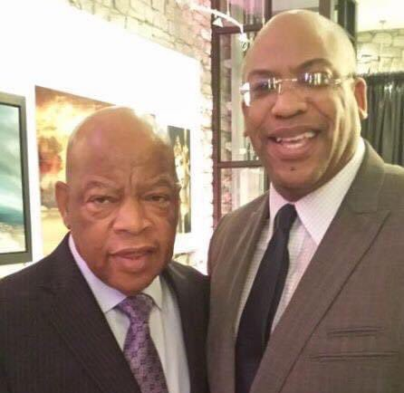
Judge Rucker and Congressman John Lewis

Slide 8
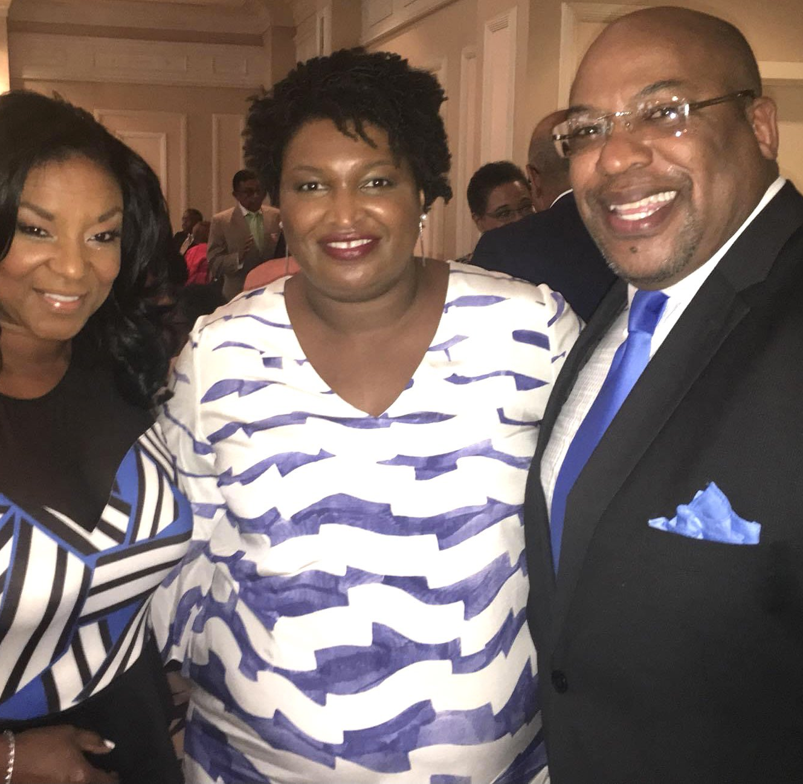
Judge and Ms. Rucker with Stacey Abrams

Slide 9
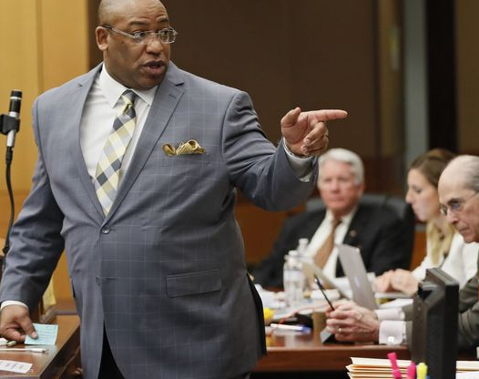
Mr. Rucker in Trial

Slide 10
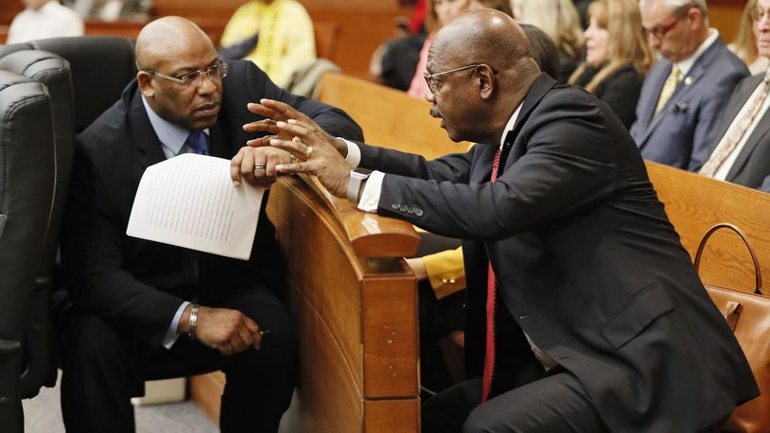

Slide 11
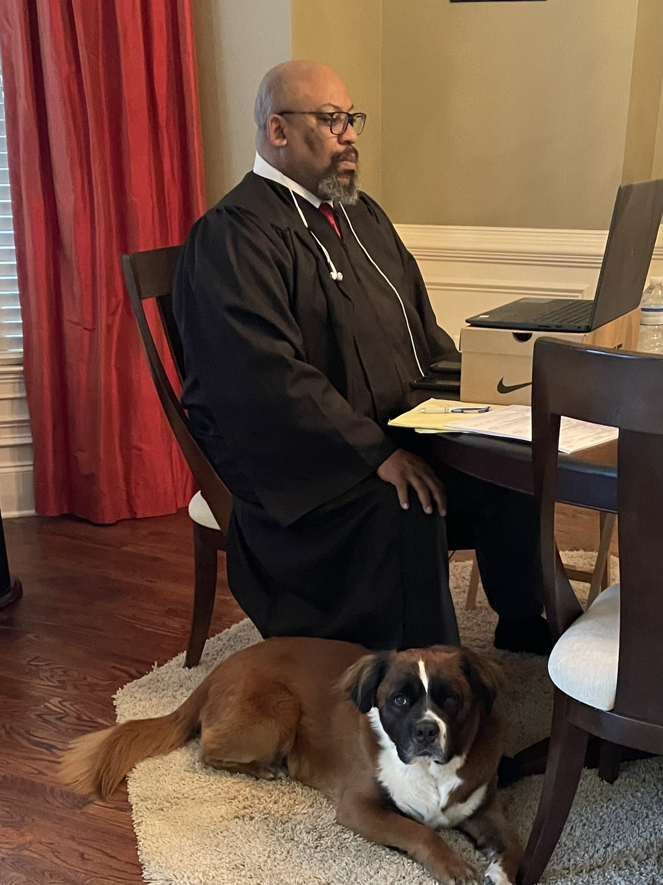
Judge Rucker
(and Jack McCoy)

Slide 12
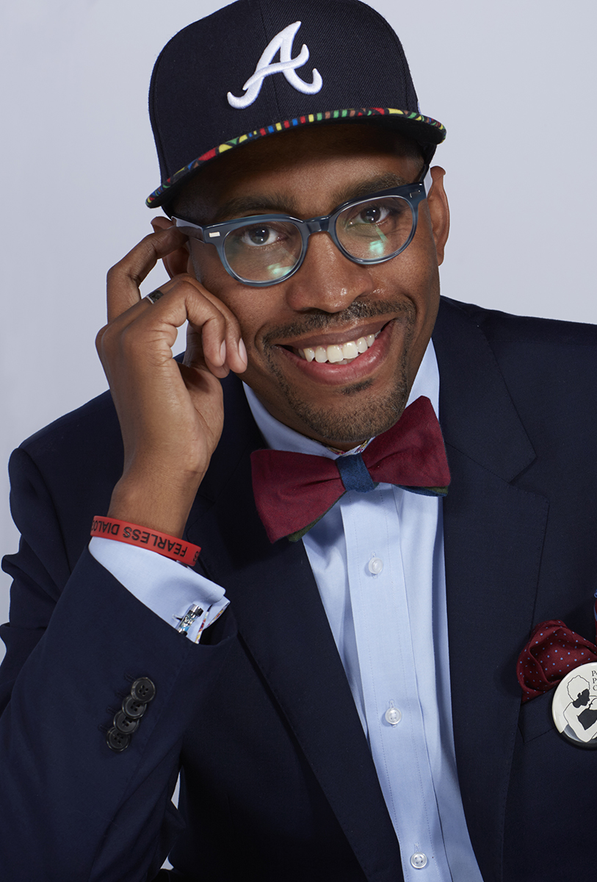
Professor Gregory Ellison
“Fearless Dialogues”
What does it mean to be a problem?
What does it mean to die a good death?

Slide 13
Welcome Judge Clint Rucker

