Slide 1



HAMMER: Boosting Fidelity of Noisy Quantum Circuits
by Exploiting Hamming Behavior of Erroneous Outcomes
Swamit Tannu*
Poulami Das⁺
Ramin Ayanzadeh⁺
Moinuddin Qureshi⁺
*
⁺
^{ASPLOS 2022}
Notes:
Good afternoon, I am Poulami from Georgia Tech where I am advised by Prof. Moin Qureshi. I will be talking about HAMMER, a post-processing technique to improve the Fidelity of Near-term quantum programs by exploiting the Hamming behavior of errors. This work was done in collaboration with Swamit and Ramin

Slide 2

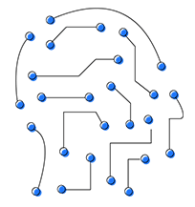



Why Quantum Computers?
Machine Learning
Drug Discovery
Logistics
Energy
Classical Computer
Execution Time
Quantum Processing Unit (QPU)
Control Processor
Quantum
Computer
Problem Size
Quantum Bits
Quantum Computers can enable solutions to important problems
Quantum bits are susceptible to errors
Notes:
Quantum Computers are domain specific (click) accelerators that can speedup computationally hard problems using properties of quantum bits or qubits. (click)
Unfortunately, qubits are unreliable (click) and prone to errors.

Slide 3

NISQ Era of Computing
Qubit Error
Error free outcome
Four Qubit
Quantum Program
Erroneous outcome
Quantum Computer
Statistical
Inference
1111
Solution
Output Probability
1000
QEXE
Output
Repeat Execution
for N Trials
1000
1110
1111
1011
0000
1100
Output Log of N trials
The program solution is inferred from the output distribution
Notes:
So, suppose we run a 4-qubit program whose correct output is all 1s, on a quantum computer, we get incorrect outcomes as a result of errors.
On existing quantum hardware, we can not eliminate qubit errors. So, we run the program for multiple trials and obtain an output distribution.
Then, we leverage statistical techniques to infer the solution from this distribution.

Slide 4
Focus on the Wrong to Make it Right?
Error free outcome
Software Mitigation of Hardware Errors is important in NISQ Era
Erroneous outcome
Maximize the probabilities of the correct solutions
1111
1000
Output Probability
Output
1000
1110
1111
1011
0000
1100
Output Log of N trials
Can we use the wrong answers to improve Application Fidelity?
Notes:
As we can see here, in addition to the correct outcome, there are these several incorrect outcomes that are produced as well.
To make near-term quantum computers useful, we must mitigate qubit errors.
As a result, in recent years, several proposals try to maximize the probability of the correct outcome by using software techniques. However, in most of the studies, the focus is often on improving the probability of the correct answer and the incorrect outcomes are often ignored. But are erroneous outcomes completely arbitrary and without any information? Or can we use them in some manner to improve the application fidelity.

Slide 5




Not All Errors Are Equally Likely
4-qubit Bernstein Vazirani Program
Sorted by Hamming Distance (HD)
Uniform
More likely
HD=1
Incorrect
HD=3
HD=2
HD=4
Frequent incorrect outcomes are close to the correct one(s) in Hamming Space
Do errors have a structure?
Notes:
To understand this, lets take a look at the output of a 4-qubit BV program.
We observe that, in addition to the correct secret key which is “1111” , a lot of incorrect outcomes are produced as expected. However, we observe that these errors are not really occurring with uniform probability. In fact, if they were, they would all appear with the probability corresponding to the horizontal line shown here
Instead, many of these outcomes are way more likely than the others.
So, we ask this question- Do errors have a structure?
To understand this, we sort these outcomes based on their Hamming Weight with respect to the correct outcome. We observe that incorrect outcomes that are a Hamming Distance away are significantly more likely than others. And the cumulative probabilities of the outcomes at a certain Hamming distance, decreases with increasing Hamming Distance.
Thus, Frequent incorrect outcomes are usually close to the correct ones in the Hamming Space.

Slide 6
Outline
Background and Motivation
Experimental Characterization
HAMMER: Insight and Design
Key Results
Conclusion
Notes:
To answer these questions, we perform a detail characterization on IBM quantum computer and use publicly available data from Google

Slide 7
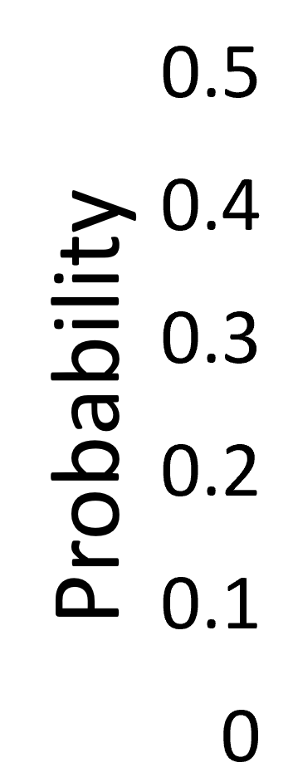
Hamming Spectrum
Hamming Spectrum of 1111
HD=3
HD=2
HD=1
HD=4
0
1
2
3
4
Hamming Distance (HD)
Hamming Spectrum of 0000
0
1
2
3
4
Hamming Distance (HD)
Notes:
To visualize the structure in Hamming space, we introduce the notion of a Hamming Spectrum.
The Hamming Spectrum of an outcome (say target) is the distribution of the probabilities of the outcomes obtained by organizing all the outcomes from the output distribution in terms of their Hamming Distance from the target.
For example, the figure here shows the Hamming Spectrum of “1111”
Here, the outcome “1111” corresponds to itself whereas the all 0s outcome is at the distance 4.
Similarly, we can obtain the Hamming Spectrum of 0000
One of the key things we notice here is that, “1111” which is the correct outcome, has neighbors at short Hamming distances appearing with high probability compared to the incorrect outcome “all 0s”

Slide 8
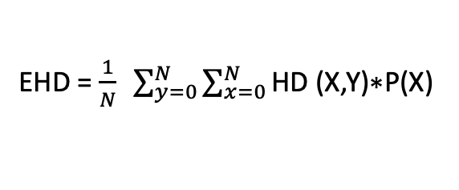
Expected Hamming Distance (EHD): To Quantify Error Structure
EHD = $\frac{1}{N} \sum_{y=0}^{N}{\sum_{x=0}^{N}{\text{HD}\text{ (}\text{X}\text{,}\text{Y}\text{)∗}\text{P}\text{(}\text{X}\text{) }}}$
EHD₀₀₀₀
= 1 * 0.05
+ 1 * 0.05 +
+ … + 4* 0.18
2* 0.05
:
:
:
Probability
EHD₁₁₁₁ = 1 * 0.15
+ 1 * 0.05 +
+ … + 4* 0.28
We propose EHD to Quantify the Structure in the Qubit Errors
Notes:
So now that we know that there exists a structure in Hamming Space, we need a metric to quantify it so that we can leverage the structure to improve the application fidelity.
We compute the expected value of a Hamming spectrum by computing a weighted sum of the Hamming distances between all pair of output strings and use the probabilities as the weighing parameter.
For example, we can calculate the EHD of 0000 by adding up the weighted pairwise distance between 0000 and all other output strings. Similarly, we can evaluate EHD for all the outcomes in the output distribution and compute Expected Hamming Distance or EHD for the entire output distribution.
The EHD allows us to measure the spread of the distribution → if errors are uniform, the spread would be higher, whereas if our earlier observation holds true, we would have a distribution with lot of incorrect outcomes clustered around the correct outcome and hence the spread would be lower.

Slide 9
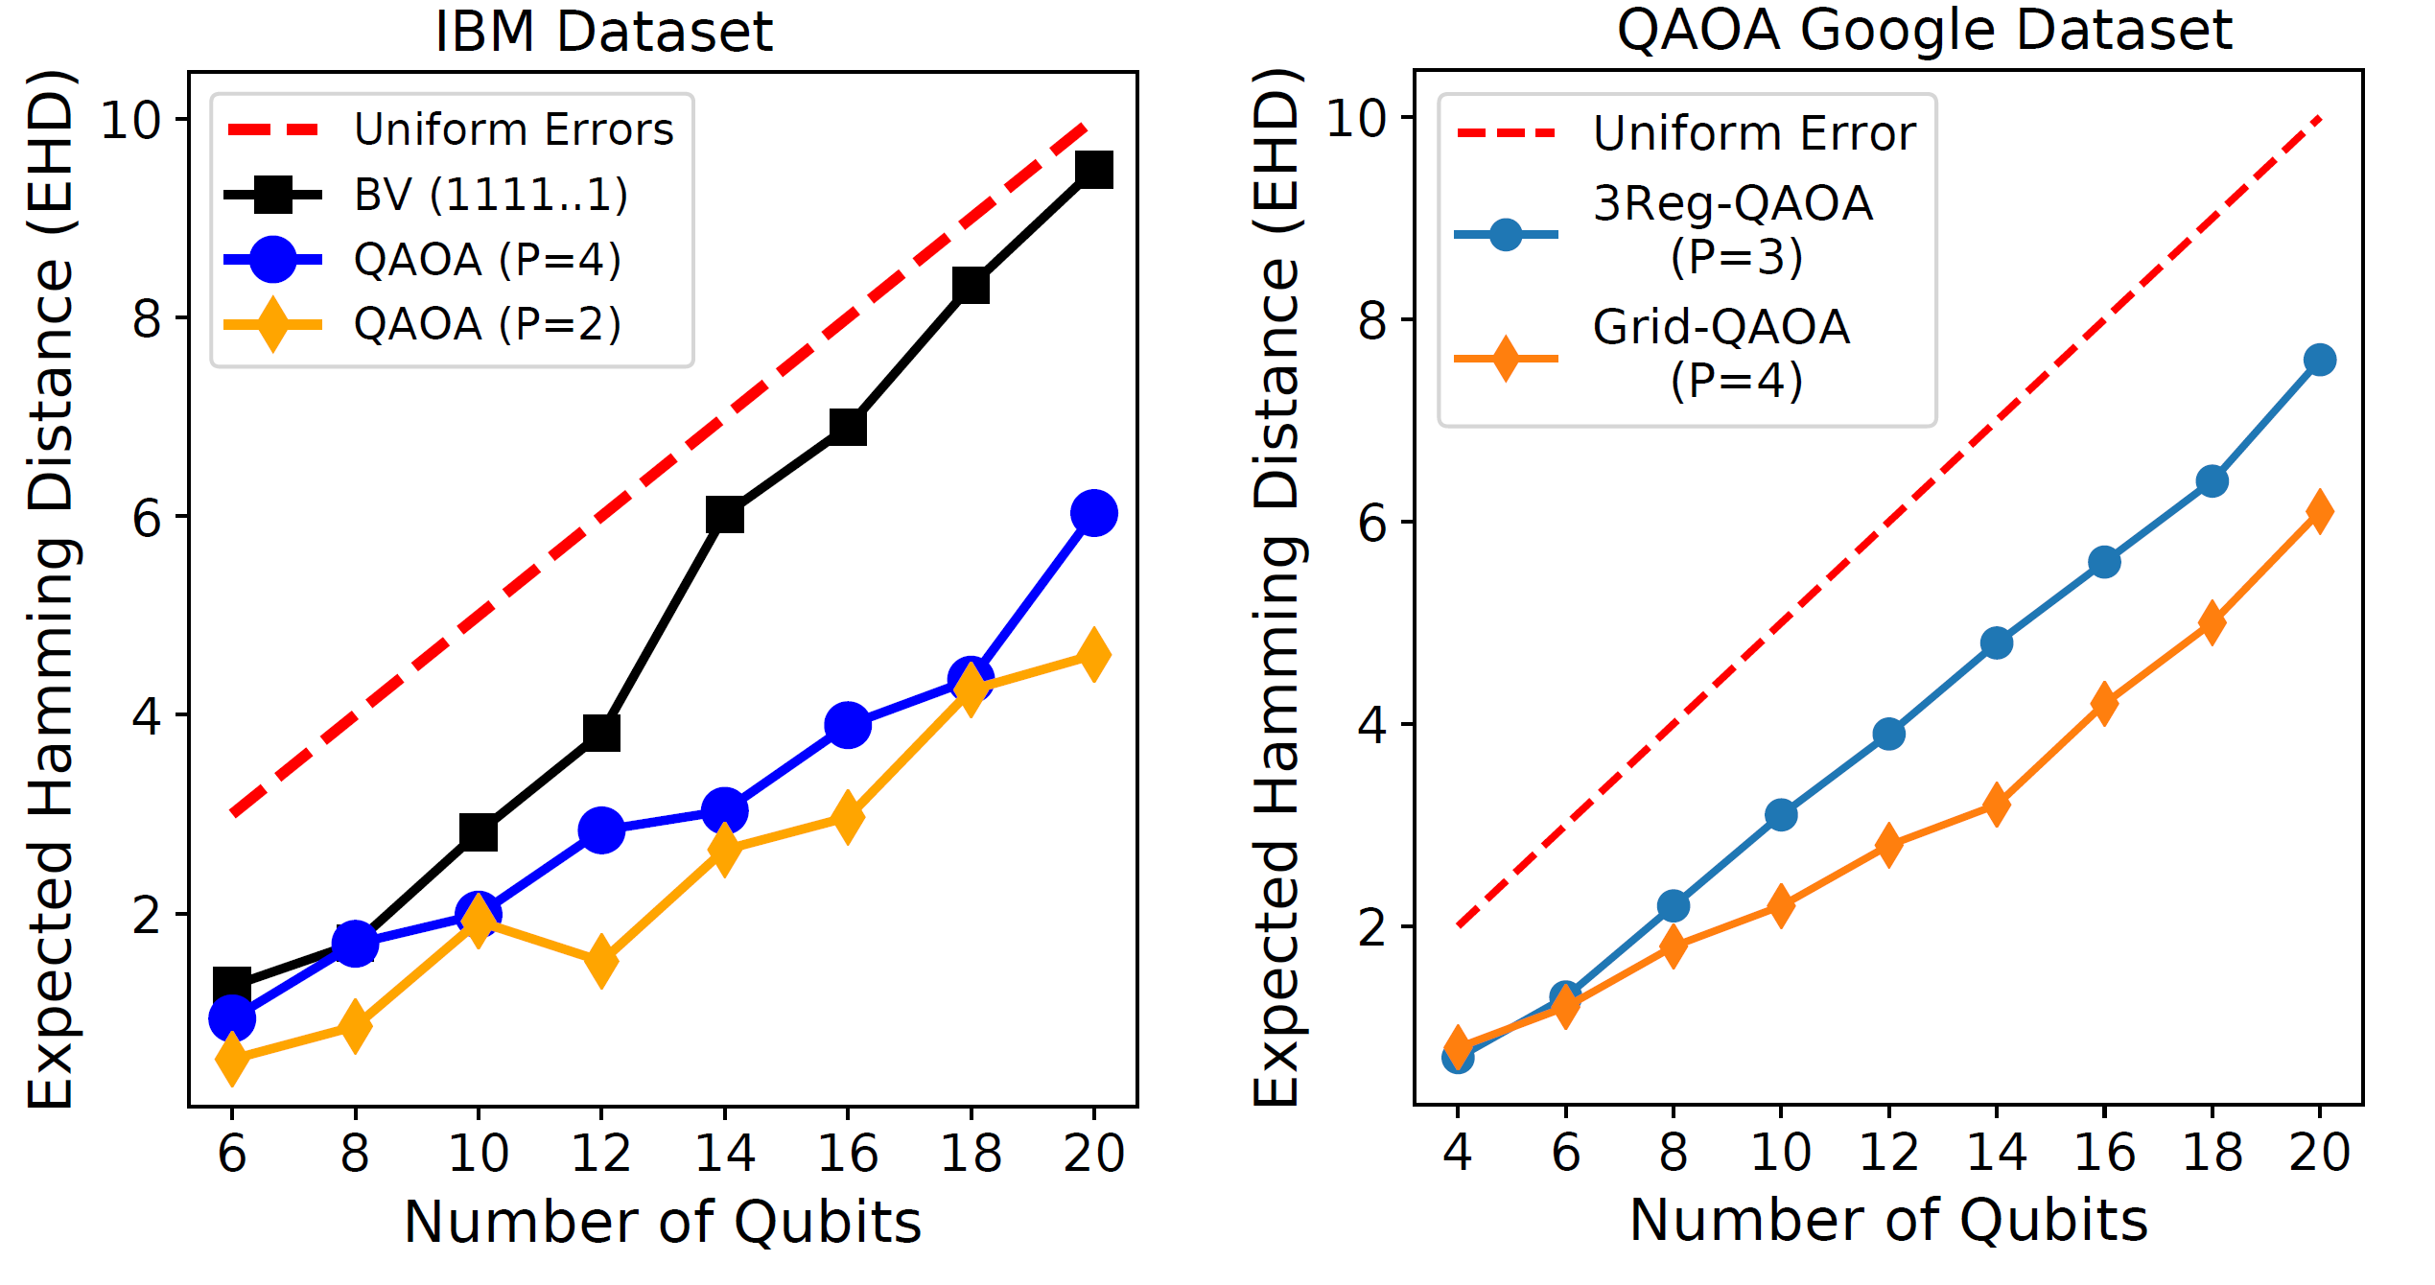
Characterizing Error Structure using EHD
We observe structure in the errors across multiple QPUs and benchmarks
Notes:
And our characterization results shown here for BV and QAOA workloads indicate that indeed there is a structure in errors as the EHD is lower than N/2

Slide 10
HAMMER: Overview
Output distribution
Probability
$$Likelihood Estimate: L\left(x\right)=P\left(x\right)∗S(x)$$
Output Strings
Hammer
Likelihood
Structure in Errors
1010
Output Strings
1110
0111
HS
Filter
Cumulative
Hamming Spectrum
Weight
1111
1101
1011
0011
1001
HAMMER is a postprocessing technique that evaluates likelihood of bitstring
Notes:
To leverage the structure in errors, we propose HAMMER, which is a post processing technique that we can run on the output distribution of a quantum circuit.
What HAMMER does is rather than just relying on the probabilities of each outcome, it looks at the neighborhood of each outcome in Hamming Space.
Using this analysis, HAMMER tries to capture how dominant are the neighbors of an outcome in the output distribution? And by using this relationship, HAMMER tries to estimate the likelihood of each outcome being correct?

Slide 11
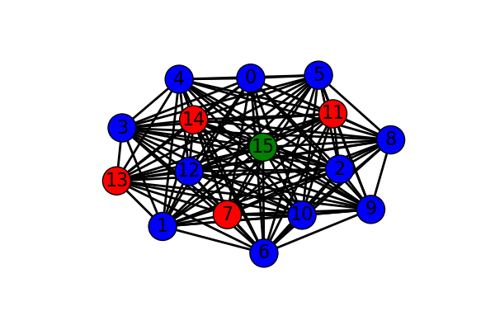
Challenge in utilizing Hamming Structure
1010
4
0
5
1110
14
7
3
1111
0111
15
8
1101
13
12
2
1011
0011
11
10
9
1
0
1
2
3
4
6
1001
Hamming Distance
Pitfall: Hamming Structure can not be leveraged by simply using Hamming neighborhood information of the input graph.
Notes:
But using this structure in Hamming space is not straight forward, for example consider the Hamming Spectrum (click) of the four-bit quantum program, if we zoom in the sub-set of outcomes and connect just the one-hamming away nodes, we see this nice structure, we can say the correct outcome is densely connected. We may be tempted to use simple metrics like node degree to capture this structure, unfortunately errors do have some fuzziness, and we may want to look at not just 1-hamming away neighbors but in a larger neighborhood (click), but the number of neighbors scale exponentially with Hamming distance (click).

Slide 12
Hamming Spectrum Filter: Motivation
Score (1111) = 0.1 + 0.25 + 0.1 + 0.05 = 0.5
Score (0111) = 0.1 + 0.25 + 0.1 +0.05 = 0.5
0.25
0.05
1010
0.25
0.05
1110
1010
0.15
1110
0.2
0.1
0110
0.15
0.2
0.1
0110
1111
0111
0.1
0.15
1111
0111
0.05
0.1
0.15
1101
1011
0011
0.05
1101
1011
0011
0.05
0.05
1001
1001
Weak outcomes can have strong neighbors in hamming space
Notes:
To motivate the need for filter that restricts the neighborhood, consider an output distribution represented as a graph, where each node is the output string and all nodes that are 1-hamming distance away are connected via an edge,
We can compute the neighborhood score by adding probabilities all the neighbors, for 1111 score is 0.5
Now consider this other node, which we know is erroneous, if use the same definition of the score, we again get score of 0.5, so we have a problem because there is chance that unlikely string can have Hamming structure. The other problem is on the dense graph we see equalization that is all nodes get similar scores.

Slide 13
Hamming Spectrum Filter: Motivation
Score (x) → Sum of probabilities of all the Hamming neighbors of input string x
Score (1111) = 0.1 + 0.25 + 0.1 +0.05 = 0.5
Score (0111) = 0.2 + 0.15 +0.15 = 0.5
0.25
0.05
0.05
0.25
1110
1010
1010
0.15
1110
0.1
0.15
0.2
0110
0.1
0110
0.2
1111
0111
1111
0111
0.1
0.05
0.15
0.1
0.05
0.15
1101
1011
0011
1101
1011
0011
0.05
0.05
1001
Filtered Score (1111) = 0.1 + 0.1 + 0.05 = 0.25
Filtered Score (0111) = 0.00
1001
Filtered Score → Sum neighbors which have lower probability of occurrence than x
Notes:
To solve this problem, we modify the score, instead of summing all Hamming neighbors, we sum probability of neighbors which have lower probability of occurrence than x.

Slide 14
Hamming Spectrum Filter: Design
Hamming
Spectrum (HS)
Filtered Hamming
Spectrum
0
1
2
3
4
0
1
2
3
4
Hamming Distance
Hamming Distance
Filtering dominant strings from HS avoids undesired equalization of scores
Notes:
To implement this filter, we simply remove all outcomes that are greater than input string x from the Hamming spectrum

Slide 15
Cumulative Hamming Spectrum
Hamming Spectrum
Cumulative Hamming Spectrum (CHS)
Likely Solution String
0
1
2
3
4
0
1
2
3
4
Hamming Distance
Hamming Distance
String that is unlikely
to be the solution
0
1
2
3
4
0
1
2
3
4
Hamming Distance
Hamming Distance

Slide 16
Sharpening CHS by Weighing Hamming Buckets
Filtered CHS
Weights
Score
0.1
0.08
=
0.06
*
Probability
0.04
0.02
0
0
1
2
3
4
5
6
7
0
2
4
6
8
0
1
2
3
4
5
6
7
Hamming Distance
Hamming Distance
Hamming Distance

Slide 17
Outline
Background and Motivation
Experimental Characterization
HAMMER: Insight and Design
Key Results
Conclusion

Slide 18
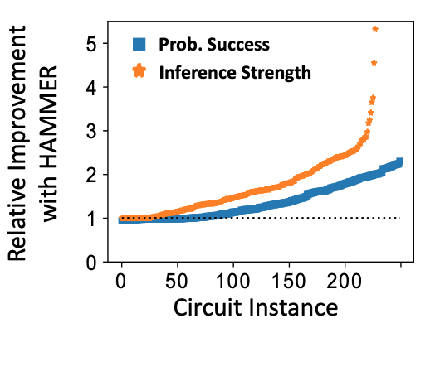
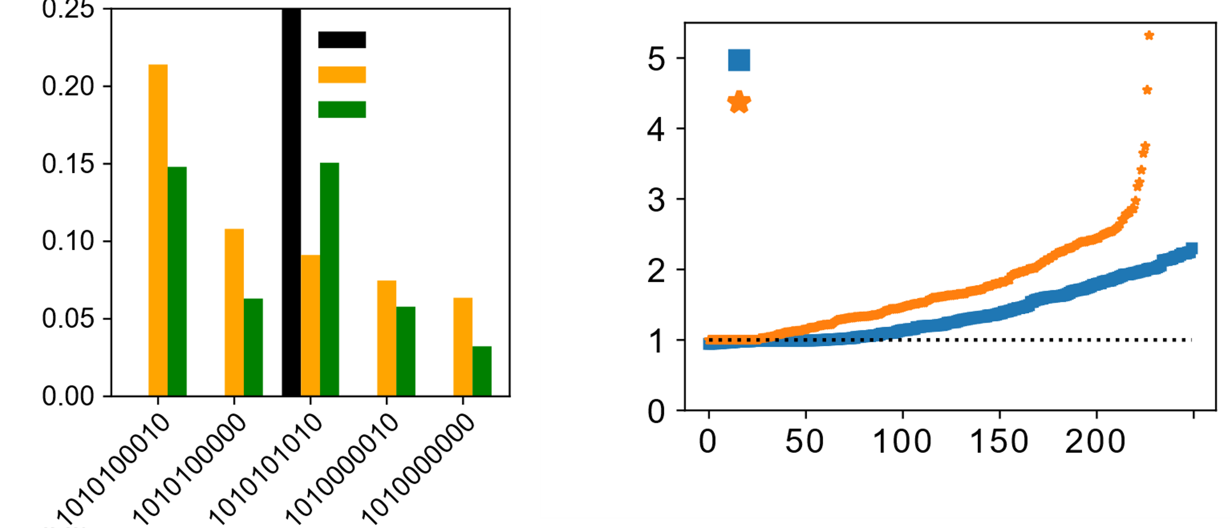
Evaluations: Bernstein Vazirani
Parameters | Value
Total No. of Circuits | 250
Number of Qubits | 5 to 15
Hidden Keys | 10101..1 and 1111…1
QPU Hardware | IBM Paris, Toronto, Manhattan
Metrics | Probability of Success (PST)
 | Inference Strength (IST)
0.25
Ideal
Baseline
PST
Hammer
IST
Likelihood
Relative Improvement
with HAMMER
Circuit Instance
Output Strings

Slide 19
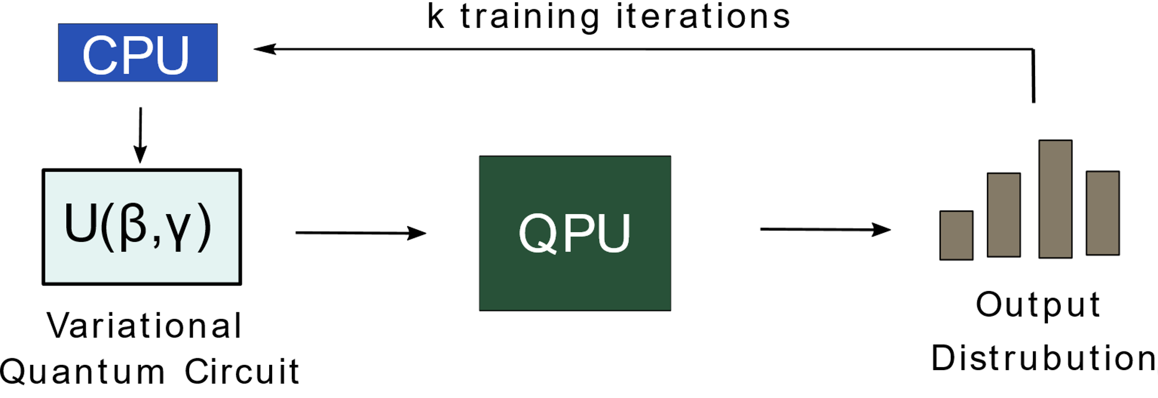
Evaluations: QAOA
Parameters | Value
Total No. of Circuits | 220
Number of Qubits | 5 to 20
Problems | Max cut on Grid, 3-Reg
QPU Hardware | Google Sycamore
Metrics | Average Quality of Solution
CPU
K training iterations
U(β, γ)
QPU
Variational Quantum
Algorithm
Output
Distribution
Notes:
Small change in the output, such as few bit flips can have a significant impact on the cost, especially for realistic optimization problems where constraints have weights.
When training QAOA this

Slide 20
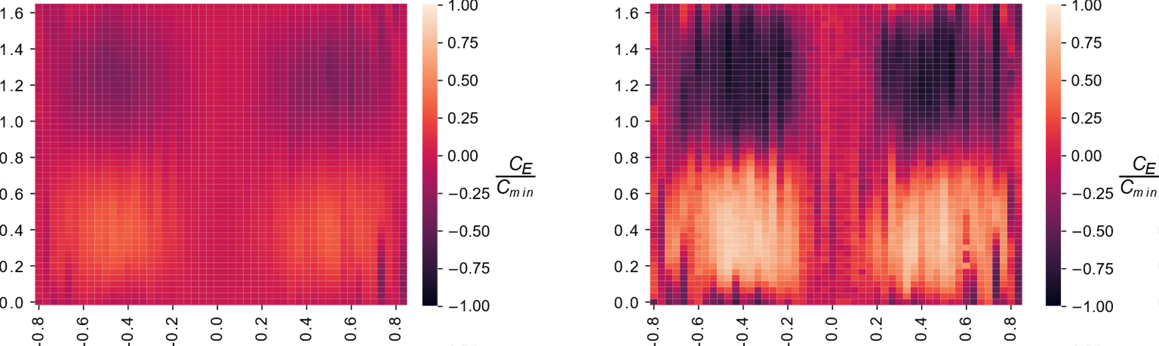
Postprocessing Parameter Grid Search on Google QAOA Dataset
Google Baseline
Postprocessed with HAMMER
Challenge: Quality of solution become insensitive to changes in Beta and Gamma values due to noise
Gamma
Beta
Beta
HAMMER can sharpen the gradient on the cost function landscape

Slide 21
Conclusion
Programs executed on NISQ Machines produce both correct and incorrect outcomes
Erroneous outcomes exhibit a close relationship with the correct answers in Hamming Space
We propose HAMMER, a post-processing technique that leverages the structure of the erroneous outcomes to improve application fidelity
HAMMER improves the quality of solution by 1.37x on average and sharpens the gradient for variational quantum circuits

Slide 22
Backup Slides

Slide 23
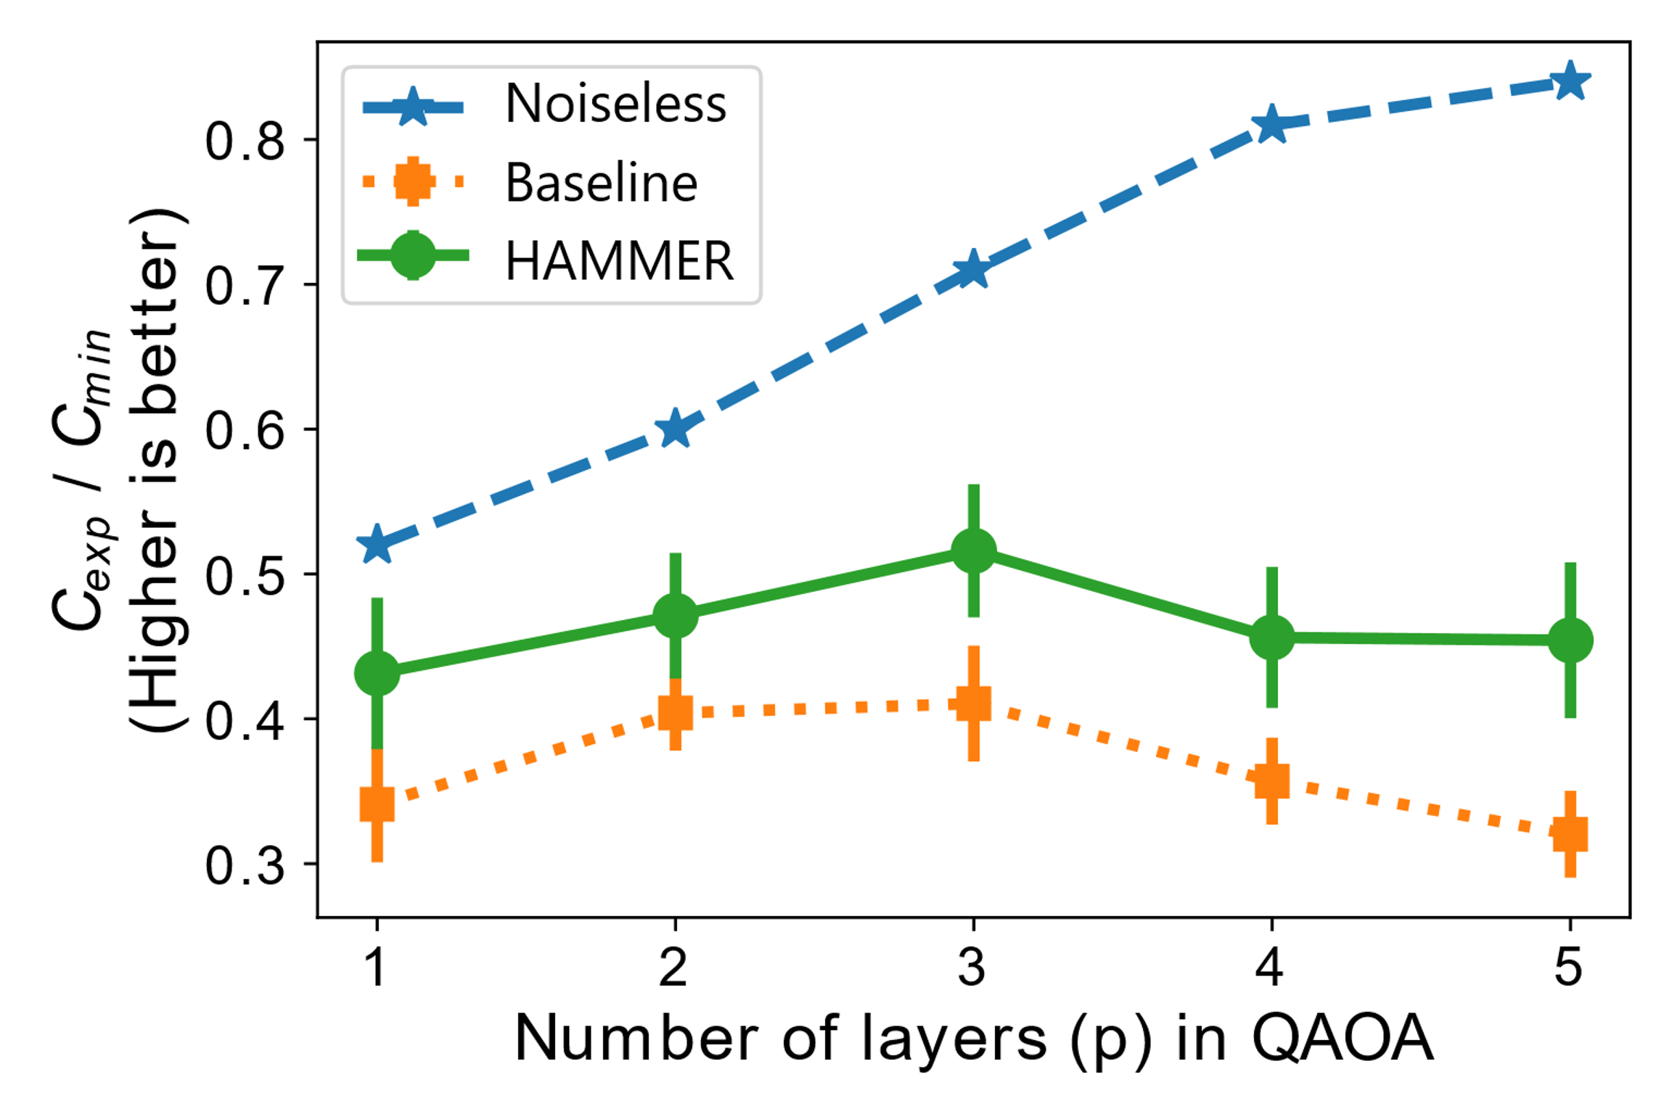
Evaluation of HAMMER with QAOA
Algorithmic quality of solution improves with number of layers used in the QAOA circuit
Increasing number layers demand more gates which results in higher noise, degrading quality of solution
HAMMER improves quality of solution by attenuating spurious outcomes

Slide 24


HAMMER: Complexity
Computational Steps O (n²)
P$\left(x\right)$
Filter
Cumulative
Hamming Spectrum
Weight
S $\left(x\right)$
Probability
Score
Output Strings
Output Strings
HAMMER
Trials (T) | Unique Outcomes | Operations in Billion
 |  | Qubits (n) = 100 | Qubits (n) = 500
32k | 10% | 0.001 | 0.001
 | 100% | 1 | 1
256k | 10% | 0.6 | 0.6
 | 100% | 64 | 64
Notes:
We observe these clusters in errors, which is interesting but what we care about is are these clusters formed around the correct or expected answers.

