Slide 1
Patterns of the Past: A Study on Historical Migration Network Structures
Maryam Torkashvand¹, Caglar Koylu¹, Hoeyun Kwon¹, Alice Bee Kasakoff ²
¹ Geographical and Sustainability Sciences, University of Iowa, Iowa City, Iowa, USA ² Department of Geography, University of South Carolina, Columbia, South Carolina, USA
Maryam Torkashvand
maryam-torkashvand@uiowa.edu
Grant No. 2215568
May 2023 | Social Spatial Networks Workshop

Slide 2
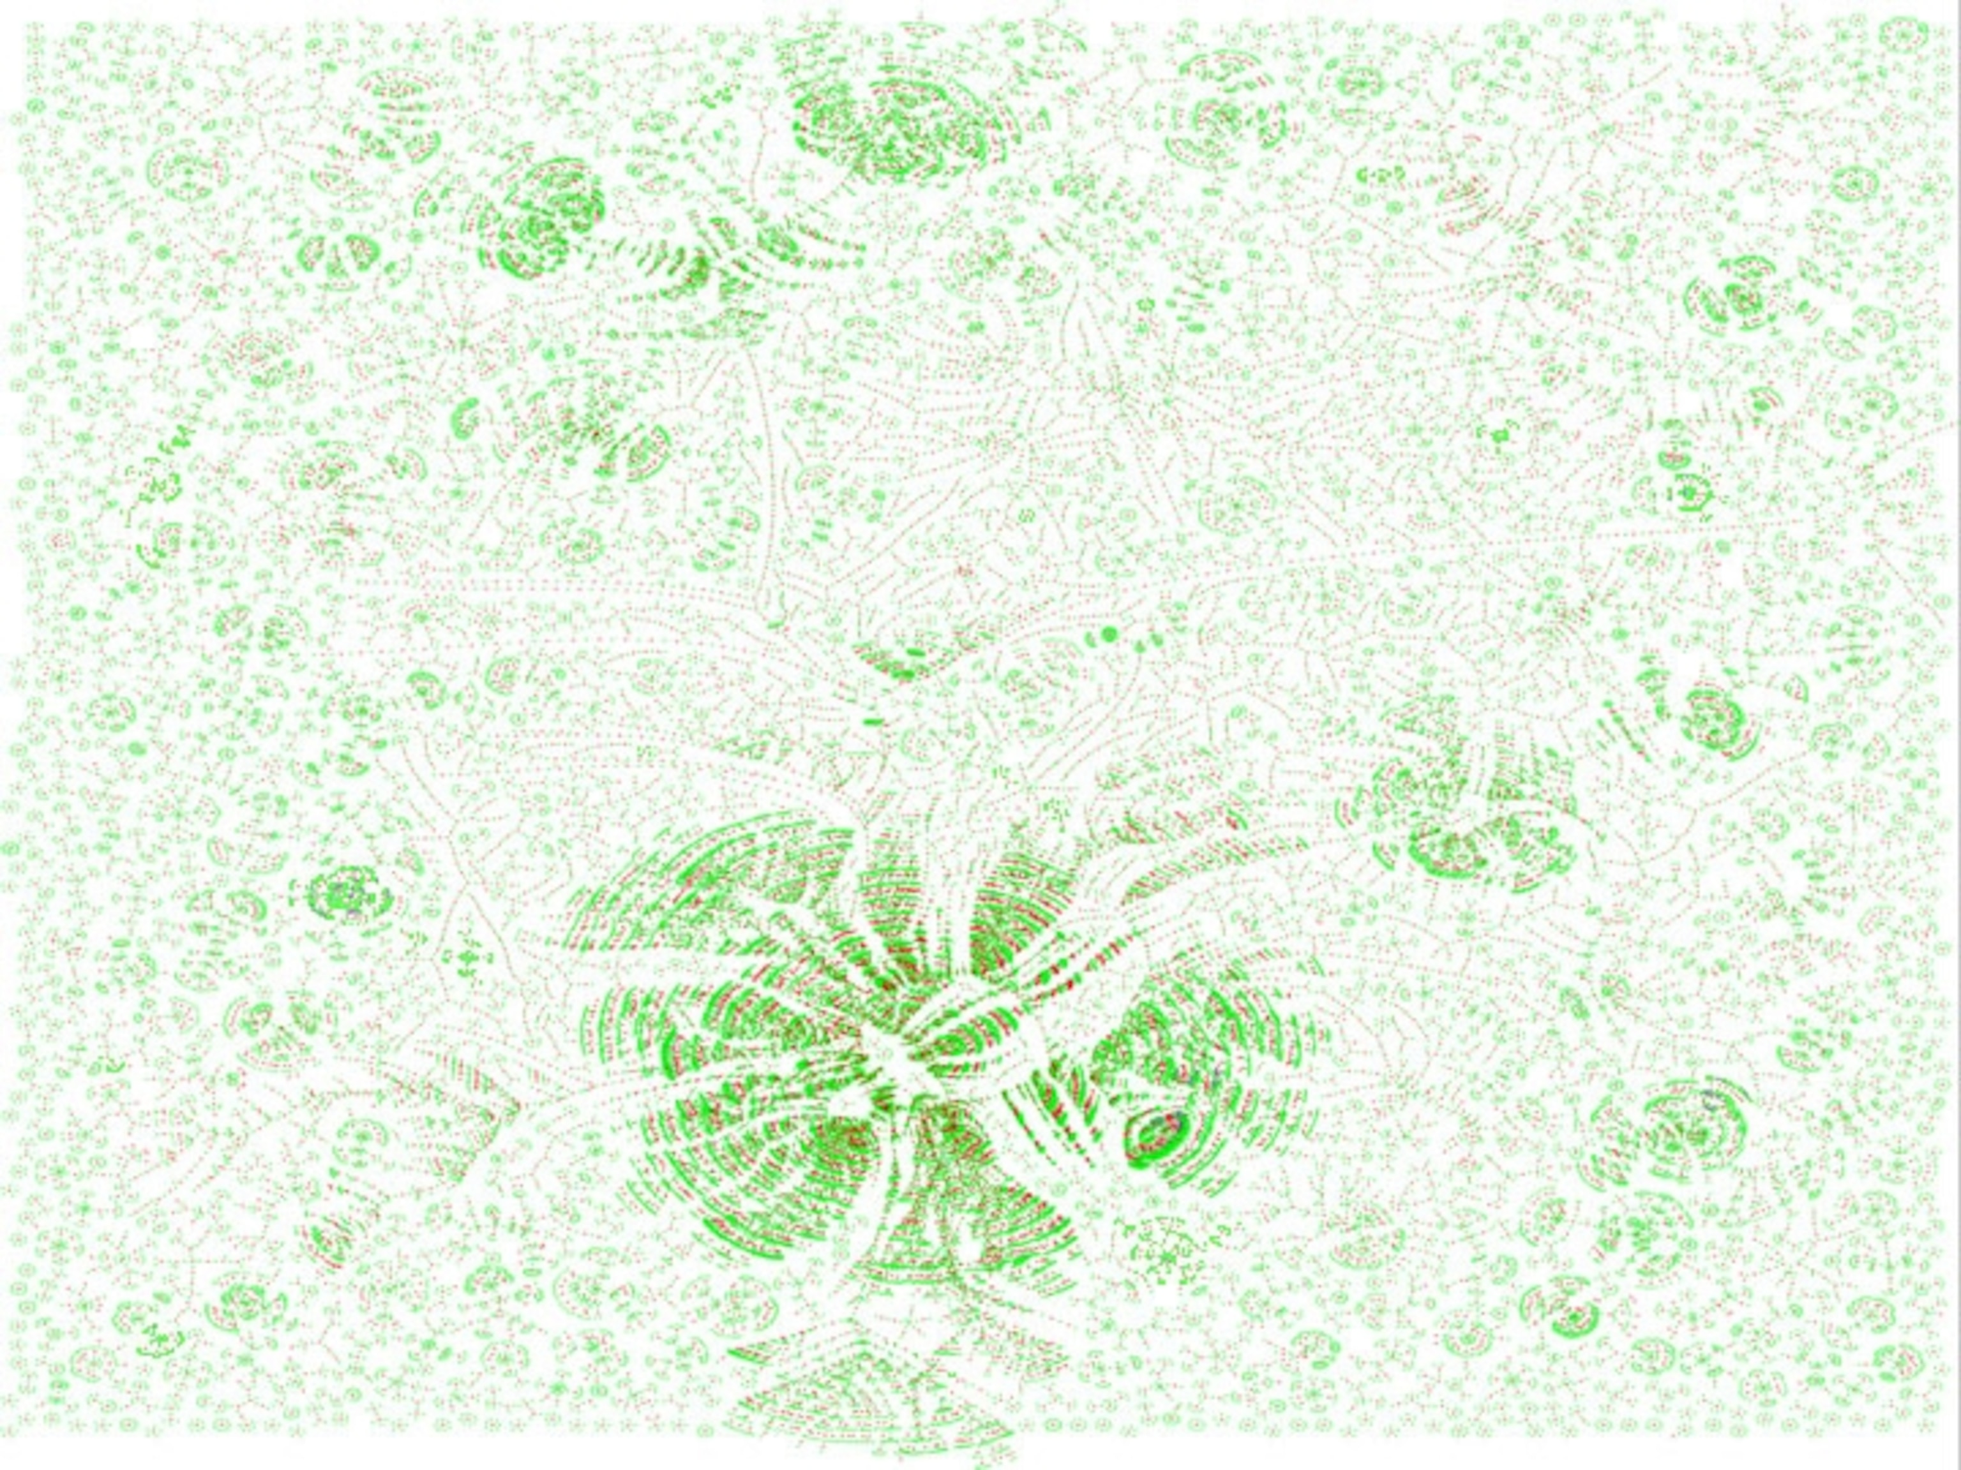
Introduction
Study Questions
Methodology
Results
Family Tree dataset
Network of family members over generations
Contains spatiotemporal information
Our dataset includes:
～40 million individuals
～14 generations
70,000 people connected through marriage (red) and shared ancestors
Kaplanis et al. (2018). Quantitative analysis of population-scale family trees with millions of relatives. Science, 360(6385), 171-175.
Notes:
include parent-child, sibling, and spouse relationships
spatiotemporal information such as birth and death dates and locations

Slide 3
Introduction
Study Questions
Methodology
Results
Extracting migration from Family tree using the Child ladder method
Birthplace child #4 : Washington
Migration event
Birthplace child #3 : Minnesota
Time
Birthplace child #2 : Minnesota
Migration event
Birthplace child #1 : New York

Slide 4
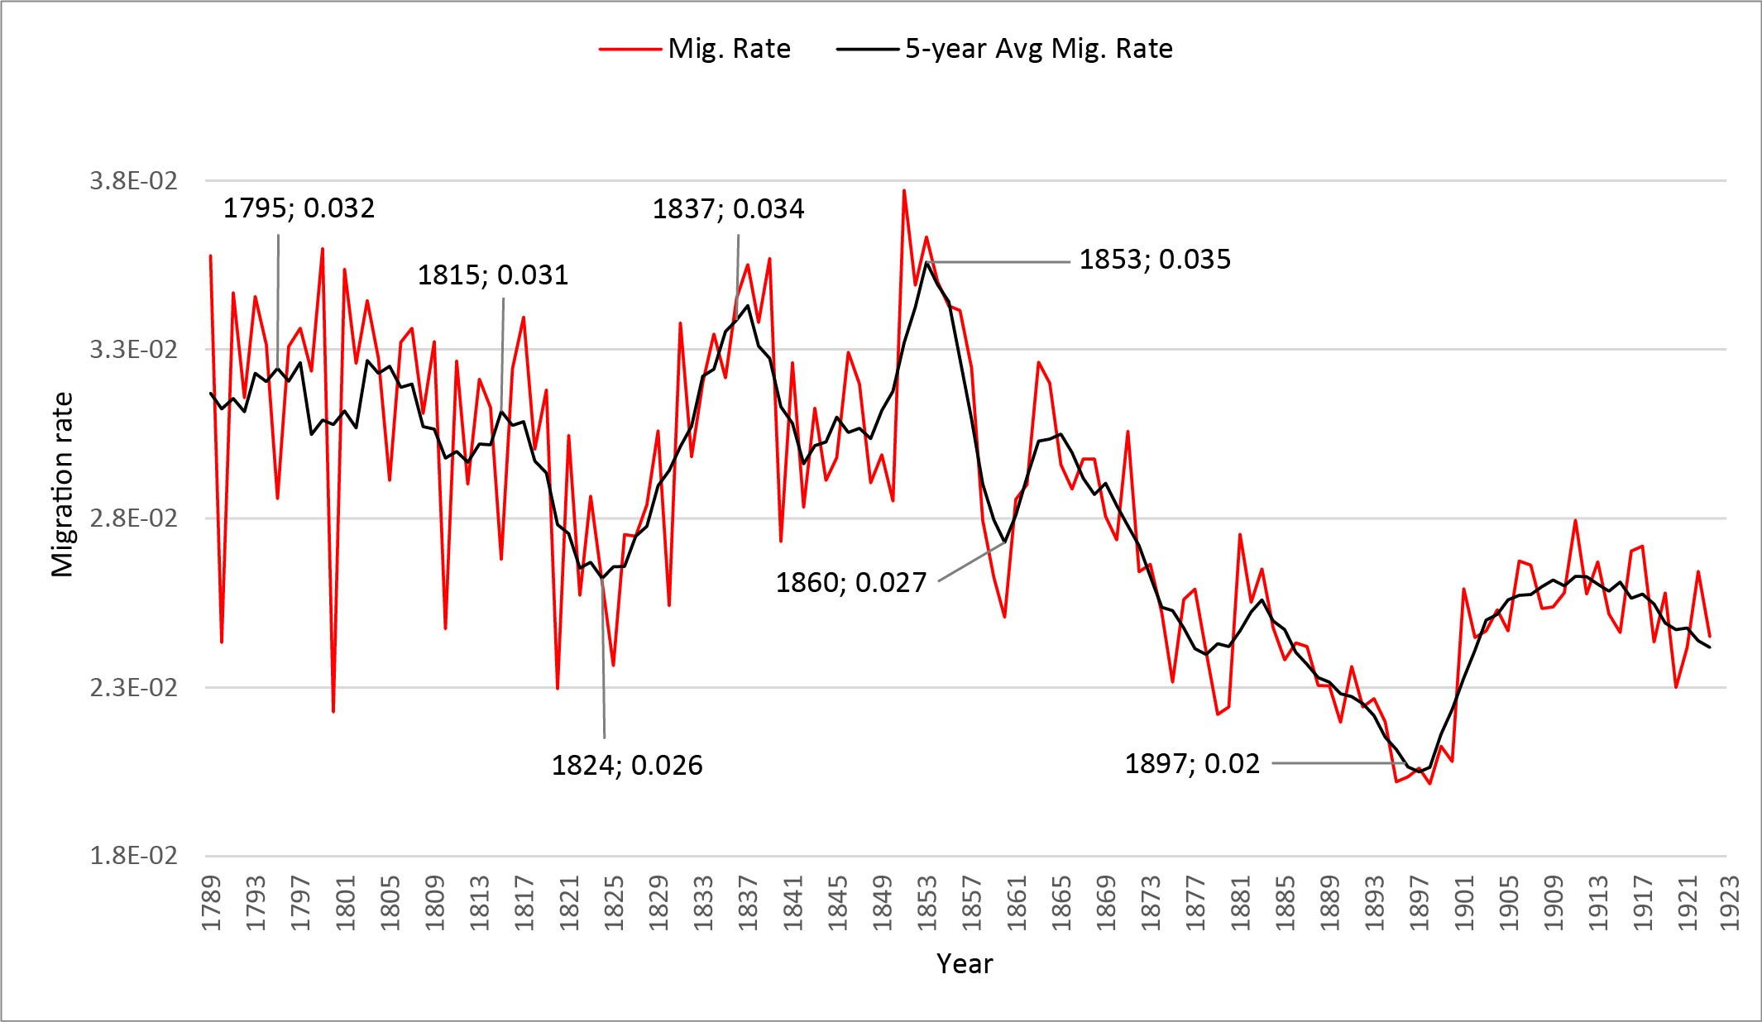
Introduction
Study Questions
Methodology
Results
Measuring migration rate and Temporal partitioning
Koylu, C., & Kasakoff, A. (2022). Measuring and mapping long-term changes in migration flows using population-scale family tree data. Cartography and Geographic Information Science, 49(2), 154-170. DOI: https://doi.org/10.1080/15230406.2021.2011419
Notes:
Using natural Jenks classification to break the continuous time to intervals
maximize the similarity of migration rate values within each period
that these periods shows us an overview of migration changes during the 135 years

Slide 5
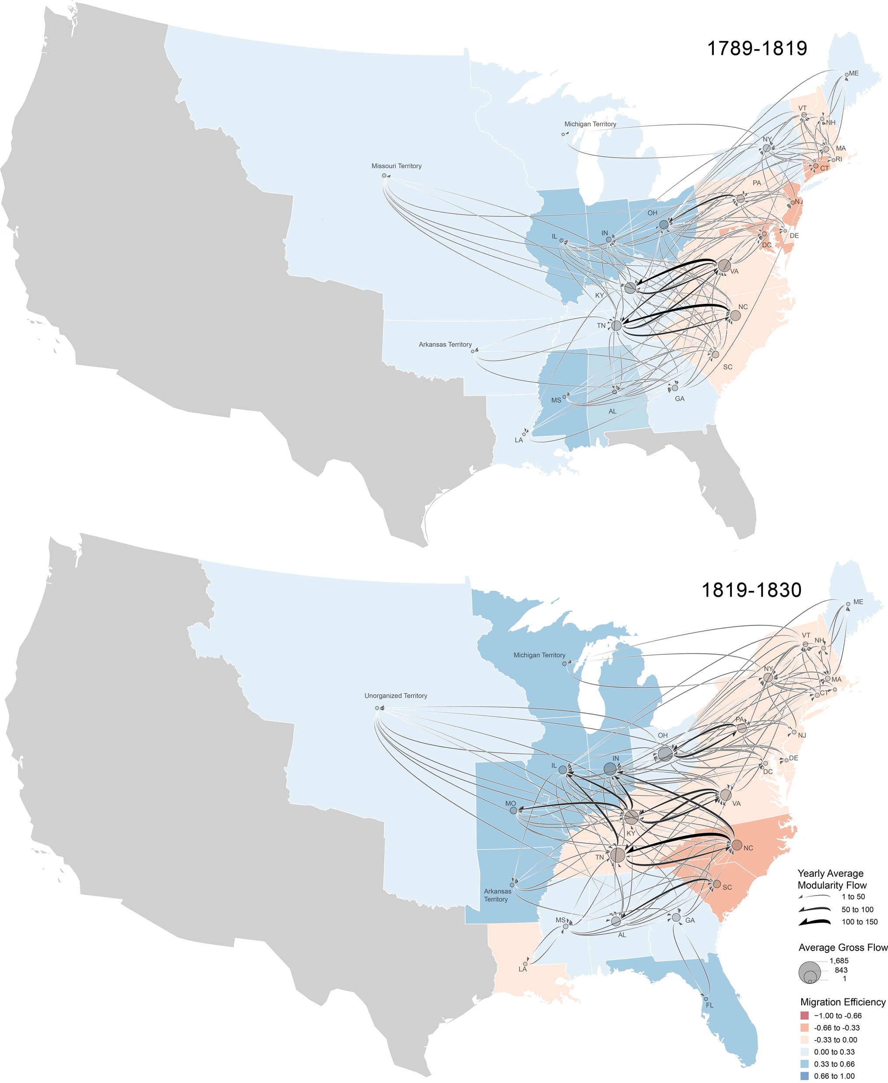
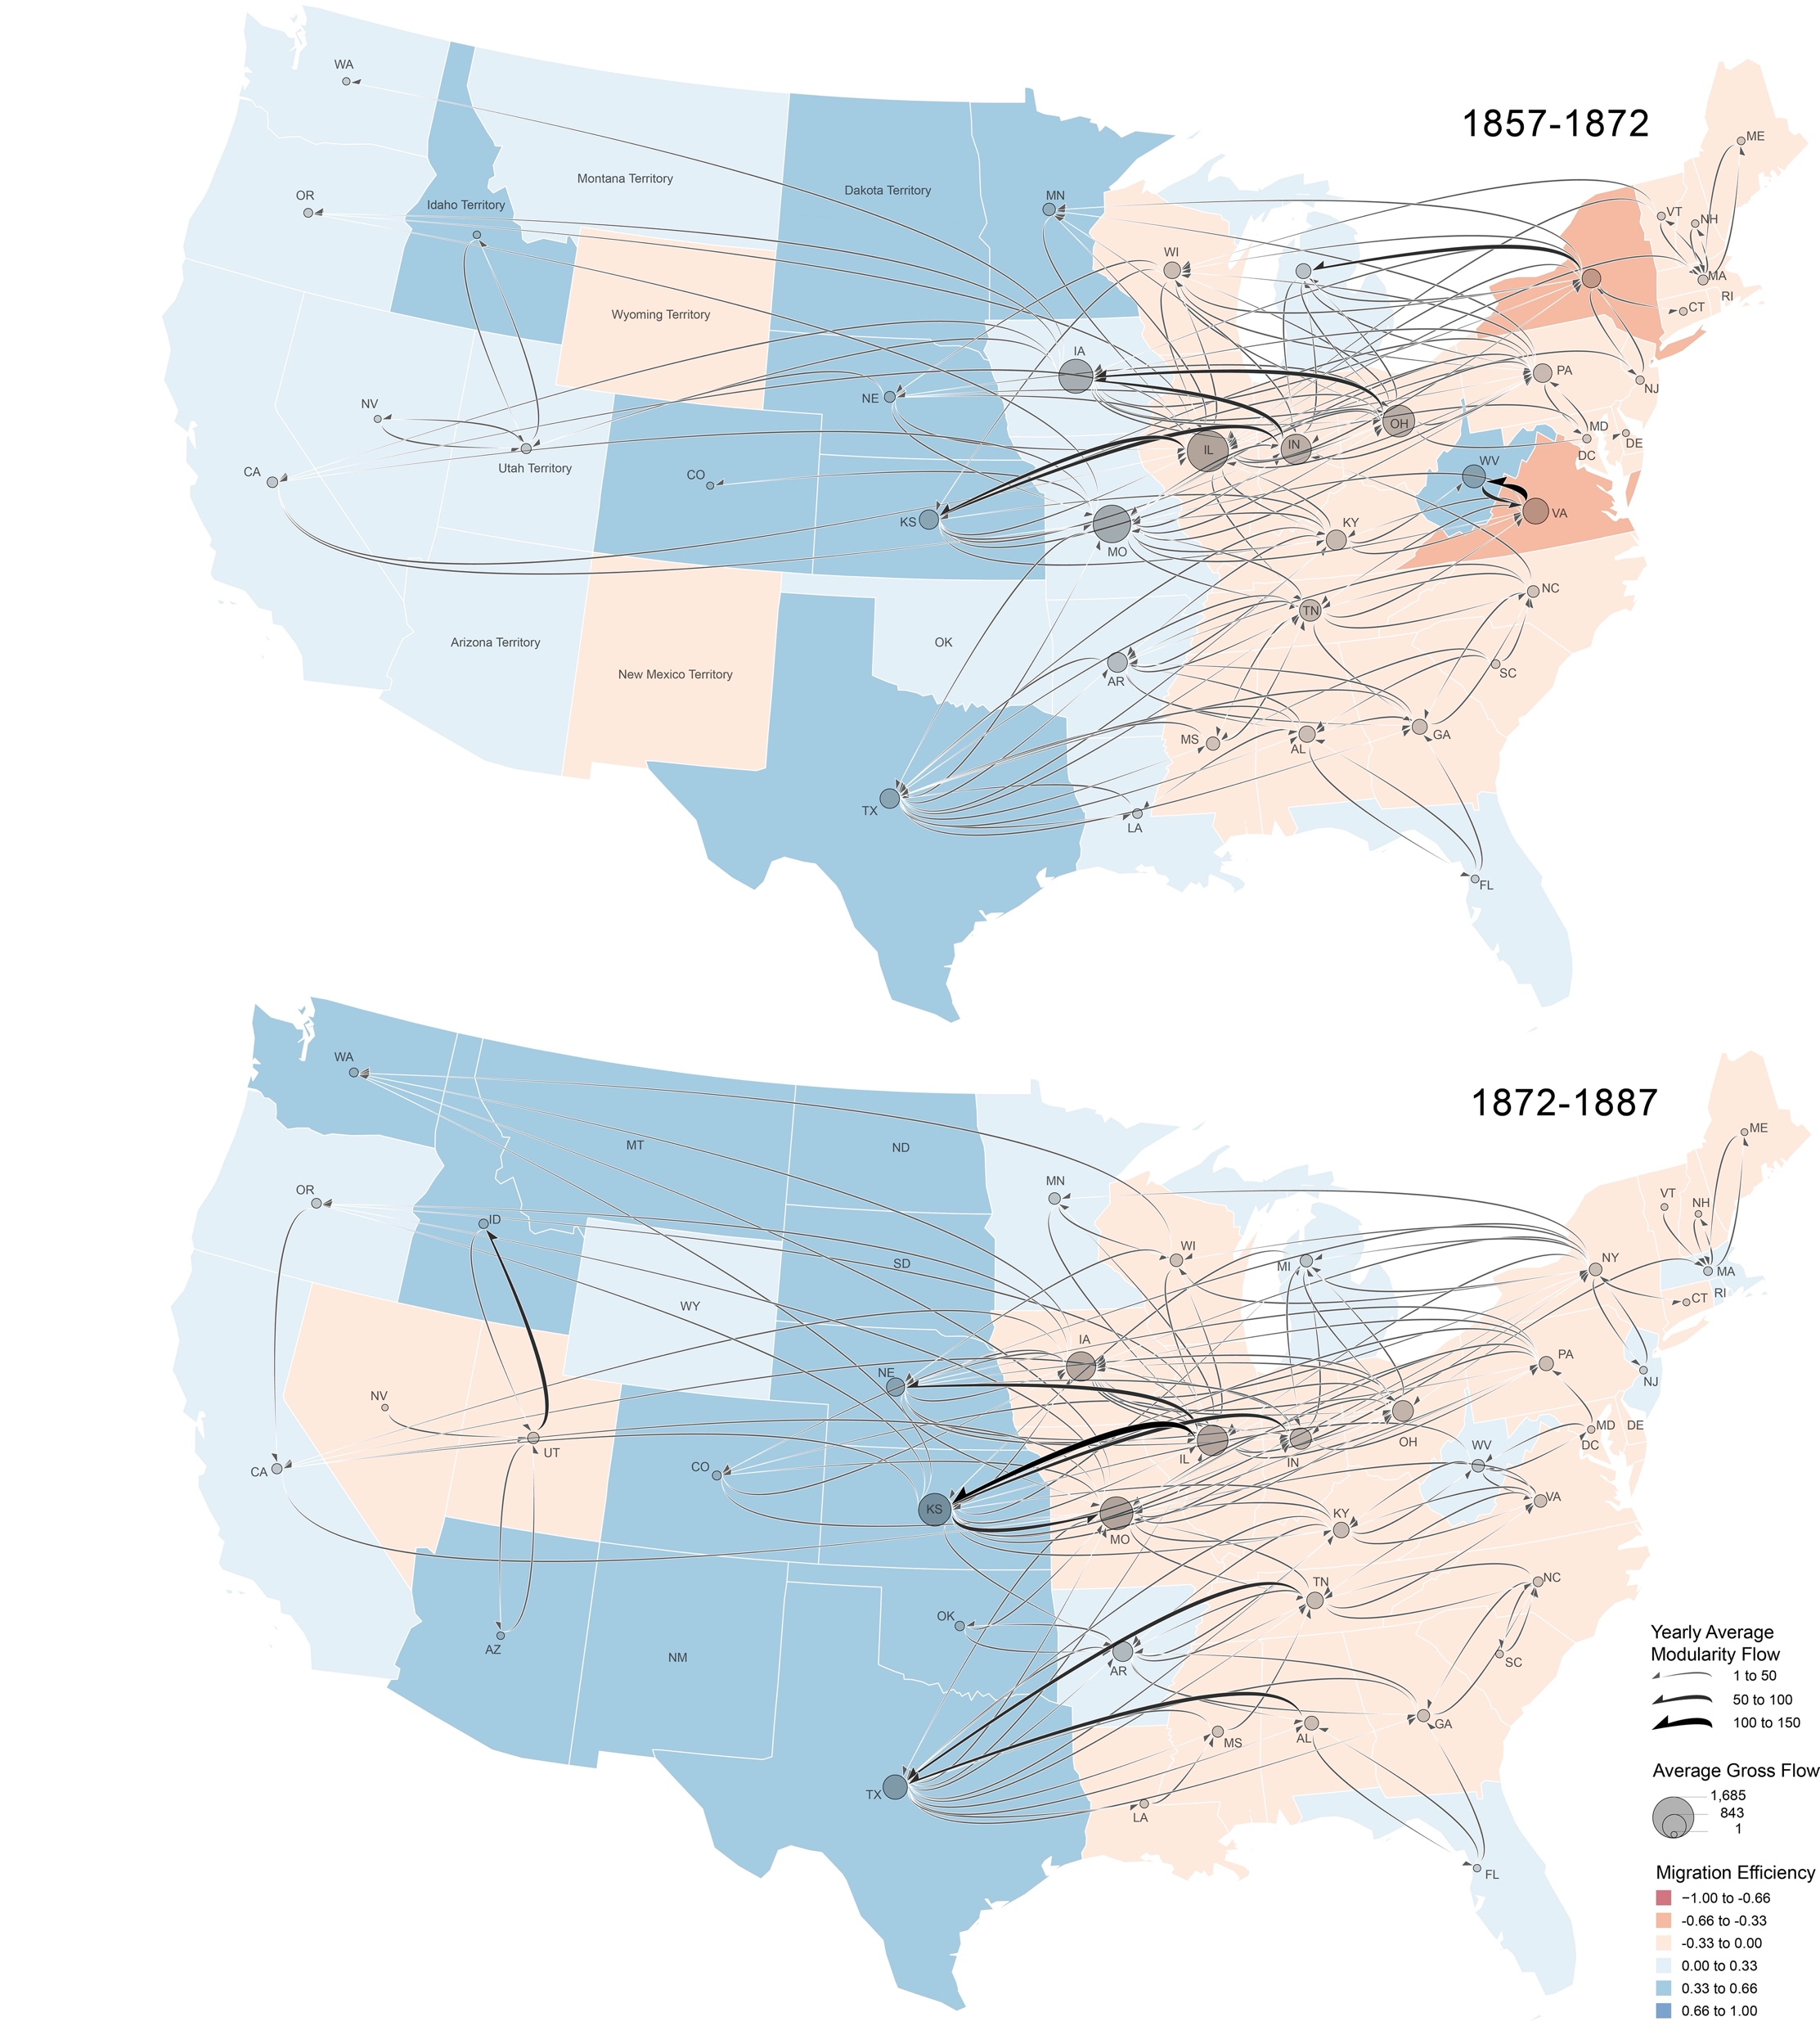
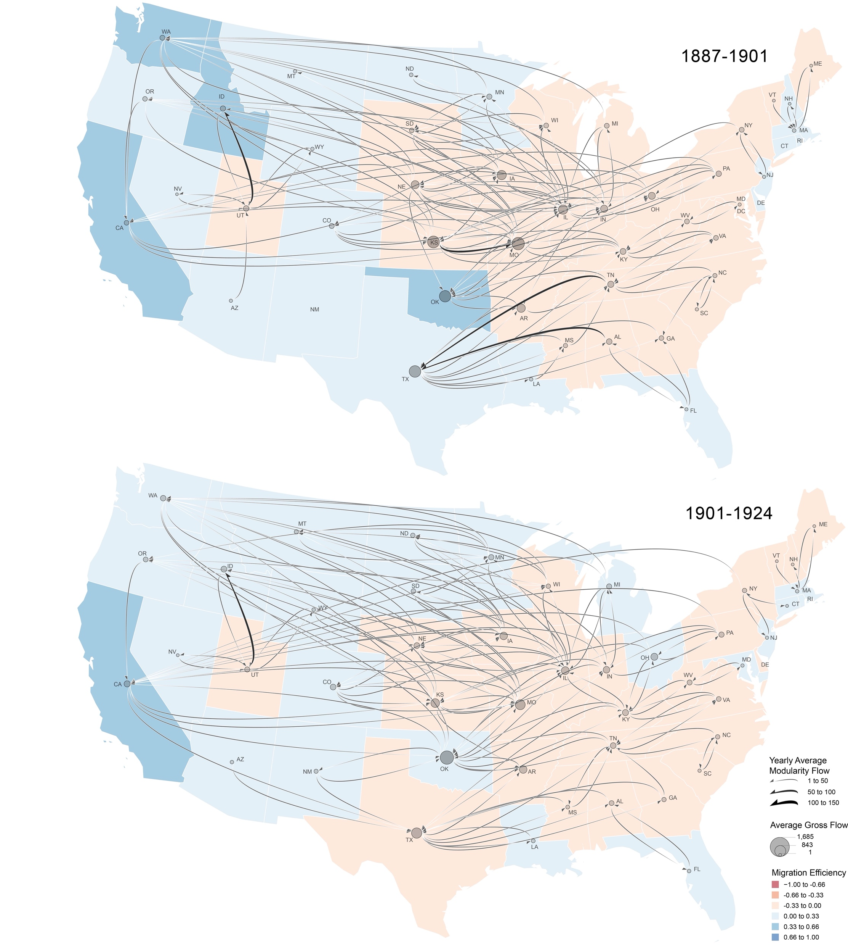
Introduction
Study Questions
Methodology
Results
Koylu, C., & Kasakoff, A. (2022). Measuring and mapping long-term changes in migration flows using population-scale family tree data. Cartography and Geographic Information Science, 49(2), 154-170. DOI: https://doi.org/10.1080/15230406.2021.2011419

Slide 6
Introduction
Study Questions
Methodology
Results
Structure of the migration network?
How it changed over time?
What can it tell us about the present?

Slide 7
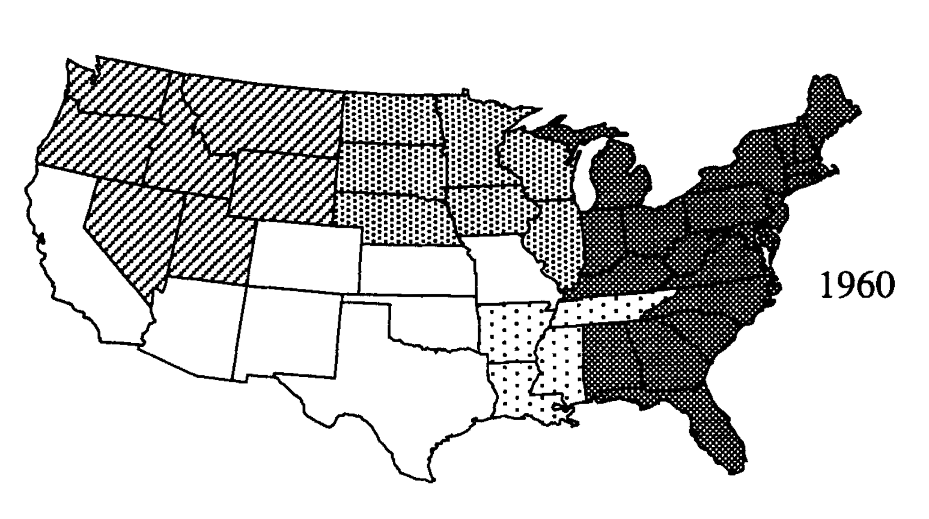
Introduction
Study Questions
Methodology
Results
Migration regions
Subsystem
Groups of spatial units with a high degree of connection internally but low interaction with other subsystems
Using flow matrices, such as hierarchical regionalization
Pandit, K. (1994). Differentiating between subsystems and typologies in the analysis of migration regions: A US example. The Professional Geographer, 46(3), 331-345. https://doi.org/10.1111/j.0033-0124.1994.00331.x
Notes:
identifying subsystems from flow matrices, such as hierarchical regionalization This method is based on standardization or scaling the flow matrix and clustering the units based on the volume of flows.

Slide 8
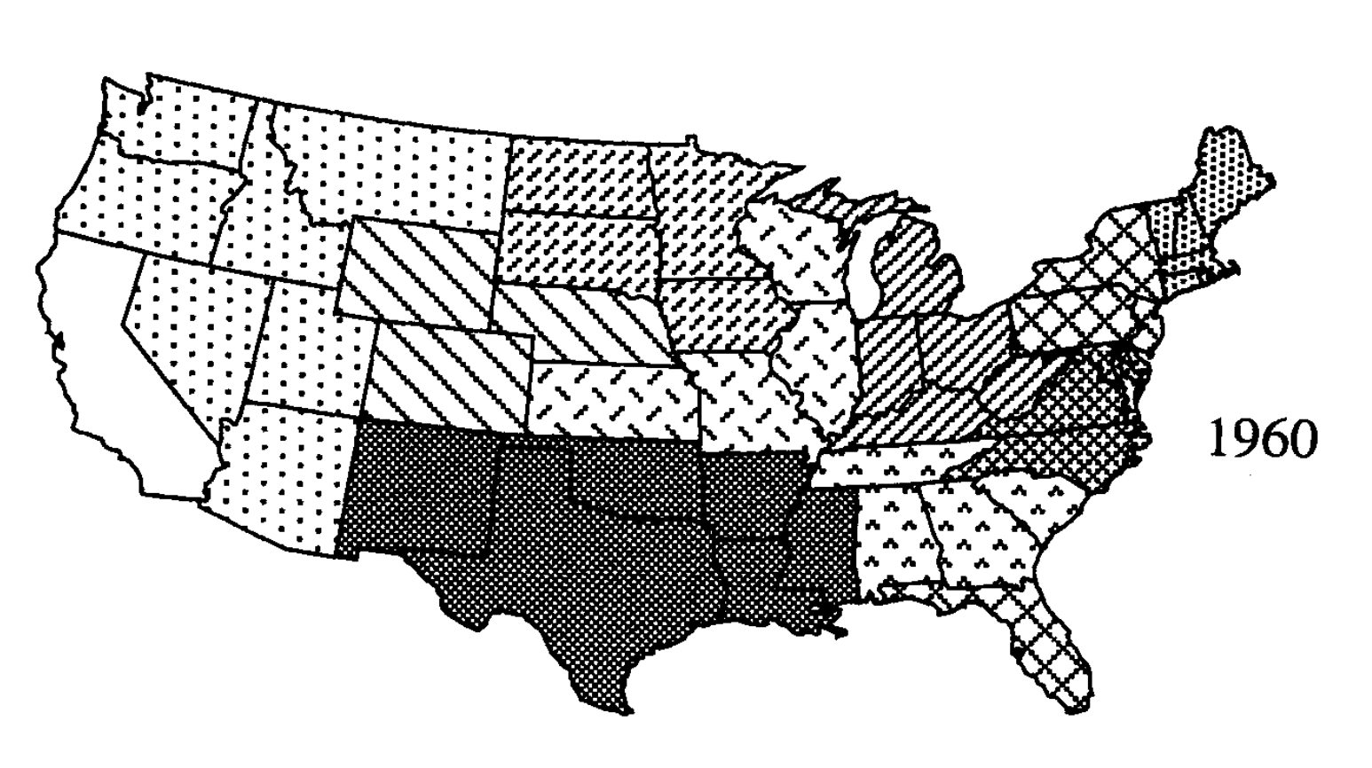
Introduction
Study Questions
Methodology
Results
Migration regions
Typology
Based on the similarity of flows between areas.
Principle Component Analysis (P.C.A.)
Pandit, K. (1994). Differentiating between subsystems and typologies in the analysis of migration regions: A US example. The Professional Geographer, 46(3), 331-345. https://doi.org/10.1111/j.0033-0124.1994.00331.x

Slide 9
Introduction
Study Questions
Methodology
Results
Migration Network
Nodes States
Links Number of migrant families
Extracting migration networks using the Louvain Community detection algorithm
6
8
2
2
1
3
Notes:
In the first phase , the individual nodes are moved to the community in the way that maximize the quality function.
Then in second phase, an aggregate network is created based on those partition that are obtained in the first phase.

Slide 10
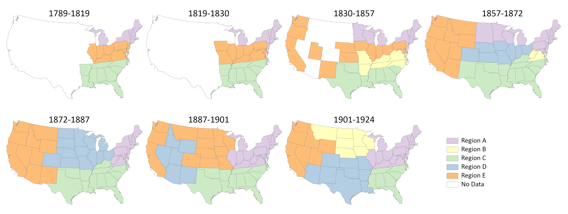
Introduction
Study Questions
Methodology
Results
Notes:
the North/South division of U.S. can be seen throughout the history, as we can see these northern and southern parts in all periods.
California Gold Rush (1848–1855).
in 1867 the transcontinental railroad has been finished
the separation of West part After Civil War which was in 1862.
In 1887-1901 period, the some west stats were in a same region with some great plain and Midwest states
in the last period we can see that there is another formation of west region, and the middle region is split into northern and southern parts.

Slide 11
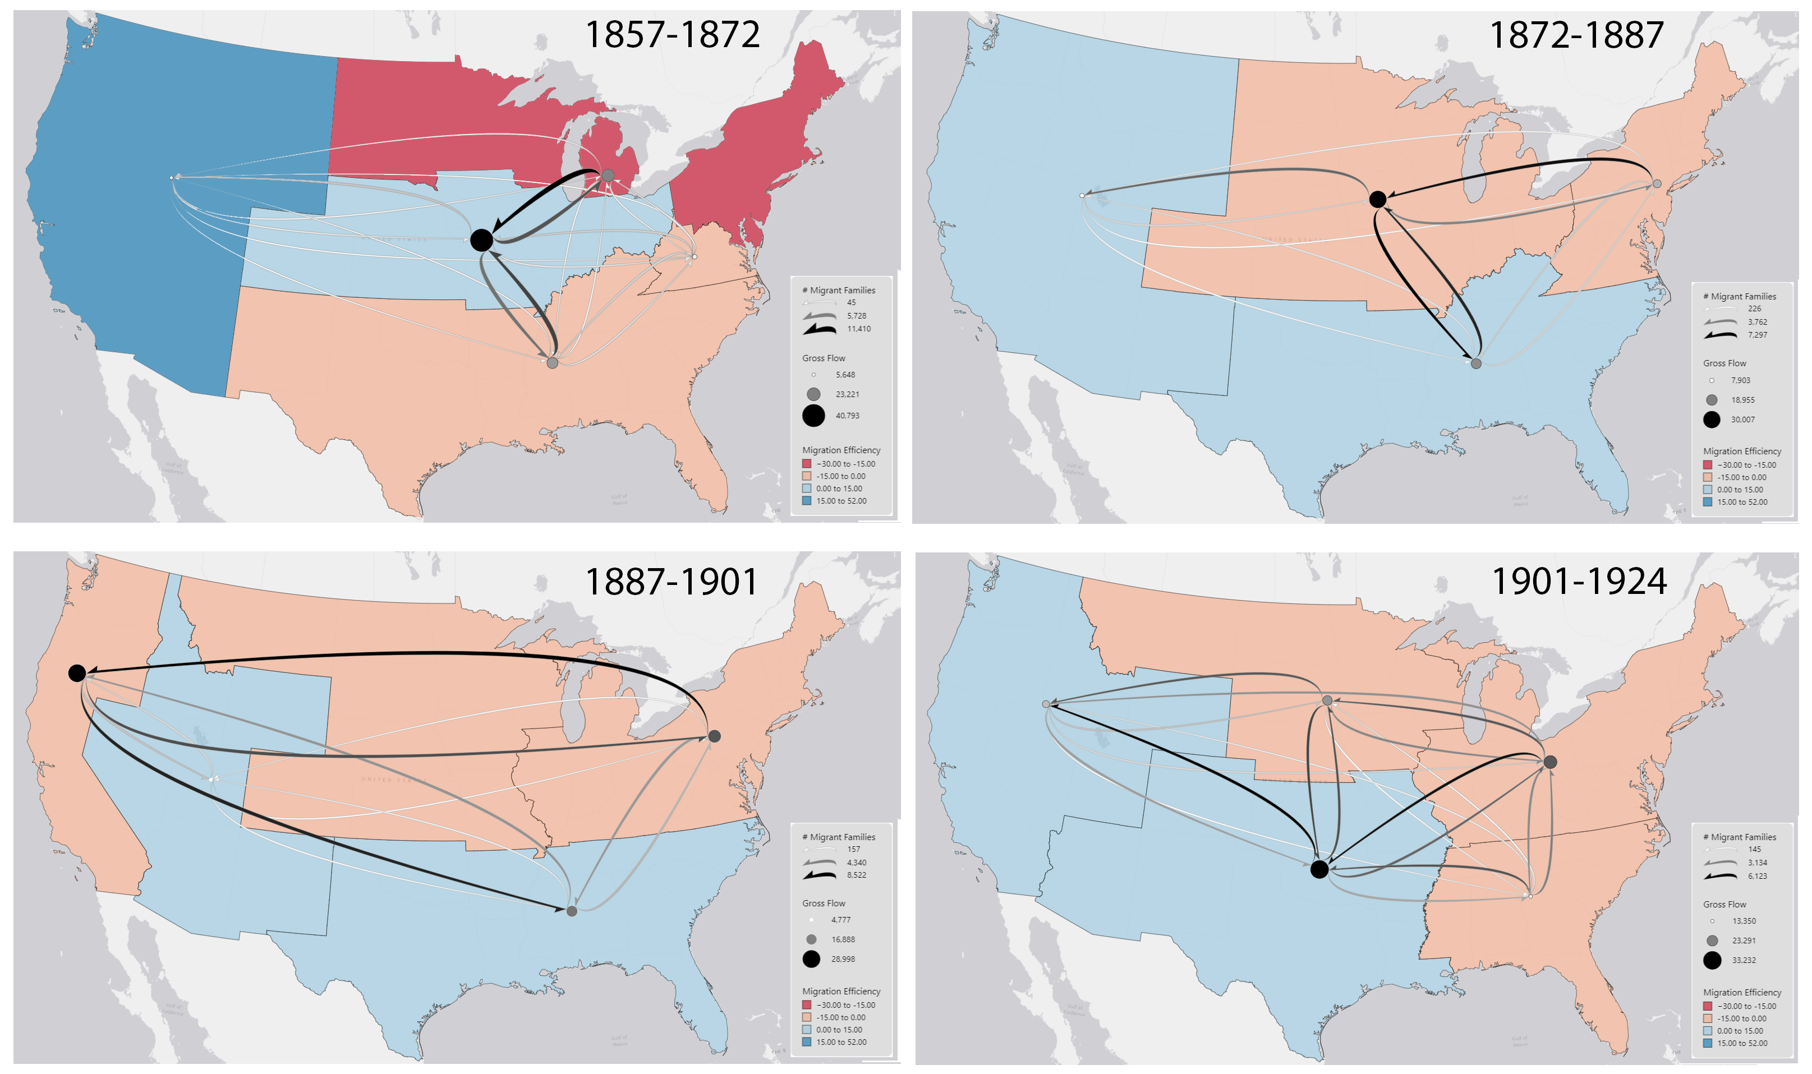
Introduction
Study Questions
Methodology
Results
Notes:
We can take a look at the migration flow of families between the regions in our last four periods. Here the nodes are placed at the geometric centroid of regions, and the curved show the total volume of flows between regions.
In these maps, Red shades show regions that send more migrants than they receive. blue shades are those that receive more migrants than they send.

Slide 12
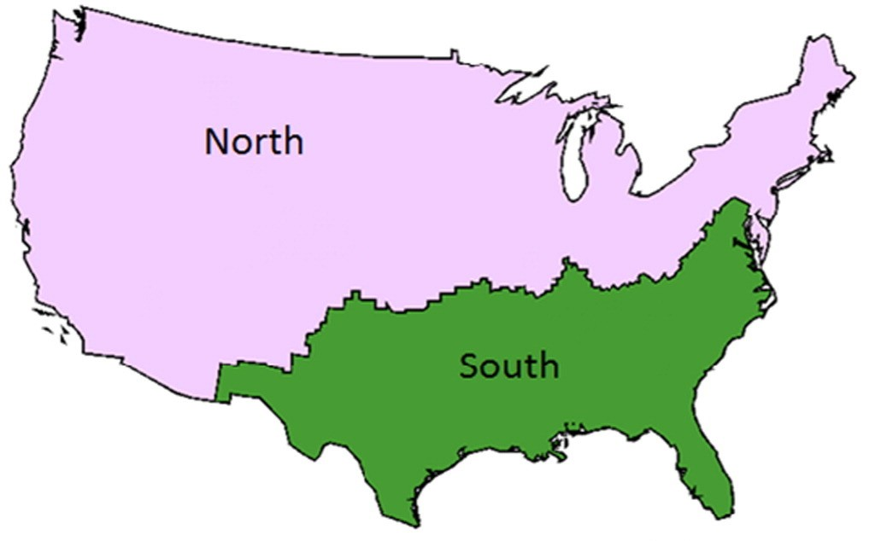
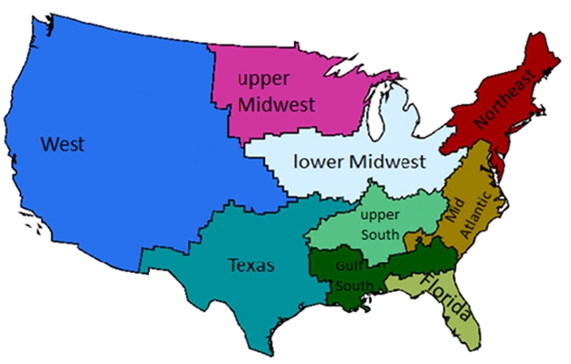
Introduction
Study Questions
Methodology
Results
Migration Regions and Dialects
Dialect regions extracted from Twitter data
(Oct. 7, 2013 - Oct. 6, 2014)
(Huang et al., 2016)

Slide 13
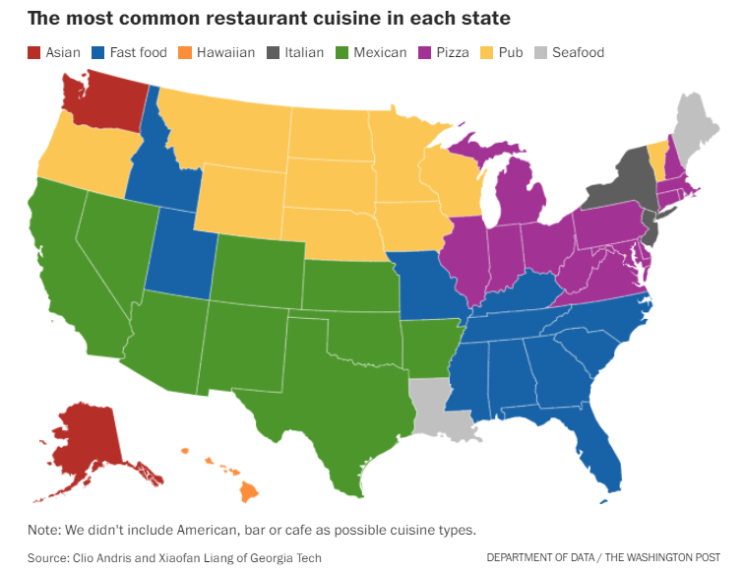
Introduction
Study Questions
Methodology
Results
Foodway Map
(Liang and Andris, 2021)

Slide 14
Thank you!
Any questions or comments?
maryam-torkashvand@uiowa.edu
Grant No. 2215568
www.geo-social.com

