Slide 1
SNoMaN Workshop
May 18–19, 2023
Extracting Dynamic Social Network Edgelists from Event Data
David G. Russell
Department of Geography
University of Florida
David.Russell@ufl.edu
Notes:
Good morning, everyone, صباح الخير boker tov, and thank you for coming to this session. My name is David Russell, and I’m a PhD student at the University of Florida. And today I’ll be taking you through the results of a research paper entitled “Landscapes of control: The geography of counterinsurgency in the Sinai.”

Slide 2
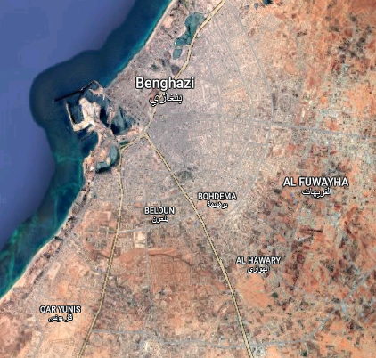
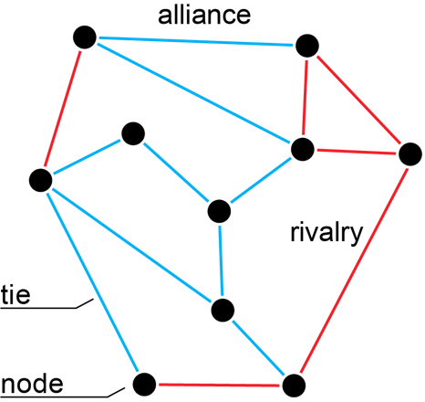
Mapping conflict networks
Actor A fought Actor B alongside Actor C
Event data from the Armed Conflict Location & Event Data Project (ACLED)
In North and West Africa, from January 1, 1997 – December 31, 2022:
56,365 violent events
205,413 deaths
Events always involve multiple actors, and we can use this information to construct a sociogram
Actor B fought Actor C
Actor A fought Actor B
Source: OECD/SWAC (2021)

Slide 3
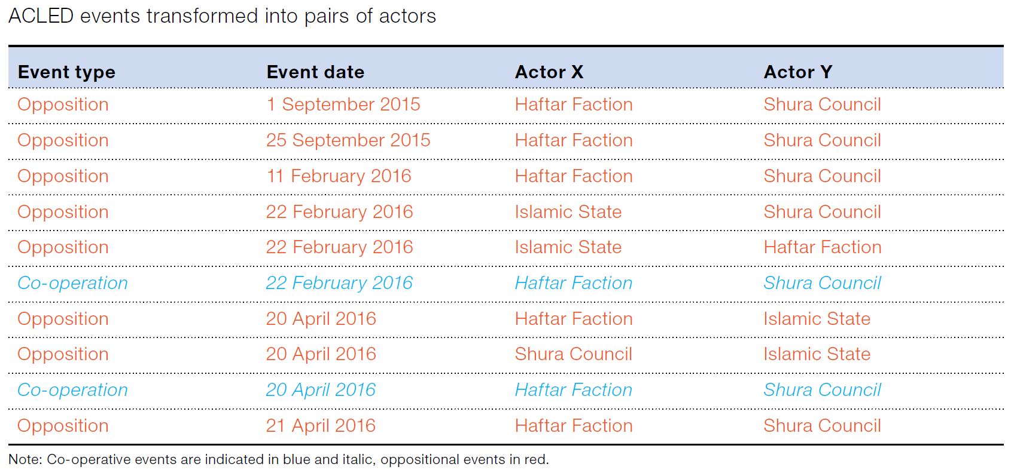
Dynamic Network Analysis
From events to dyads
Event data with lists of participants can be turned into lists of relationships between all possible pairs of actors
Each pair of actors forms a dyad. Its relationship can be cooperative or conflictual, depending on event details
Source: OECD/SWAC (2021)

Slide 4
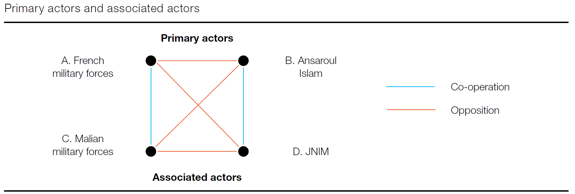
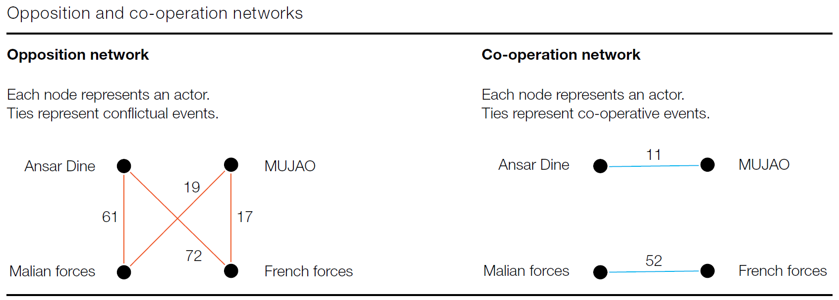
Dynamic Network Analysis
Opposition and cooperation networks
Active ties between dyads can be cooperative or conflictual
Cooperative and conflictual ties can be considered together (signed network) or separately (unsigned networks)
Ties can be weighted by the number of events involving both actors/nodes
Source: OECD/SWAC (2021)

Slide 5
Dynamic Network Analysis
From dyads to edges
Relational data over time is most efficiently stored as a list of relationships with beginning and end dates: an edgelist
Edges can be cooperative, conflictual, or non-existent (lapsed)
An edge duration limit specifies how long a relationship will last after its last event
Source: OECD/SWAC (2021)

Slide 6
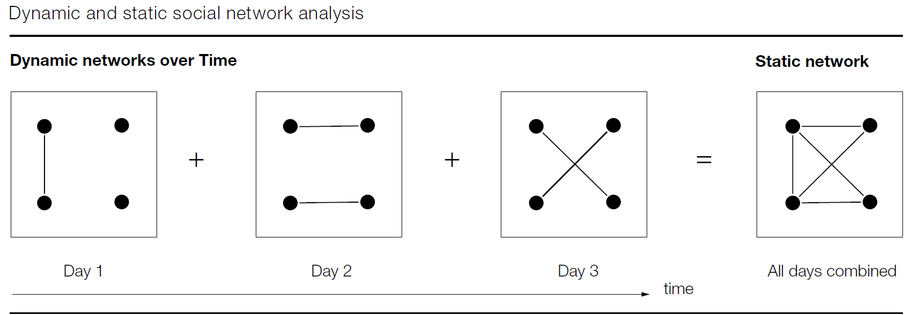
Dynamic Network Analysis
Networks over time
A dynamic network can be a series of static networks at different snapshots in time
Network measures like density and centralization can be measured at temporal intervals
Source: adapted from Uddin et al. (2015) by OECD/SWAC (2021)

Slide 7
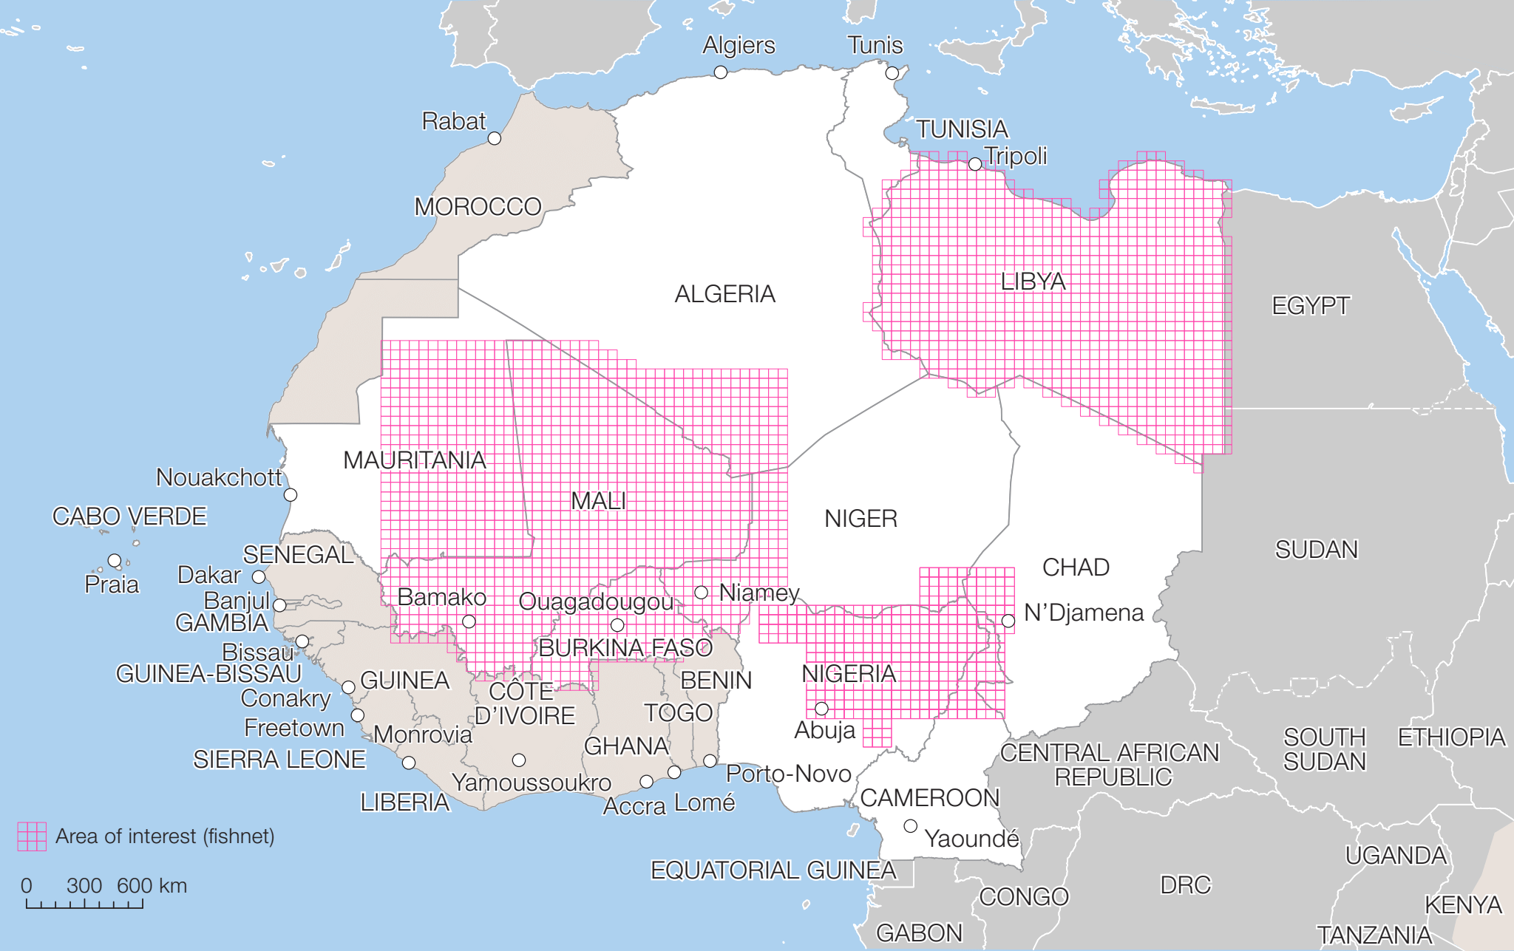
Spatializing Social Networks
Constructing social networks from spatialized event data means we can subset the network by the location in which the network’s events happened
Source: OECD/SWAC (2021)
Source: OECD/SWAC (2021)

Slide 8
References and acknowledgements
Walther, O. J., Radil, S. M., & Russell, D.G. (2021). Mapping the changing structure of conflict networks in North and West Africa. African Security 14 (3), 211-238.
OECD. 2021. Conflict Networks in North and West Africa. Paris.
Travel to this conference was supported by a Travel Support Award from the Spatial Social Network Workshop. This research is funded by the OECD Sahel and West Africa Club.

