Slide 1
Spatial social networks in human mobility patterns: A case study of disaster response
SNoMaN Workshop 2023: Lightening Talk
Presented By: Annetta Burger
burgerag@ornl.gov
Oak Ridge National Laboratory

Slide 2
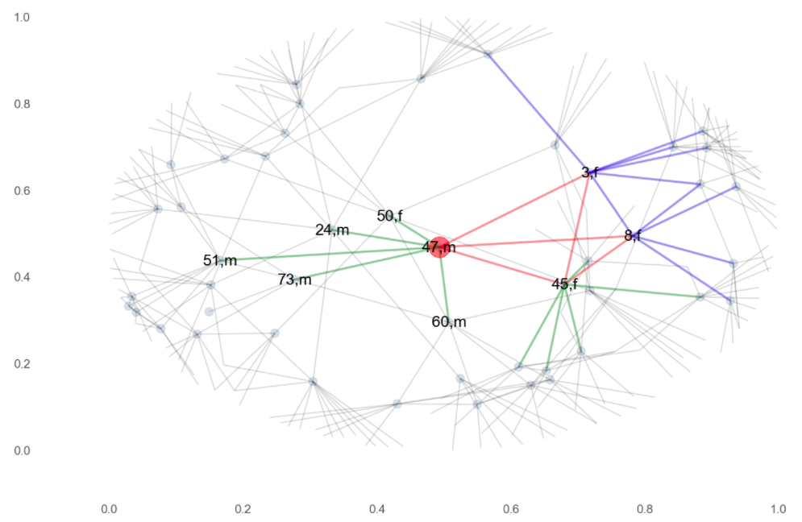
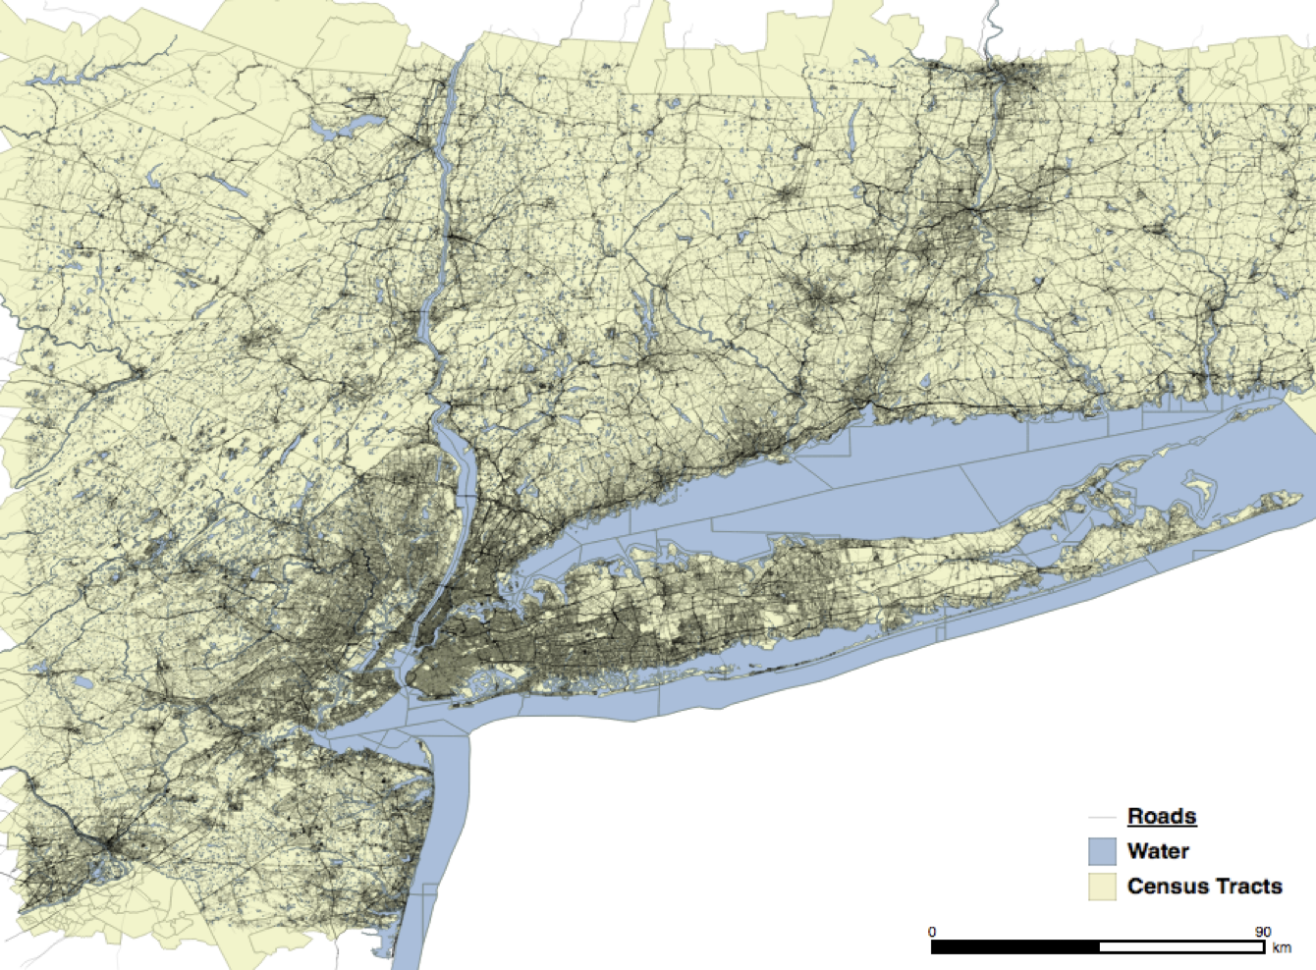
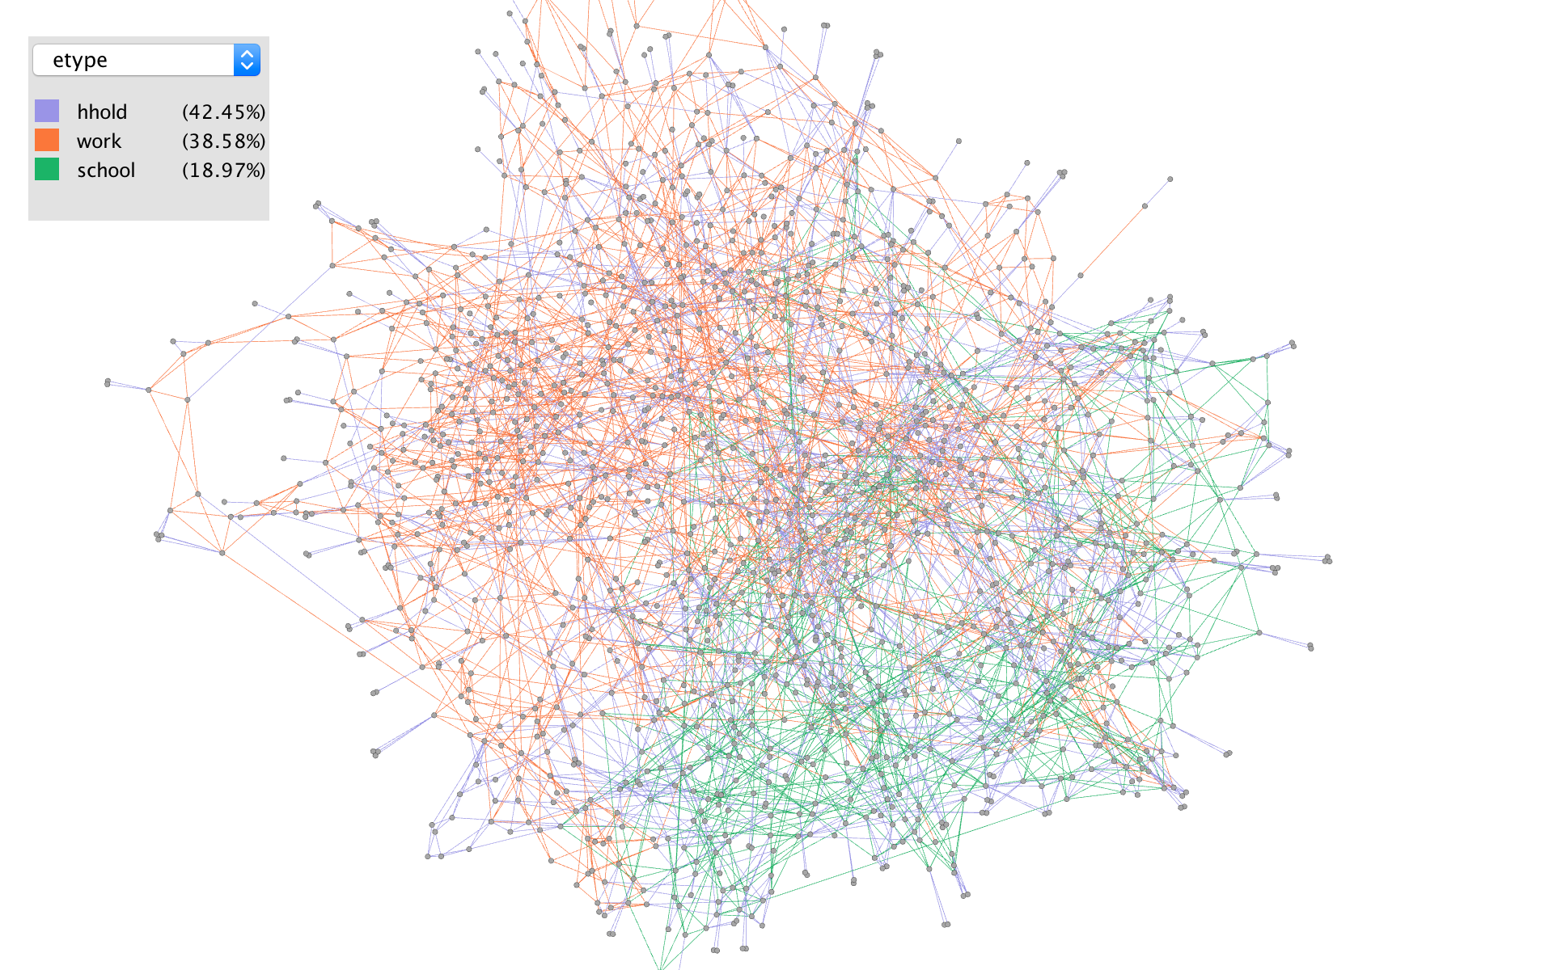
How do social networks impact human behavior in disaster and survival outcomes?
Preparation – Leads some households to be more knowledgeable and better prepared
Evacuation – Evacuation as family units
Impact – Sheltering in cohorts and flight in emergent groups
Recovery – Search and rescue, debris removal, financial loans and gifts, shelter, childcare, emotional support, and information
Reconstruction – Financial loans and gifts and information

Slide 3
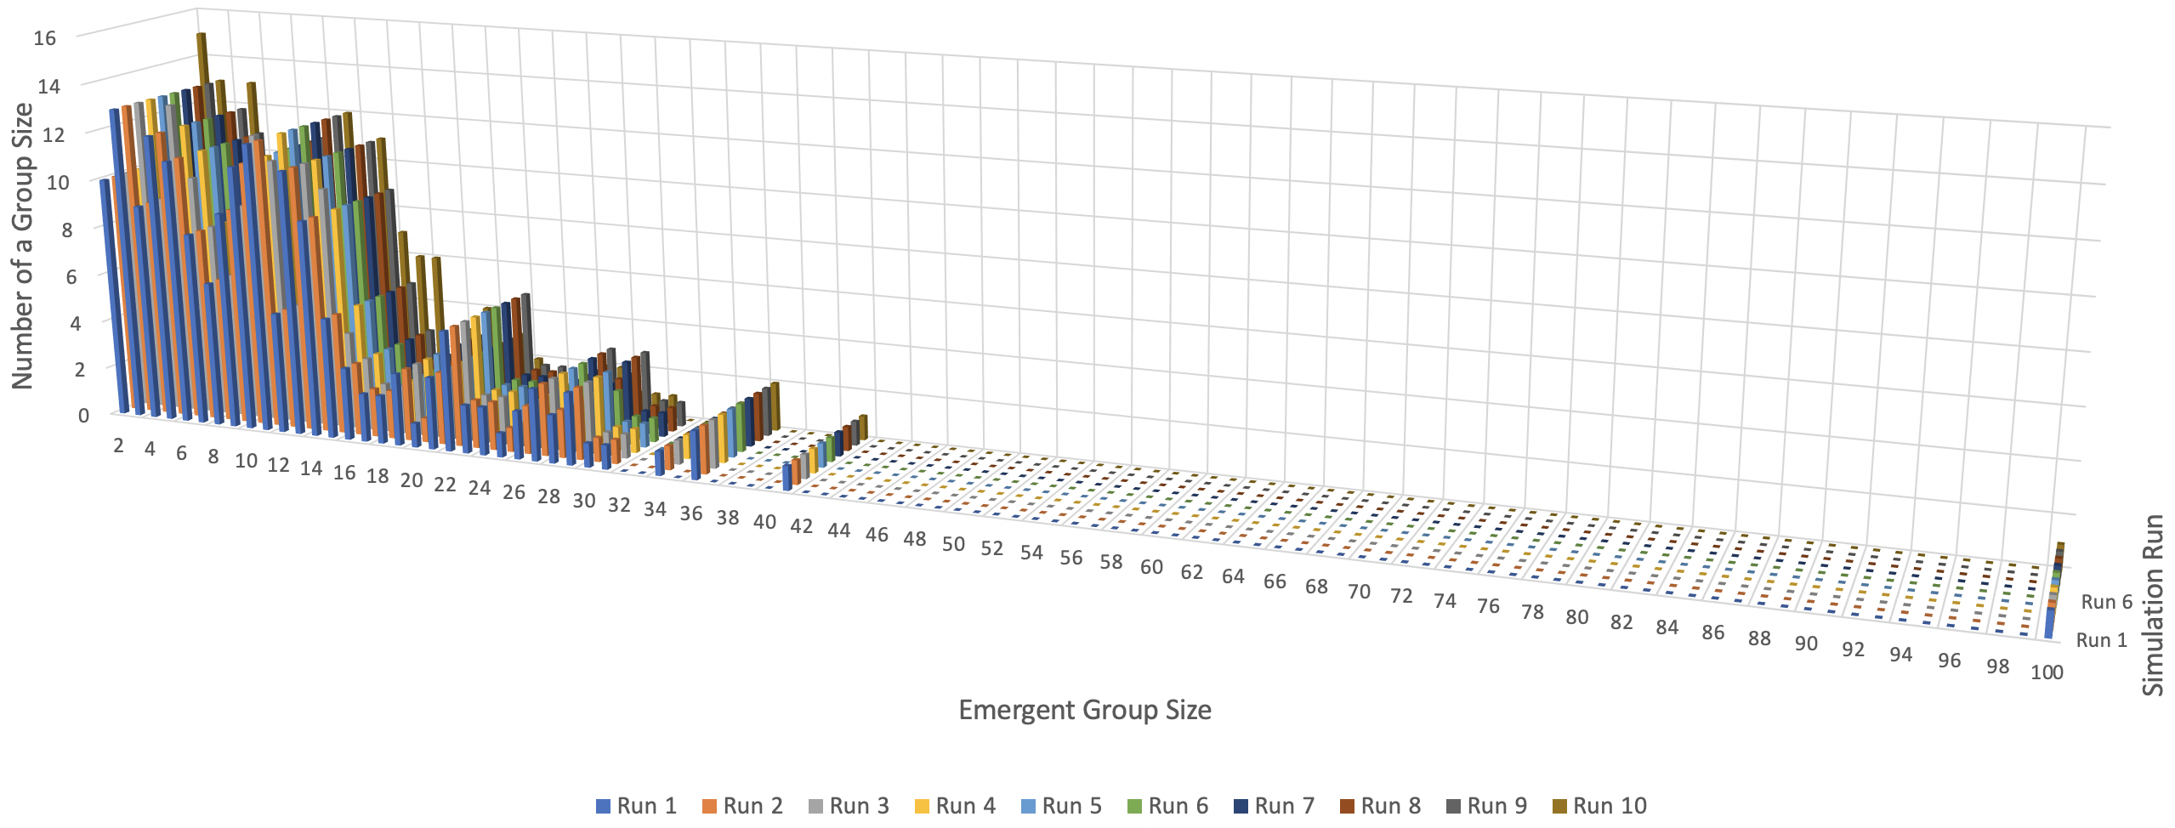
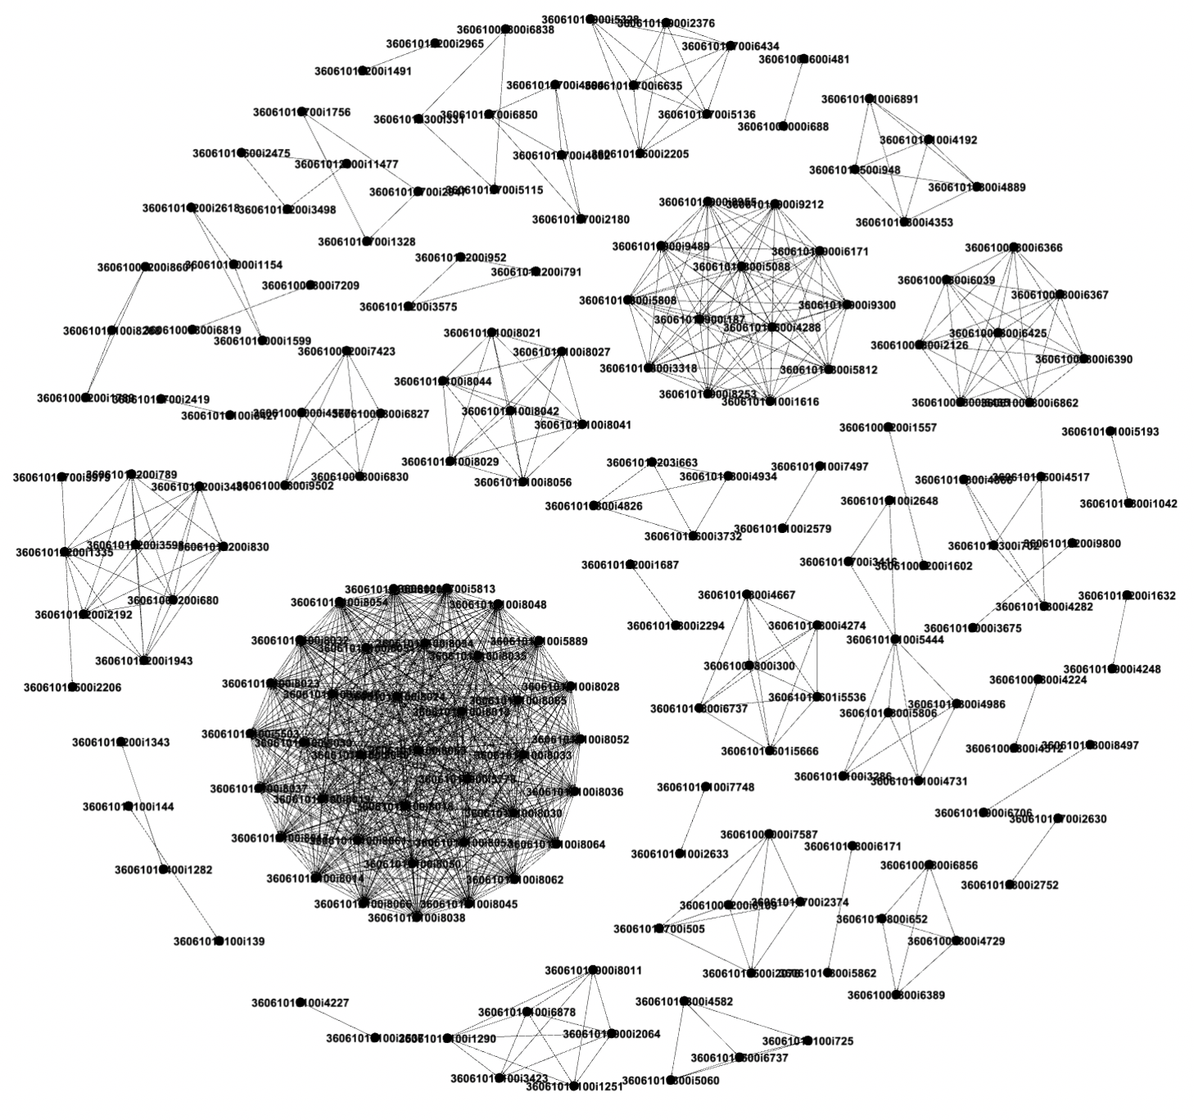
Human Behavior in NWMD Event
Effects
NWMD
Detonation
Road Network
Destroyed/Impaired
Agents
Emergent Group
Formation
Goals:
Work, School, Home
New Goals:
Safety, Info, Aid
Individuals & Commuting Groups
Shelter
Flee
Evacuation
Aid
Commute
~1030 steps
Commute
~2475 steps
Commute
~3915 steps
Commute
~450 steps
Commute
~1890 steps
Commute
~3330 steps
Commute
~4770 steps
Commute
~6210 steps
Minutes
720
2160
5040
6480
0 steps
0 hrs
1440 steps
24 hrs
2889 steps
48 hrs
3660
4320 steps
72 hrs
Baseline
Emergent Groups for Population Size 22,960
Notes:
Building from ethnographic and other empirical data we can build a timeline of the event as well as possible scenarios that characterize potential experiences
Geospatially accurate, representing both the physical infrastructure and population behavior
Mobility
Entities that have agency with goals and decision-making capacity
Key motivator in emergencies – individual and family safety – need to represent the social network

Slide 4
ABM NWMD Detonation – Response Pattern
Notes:
Video of a small representative population
Larger points represent carpools and other groups
Color represented health with healthy green agents ranging to black dead agents

Slide 5
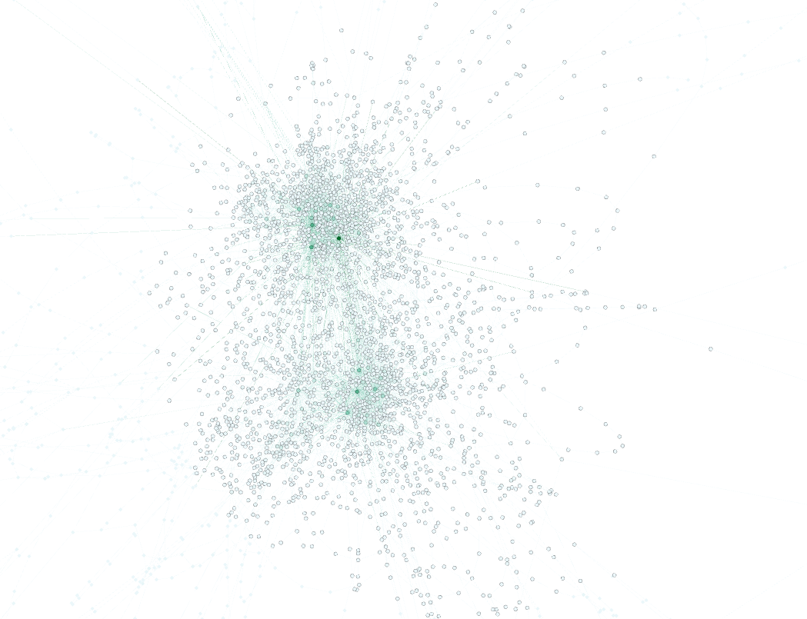
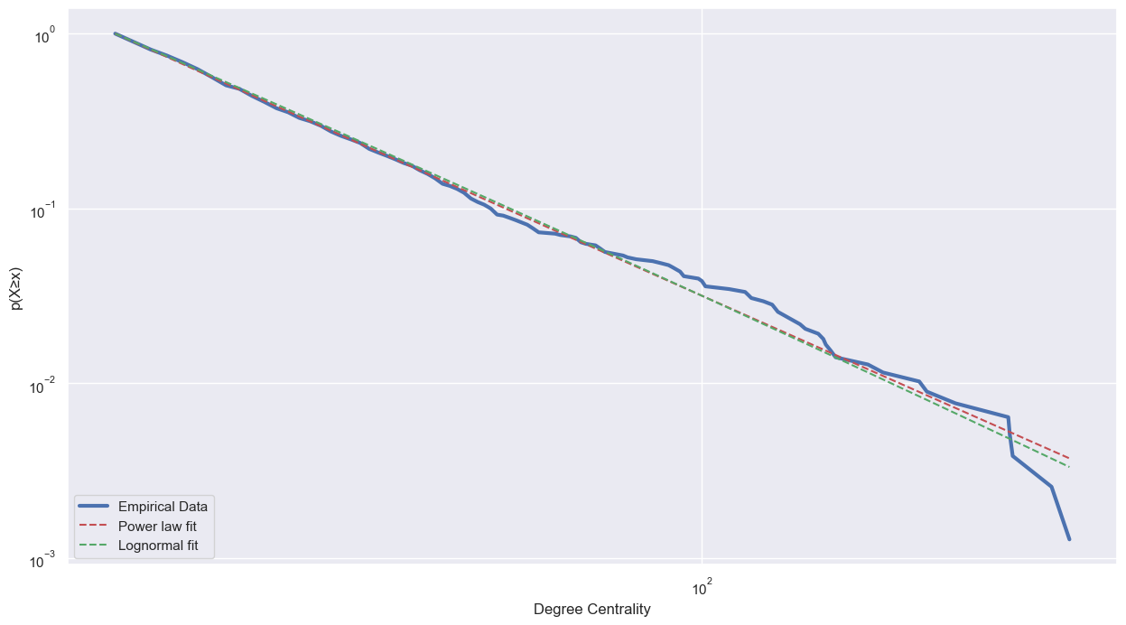
HAYSTAC -- Spatial Networks from Mobility Data
GeoLife User153 Spatial Network
Degree Centrality of Aggregate GeoLife Spatial Network

Slide 6
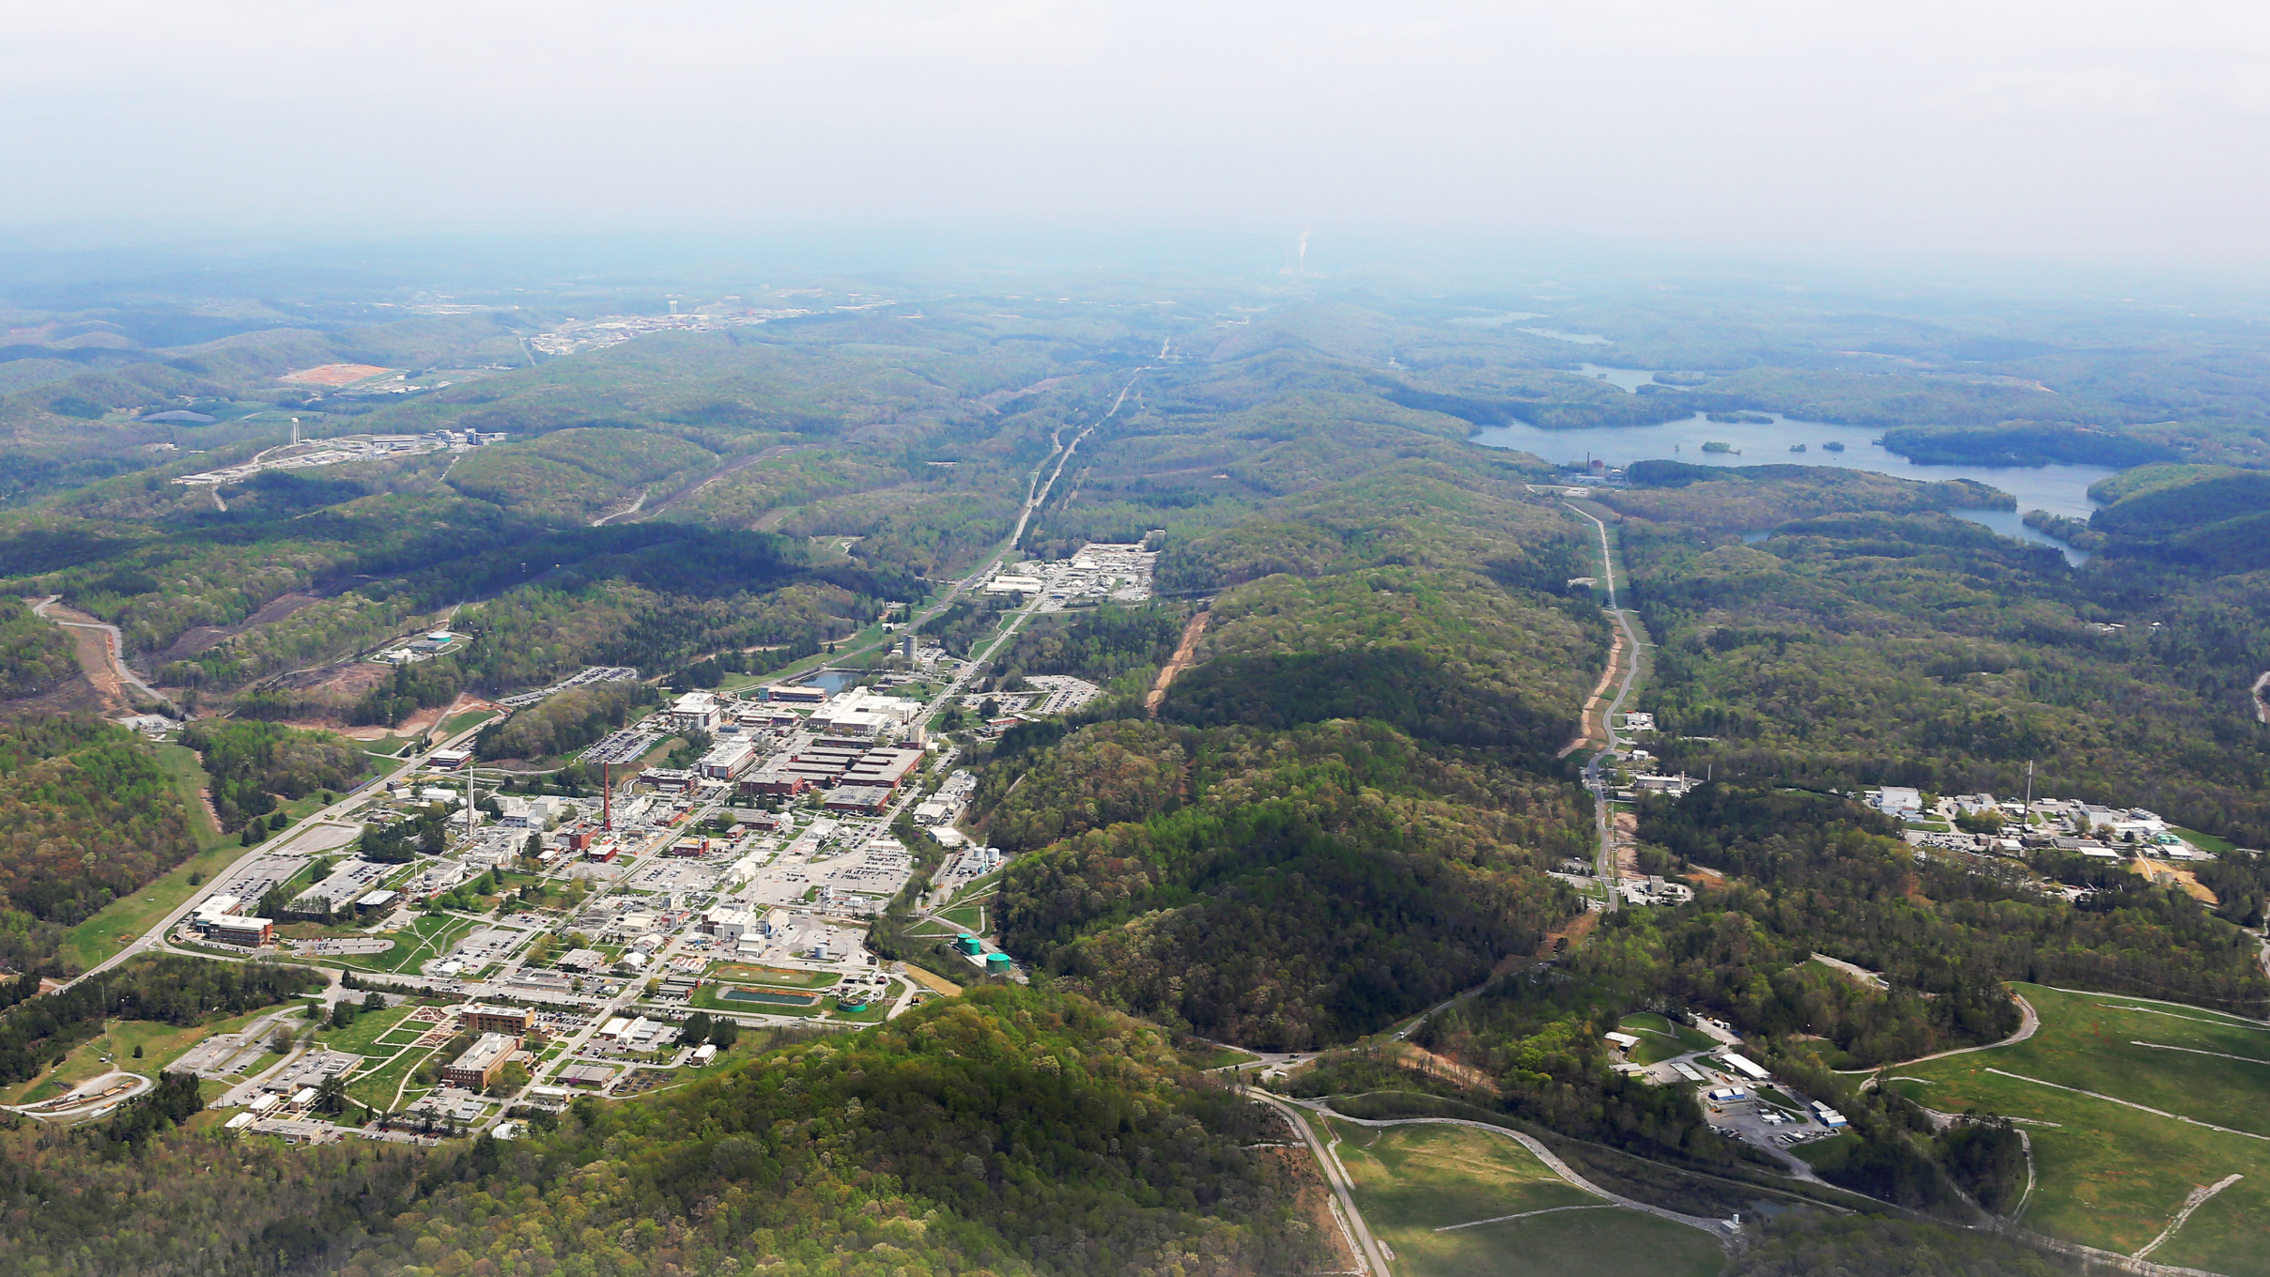
Q&A and Discussion

