Slide 1
Geolocated social media operationalized to address the opioid overdose crisis in America

Slide 2
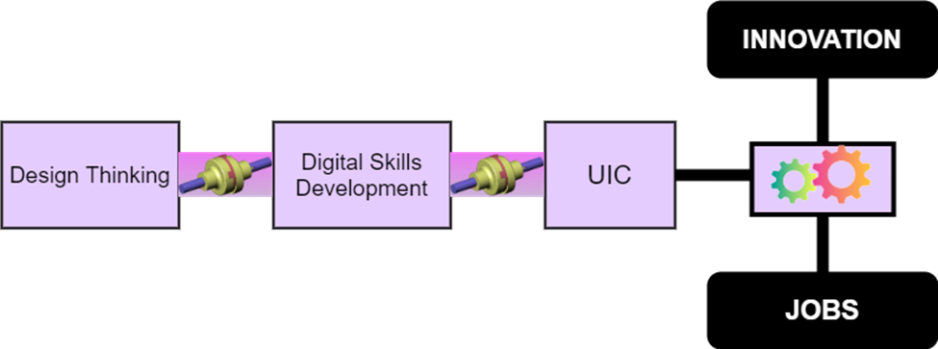

A well constructed operating model must support the project
Anthony J. Corso, Ph.D., MBA
Professor of Computing, Software, and Data Sciences
Nathan A. Corso, Research Assistant
Student, Bachelor Statistics and Data Analytics and Minor Data Science
Phil Breitenbucher, Ed.D., MSW
Assistant Professor of Social Work
California Baptist University
Notes:
The operating model, therefore, addresses theory, abstracts, artifacts, etc. It identifies provisions that govern the activities of people, technology, capital investment, and extensive use of software and IS to enable the organization to deliver promised value from project development and implementation.
Do not leave this slide until the audience feels comfortable with the title and how the operating model supports its undertaking.
Does the audience see:
This presentation will describe a GIS research project using location analytics and social media to illustrate public sentiment of opioids pre and post death of a public athletic figure and the change in sentiment post sentencing of the fentanyl distributer?

Slide 3

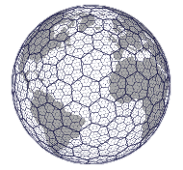
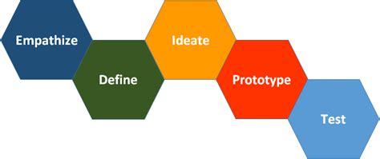


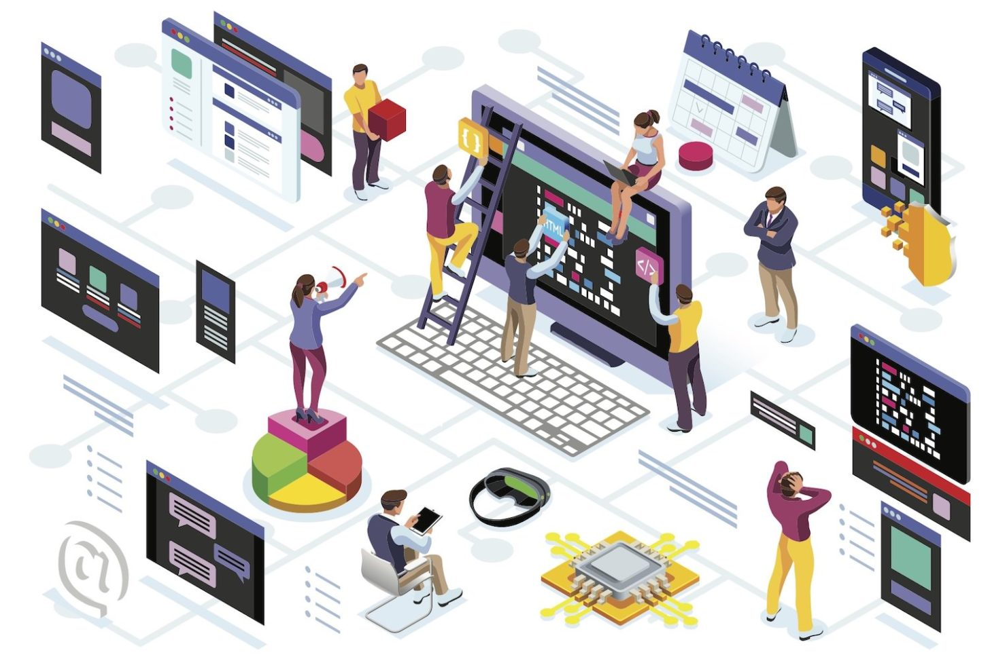
The operating model must define the foundation of one’s future business paradigm
Notes:
Design Thinking: https://dschool.stanford.edu/resources/getting-started-with-design-thinking
Digital Skills: https://equip.learning.com/digital-skills-list
Digital Citizenship: Model safe, legal, and ethical behavior when using technology.
Operation & Application: Use common technology devices with proficiency, select appropriate tools for given tasks, and leverage technology throughout the learning process.
Inquiry & Innovation: Collect, organize, and visualize information with technology programs and produce creative digital artifacts to convey understanding and inform audiences
Problem Solving & Critical Thinking: Leverage technology in the problem-solving process and model computational processes to uncover, apply, and scale solutions.
Online Communication, Collaboration, and Research: Develop learning networks to communicate information in a variety of online formats, curate and synthesize resources, and collaborate with others using digital mediums.
UIC: MIT 8 best practices.
Results of work

Slide 4
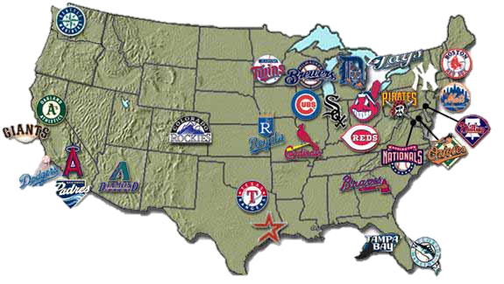


Data driven investigation can proffer many research questions
How can Location Analytics and Social
Media be used to address the opioid overdose crisis in America?

Slide 5
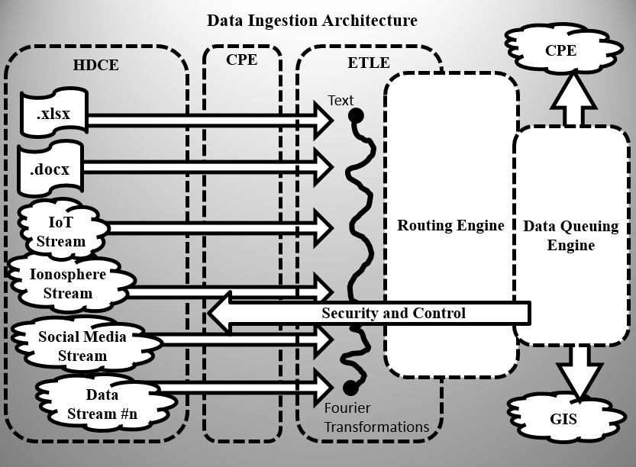
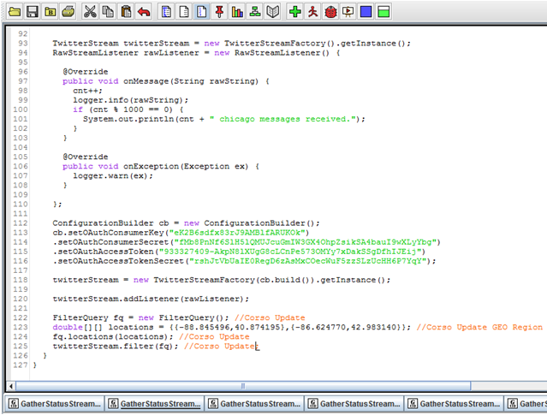
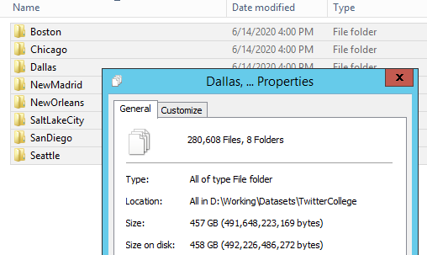
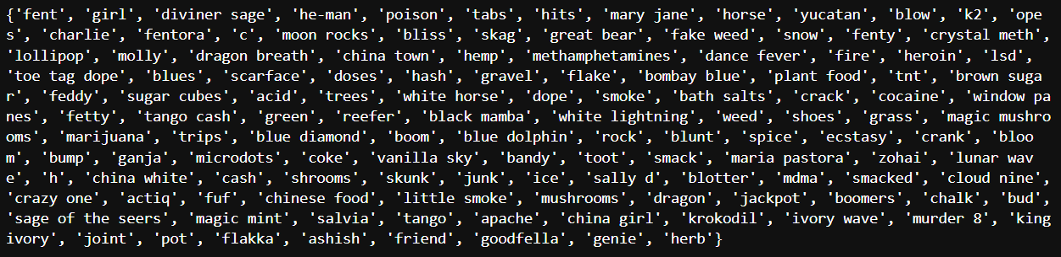

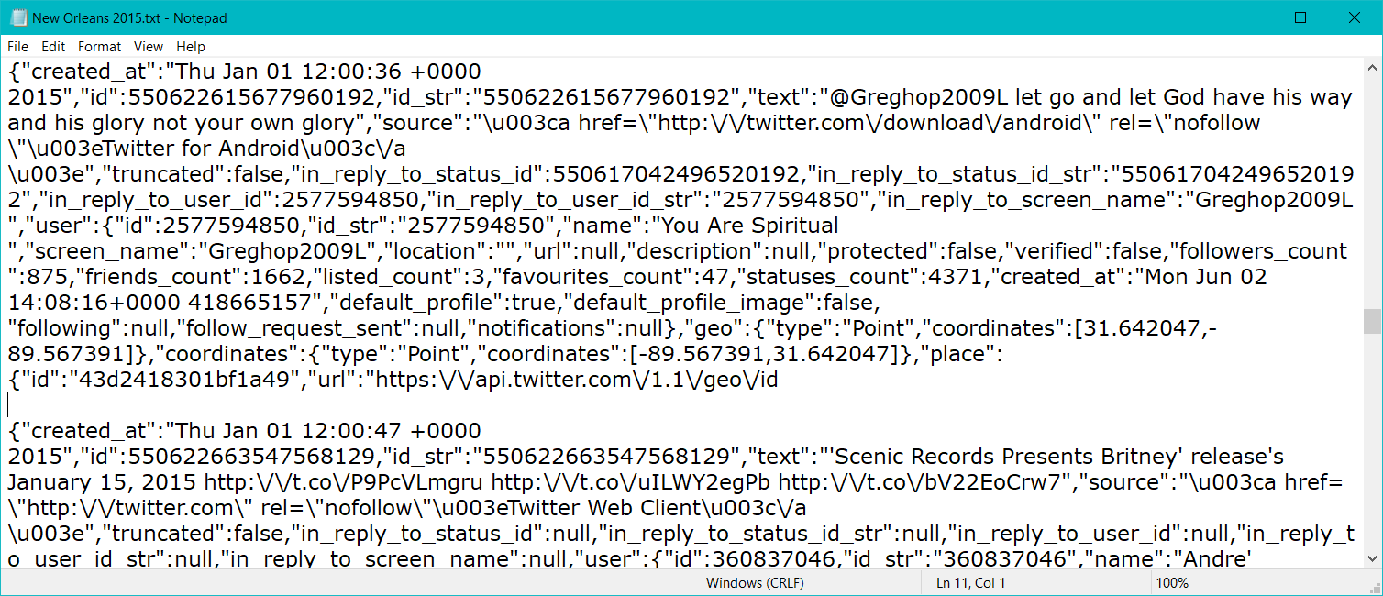
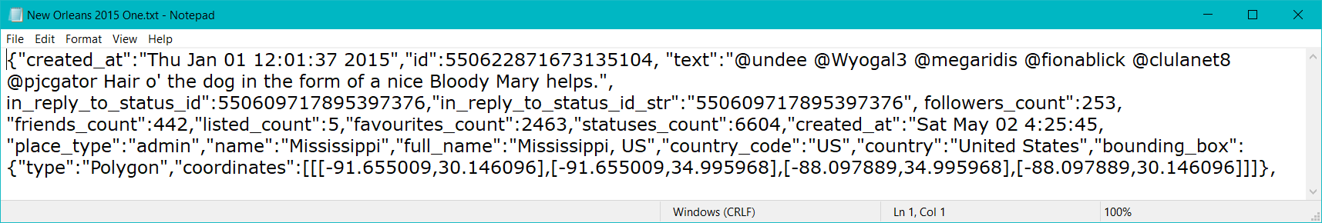
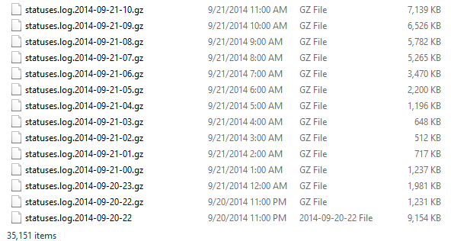
Advanced data driven analysis must consider a data ingestion architecture

Slide 6
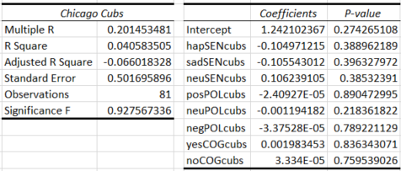
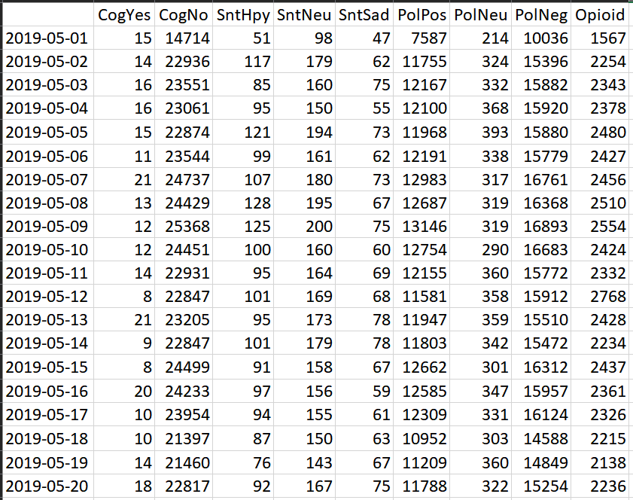
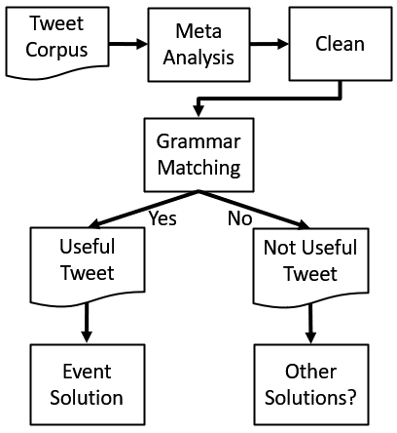
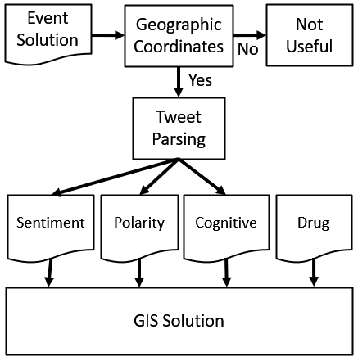
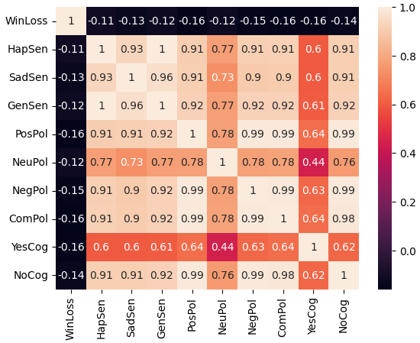
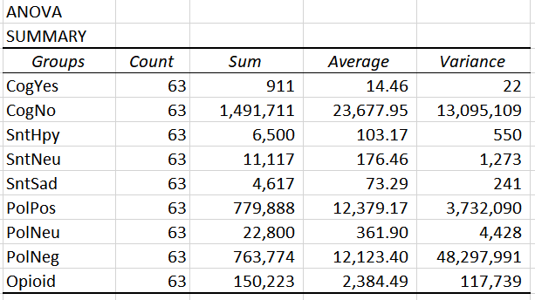
Simple case study research allows for the exploration and analysis of data and their predictive capabilities

Slide 7
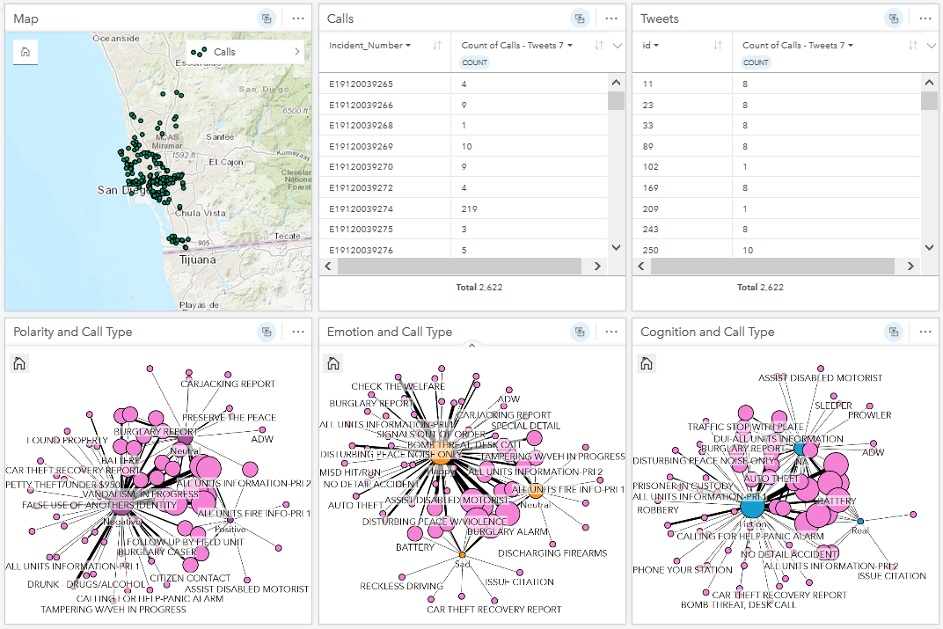
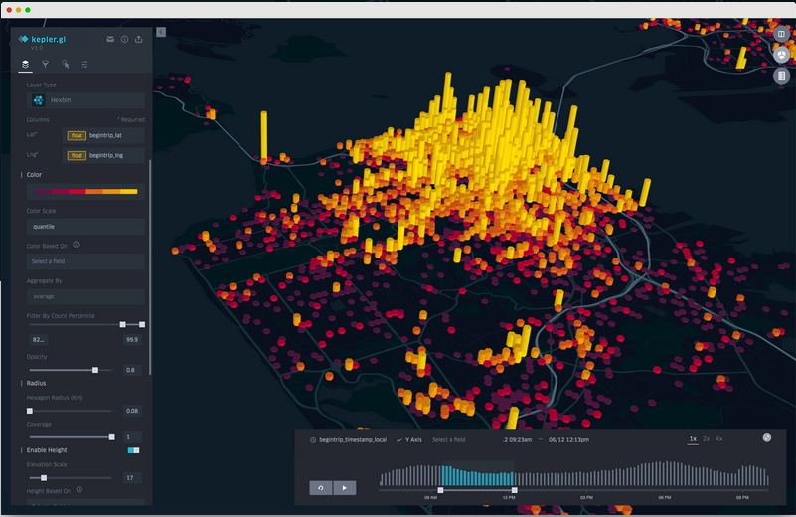

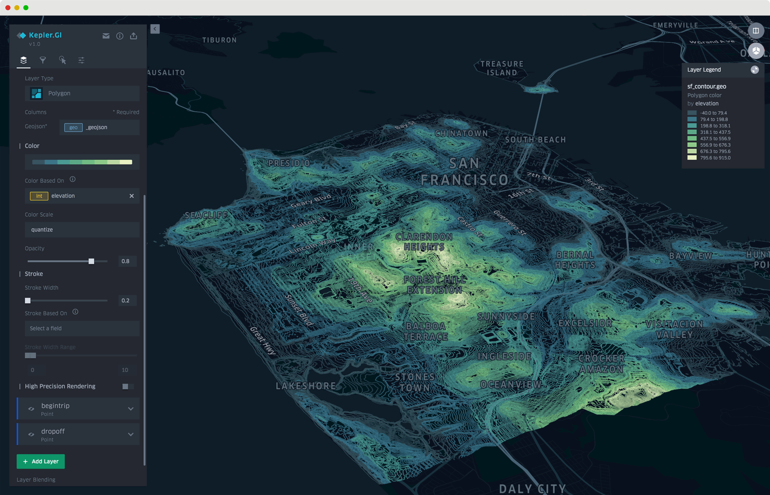
Statistically valid results can be spatially visualized, and this state-of-the-art paradigm requires future observation

Slide 8

In summary, the operating model supports spatial social media analysis and possesses the capabilities to support project development, implementation, and deployment of resources
Notes:
Conclusion slide. Use the headline (no more than two lines) to state your most important conclusion. Begin the headline with, In summary, or In conclusion to ensure that the audience knows they have come to the presentation’s end. Support that headline with an image and parallel points.

