Slide 1
Predicting Human Activity with GeoAI
by Fusing Physical and Social Interactions through
Graph Convolutional Networks
Song Gao
Geospatial Data Science Lab, University of Wisconsin-Madison
Email: song.gao@wisc.edu
https://geods.geography.wisc.edu/

Slide 2
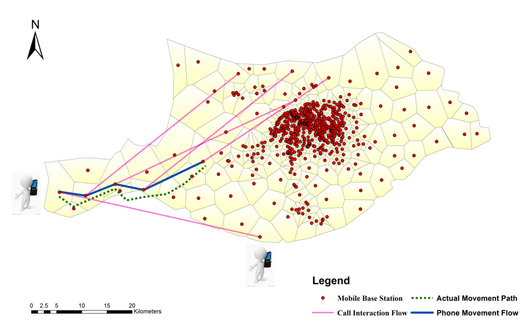
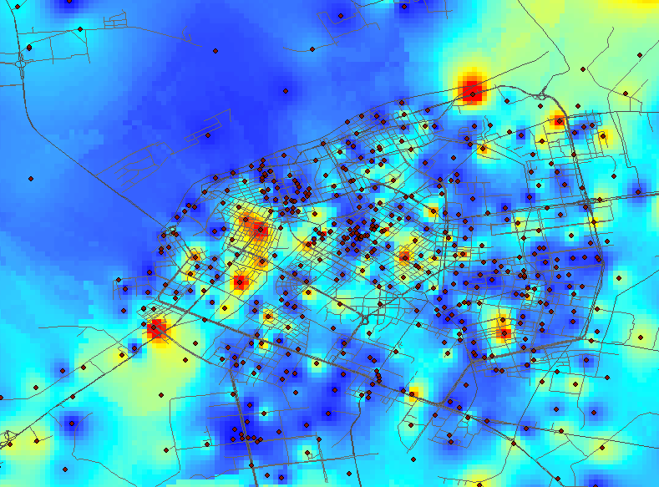
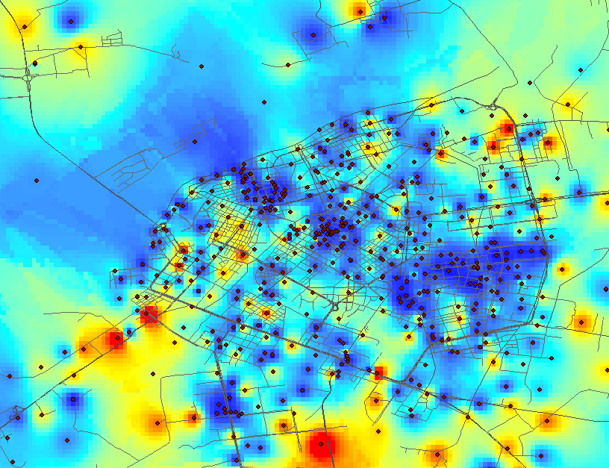
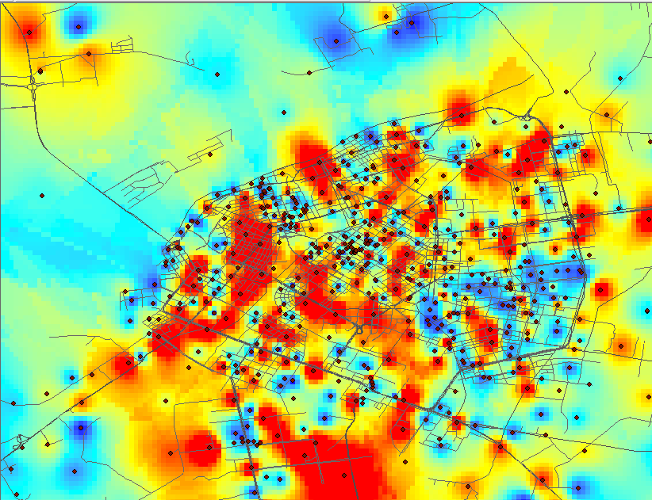
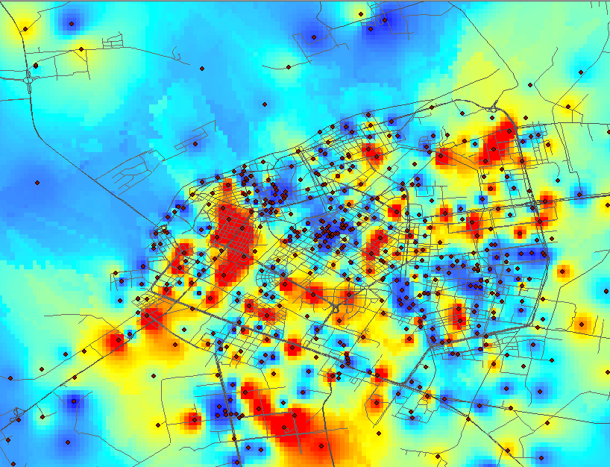
Phone Call Detail Records (CDRs)
AM 03-04
AM 06-07
AM 09-10
PM 21-22

Slide 3

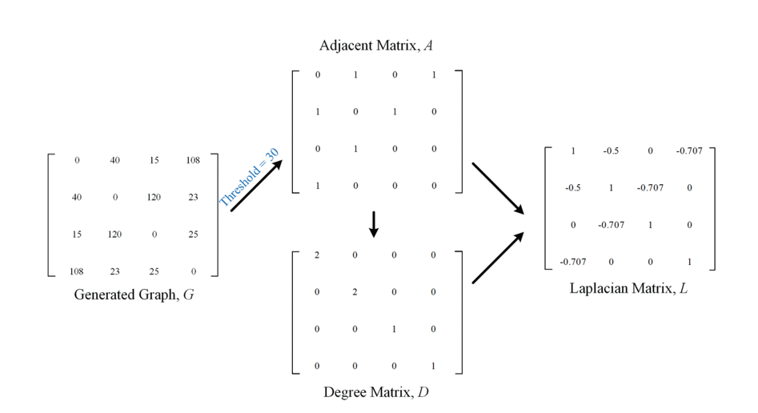
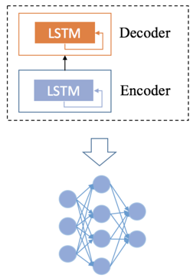
Multiple Types of Spatial Interactions
GeoDS Lab @UW-Madison
Geographical distance
Movement interaction
Social network interaction

Slide 4
The proposed AIP-IPS model
AIP-IPS: Activity Intensity Prediction using the Interactions in Physical and Social spaces.
Graph convolutional network (GCN): modeling the impacts of spatial interactions
Long short-term memory (LSTM): modeling the temporal tendency and variations of human activity intensity

Slide 5
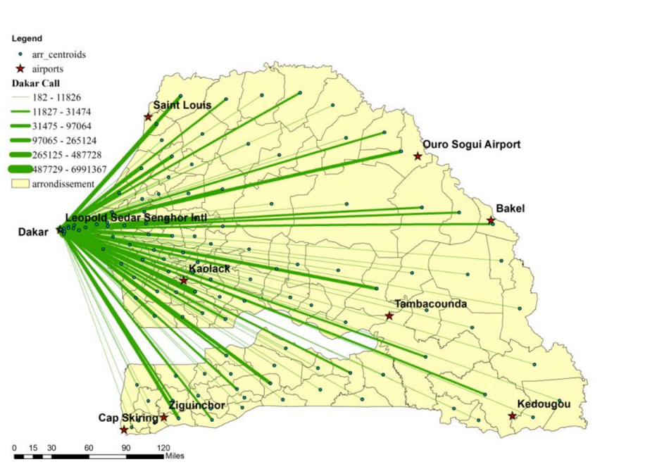
Case Study
About 9 million users in Senegal through the “Data for Development (D4D)” Senegal challenge (De Montjoye et al., 2014).
Dataset 1: a tower-to-tower call frequency data for all towers on an hourly basis of the entire population
Dataset 2: a cell tower-level CDR data at the individual level for about 10% of mobile phone users

Slide 6
The proposed AIP-IPS model
Parameter | Value | Parameter | Value
Distance threshold | 30000 | Distance graph weight | 0.3
Movement threshold | 20 | Movement graph weight | 0.1
Social threshold | 20 | Social graph weight | 0.6
LSTM hidden layers | 1 | Time sequence length | 6
GCN hidden layers | 1 | Num of hidden units | 64
Graph convolution kernel | 1 | Time step | 6

Slide 7
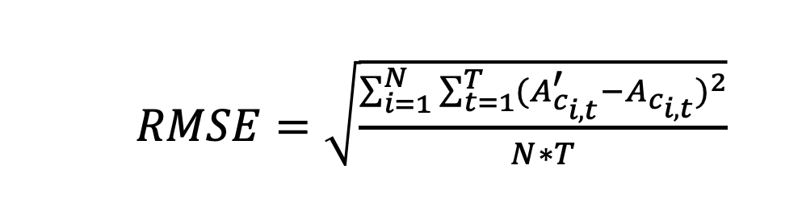
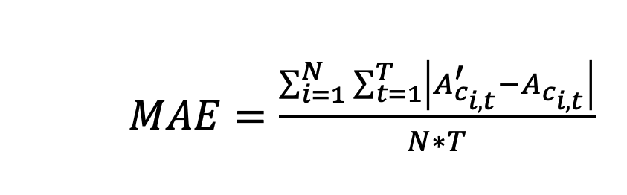
Results: Graph Fusion Performance
  $RMSE=\sqrt{\frac{\sum_{i=1}^{N}{\sum_{t=1}^{T}{{(A_{c_{i,t}}^{′}−A_{c_{i,t}})}^{2}}}}{N∗T}}$
$MAE=\frac{\sum_{i=1}^{N}{\sum_{t=1}^{T}{\left|A_{c_{i,t}}^{′}−A_{c_{i,t}}\right|}}}{N∗T}$

Slide 8
Results: Impact of Entropy (Regularity)
Notes:
corresponding to the cumulative distribution values of 60% and 90% in the activity intensity entropy statistical distribution of each dataset, respectively.

Slide 9

Summary
Modeling multi-order spatial interaction with representation learning
A deep learning prediction model using fused GCN and LSTM layers
The importance of integrated physical and social interactions on activity estimation
Li, M., Gao, S., et al. (2021). Prediction of human activity intensity using the interactions in physical and social spaces through graph convolutional networks. International Journal of Geographical Information Science, 35(12), 2489-2516
Li, M., Gao, S., et al. (2022). Fine-grained crowd distribution forecasting with multi-order spatial interactions using mobile phone data. Transportation Research Part C: Emerging Technologies. 144(103908), 1-18.

Slide 10


Thank you!
https://geods.geography.wisc.edu
Twitter: @gissong

