Slide 1
Machine Learning for Driver Profiling Using Mobility-based Network Motifs
Yuhan Ji, Song Gao, Jacob Kruse
Geospatial Data Science Lab
University of Wisconsin - Madison

Slide 2









Regularity in daily human mobility patterns
Daily routines
Underlying mechanism
  Needs/Constraints
    Work
    Rest
    Social
  Flexibility
    Occupation
    Exploration
    Preferences

Slide 3
Mobility Motif: Location-based Motif
Network Representation for Daily Routines
  Node
    Visited locations
  Directed Edge
    Trip between locations
Motif
  Discard node attributes
    Name, dwelling time, number of visits
  Discard edge attributes
    Number of trips, distance, travel time
  Focus on the network structure
Schneider, C. M., Belik, V., Couronné, T., Smoreda, Z., & González, M. C. (2013). Unravelling daily human mobility motifs. Journal of The Royal Society Interface, 10(84), 20130246.

Slide 4





Mobility Motif: Activity-based Motif
In-home
Motivation
  Explore how activity types affect location-based motif choices
Modification
  Node
    Activity type (i.e., in-home, work, and others)
  Directed Edge
    Transition between activities
Working
Other
$$W$$
$$H$$
$$O$$
$$H$$
$$O$$
$$H$$
$$O$$
Cao, J., Li, Q., Tu, W., & Wang, F. (2019). Characterizing preferred motif choices and distance impacts. Plos one, 14(4), e0215242.

Slide 5
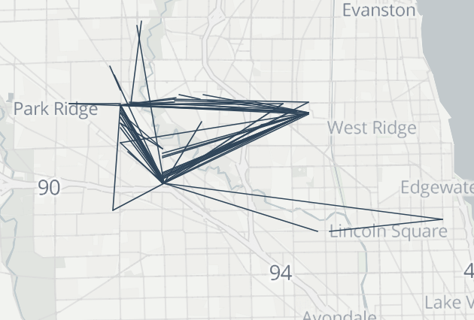





Regularity in daily human mobility patterns
Typical Users
  User 1: 19 weekdays within one month
Location-based motifs
9 days
3 days
3 days
3 days
1 day
$$W$$
Activity-based motifs
Activity-based motifs
$$H$$
$$O$$
$$H$$
$$O$$
15 days
4 days

Slide 6
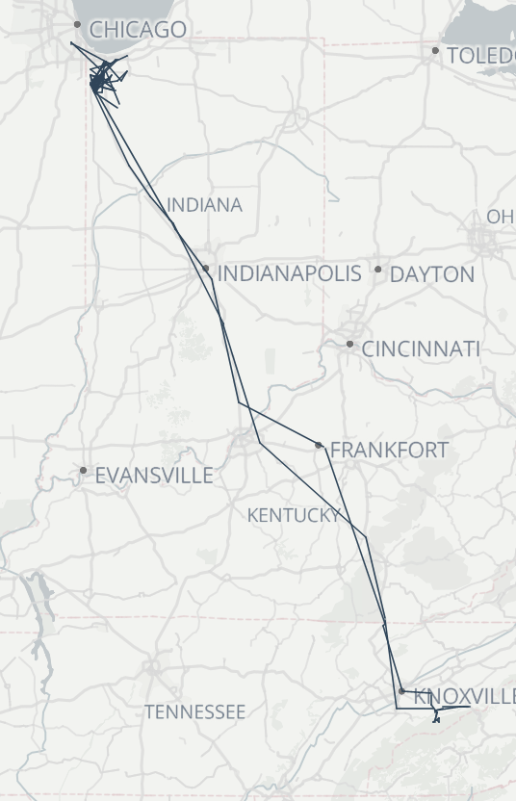
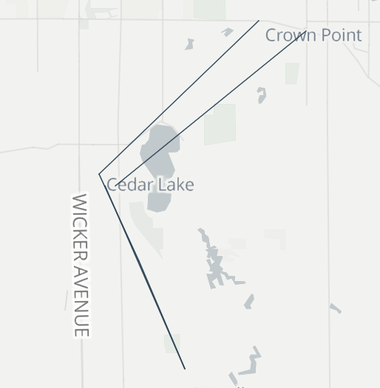
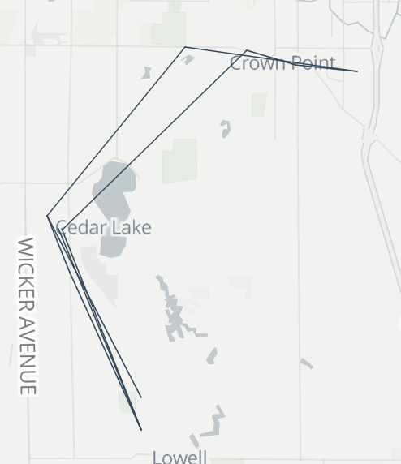
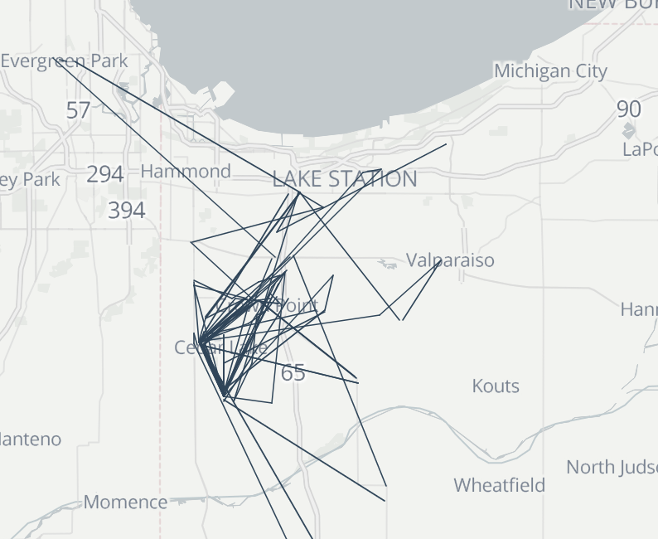
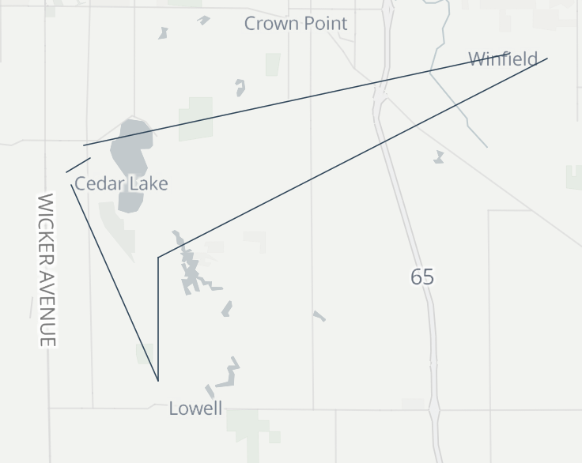
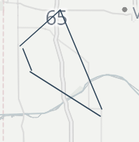






Regularity in daily human mobility patterns
Typical Users
  User 2: 15 weekdays within one month
Location-based motifs
1 day
1 day
1 day
1 day
1 day
1 day
$$W$$
$$W$$
$$W$$
$$W$$
$$W$$
Activity-based motifs
$$H$$
$$O$$
$$H$$
$$O$$
$$H$$
$$O$$
$$H$$
$$H$$
$$O$$
$$H$$
$$O$$
2 days
2 days
1 day
1 day
1 day
1 day

Slide 7

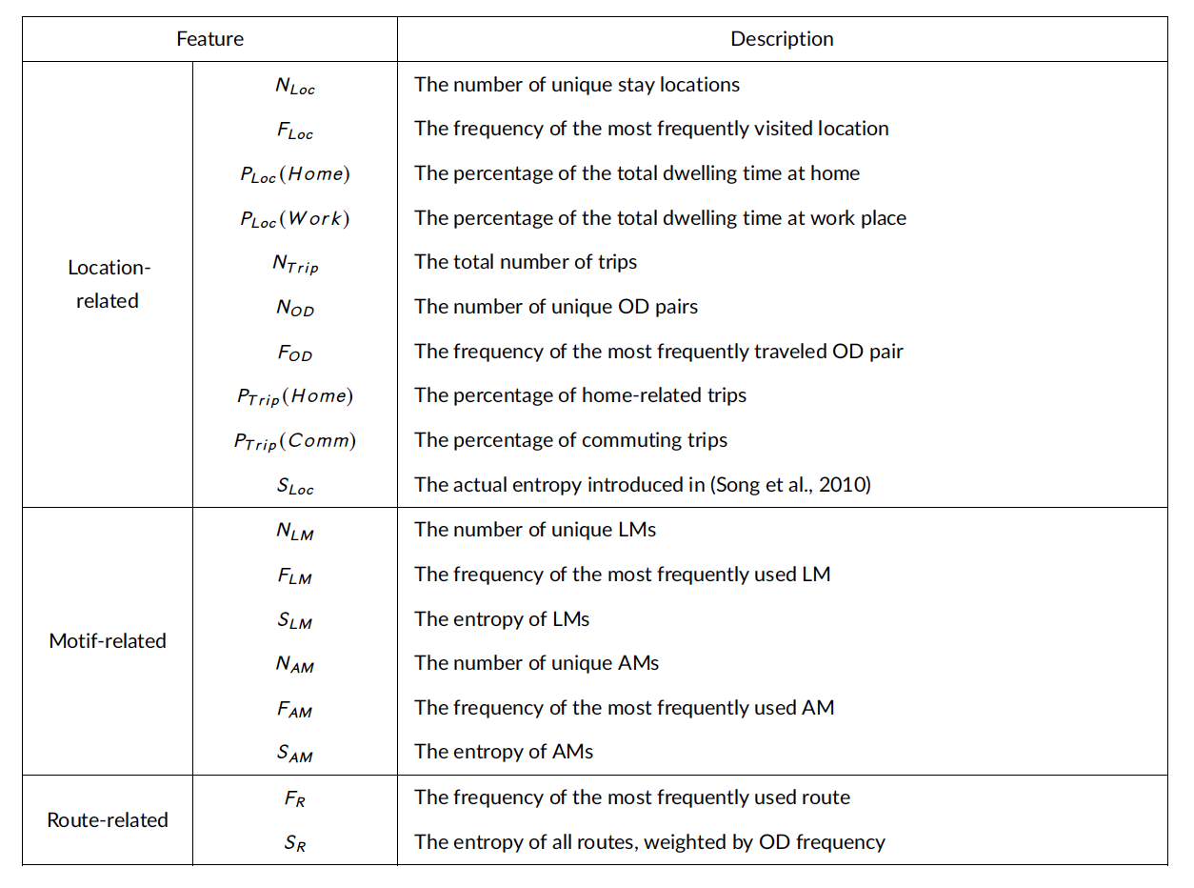
Regularity in daily human mobility patterns
Regularity in Location Visiting
Regularity in Motif Choice
Regularity in Routing Preference
Ji, Gao, et al. Rethinking the regularity in mobility patterns of personal vehicle drivers: A multi-city comparison using a feature engineering approach. (2023), Transactions in GIS.

Slide 8
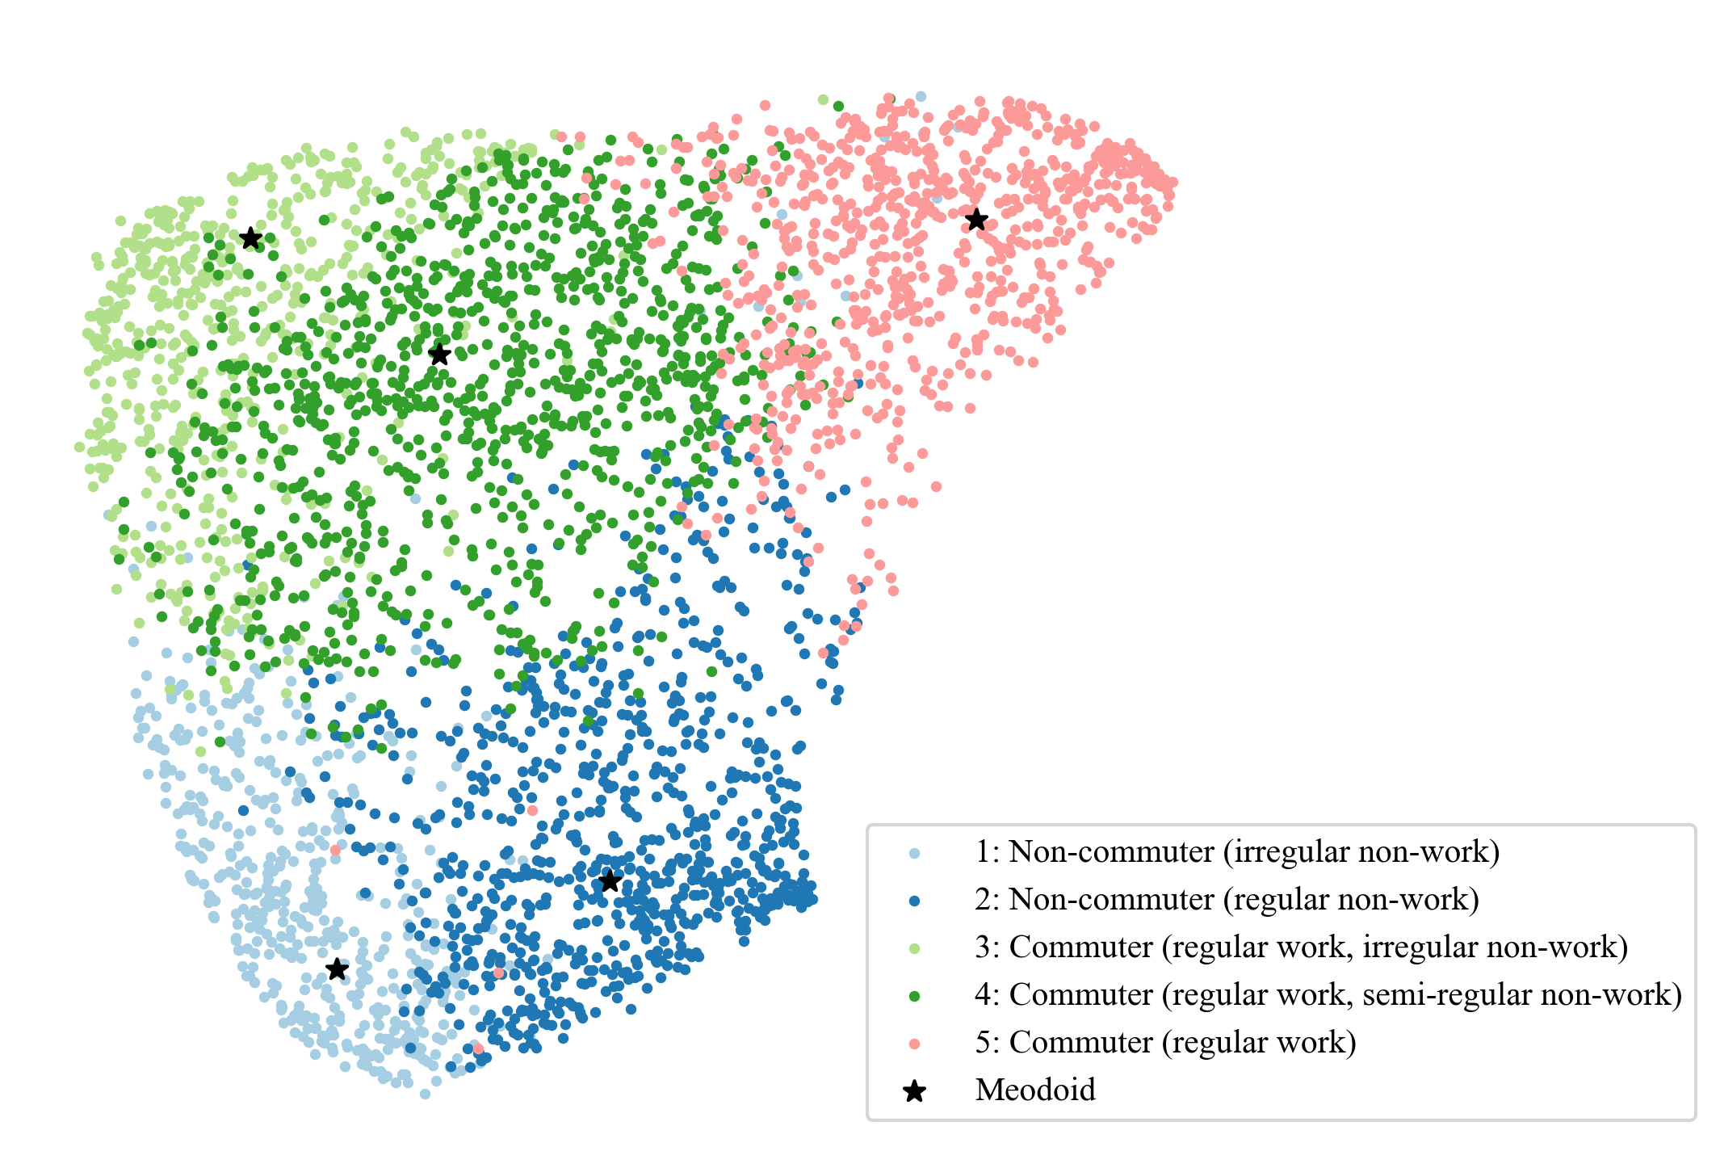
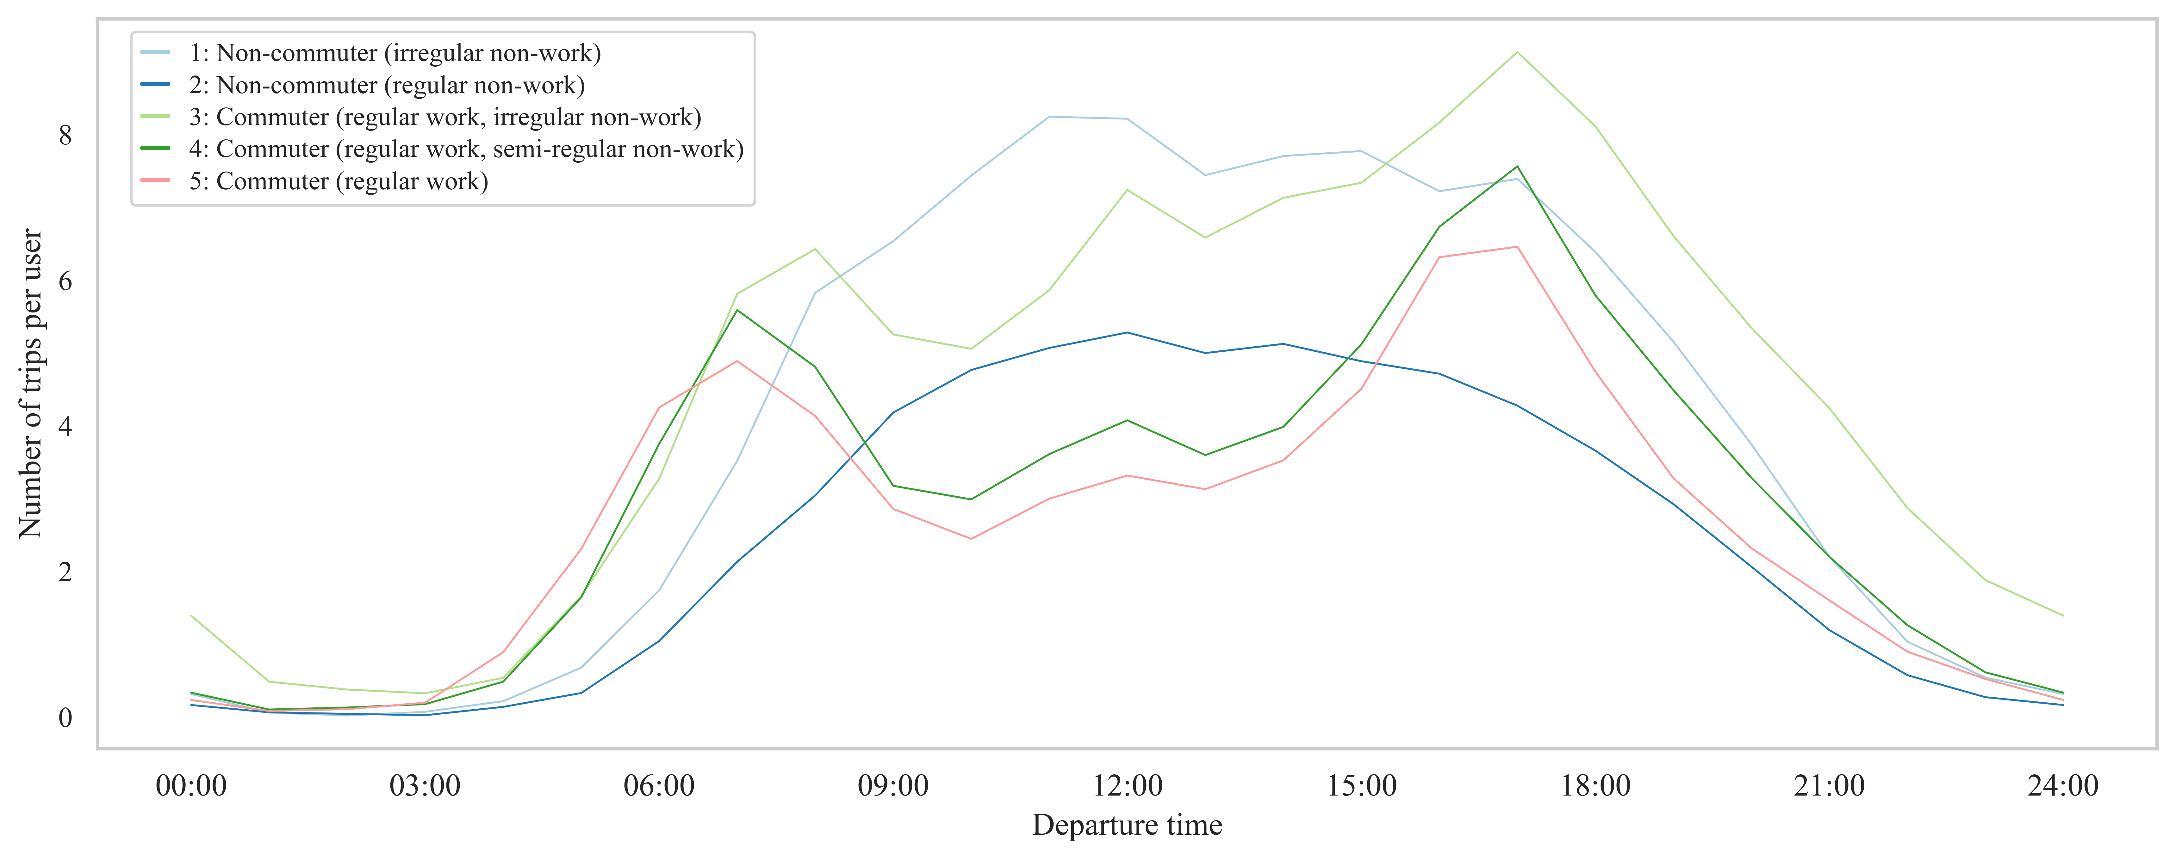
User Profiling/Clustering
A. Commuters
Travel in peak hours
Work-related motifs
Dimensionality reduction
3
  Work-focused commuters (pink)
Correlation between features
Spearman’s rank correlation coefficient
Higher correlation between the same-level features
4
  Typical drivers (dark green)
5
  Movers (light green)
KMedoids Clustering
B. Non-commuters
Travel in off-peak hours
Home-related motifs
ExtraTrees-based distance
ExtraTrees-based distance
Better for cluster cohesion
1
  Gig drivers (light blue)
Driver clusters
2
  Homebodies (dark blue)
KMedoids clustering
Mediods are identified as exemplary users of each cluster
Feature Importance
Permutation-based feature importance
Global feature importance
Local feature importance
Preference for trip departure time

Slide 9
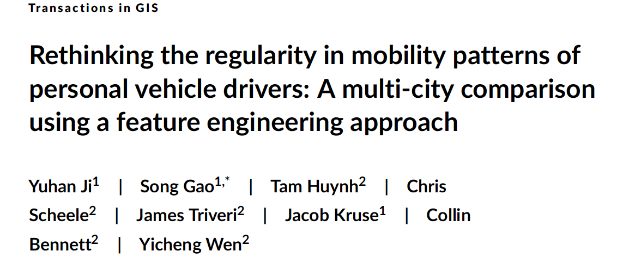
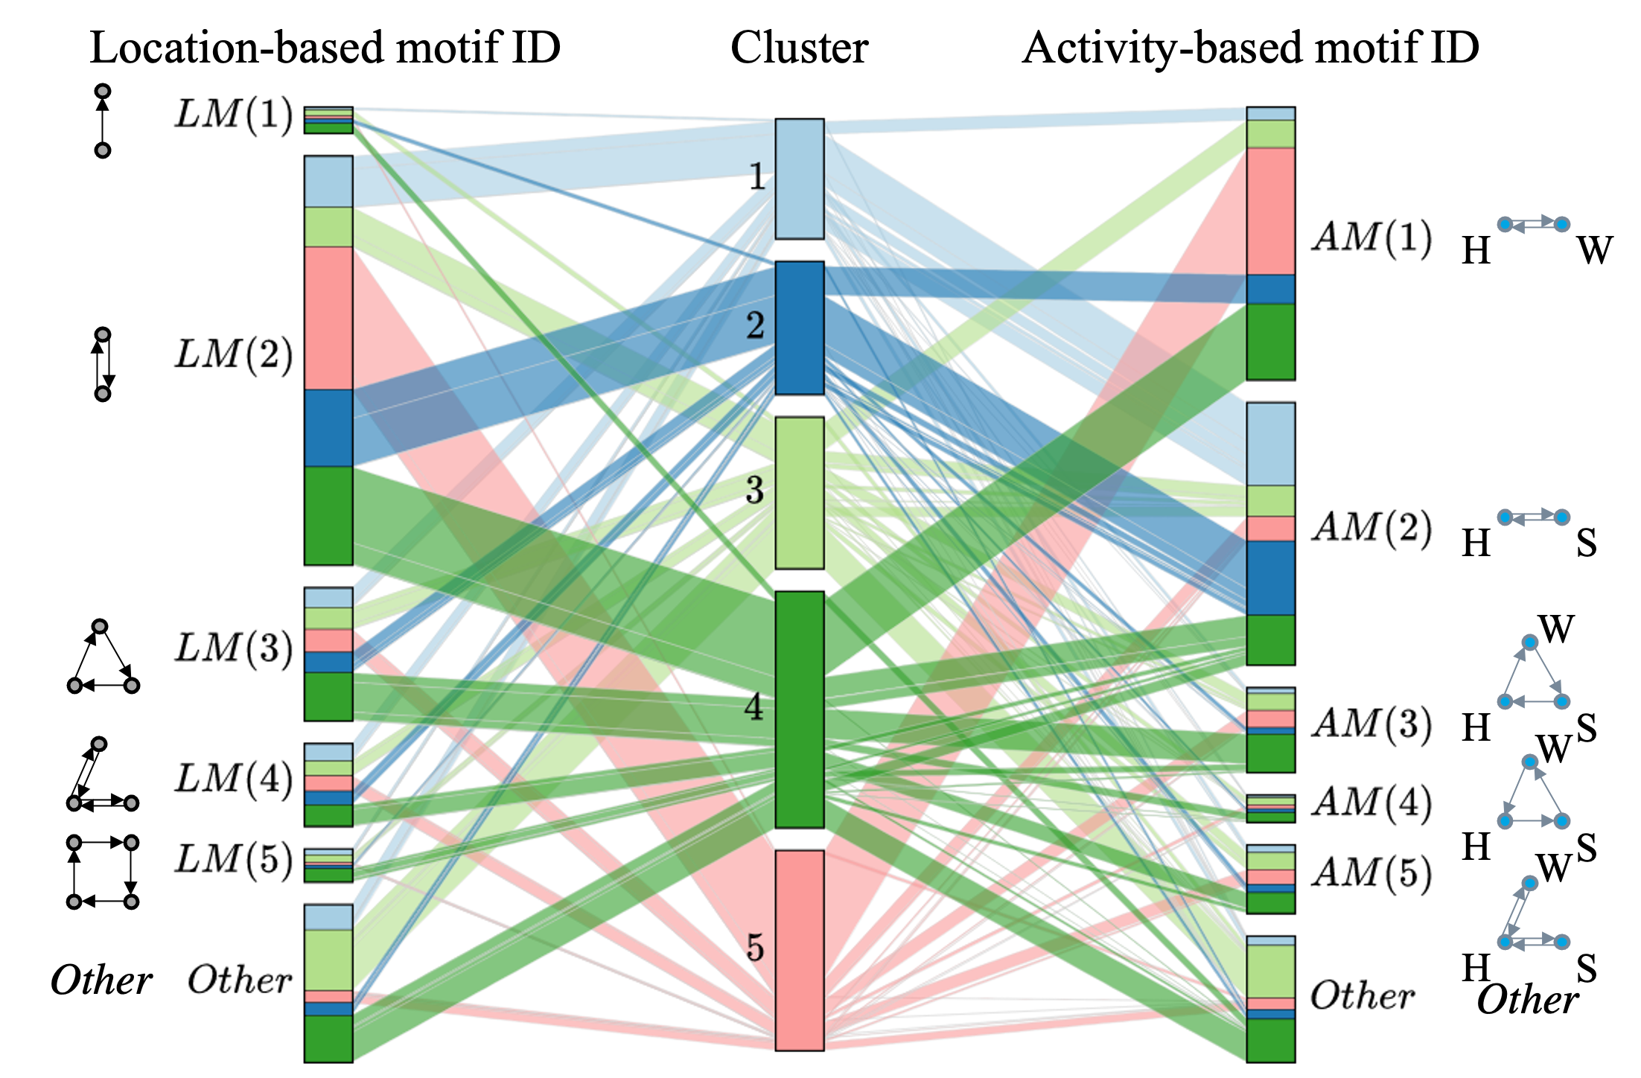
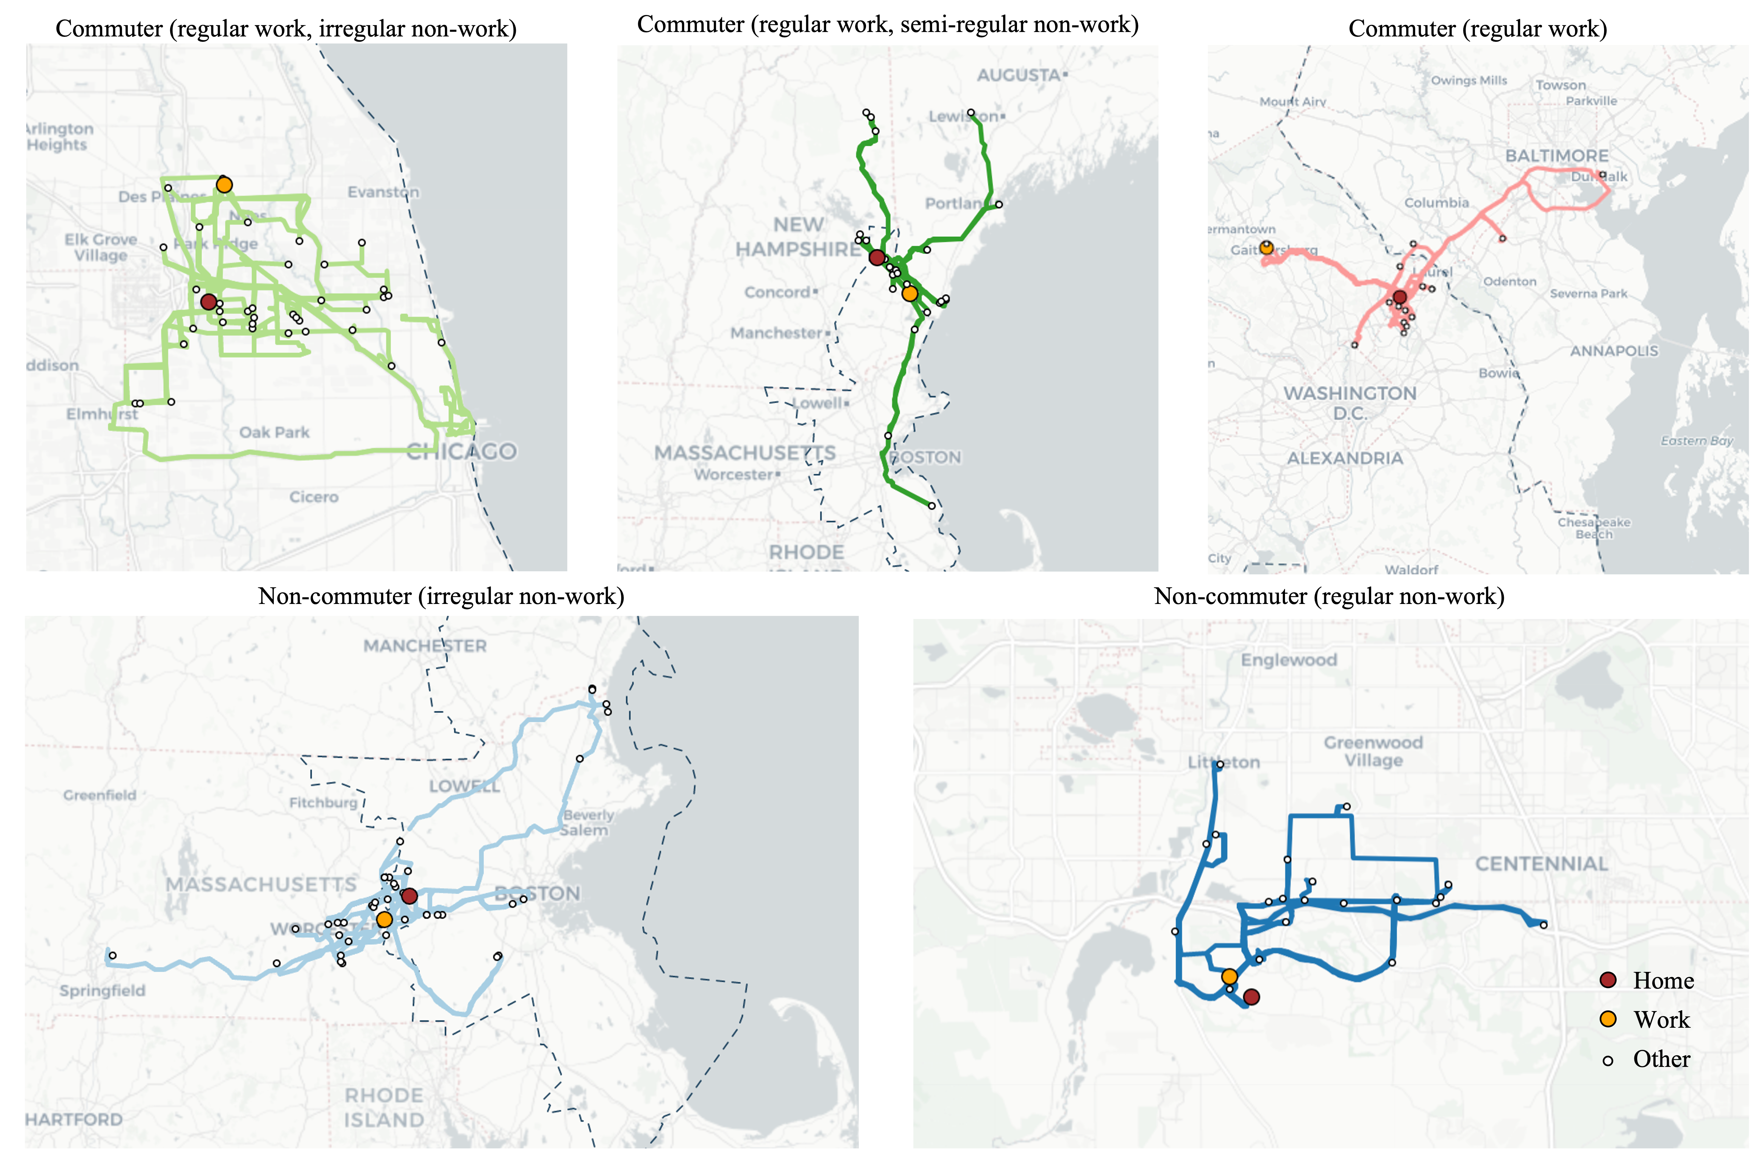
User Profiling/Clustering
A. Commuters
Travel in peak hours
Work-related motifs
B. Non-commuters
Travel in off-peak hours
Home-related motifs
  Work-focused commuters (pink)
  Gig drivers (light blue)
3
1
2
  Homebodies (dark blue)
4
  Typical drivers (dark green)
5
  Movers (light green)
Ji, Gao, et al. (2023), Transactions in GIS.

Slide 10

Thank you!
https://geods.geography.wisc.edu

