Slide 1


Kaleidoscope of geotagged social media analyses from a UGA group
Mu, Lan
Department of Geography
University of Georgia
Spatial Social Network Workshop
Georgia Tech, May 18, 2023

Slide 2

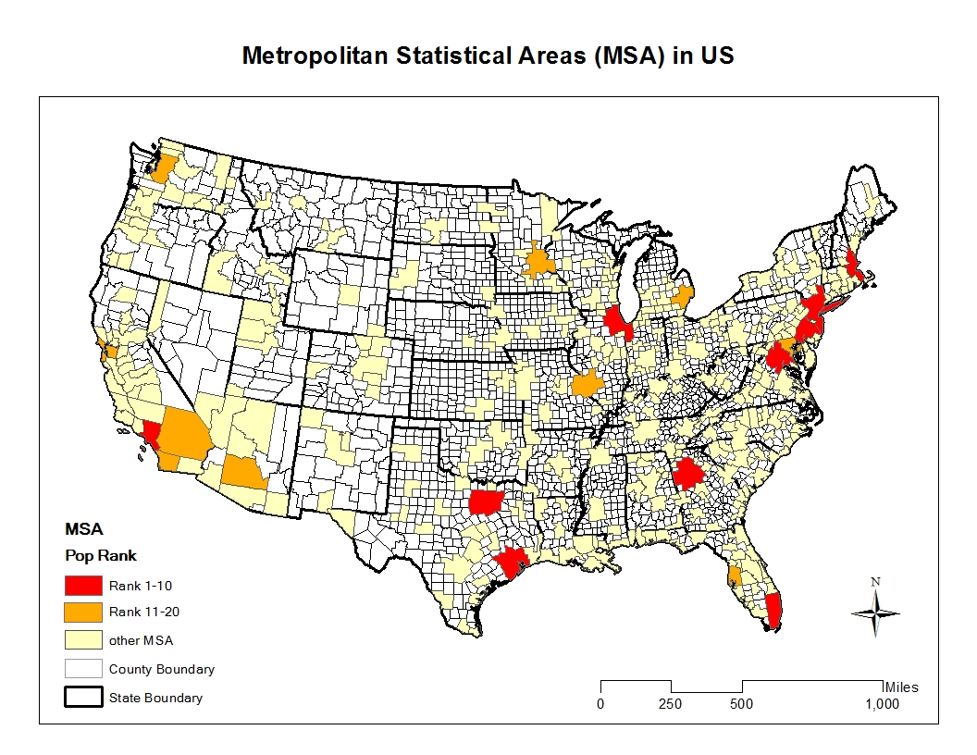
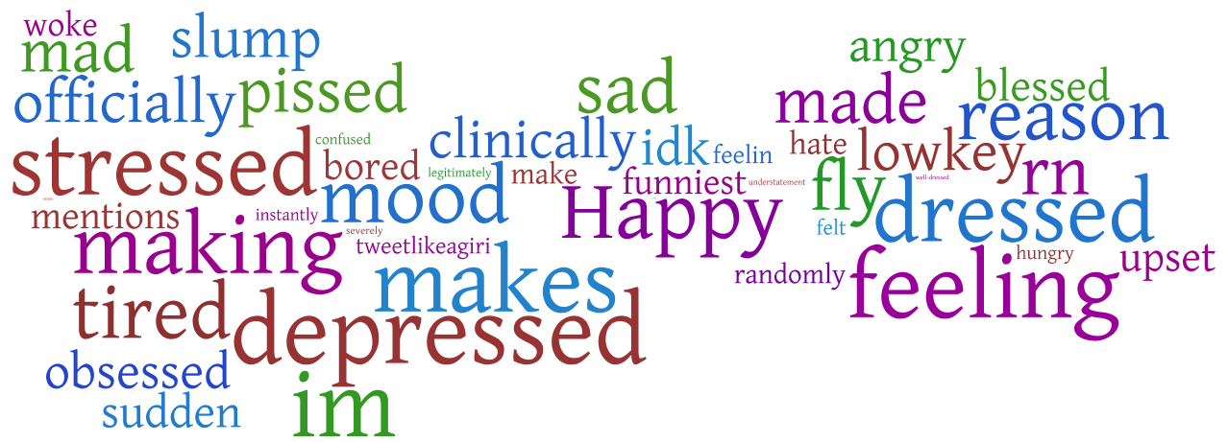
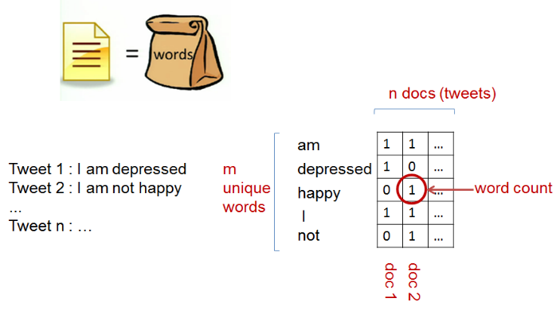

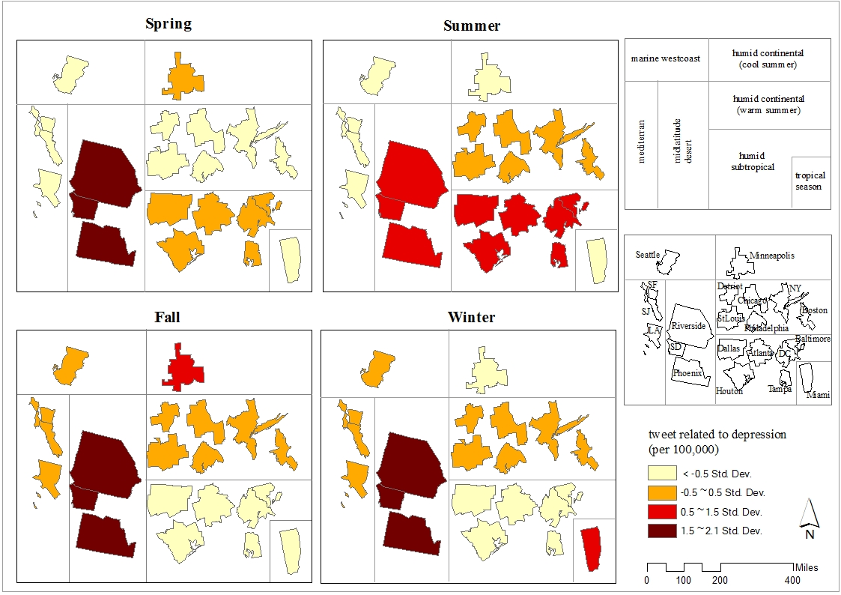
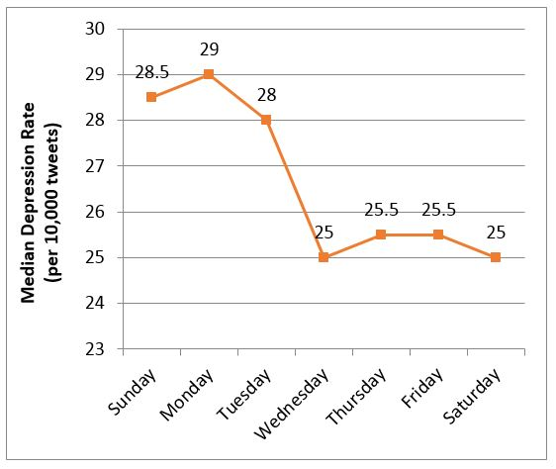

2015: Depression in Tweets
NMF
Yang, W. and L. Mu* (2015). GIS analysis of depression among Twitter users. Applied Geography. 60, 217-223. doi:10.1016/j.apgeog.2014.10.016.
Yang, W., L. Mu*, and Y. Shen (2015). The effect of climate and seasonality on depressed mood among twitter users. Applied Geography. 60, 184-191. doi:10.1016/j.apgeog.2015.06.017.

Slide 3
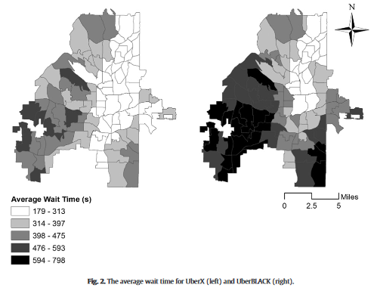
2018: Uber Accessibility
Wang, M. & L. Mu* (2018) Spatial Disparities of Uber Accessibility: An Exploratory Analysis in Atlanta, USA. Computers, Environment and Urban Systems, 67, 169-175. doi: https://doi.org/10.1016/j.compenvurbsys.2017.09.003

Slide 4
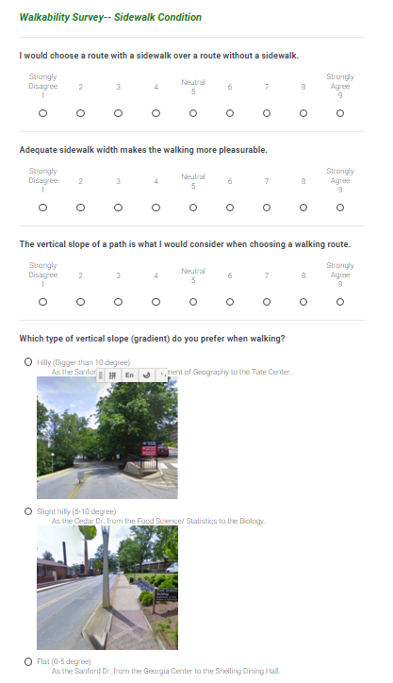
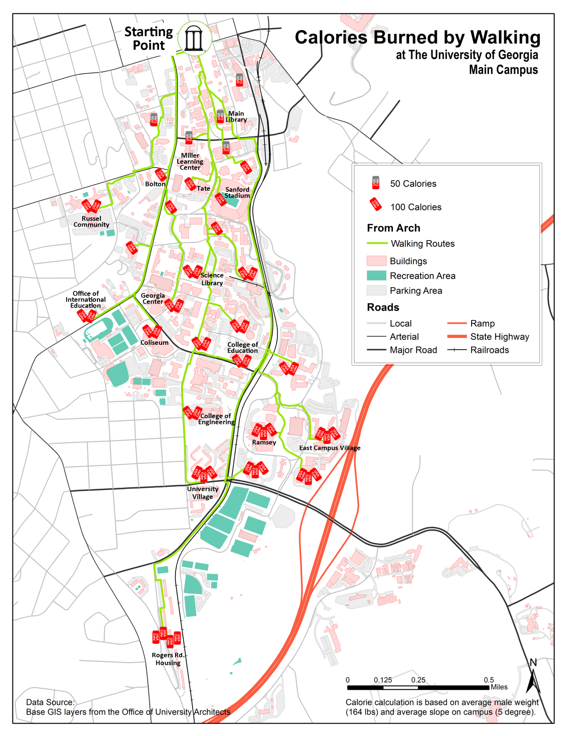
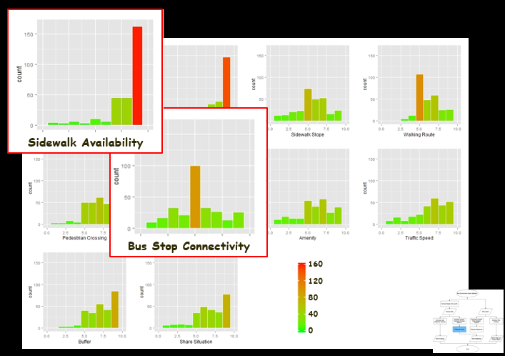
2019: Walkability
Zhang, X. and L. Mu* (2019). The Perceived Importance and Objective Measurement of Walkability in the Built Environment Rating. Environment and Planning B: Urban Analytics and City Science. doi: 10.1177/2399808319832305.
Zhang, X. and L. Mu* (2019). Incorporating Online Survey and Social Media Data into a GIS Analysis for Measuring Walkability, in E. Delmelle and Y. Lu (eds.) Geospatial Technologies for Urban Health. Springer International Publishing AG.

Slide 5
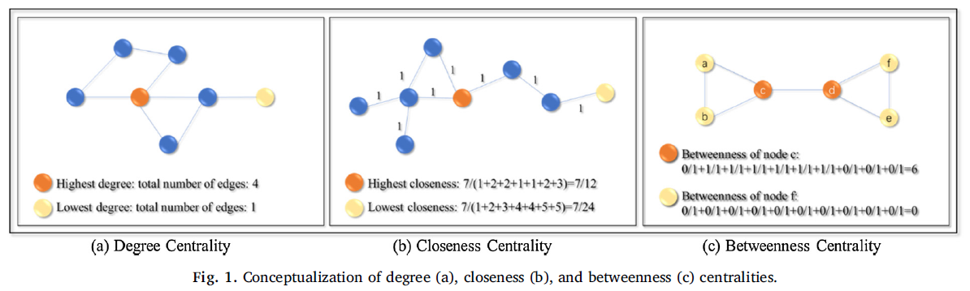
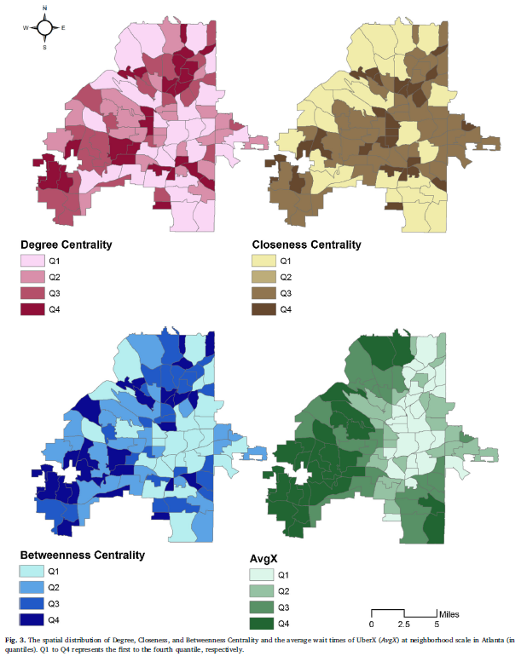
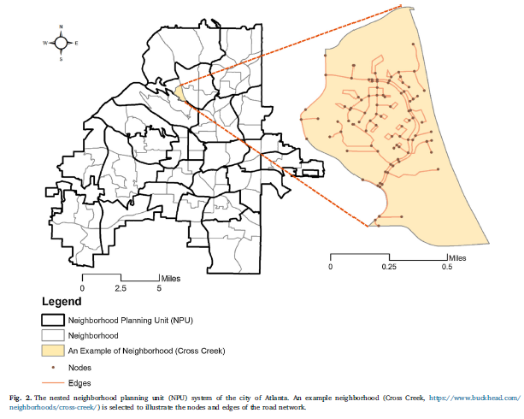
2020: Road Network Structrue and Ride-share Accessibility
Wang, M., Chen, Y., Mu, L.*, & Zhang, X. (2020). Road Network Structure and Ride-sharing Accessibility: A Network Science Perspective. Computers, Environment and Urban Systems, 80, 101430. doi:https://doi.org/10.1016/j.compenvurbsys.2019.101430

Slide 6
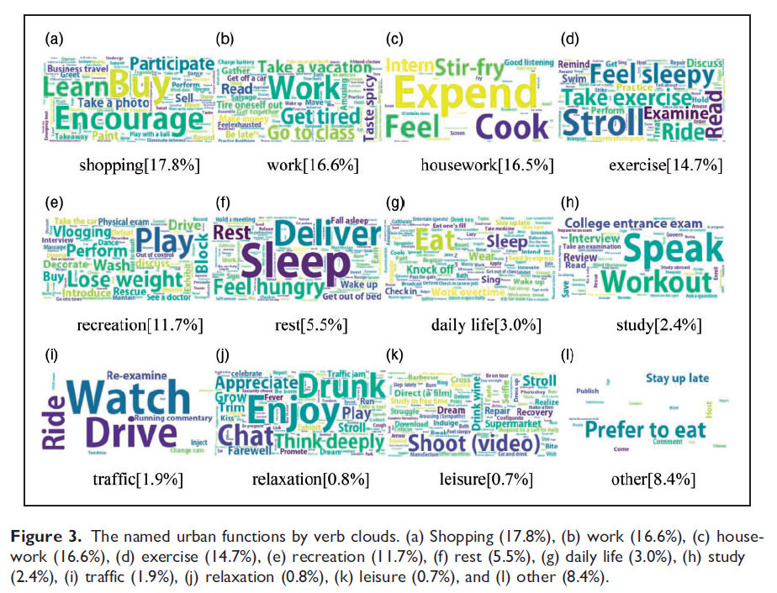
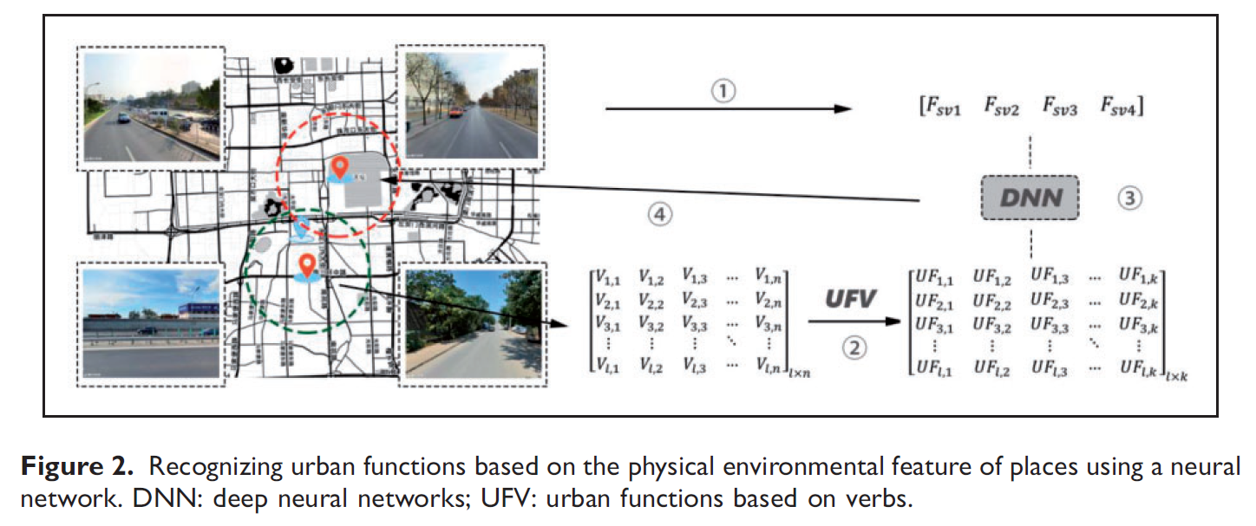
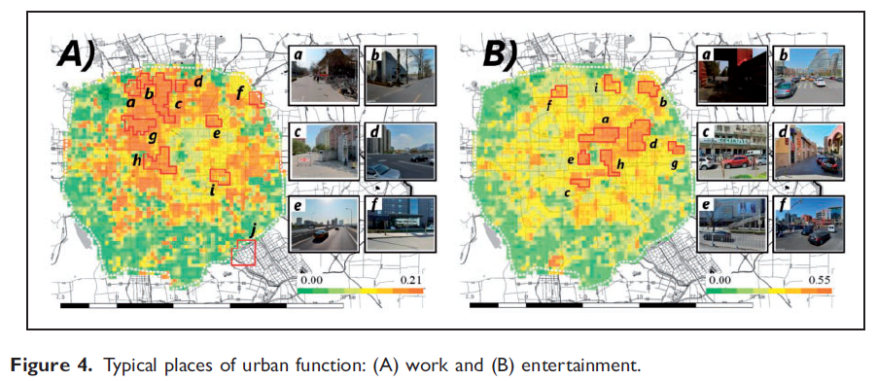
2020: Urban functions, social media and imagery
Ye, C., Zhang, F., Mu, L., Gao, Y., & Liu, Y.* (2020). Urban function recognition by integrating social media and street-level imagery. Environment and Planning B: Urban Analytics and City Science, 0(0), doi:10.1177/2399808320935467

Slide 7
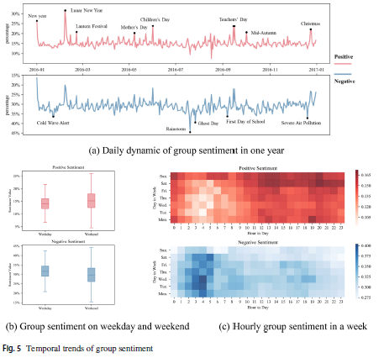
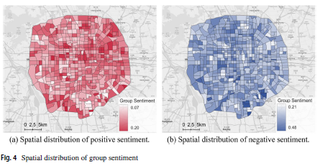
2022: Urban Sentiments
Gao, Y.*, Chen, Y. Y., Mu, L., Gong, S. Z., Zhang, P. C., & Liu, Y. (2022). Measuring urban sentiments from social media data: a dual-polarity metric approach. Journal of Geographical Systems. https://doi.org/10.1007/s10109-021-00369-z

Slide 8
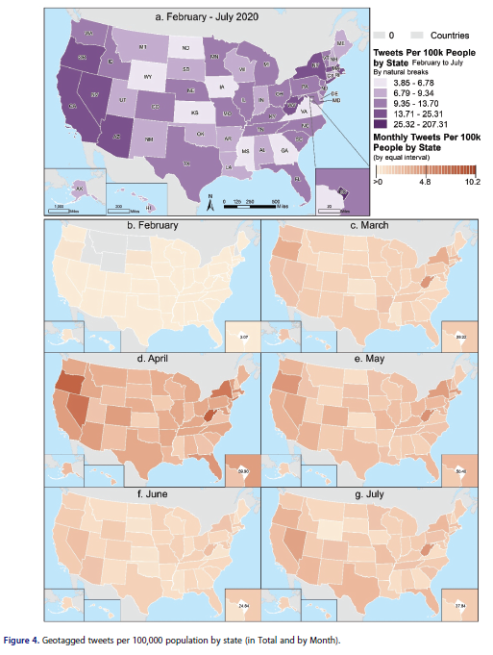
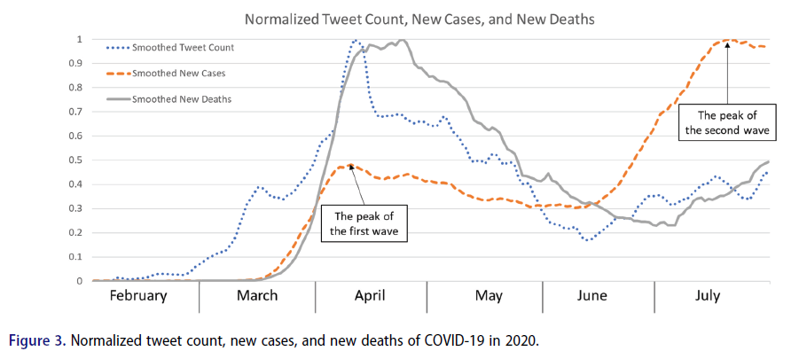
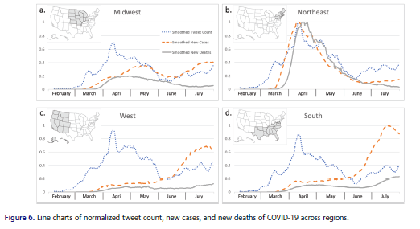
2022: COVID-19 and Cardiovascular Disease
Zhang, X., Mu, L. Zhang, D., Mao, Y., Shi L., Rajbhandari-Thapa J., Chen Z., Li Y., Pagán, J. (2022). Geographical and Temporal Analysis of Tweets Related to COVID-19 and Cardiovascular Disease in the US Annals of GIS, 28(4), 491-500. doi:10.1080/19475683.2022.2133167

Slide 9
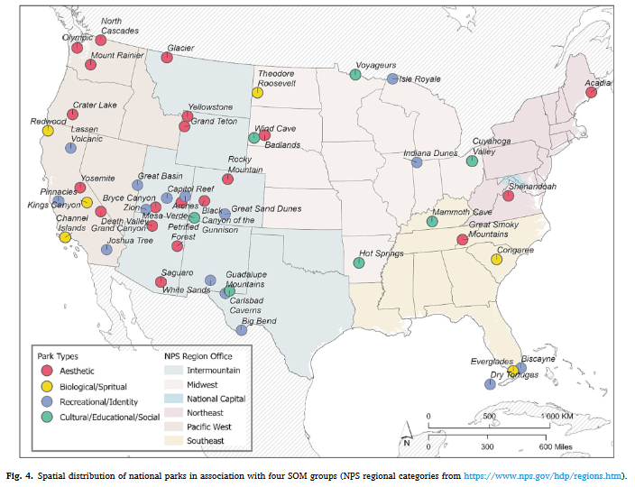
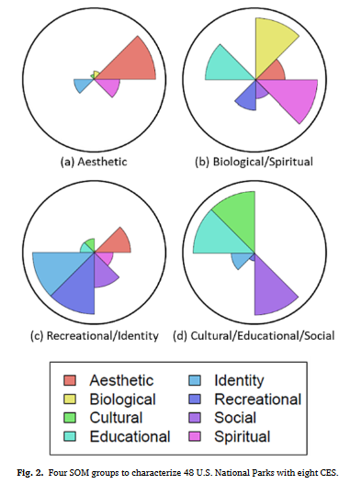
2023: Crowdsourced text and parks
Kong, I., Sarmiento, F. O., & Mu, L. (2023). Crowdsourced text analysis to characterize the U.S. National Parks based on cultural ecosystem services. Landscape and Urban Planning, 233, 104692. doi:10.1016/j.landurbplan.2023.104692

Slide 10
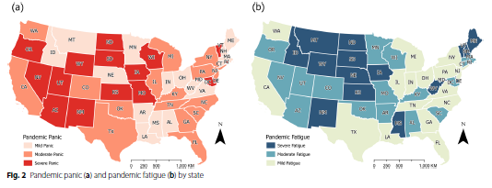
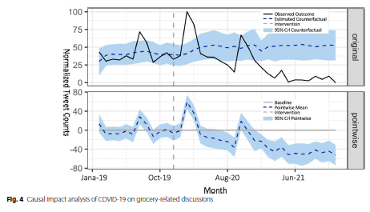
2023: Grocery Shopping during the Pandemic
N. Wu and L. Mu, "Impact of COVID-19 on online grocery shopping discussion and behavior reflected from Google Trends and geotagged tweets," Computational Urban Science, vol. 3, no. 1, p. 7, 2023, doi: 10.1007/s43762-023-00083-0.

Slide 11
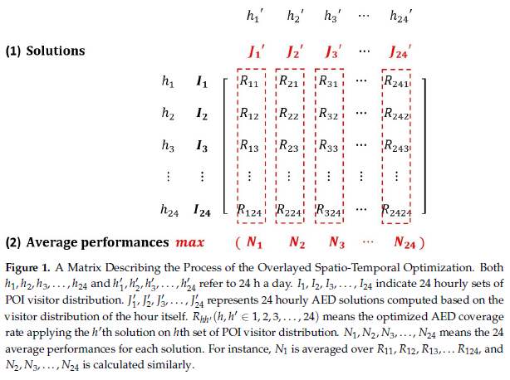
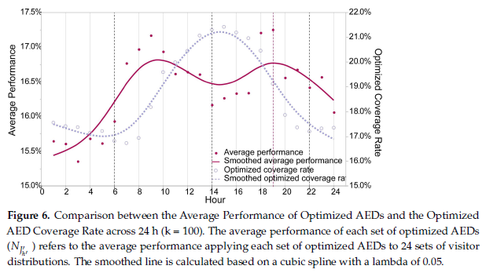
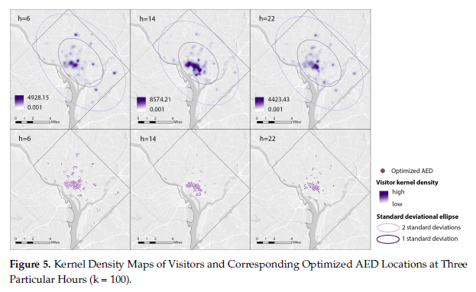
2023: AED Optimization
J. Zhang, L. Mu, D. L. Zhang, et al., "Spatiotemporal Optimization for the Placement of Automated External Defibrillators Using Mobile Phone Data," ISPRS International Journal of Geo-Information, vol. 12, no. 3, p. 91, 2023. Available: https://www.mdpi.com/2220-9964/12/3/91.

Slide 12
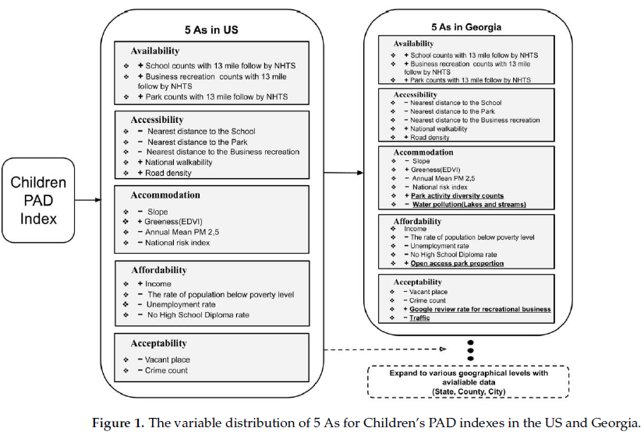
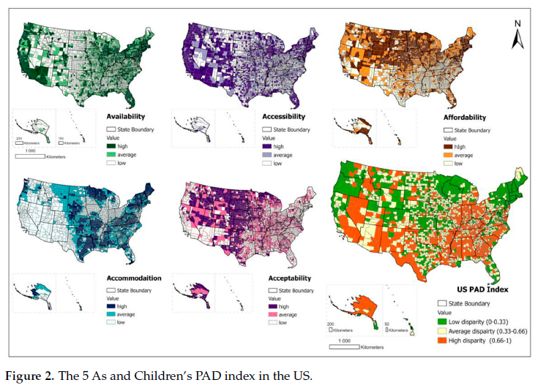
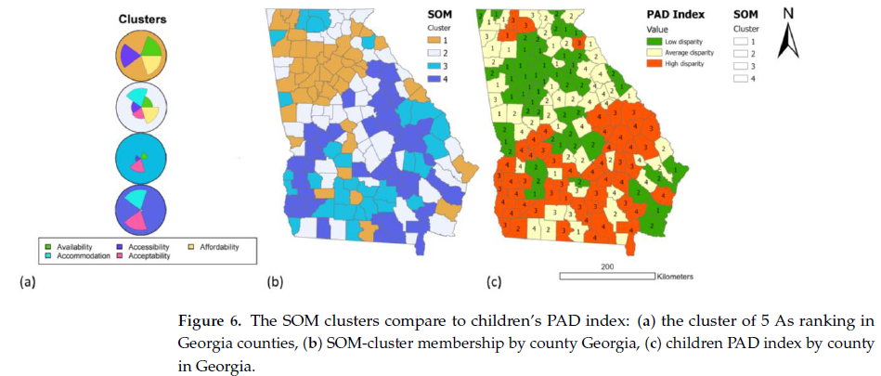
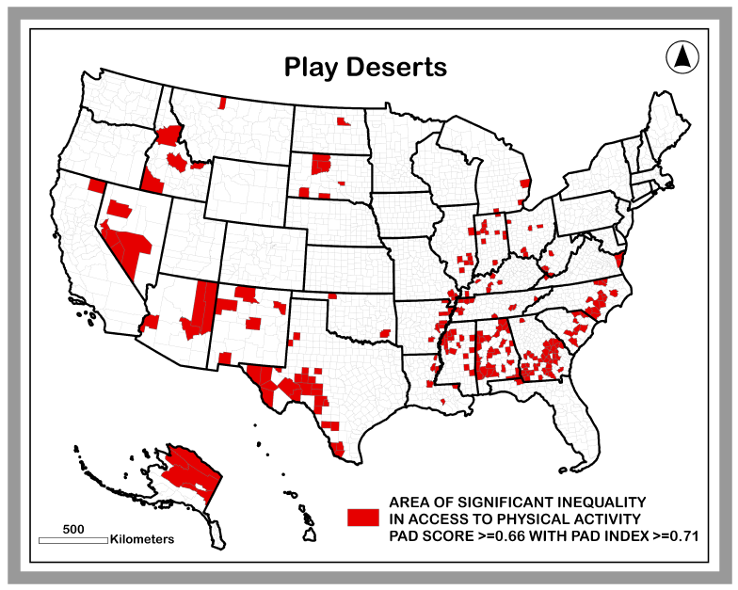
2023: Play Deserts
Yang, J.; Mu, L.; Rajbhandari-Thapa, J. Measuring and Mapping Physical Activity Disparity (PAD) Index Based on Physical Activity Environment for Children. ISPRS Int. J. Geo-Inf. 2023, 12, 134. https://doi.org/10.3390/ ijgi12030134

Slide 13
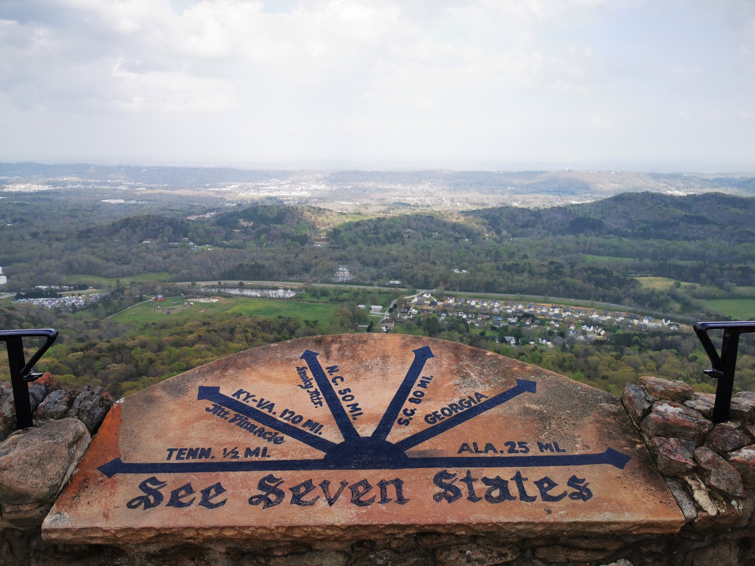

Slide 15
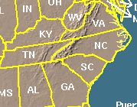
Place = Space + Identity + Attachment
Data->Information->Evidence->Knowledge

Slide 16



Acknowledgement
Questions?
mulan@uga.edu

