Slide 1
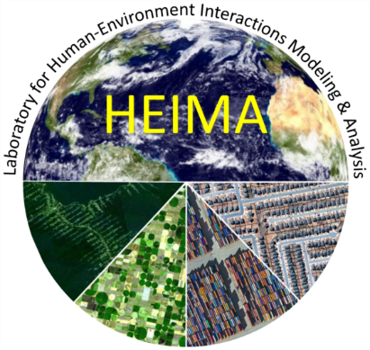
Examining the Role of Farmers’ Social Networks in the Diffusion of Climate-Smart Agricultural (CSA) practices in Alabama
Ruchie Pathak
Ph.D. Candidate
Department of Geography, University of Alabama

Slide 2
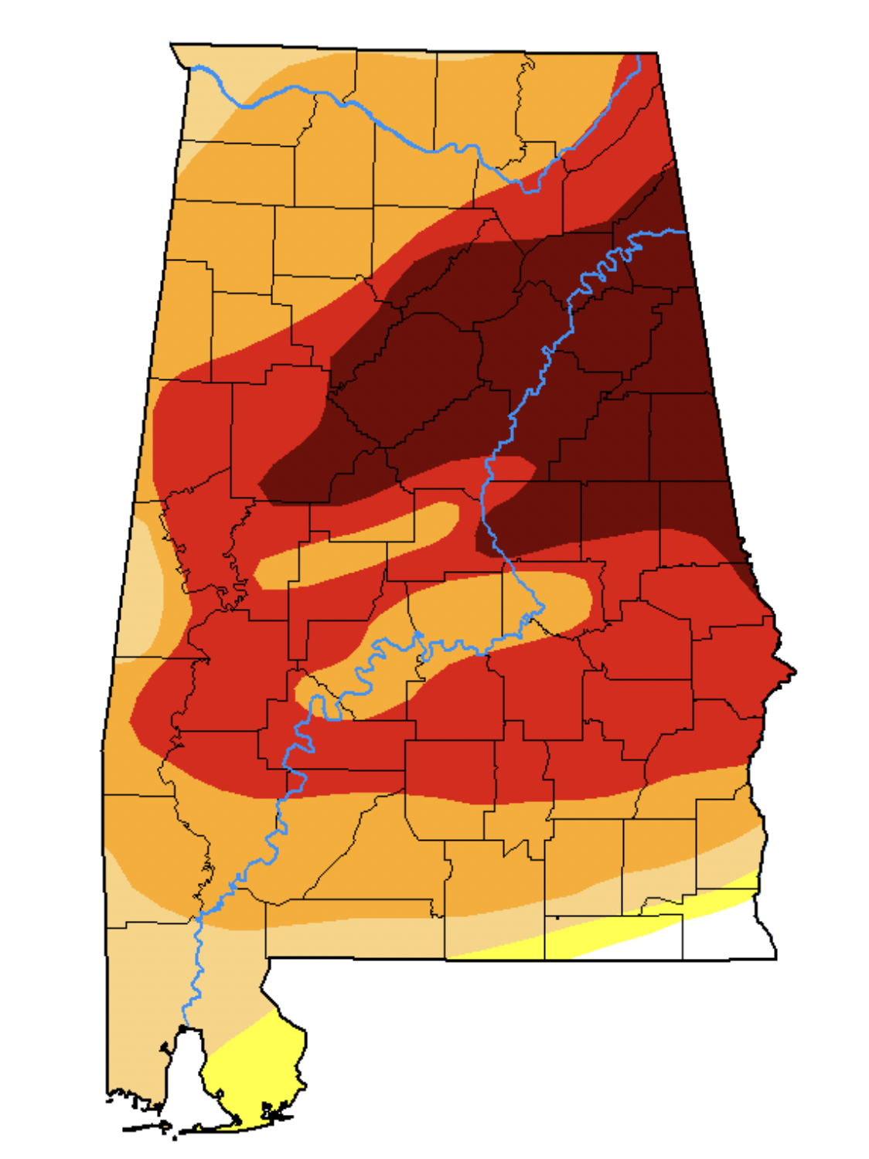
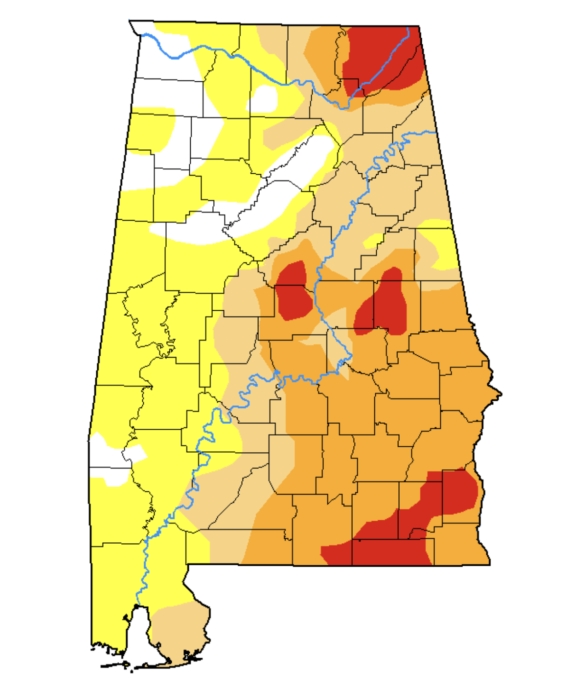
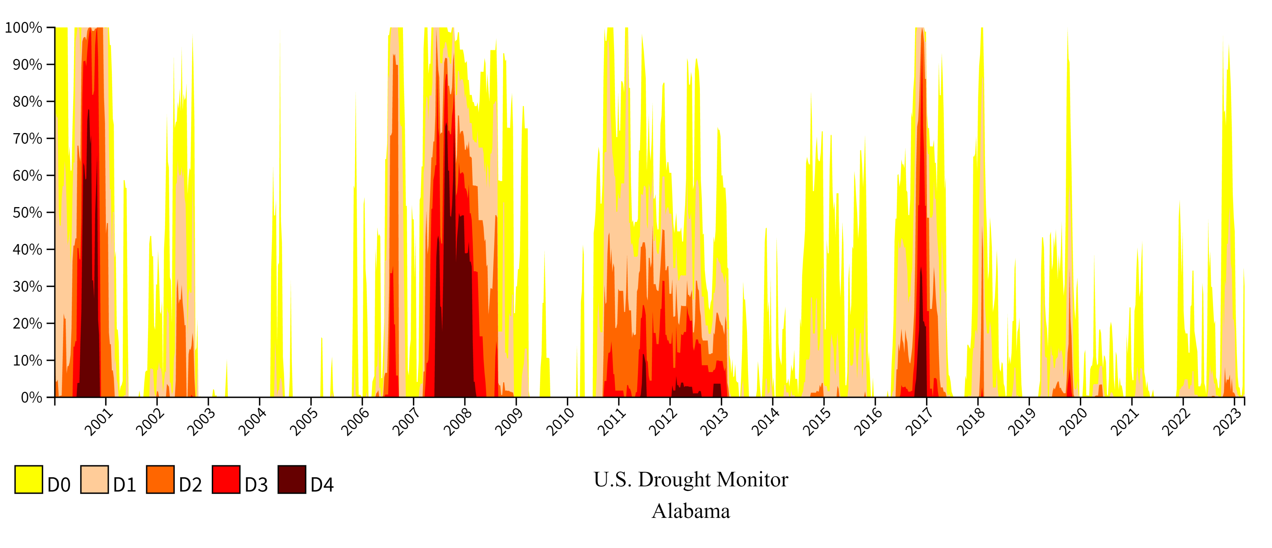
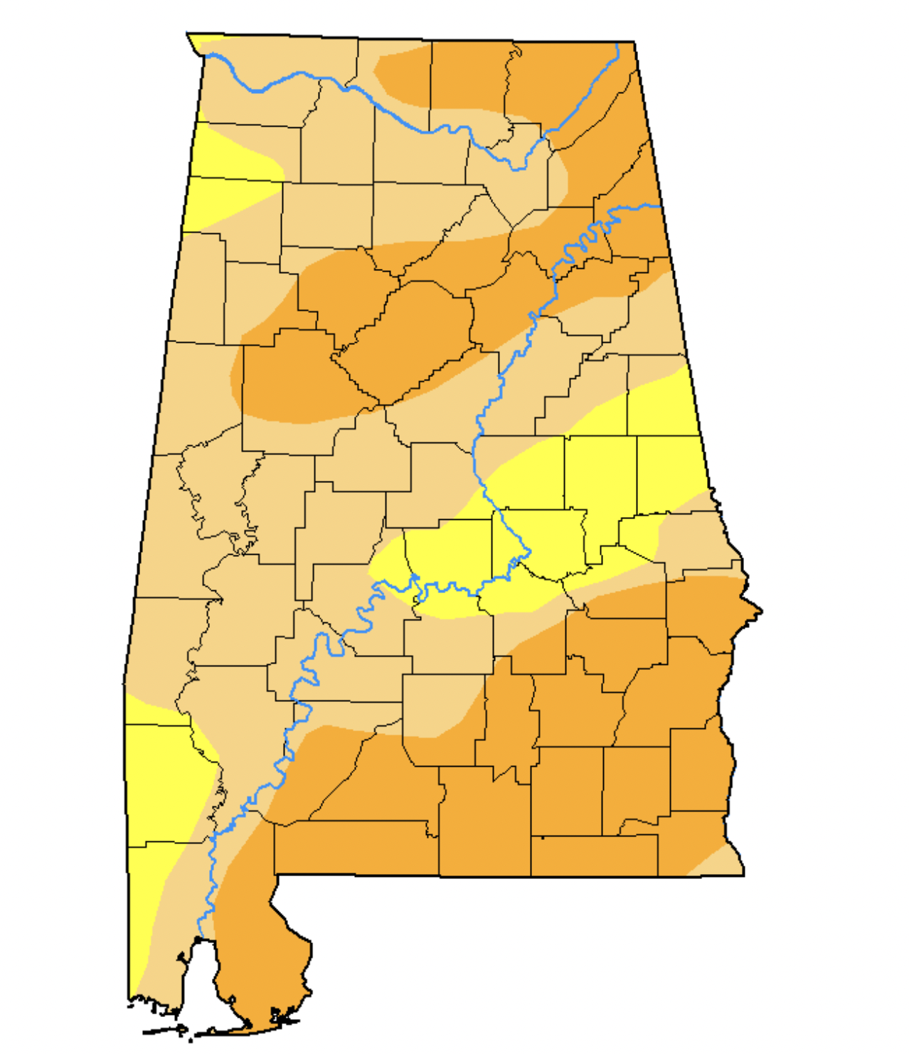
PROBLEM:
December 2016
Since 2000, Alabama has experienced 3 of the 5 worst droughts on record (Shange et al., 2014).
February 2018
October 2019
Notes:
1. Southeastern US, characterized by wet, warm, and high levels of humidity compared to other US regions is considered water rich; but temperature increases have been recorded.
2. Since 2000, Alabama has experienced 3 of the, 5 worst droughts on record.
In the last two decades itself Alabama has experienced recurring droughts, and unpredictable rainfall patterns. RISING TEMPERATURES..SHORTER GROWING SEASONS..
D4: EXCEPTIONAL DROUGHT

Slide 3
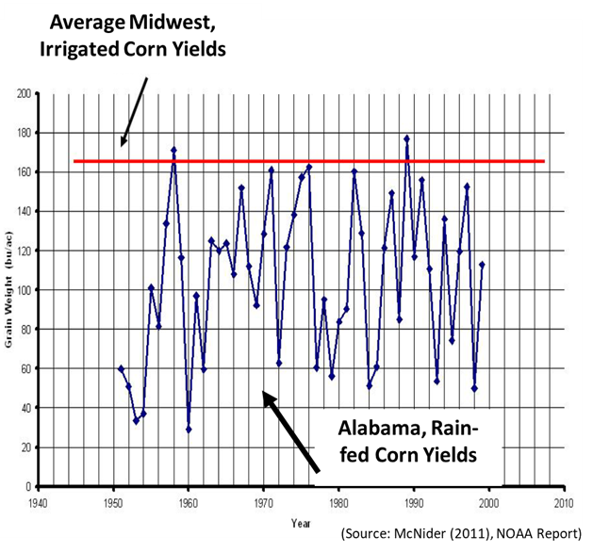
PROBLEM:
Irrigation can reduce the risk of climate variability (Calzadilla et al. 2013).
But new adoption has been slow..
“Alabama irrigated acreage (189,000 acres) well behind neighboring states of Mississippi (1,650,000 acres) and Georgia (1,450,000 acres)” (USGS, 2015).
Small-scale, socially disadvantaged, and/or limited resource producers– most disproportionately impacted by climate change.
Notes:
Variability due to climate..irrigation can help with adaptation…small-scale and rainfed farmers disproportionately impacted..
And while the state, on average, receives abundant rainfall each year, precipitation is often inconsistent during the summer months, when plants need it the most.

Slide 4
Adoption of agricultural adaptations depends on..
incentives provided by policies and market conditions;
support of local and national governments; public-private partnerships;
farmers’ own preferences, goals, and cultural and socioeconomic characteristics (International Food Policy Research Institute, 2021).

Slide 5
SOCIAL CAPITAL
“the ability to develop and use various kinds of (social) networks, associations, norms, values, and degree of trust among people” (Collier, 2002; Grootaert, 2002; Wossen et al., 2015; Hunecke et al., 2017).
Social networks can improve access to resources (~financial, informational) (Genius et al., 2013; Wang et al., 2015).
These networks can act as a leverage point for catalyzing change and scaling up of adaptations (Abson et al., 2017).
Notes:
It is believed that it is thru these associations and groups that farmers receive the information that is needed by them for making decisions on sustainable farming practices.
Promote the diffusion of new technologies because the externalities associated with them can be internalized if farmers within a network work together to overcome their difficulties (Lubell et al., 2011; Ravi Kumar et al., 2015).

Slide 6
Research Goal and Related Questions:
GOAL: This study aims to understand the diffusion and adoption of climate-smart agricultural (CSA) practices in Alabama.
What are farmers’ perceptions of climate change and the opportunities, benefits, barriers, and efficacy of CSA practices?
What are the factors (~sociocultural, economic, institutional) that can promote or constrain their implementation?
Does a farmer’s social network play any role in CSA diffusion?

Slide 7
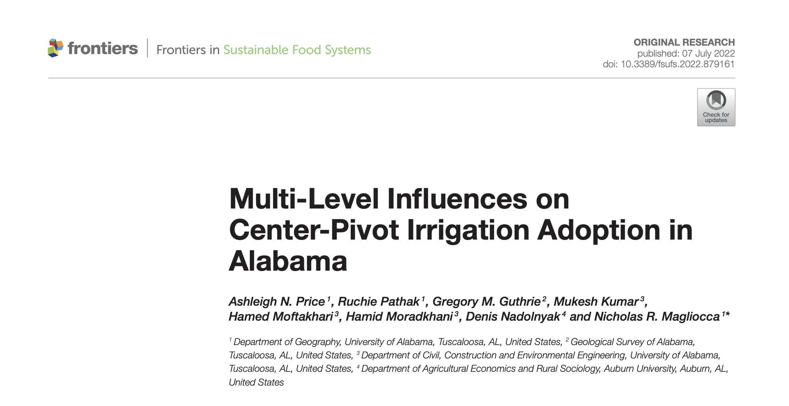
Created ‘social neighborhoods’ using parcel's proximity to agricultural extension centers and farmers' cooperatives.
Spatial boundaries were generated using Thiessen polygons around the locations of each Extension office and nearest Cooperative.
Warm colors indicate increased likelihoods (~positive intercept values) of irrigation adoption.
Price, A. N., Pathak, R., Guthrie, G. M., Kumar, M., Moftakhari, H., Moradkhani, H., ... & Magliocca, N. R. (2022). Multi-Level Influences on Center-Pivot Irrigation Adoption in Alabama. Frontiers in Sustainable Food Systems, 253.
Notes:
Study to identify the factors that influence the adoption of Center-Pivot irrigation in Alabama.
- We tried to identify the diff factors that influence the adoption of center-pivot irrigation systems in Alabama. We used spatial data for this analysis. We had parcel-level data of location of center-pivots. So one of our hypothesis was actually that social networks influence the location of adoption of irrigation tech.
- Created ‘social neighborhoods’ using each parcel's proximity to agricultural extension centers and farmers' cooperatives.
- “modeled social influences using a multi-level structure with the creation of social neighborhoods to test the influence of social network on irrigation technology adoption.
Irrigated acres in social neighborhood significant in Northern Valley and Black Belt regions

Slide 8
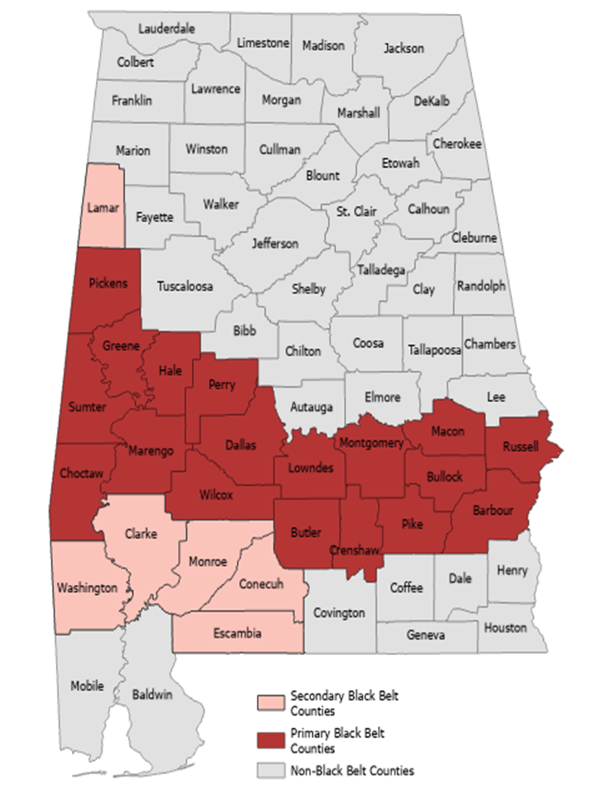
DATA COLLECTION:
Through mixed-methods approach.
103 completed surveys received so far.
14 personal interviews conducted: 8 producers and 6 non-producers
Notes:
Using GIS tools, map the data and explore spatial differences in the perceptions, drivers of, and/or barriers to these practices.
Note: this map shows home location of participants but they may have land outside the study region. Primary residence and land both inside and outside study area.

Slide 9
Preliminary Results:
Notes:
Some of the questions to gather this information include- 1) How do you receive agricultural-related information?
2) Who are you more likely to take agriculture-related advice from?
3) Mention all the support services or organizations you seek for agricultural assistance
4) Which is the most trusted source of information according to you?

Slide 10
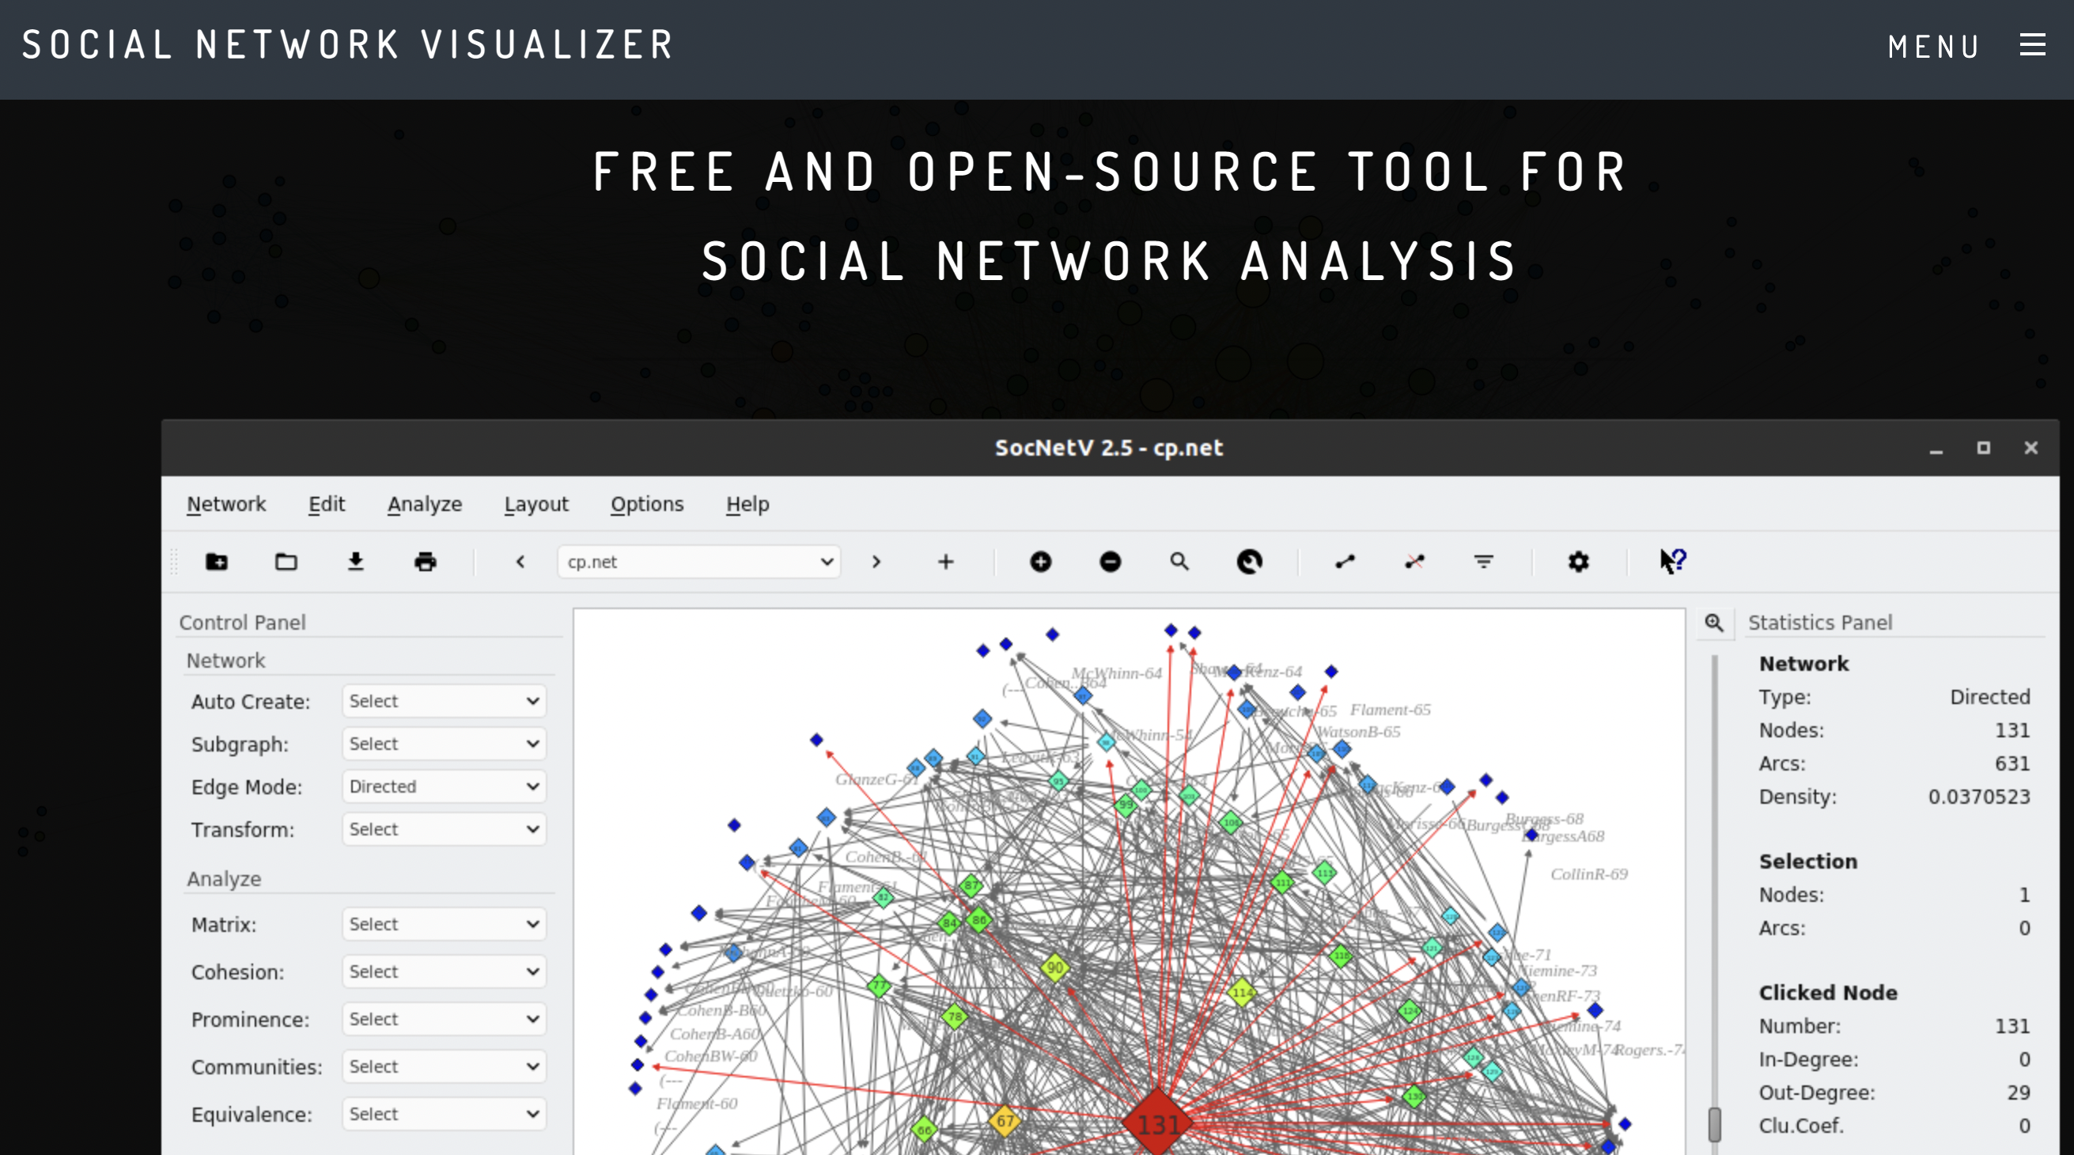
Social Network Analysis (SNA)
- To identify individuals or institutions that play a central role; how they are positioned within a network (Mohan and Paila, 2013); understand the relationship among them (Prell et al., 2009).
- Connectedness; Closeness; Strength of ties; Centrality;
Notes:
Examine the role played by farmers’ social networks in the diffusion and/or adoption of CSA practices.
- Identify who are the key actors that can facilitate farmer-to-farmer learning about such practices? Who is the most connected actor and with whom they are connected..Kind of assess the social structure using this network analysis approach.
Degree centrality refers to how many others a stakeholder is directly connected to; stakeholders with a high degree centrality can be seen as important players for mobilizing the network and bringing other stakeholders together.
identifying stakeholders to be included in research
include the stakeholder to begin with data collection
Develop an understanding of how a farmer’s social network can act as a leverage point for catalyzing change and scaling up of adaptation of (farming) communities (Abson et al., 2017).

Slide 11
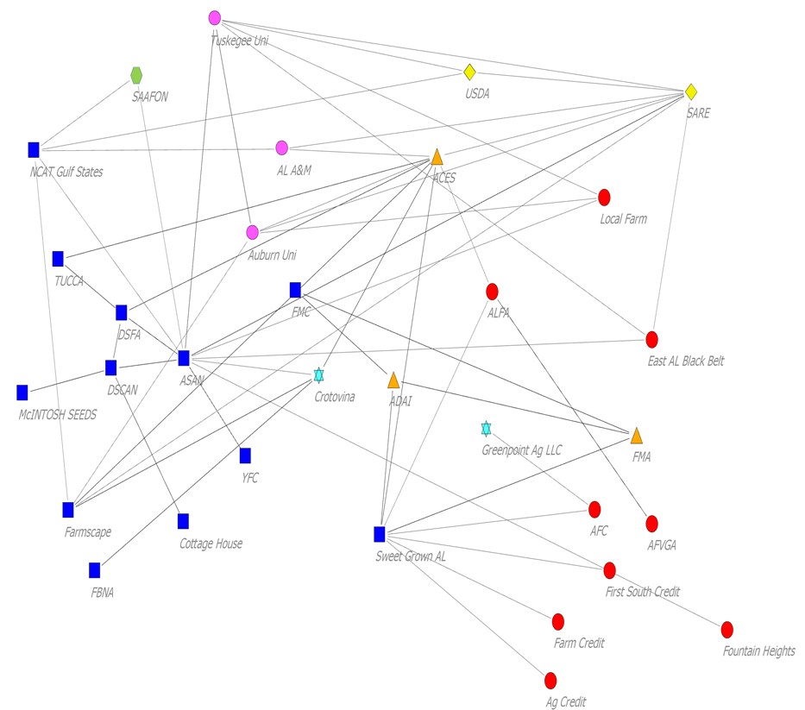
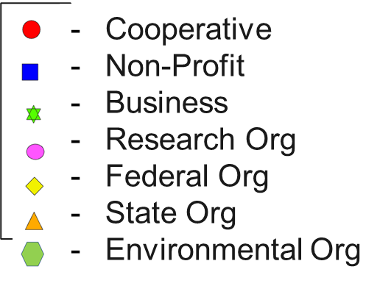
Social Network Analysis (SNA)
- To identify individuals or institutions that play a central role; how they are positioned within a network (Mohan and Paila, 2013); understand the relationship among them (Prell et al., 2009).
- Connectedness; Closeness; Influence range; Strength of ties; Centrality;
Notes:
Examine the role played by farmers’ social networks in the diffusion and/or adoption of CSA practices.
- Identify who are the key actors that can facilitate farmer-to-farmer learning about such practices? Who is the most connected actor and with whom they are connected..Kind of assess the social structure using this network analysis approach.
Degree centrality refers to how many others a stakeholder is directly connected to; stakeholders with a high degree centrality can be seen as important players for mobilizing the network and bringing other stakeholders together.
identifying stakeholders to be included in research
include the stakeholder to begin with data collection
Develop an understanding of how a farmer’s social network can act as a leverage point for catalyzing change and scaling up of adaptation of (farming) communities (Abson et al., 2017).

Slide 12
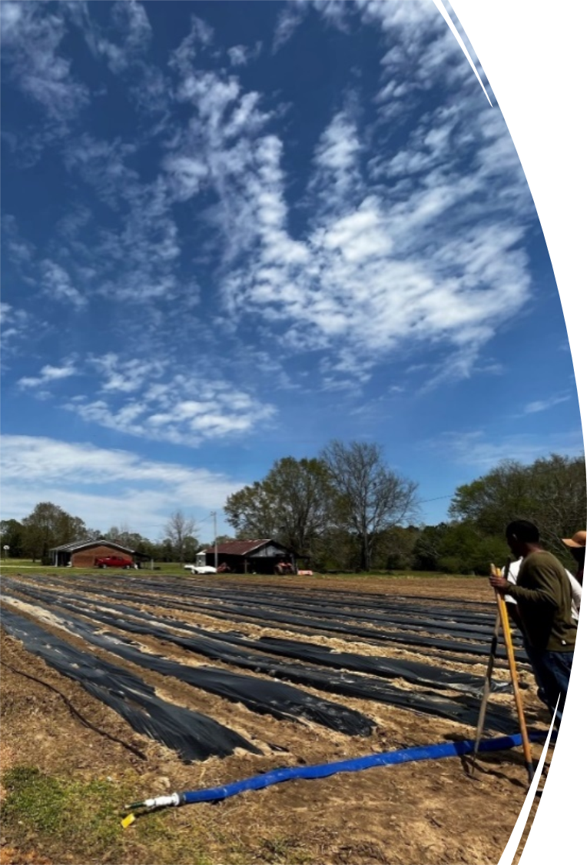
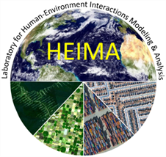
Ruchie Pathak Ph.D. Candidate Department of Geography, University of Alabama Email: rpathak@crimson.ua.edu
THANK YOU!

